Slide 1

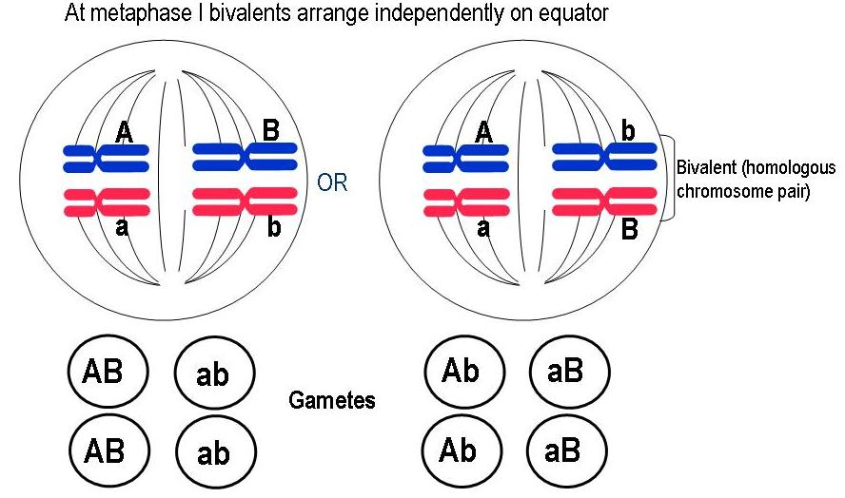
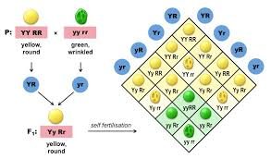
Dihybrid Inheritance- General
Outcome:
Draw dihybrid crosses to predict offspring genotypes and phenotypes.
Apply knowledge to calculate the predicted ratios of genotypes and phenotype of offspring, using fully labelled diagrams, when supplied with appropriate information.
Definition:
Dihybrid: The inheritance of 2 characteristics controlled by two separate genes inherited independently.

Slide 2
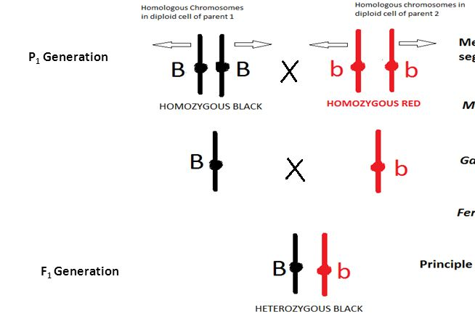
Dihybrid Inheritance- General
What have we learnt so far?
Monohybrid crosses involve 1 gene at 1 locus on 1 chromosome.
You inherit 1 allele for this gene from each parents
You have 2 alleles for each gene.

Slide 3
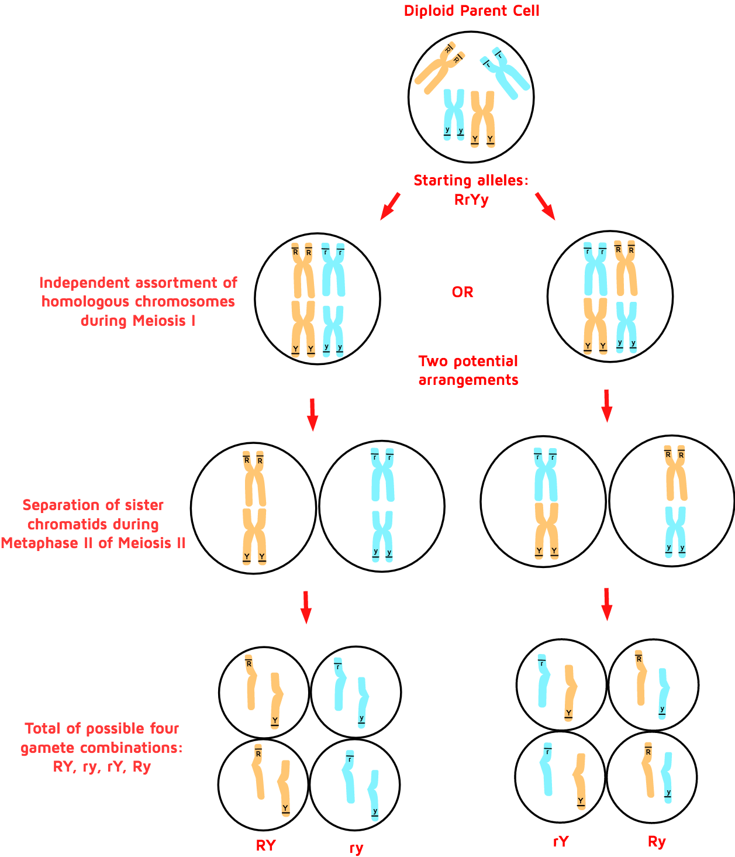
Dihybrid Inheritance- General
Dihybrid crosses involve 2 gene at 2 locus on 2 chromosome.
Each gene has a different letter.
You inherit 1 allele for each gene from each parents.
You inherit 1 letter from each gene
You have 2 alleles for each gene.
For dihybrid crosses you have 4 letters in your genotype

Slide 4

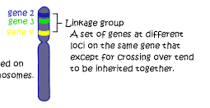
Dihybrid Inheritance- General
2 types:
Inheritance of 2 separate genes at different loci on different chromosome i.e. unlinked
Inheritance of 2 separate genes at different loci on the same chromosome ie linked- known as Linkage

Slide 5
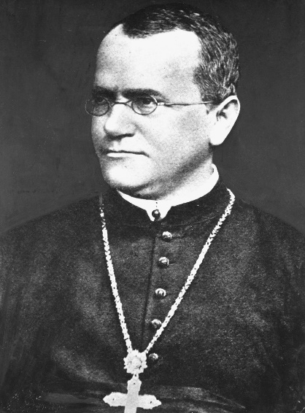
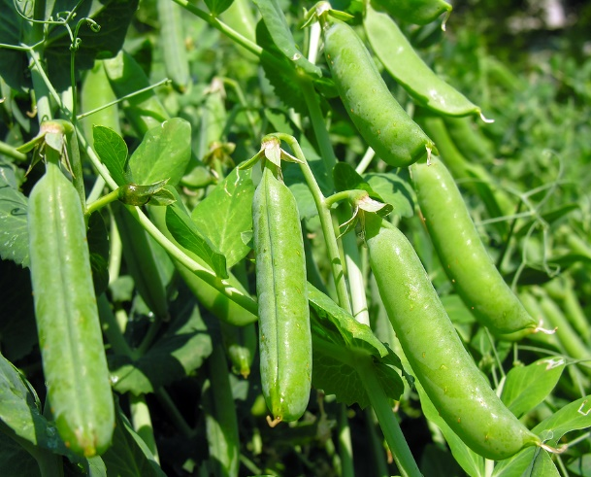
Dihybrid Inheritance- Non-linked.
Mendel had observed that the seeds of his pea plants round or wrinkled and whether they were green or yellow.
Mendel discovered:
That the allele for yellow colour was dominant to that for green.
That the allele for round peas was dominant to the allele for wrinkled peas.
1) round and yellow
2) round and green
3) wrinkled and yellow
4) wrinkled and green

Slide 6
Dihybrid Inheritance- Non-linked.
Let the allele for yellow colour = Y
Let the allele for green colour = y
Let the allele for round shape = R
Let the allele for wrinkled shape = r
There are four possible combinations of the two characteristics. Peas can be:
1) round and yellow
2) round and green
3) wrinkled and yellow
4) wrinkled and green
Complete the phenotype table on page 16 in your booklet.

Slide 7
Dihybrid Inheritance- Non-linked.
Possible Genotypes | Phenotype
RRYY | Round & Yellow
RrYy | Round & Yellow
rrYY | Wrinkled & Yellow
RRyy | Round & Green
State the genotype of:
A seed heterozygous for colour & homozygous recessive for shape ________
A seed homozygous recessive for colour & homozygous recessive for shape ________
RrYy
rryy

Slide 8
List the possible gametes produced from the following individuals on page 17 in your booklet.
Remember: Gametes are haploid and must be drawn in circles
Dihybrid Inheritance- Non-linked.
Genotype | Possible gametes (in circles)
RRYY
rryy
rrYy
RRyy
Rryy
RrYy

Slide 9
Dihybrid Inheritance- Non-linked.
Genotype | Possible gametes (in circles)
RRYY
rryy
rrYy
RRyy
Rryy
RrYy
RY
Exam tip:
If all the gametes are the same you only need to write it out once.
ry
rY
ry
Ry
Ry
ry
RY
Ry
rY
ry

Slide 10
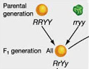
Dihybrid Inheritance- Non-linked.
Mendel crossed homozygous round, yellow seed plants (RRYY) with homozygous wrinkled, green seed plants (rryy). The F₁ offspring all had round, yellow seeds (RrYy). When he crossed these individuals the phenotypic ratio of the F₂ offspring was:
9 round/yellow : 3 round/green : 3 wrinkled/yellow : 1 wrinkled/green

Slide 11

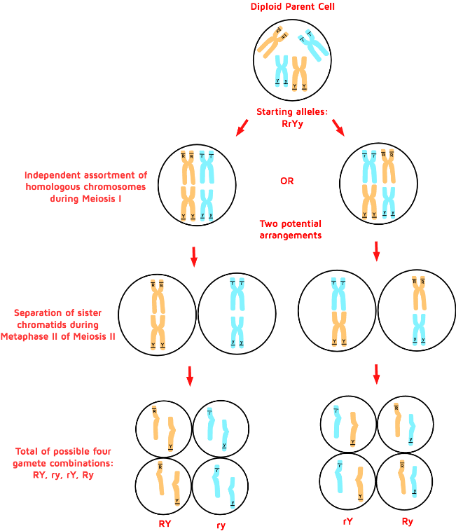
Dihybrid Inheritance- Non-linked.
Words to use to fill in the gaps on page 17 in your booklet:
Heterozygous Both Dominance
9:3:3:1 ratio is typical of a dihybrid cross between two parents
who are heterozygous at both gene loci
and the alleles show complete dominance

Slide 12
Dihybrid Inheritance- Non-linked.
Draw a cross to predict the ratio of offspring produced from this F₁ generation (RrYy) on page 17 in your booklet.
Parental Phenotype= Round, Yellow x Wrinkled, Green
Parental Genotype= RRYY rryy
Gametes =
RY
ry
 |  | Round yellow
Wrinkled Green |  | RrYy Round Yellow
RY
ry
F1 Genotype RrYY
F1 Phenotype Round Yellow
F1 ratio 100%

Slide 13
Dihybrid Inheritance- Non-linked.
Parental Phenotype= Round, Yellow x Round, Yellow
Parental Genotype= RrYy RrYy
Gametes =
RY
Ry
rY
ry
RY
Ry
rY
ry
 | RRYY | RRYy | RrYY | RrYy
 | RRYy | RRyy | RrYy | Rryy
 | RrYY | RrYy | rrYY | rrYy
 | RrYy | Rryy | rrYy | rryy
RY
Ry
rY
ry
Exam tip: Look at the shape of the phenotypes
RY
Ry
rY
ry
F1 Phenotype Round Yellow Round Green Wrinkled Yellow Wrinkled Green
F1 ratio 9: 3: 3: 1

Slide 14
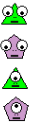
Dihybrid Inheritance- Non-linked.
1 gene controls number eyes – one or two eyes
1 gene controls head shape – triangular or pentagonal
The two eyed allele is dominant to the one eyed allele.
The triangular head allele is dominant to the pentagonal head allele.
Decide on appropriate letters to represent the alleles.
Draw a genetic diagram to explain the result of a cross between two parents who are heterozygous for both characteristics on page 18 in your booklet

Slide 15
Dihybrid Inheritance- Non-linked.
Parental Phenotype= Two eye, triangle Two eye, triangle
Parental Genotype= EeTt EeTt
Gametes =
ET
Et
eT
et
ET
Et
eT
et
 | EETT | EETt | EeTT | EeTt
 | EETt | Eett | EeTt | Eett
 | EeTT | EeTt | eeTT | eeTt
 | EeTt | Eett | eeTt | eett
ET
Et
eT
et
ET
Et
eT
et
F1 Phenotype Two, triangle Two, pentagon One, triangle One, pentagon
F1 ratio 9: 3: 3: 1

Slide 16
Apply this knowledge to the exam questions on page 18-19.
The questions are worth 9 marks. Can you complete the exam question in 12 minutes?
Once you have completed the question, check your answers using the markscheme.
Remember
Highlight which part of your answer is also on the markscheme. Allow you to see which part of your answer are relevant.
If it isn’t on the mark scheme it is not right, if it isn’t written as the markscheme it is not right.
In a different coloured pen add corrections to the question.
Anything you don’t understand make a note of for when you speak to your teacher.

Slide 17
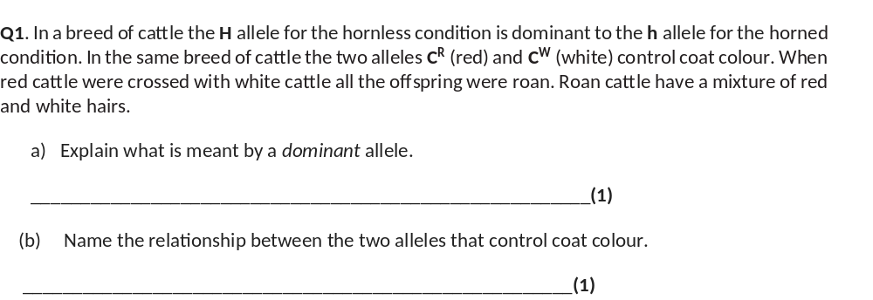
is always expressed(in the phenotype) / produces (functional) proteins;
codominance;

Slide 18
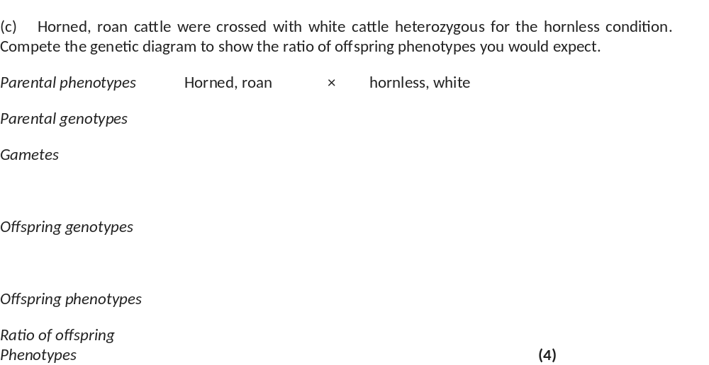
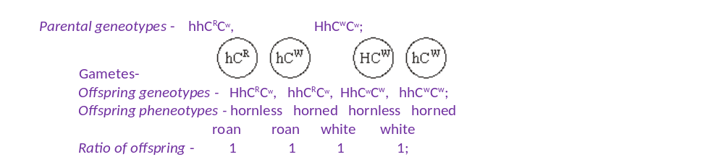

Slide 19
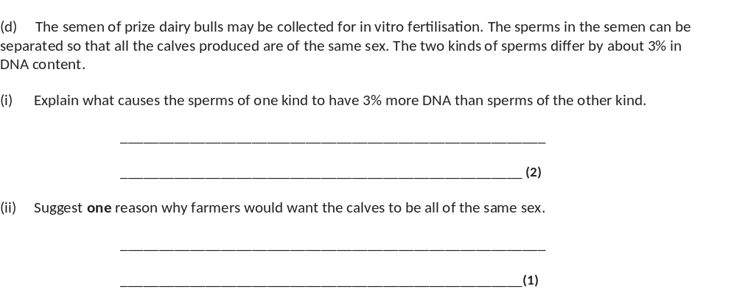
sperm(with more DNA) have X chromosome;
X is larger / has more genes than Y;
female for milk / males for meat / male or female for breeding

Slide 20
