Slide 1

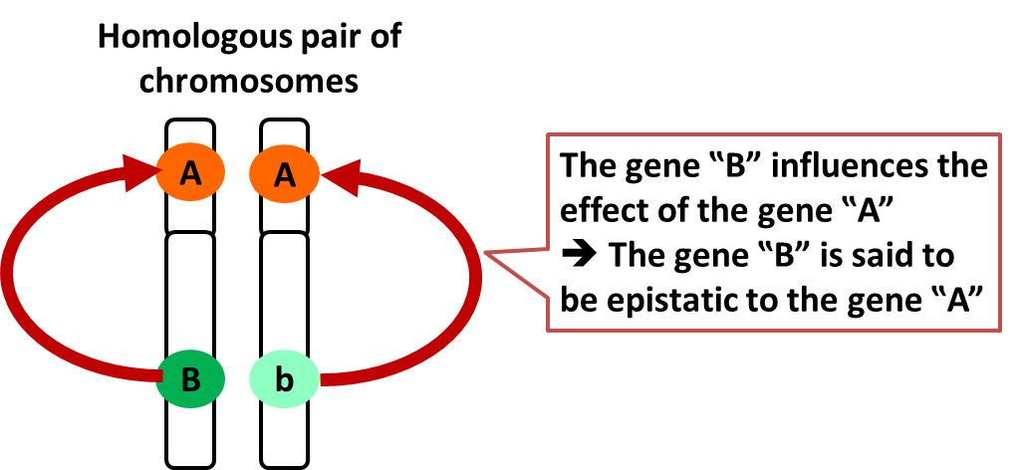
Dihybrid Inheritance- Epistasis
Outcome:
Draw epistasis crosses to predict offspring genotypes and phenotypes.
Apply knowledge to calculate the predicted ratios of genotypes and phenotype of offspring, using fully labelled diagrams, when supplied with appropriate information.
Definition:
Epistasis: One gene locus masks or suppresses the expression of another gene locus.
Complete the definition on page 1 in your booklet

Slide 2

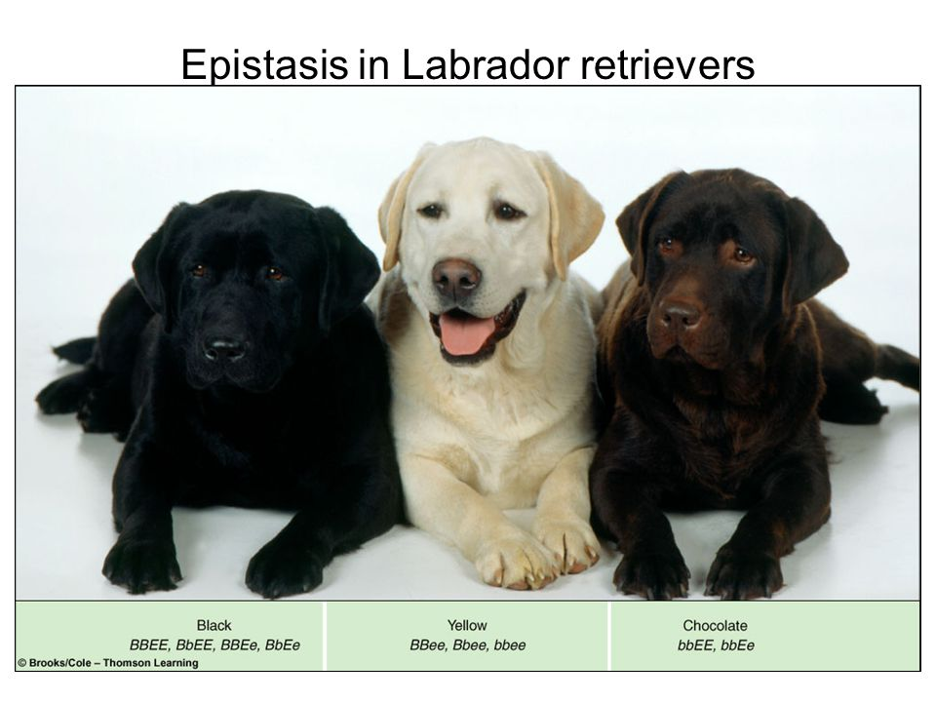
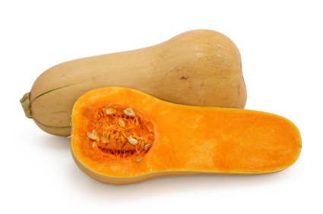
Dihybrid Inheritance- Epistasis
There are three types of epistasis:
A dominant allele at one locus masks the expression of alleles at the second locus
Homozygous recessive alleles at one locus masks the expression of alleles at the second
2 enzymes coded for by 2 genes act sequentially in a metabolic pathway
ALL epistasis questions will be application questions.

Slide 3
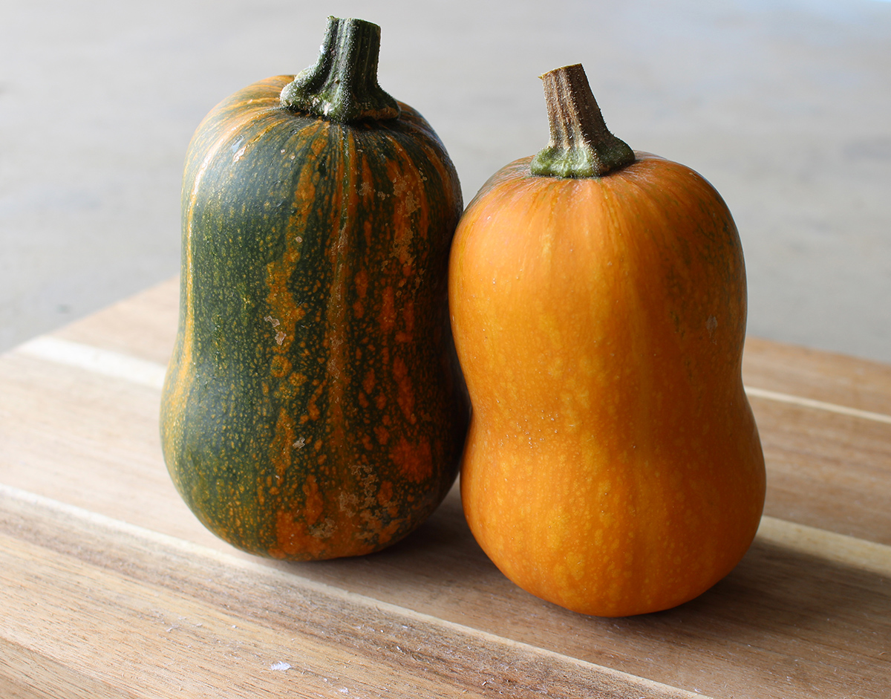
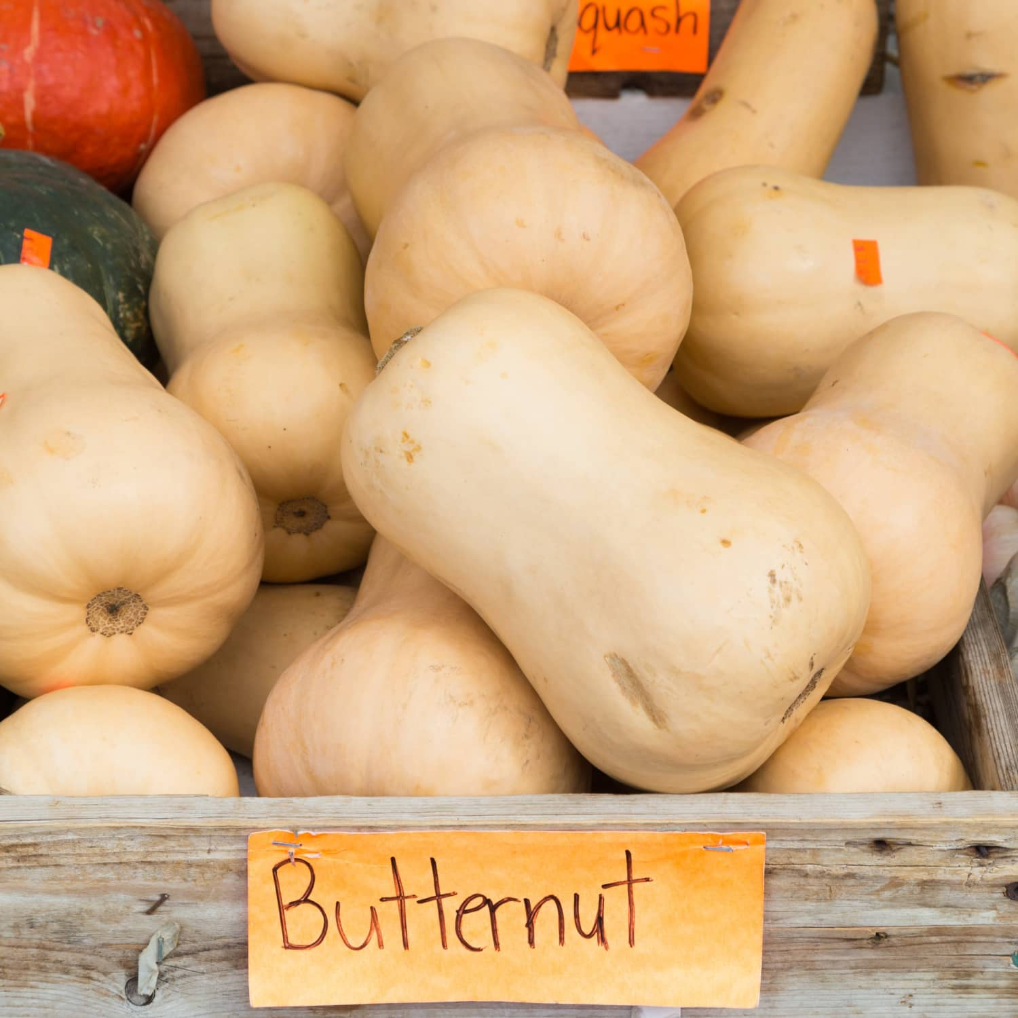
Epistasis type 1: A dominant allele at one locus masks the expression of alleles at the second locus.
Fruit colour in butternut squash.
Inheritance of fruit colour in butternut squash involves interaction between 2 gene loci D/d and E/e. Individuals with dominant D allele have white fruit regardless of the E/e locus. In homozygous dd individuals, E allele produces yellow fruit and ee produces green fruits.
Green Yellow White

Slide 4

Epistasis type 1: A dominant allele at one locus masks the expression of alleles at the second locus.
D_E/e = white fruit
ddE_ = yellow fruit
ddee = green fruit
The D allele masks the expression of the E/e gene
There may only be 1 phenotype but there are 2 genes so there are still 2 alleles per gene.
Complete the phenotype table on page 20.

Slide 5
Epistasis type 1: A dominant allele at one locus masks the expression of alleles at the second locus.
Genotypes | Phenotypes
DdEe | White
DDee | White
ddEE | Yellow
ddEe | Yellow
ddee | Green
If 2 double heterozygotes are crossed DdEe x DdEe
F1 phenotype ratio: 12 white : 3 yellow : 1 green
Draw a genetic cross to show this outcome on page 20 in your booklet.

Slide 6
Epistasis type 1: A dominant allele at one locus masks the expression of alleles at the second locus.
Parental Phenotype= White fruit x White fruit
Parental Genotype= DdEe DdEe
Gametes =
DE
De
dE
de
DE
De
dE
de
 | DDEE | DDEe | DdEE | DdEe
 | DDEe | Ddee | DdEe | Ddee
 | DdEE | DdEe | ddEE | ddEe
 | DdEe | Ddee | ddEe | ddee
DE
De
dE
de
DE
De
dE
de
F1 Phenotype White fruit Yellow Green
F1 ratio 12: 3: 1

Slide 7
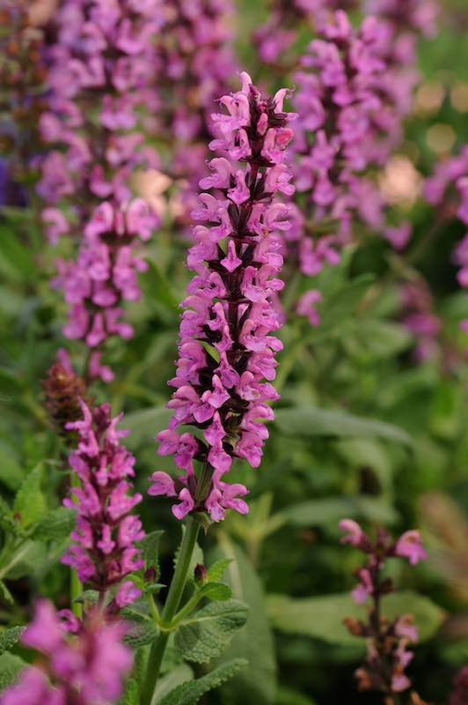
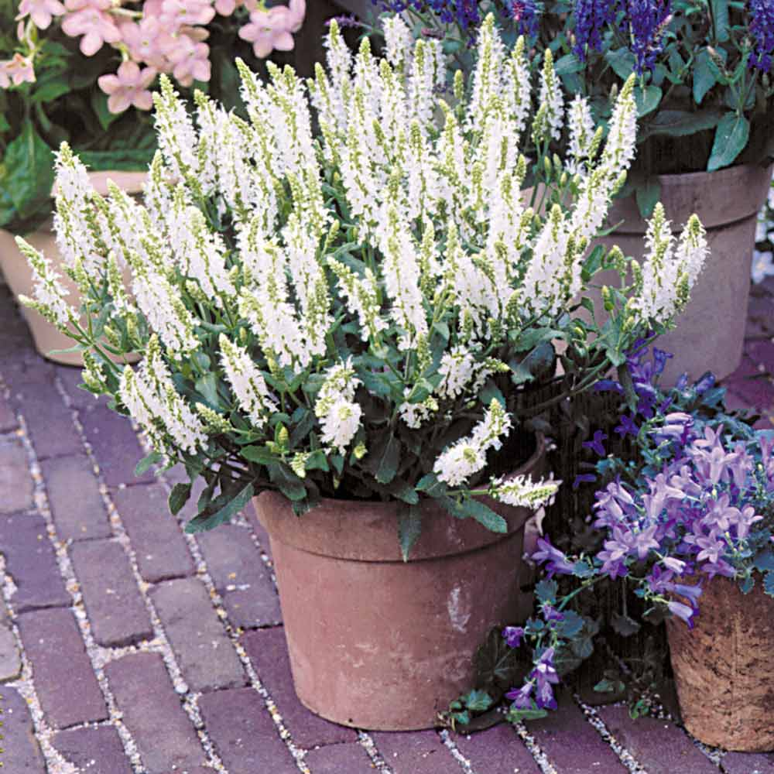
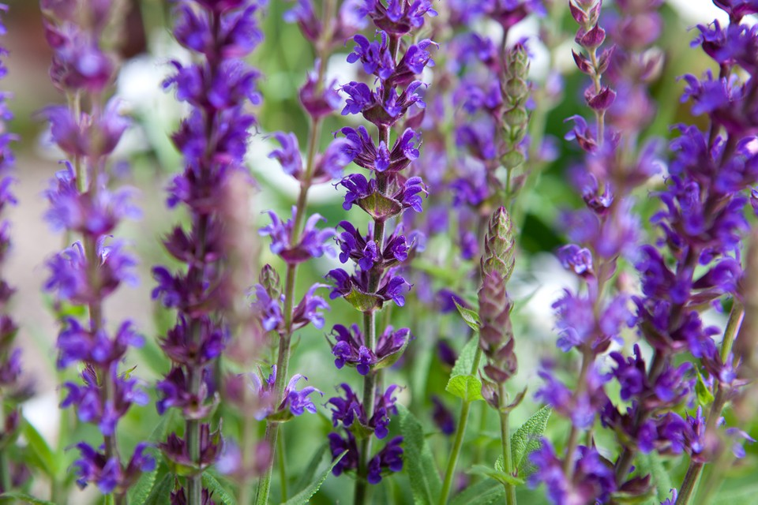
Epistasis type 2: Homozygous recessive alleles at one locus masks the expression of alleles at the second.
Salvia flower colour.
The 2 loci involved are A/a and B/b
The homozygous aa is epistatic to both alleles of the gene B/b.
Neither the allele, B, for purple nor the allele, b, for pink can be expressed if there is no dominant allele, A, present.
So if aa is present, the flowers will always be white.

Slide 8
Epistasis type 2: Homozygous recessive alleles at one locus masks the expression of alleles at the second.
Complete the phenotype table on page 21 in your booklet
Genotypes | Phenotypes
A-B-
A-bb
aaB-
aabb
If 2 double heterozygotes are crossed AaBb
F1 offspring interbred the ratio will be 9 purple : 3pink : 4 white
Draw a genetic diagram to show this.
Purple
Pink
White
White

Slide 9
Epistasis type 1: A dominant allele at one locus masks the expression of alleles at the second locus.
Parental Phenotype= Purple Flower x Purple Flower
Parental Genotype= AaBb AaBb
Gametes =
AB
Ab
aB
ab
AB
Ab
aB
ab
 | AABB | AABb | AaBB | AaBb
 | AABb | Aabb | AaBb | Aabb
 | AaBB | AaBb | aaBB | aaBb
 | AaBb | Aabb | aaBb | aabb
AB
Ab
aB
ab
AB
Ab
aB
ab
F1 Phenotype Purple flower Pink flower White flower
F1 ratio 9: 3: 4.

Slide 10
Epistasis type 3: 2 enzymes coded for by 2 genes act sequentially in a metabolic pathway
A plant produces a red pigment in its petals like this:
Enzyme A Enzyme B
Starting molecule intermediate molecule red pigment
Enzymes A and B are coded for by genes A and B.
Dominant alleles code for a functional enzyme.
Recessive alleles code for a non-functioning enzyme.
If either gene is homozygous recessive, that enzyme will be non-functional and the pathway will not be completed, regardless of whether the other enzyme in functioning normally.

Slide 11
Apply this knowledge to the exam questions on page 22-24.
The questions are worth 16 marks. Can you complete the exam question in 20 minutes?
Once you have completed the question, check your answers using the markscheme.
Remember
Highlight which part of your answer is also on the markscheme. Allow you to see which part of your answer are relevant.
If it isn’t on the mark scheme it is not right, if it isn’t written as the markscheme it is not right.
In a different coloured pen add corrections to the question.
Anything you don’t understand make a note of for when you speak to your teacher.

Slide 12
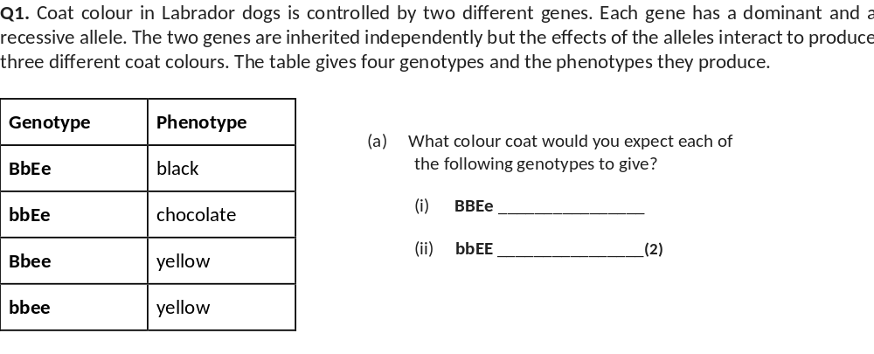
black;
chocolate;

Slide 13
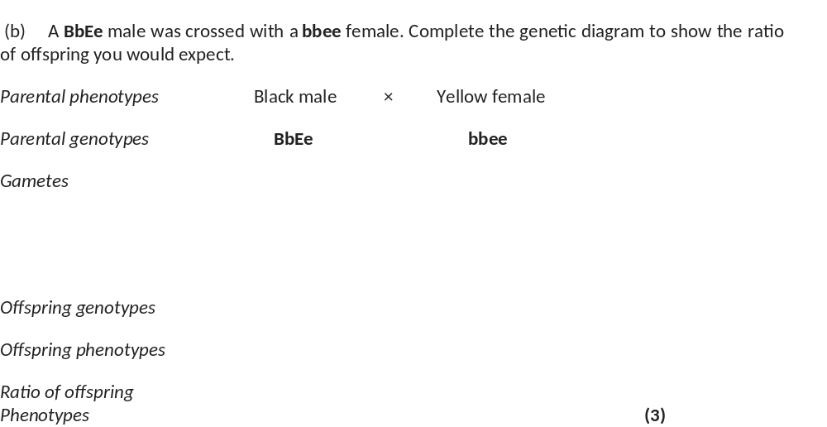
(b) A BbEe male was crossed with a bbee female. Complete the genetic diagram to show the ratio of offspring you would expect.
Parental phenotypes Black male × Yellow female
Parental genotypes BbEe bbee
Gametes BE, Be, bE, be and be;
Offspring genotypes BbEe, Bbee, bbee, bbEe;
Offspring phenotypes
Ratio of offspring 1 black: 2 yellow: 1 chocolate
Phenotypes (3)

Slide 14
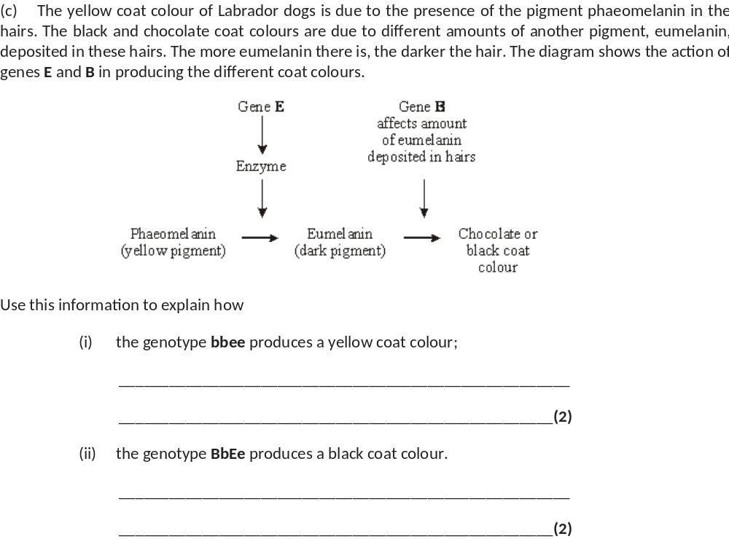
no enzyme coded for when no dominant / E allele;
phaeomelanin not converted – (remains yellow);
E allele results in enzyme producing eumelanin;
B allele - more eumelanin deposited in hairs;

Slide 15
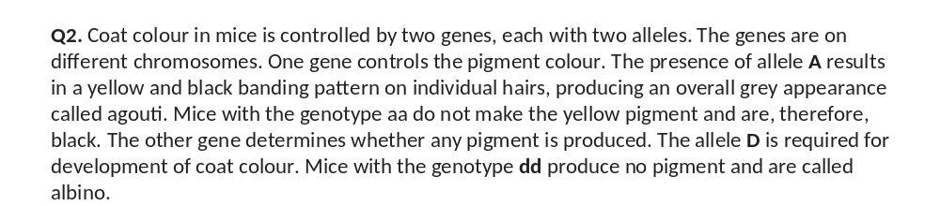
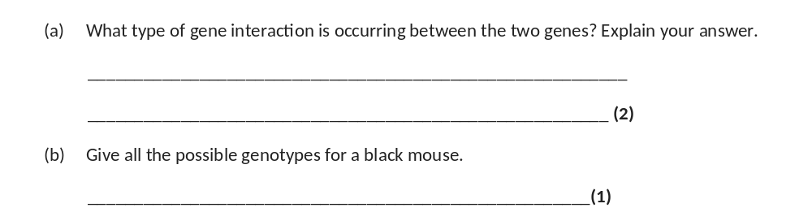
epistasis;
one gene influences the expression of another / description
using example in question;
aaDD, aa Dd (or DDaa, Ddaa);

Slide 16
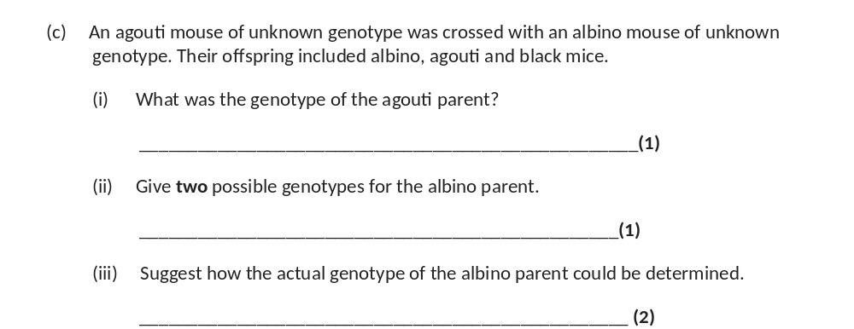
AaDd (or DdAa)
aadd, Aadd (or ddaa, ddAa)
cross with black individual / genotype aaDd or aaDD;
genotype is Aadd if agouti offspring / genotype is aadd if no
agouti offspring;
Accept;
repeat cross using original parents many times;
ratio is 4 albino : 3 agouti : 1 black if Aa, or 2 albino : 1 agouti :
1 black if aa

Slide 17
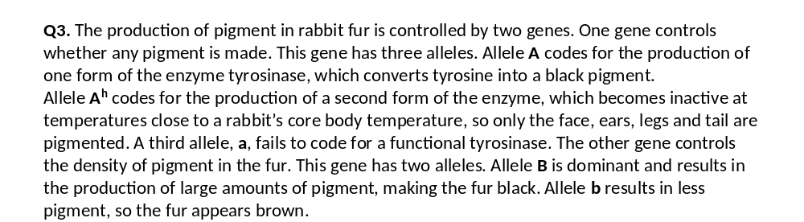
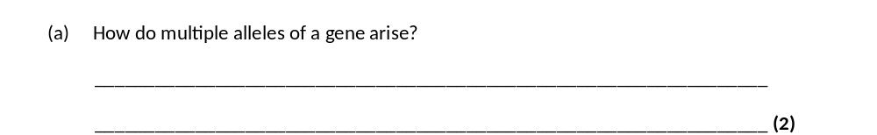
mutations;
which are different / at different positions in the gene;

Slide 18
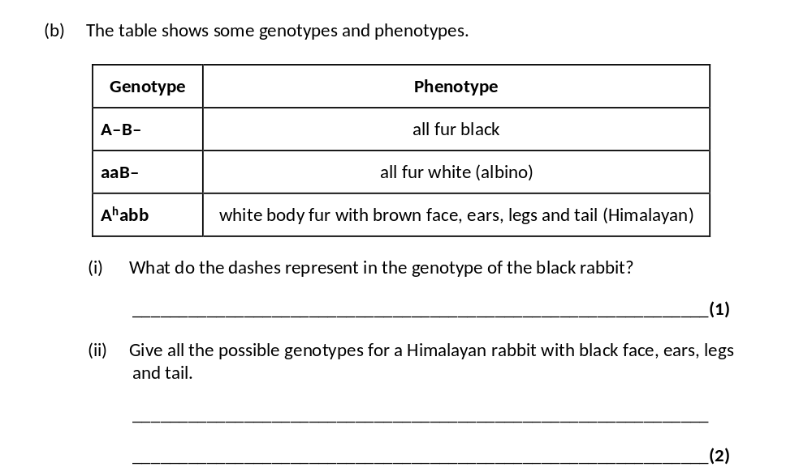
either dominant or recessive allele
A^{h}A^{h} BB, A^{h}aBB, A^{h}A^{h} Bb, A^{h}aBb;

Slide 19
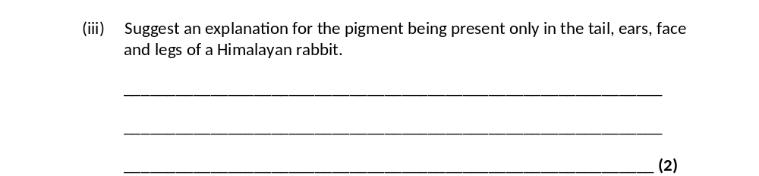
temperature lower at extremities;
enzyme active / not denatured;

Slide 20
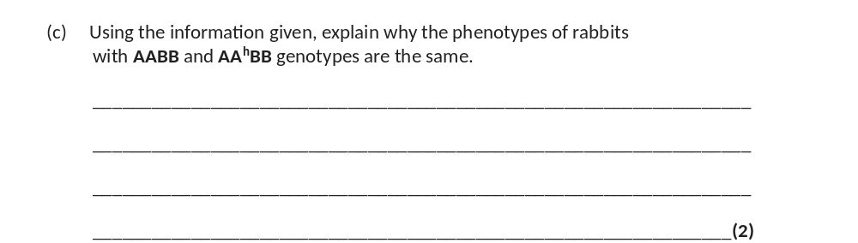
if allele A is present (normal) tyrosinase / enzyme is produced, so it does
not matter what other allele is present / explanation of why heterozygote is
same phenotype as double dominant in terms of enzyme produced;
phenotype / rabbit is black as both have alleles A and B;

Slide 21
Dihybrid Inheritance- Autosomal Linkage
Outcome:
Draw autosomal linkage crosses to predict offspring genotypes and phenotypes.
Apply knowledge to calculate the predicted ratios of genotypes and phenotype of offspring, using fully labelled diagrams, when supplied with appropriate information.
Fill in definition on page 1 in your booklet

Slide 22
Chromosomes other than the sex chromosomes are called autosomes.
So far we have looked at loci that are on separate chromosomes.
Genes are linked if they are inherited on the same chromosome.
This means alleles are inherited together. The alleles are on the same chromosome so cannot assort independently.
Dihybrid Inheritance- Autosomal Linkage
Outcome:
Draw autosomal linkage crosses to predict offspring genotypes and phenotypes.
Apply knowledge to calculate the predicted ratios of genotypes and phenotype of offspring, using fully labelled diagrams, when supplied with appropriate information.

Slide 23
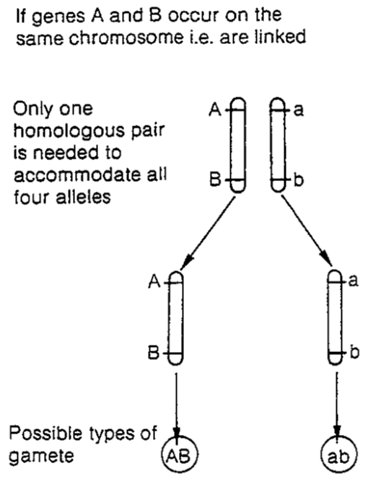
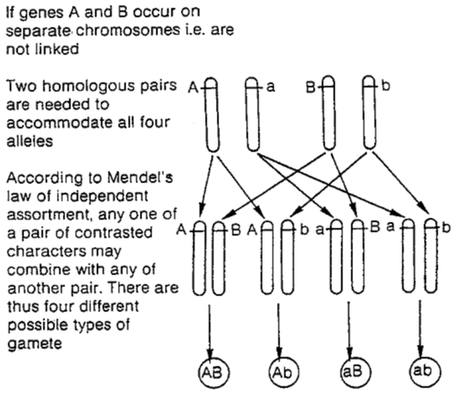
Dihybrid Inheritance- Autosomal Linkage
http://www.bing.com/videos/search?q=what+is+independent+assortment&adlt=strict%2cstrict&view=detail&mid=F24E556C66BC814BAD07F24E556C66BC814BAD07&rvsmid=65E8BF01BA36E9F7558A65E8BF01BA36E9F7558A&fsscr=0&FORM=VDFSRV – What is independent assortment?
Complete the questions on page 26 in your booklet
If there is no independent assortment, does this mean there is more or less genetic variation?
Does this mean that the offspring are more likely or less likely to have the same alleles and so the same phenotype as their parents?
Linked Unlinked
Less
More likely
There are only two different gametes produced as no independent assortment. (even though the parental genotype is AaBb)

Slide 24
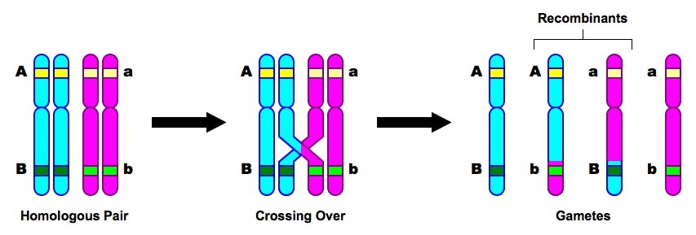
Dihybrid Inheritance- Autosomal Linkage
Crossing over of non-sister chromatids can still occur
Is random so may NOT happen

Slide 25
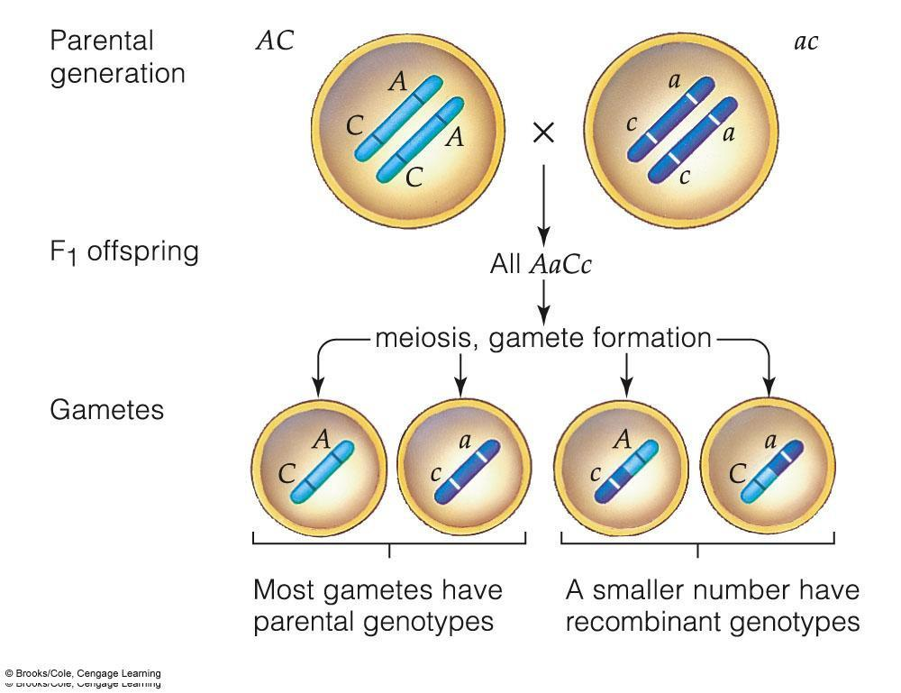
Dihybrid Inheritance- Autosomal Linkage
This is because crossing may not occur.
Crossing over may occur but not in the right place.

Slide 26
Dihybrid Inheritance- Autosomal Linkage
Most common exam question.
Explain the effect of linkage:
Alleles are linked
State common gametes produced
Crossing over will produce other gametes
State other gametes
Fewer specific individuals will be produced
Apply to the information in the question
Alleles are linked
AB and ab will be common gametes
Crossing over will produce other gametes
Ab, aB will also be produced
Fewer individuals of these will be produced
Complete practice cross question on page 27 in your booklets.
WITHOUT CROSSING OVER

Slide 27
Dihybrid Inheritance- Autosomal Linkage
Genetic cross following dihybrid unlinked rules
Parental Genotype= AaBb AaBb
Gametes =
AB
Ab
aB
ab
AB
Ab
aB
ab
 | AABB | AABb | AaBB | AaBb
 | AABb | Aabb | AaBb | Aabb
 | AaBB | AaBb | aaBB | aaBb
 | AaBb | Aabb | aaBb | aabb
AB
Ab
aB
ab
AB
Ab
aB
ab
F1 Phenotype A-B- A-bb aaB- aabb
F1 ratio 9: 3: 3: 1

Slide 28
Dihybrid Inheritance- Autosomal Linkage
Genetic cross following dihybrid linked rules
Parental Genotype= AaBb AaBb
Gametes =
AB
ab
AB
ab
 | AABB | AaBb
 | AaBb | aabb
AB
ab
AB
ab
F1 Phenotype A-B- aabb
F1 ratio 3: 1

Slide 29
Apply this knowledge to the exam questions on page 27-28
The questions are worth 7 marks. Can you complete the exam question in 10 minutes?
Once you have completed the question, check your answers using the markscheme.
Remember
Highlight which part of your answer is also on the markscheme. Allow you to see which part of your answer are relevant.
If it isn’t on the mark scheme it is not right, if it isn’t written as the markscheme it is not right.
In a different coloured pen add corrections to the question.
Anything you don’t understand make a note of for when you speak to your teacher.

Slide 30
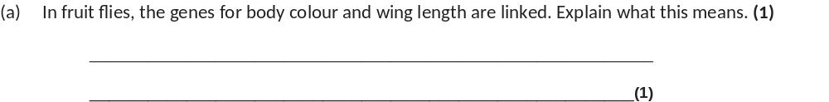
(a) (Genes / loci) on same chromosome.
1

Slide 31
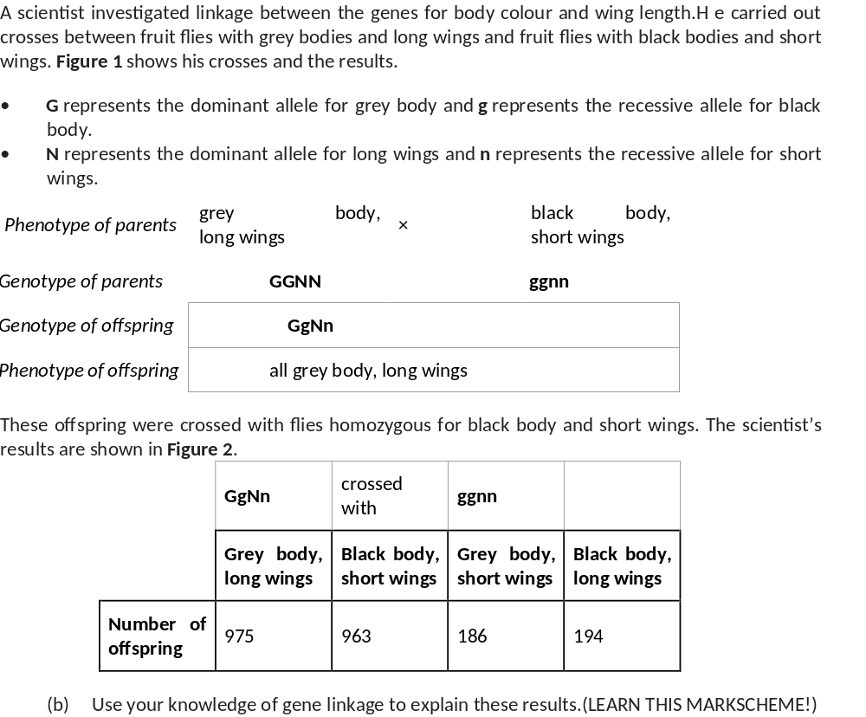
1. GN and gn linked;
2. GgNn individual produces mainly GN and gn gametes;
3. Crossing over produces some / few Gn and gN gametes;
4. So few(er) Ggnn and ggNn individuals.
4

Slide 32
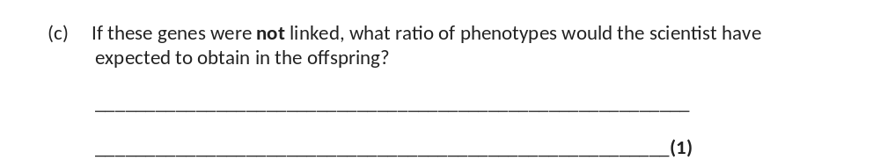
(Grey long:grey short:black long:black short) =1:1:1:1
Complete the True or False quiz on page 28 in your booklet.
Any statements that are false will need to be corrected.

Slide 33
Dihybrid Inheritance- Autosomal Linkage
Phenotype describes how the amino acids are expressed.
In the condition haemophilia, males cannot be carriers.
In a co-dominant cross, 3 alleles exert an affect on the phenotype.
Autosomal linkage is when genes are inherited on the same chromosome.
Autosomal linkage reduces phenotypic variation.
A diploid organism has 2 alleles for each characteristic.
The expected ratio from a dihybrid cross, where both parents are heterozygous is 9:3:3:1.
Epistasis is where genes on sex chromosomes affect the expression of genes on other chromosomes.
Multiple alleles is where there are more than two alleles for a gene.
Crossing over is when pairs of sister chromatids form chiasmata during Prophase 1.

Slide 34
Dihybrid Inheritance- Autosomal Linkage
Phenotype describes how the amino acids alleles are expressed.
In the condition haemophilia, males cannot be carriers. T
In a co-dominant cross, 3 2 alleles exert an affect on the phenotype.
Autosomal linkage is when genes are inherited on the same chromosome. T
Autosomal linkage reduces phenotypic variation. T
A diploid organism has 2 alleles for each characteristic. T
The expected ratio from a dihybrid cross, where both parents are heterozygous is 9:3:3:1. T
Epistasis is where genes on sex chromosomes affect the expression of genes on other chromosomes.
Multiple alleles is where there are more than two alleles for a gene. T
Crossing over is when pairs of non-sister chromatids form chiasmata during Prophase 1.

Slide 35
Dihybrid Inheritance- Autosomal Linkage
On Whiteboards……
Identify mistakes and inaccuracies in the following:
Chromosomes are linked when the loci for two genes are on the same chromosome. Crossing over does not occur but independent assortment does. This reduces phenotypic variation.
In multiple alleles, the different alleles code for different sequences of alpha glucose which then gives the protein produced a different 3D shape. This is due to differences in primary structure. An example of this is the inheritance of colour blindness.

Slide 36
Dihybrid Inheritance- Autosomal Linkage
On Whiteboards……
Identify mistakes and inaccuracies in the following:
Chromosomes are linked when the loci for two genes are on the same chromosome. Crossing over does occur but independent assortment does not. This reduces phenotypic variation.
In multiple alleles, the different alleles code for different sequences of amino-acids which then gives the protein produced a different 3D shape. This is due to differences in primary structure. An example of this is the inheritance of blood groups.

