Slide 1
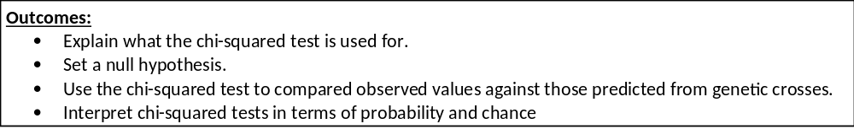
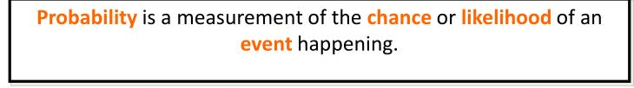
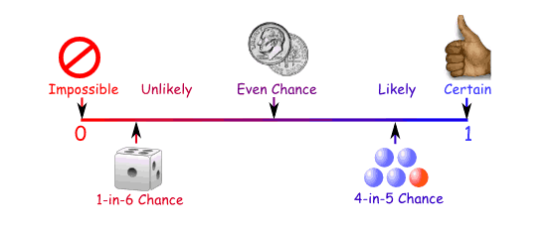
The Chi Squared Test

Slide 2

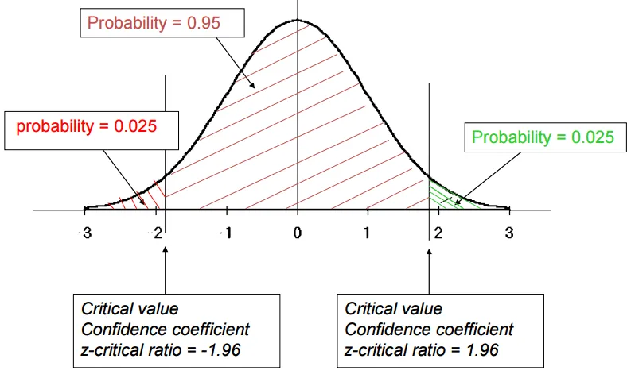
The Chi Squared Test
There are different statistical tests that can be assessed:
Definitions:
Chi squared test- Used to compared expected and observed data
Student t-test
Used to compare means from 2 sets of data
Correlation co-efficient
Used to compare data from 2 different variables that have been sampled
These test the probability of the difference in the values is due to chance or if the difference in the values is statistically different.
Biologists used the “95% confidence” rule
Complete page 29 in your booklet

Slide 3
The Chi Squared Test
“95% confidence” rule
This is the probability (p) that the difference in data was created by chance.
Biologists use a probability value or p value of 5% (0.05) as cut off.
If the p value given in the questions is less than 5% this means you are more than 95% sure that the difference in the data is significant and did not happen by chance.
We can draw conclusions from the difference in the data.
If the p value given in the questions is more than 5% this means you are less than 95% sure that the difference in the data is significant so the difference happened by chance.
We can’t draw conclusions from the difference in the data.

Slide 4
The Chi Squared Test
Probability and chance
There are other statistical tests we can do which include:
Chi squared test- We will study this in more detail later on in year 2
Used to compared expected and observed data
Student t-test
Used to compare means from 2 sets of data
Correlation co-efficient
Used to compare data from 2 different variables that have been sampled
When answering questions using the different statistical tests you must APPLY your answer to the specific test.
We are going to specifically look at the Chi-squared test for inheritance crosses.

Slide 5
The Chi Squared Test
Used for categorical data.
To test if the difference between the observed and expected data is due to chance or significantly different so due to another factor.
How do we know if the difference between the two is just due to chance, or is significantly different and there must be another explanation?

Slide 6
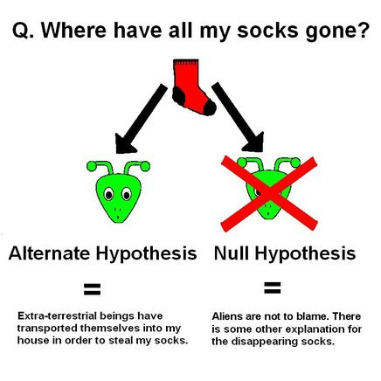
Null hypothesis
The X² test is used to test the null hypothesis.
Definition:
Null hypothesis: The null hypothesis states that there is no significant difference between the observed and expected values.
We can then either accept or reject the null hypothesis.

Slide 7
The Chi Squared Test.
Simple example!
Toss a coin 100 time and you might expect to get 50 heads and 50 tails (expected values). In reality, it would be unlikely you actually get this.
If it lands on heads 55 times and tails 45 times (observed values), does this mean the coin is weighted? Or is it just due to chance?
We now use these Expected (E) and Observed (O) figures in the Χ² test.
The formula is
X² = sum of (O-E)²
E
Complete the table on page 29 in your booklet

Slide 8
The Chi Squared Test.
Class | Observed (O) | Expected (E) | O-E | (O-E)² | (O-E)² E
Heads | 55 | 50 | +5 | 25 | 0.5
Tails | 45 | 50 | -5 | 25 | 0.5
 |  |  |  |  | Sum =1.0
So we now have a calculated value but what does it mean?
THIS will be the most marks in the exam
Explain the chi-squared results.

Slide 9
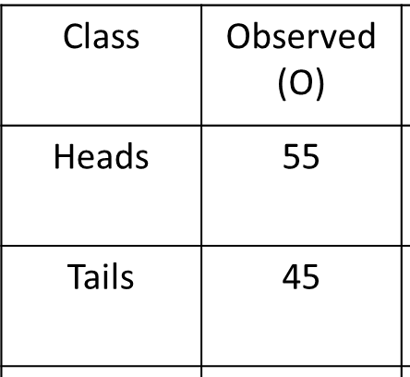
The Chi Squared Test- What does it mean?
1. Work out the degrees of freedom (df)
df = n-1 (where n = no of different phenotypes or phenotypic classes)
Here we have 2 phenotypic classes so df = 2-1 = 1
2 different phenotypes
2-1 = 1 degree of freedom

Slide 10
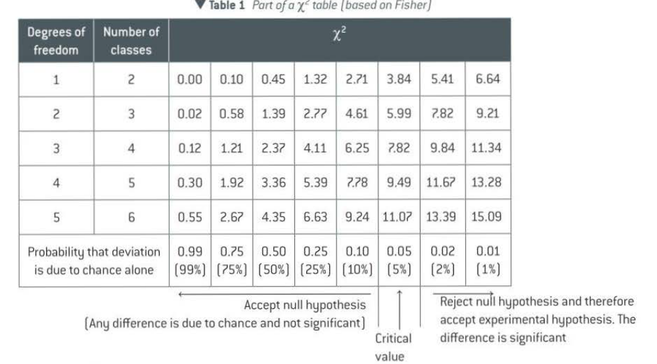
The Chi Squared Test- What does it mean?
2. Find calculated Value
Use the provided X² table that the examiner will provide.
Use the table on page Pg 444 in the Toole and Toole textbook,
Biologists always compare against the probability of 0.05 (p value).

Slide 11
The Chi Squared Test- What does it mean?
3. Find the P (probability) value.
Look along the row showing 1 df for our calculated value of 1.0
Between which P values does it fall?
From the Chi-squared calculation we have produced a calculated value (1.0)
From the table we have used this calculated value to produce a P-values between 0.25 and 0.50.

Slide 12

The Chi Squared Test- What does it mean?
4. Compare values and draw conclusion
Is this greater or smaller than the P value of 0.05 (5%) which we always compare against?
If our p-value is greater than 5% or 0.05:
The probability that the difference between the observed and expected values is due to chance is more than 5%
The differences between the observed and expected values is not significant so is due to chance
We accept the null hypothesis.
Always re-state the null hypothesis.
If our p-value is less than 5% or 0.05:
The probability that the difference between the observed and expected values is due to chance is less than 5%
The differences between the observed and expected values is significant so is not due to chance
We reject the null hypothesis.
Another factor must be effecting the results.
Give an example of the other factor.

Slide 13
The Chi Squared Test- What does it mean?
So in our example, 0.25 and 0.50 are greater than 0.05.
On a whiteboard….
Explain what the P-values show
If our p-value is greater than 5% or 0.05:
The probability that the difference between the observed and expected values is due to chance is more than 5%
The differences between the observed and expected values is not significant so is due to chance
We accept the null hypothesis.
The coin has not been tampered with.
Fill in page 30 in your booklet.

Slide 14
The Chi Squared Test.
Complete the practice question on page 30-31 in your booklet.

Slide 15
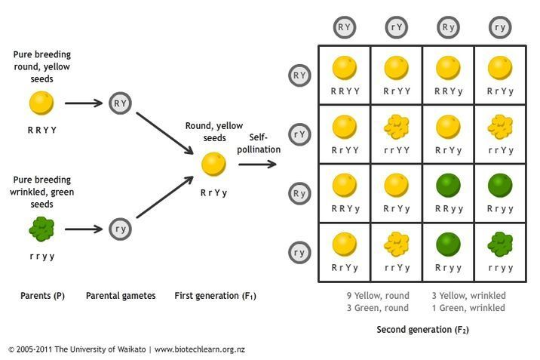
The Chi Squared Test.
Dihybrid cross with heterozygous parents.
The cross was carried out and the actual (observed - O) phenotypes are:-
169 round yellow seeds
54 round green seeds
51 wrinkled yellow seeds
14 wrinkled green seed
Total offspring = 288
Expected ratio= 9:3:3:1. Calculate the expected values- E
9/16 x 288 = 162
3/16 x 288 = 54
3/16 x 288 = 54
1/16 x 288 = 18
Ratio for phenotype/ total number of ratio x total no. off offspring.

Slide 16
The Chi Squared Test.
On whiteboard…..
Write out a null hypothesis for this genetic cross.
Copy out null hypothesis onto page 31 in your booklet.
There will be no significant difference between the observed and expected phenotypes of different types of seeds
Complete the Chi-squared table on page 31 in your booklets to produce your calculated value.
Complete steps 1-4 on page 31 in your booklet to explain if you would accept or results the null hypothesis.

Slide 17
The Chi Squared Test.
Class | O (Observed) | E (Expected) | O-E | (O-E)² | (O-E)² E
Round yellow | 169 | 162 | 7 | 49 | 0.30
Round green | 54 | 54 | 0 | 0 | 0.00
Wrinkled yellow | 51 | 54 | -3 | 9 | 0.17
Wrinkled green | 14 | 18 | -4 | 16 | 0.89
Sum of (=X²) |  |  |  |  | 1.36

Slide 18

The Chi Squared Test.
Work of Degrees of freedom (df)
Find calculate value
Find P value
Compare values and draw conclusion. What would we write?
4 phenotypes -1 = 3 DF
Calculated = 1.36
P-value = between .050 and 0.75

Slide 19
The Chi Squared Test.
If our p-value is greater than 5% or 0.05:
The probability that the difference between the observed and expected values is due to chance is more than 5%
The differences between the observed and expected values is not significant so is due to chance
We accept the null hypothesis. There will be no significant difference between the observed and expected phenotypes of different types of seeds

Slide 20
The Chi Squared Test.
There are very few exam questions so use this practice question to test yourself.
Page 32 in your booklet.
Curled wings and spineless bristles are both autosomal recessive characteristics in the fruit fly.
Pure-breeding fruit flies with straight wings and normal bristles were crossed with pure-breeding flies with curled wings and spineless bristles. The F1 all had straight wings and normal bristles.
Virgin female flies from the F1 were then test-crossed (back-crossed) with males showing both recessive characteristics, giving the following results:-
Straight wings, normal bristles 186
Straight wings, spineless bristles 18
Curled wings, normal bristles 16
Curled wings, spineless bristles 180
The ratio of phenotypes expected in a dihybrid test-cross such as this is 1:1:1:1
Use the chi-squared test and the provided table of probabilities to find the probability of results of the test-cross departing significantly by chance from the expected ratio. Show your working.
Explain the discrepancy between the E and O results of the cross.
Calculated value= 275.7.
The probability that the difference between the observed and expected values is due to chance is less than 5%
The differences between the observed and expected values is significant so is not due to chance
We reject the null hypothesis.
Another factor must be effecting the results for example the genes may be linked on the same chromosome.

