Slide 1
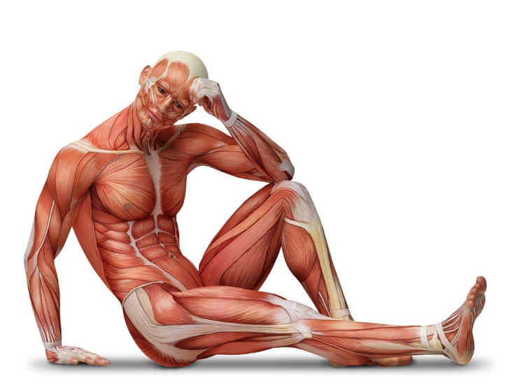
3.6.3 Skeletal muscles are stimulated to contract by nerves and act as effectors.

Slide 2
Structure and Function of the 3 types of muscles

Slide 3
Structure and Function of the 3 types of muscles
Outcome
• Describe the three types of muscle in the body
• Explain the role of skeletal muscle, linked to the role of tendons and joints
• Explain why muscles which move bones that form part of a joint, work as antagonistic pairs
• Describe some common antagonistic pairs in the body.

Slide 4
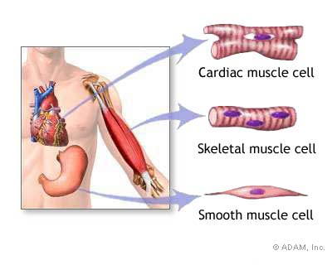
 | Skeletal | Smooth | Cardiac
Cells | Long multinucleate fibres | Short and spindle-shaped; one nucleus per cell. | Branched with intercalated discs joining cells at their ends; one nucleus per cell.
Appearance | Striped / striated | Unstriped / unstriated | Striped / striated
Controlled by | Voluntary NS | Involuntary NS | Myogenic. Involuntary NS controls RATE of contraction
Distribution | Attached to the skeleton | In tubular organs such as blood vessels, intestines, airways and reproductive system | Heart
Function | Movement and maintenance of posture | Peristalsis, uterine contraction, control diameter of blood vessels/airways. reflexes e.g. pupil size, | Contracts to pump blood around heart
Under a microscope

Slide 5
Antagonistic muscle action
Skeletal muscles are attached to bone by tendons.
Pairs of muscles contract and relax to move bones at the joint.
Bones of the skeleton are incompressible (rigid) so they act as levers, giving the muscles something to pull against.

Slide 6
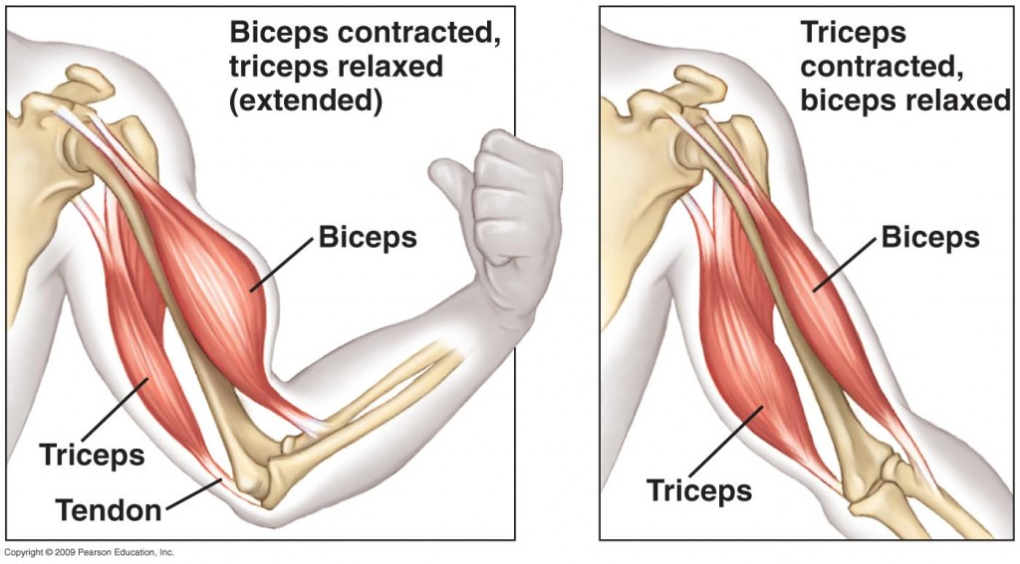
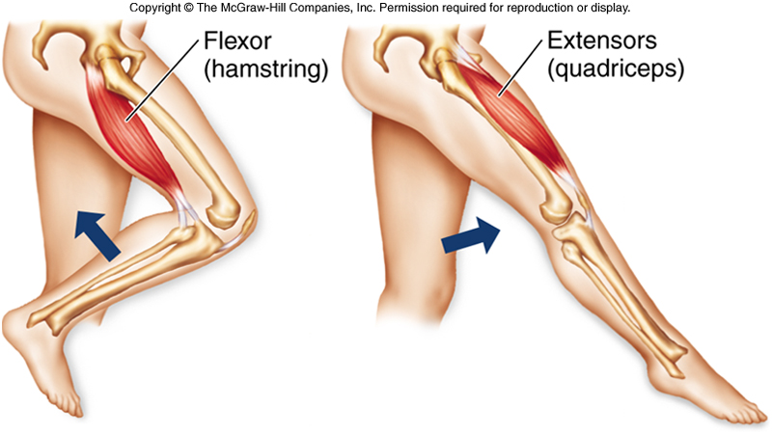

Antagonistic muscles
Definition:
Antagonistic muscle pairs:
Muscles that work together in opposition to move bones at joints.
e.g. as one contracts, the other relaxes. This pulls a bone which is part of a joint.

Slide 7
Antagonistic muscle action
https://www.youtube.com/watch?v=VCminz-X52I;
https://www.youtube.com/watch?v=NoFxgMrjR_U

Slide 8
What is the advantage of skeletal muscles being arranged in pairs?
Skeletal muscles work in pairs because they can only pull on bones when they contract (shorten).
Muscles cannot push (lengthen or expand) on bones.

Slide 9
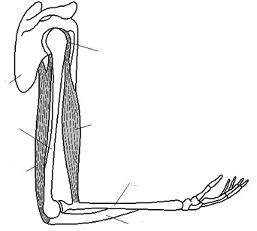
Tasks:
Put the following labels on the diagram of the elbow joint:
biceps muscle, triceps muscle, tendon, shoulder blade, radius, ulna, humerus
2. Use different colours for the biceps and triceps
3. Fill in the gaps below using these words:
relaxes, radius, triceps, contracts, extends, flexes,, biceps

Slide 10
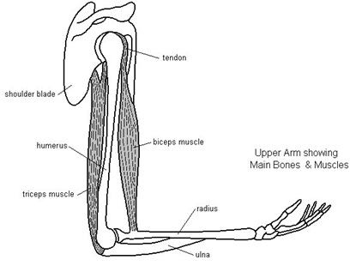
Muscles of the upper arm.
You do not need to be able to label this for your exam but you may have to apply your knowledge to a similar example

Slide 11

You do not need to know this example but you may have to apply your knowledge to a similar example
An example:
Bicep contracts and the tricep relaxes
This pulls the radius and bends (flexes) the arm at the elbow.
Tricep contracts and bicep relaxes
This pulls the ulna and straightens (extends) the arm at the elbow.

Slide 12
Stretch and challenge question
Explain how muscles maintain posture
Antagonistic muscles work at the joints
Both contract to keep the body upright
Only a few fibres contract (micro-contraction) to avoid fatigue

Slide 13
Answer the quick recap questions with your partner
1.What are the three types of muscle in the body and what are their roles?
2.Muscles can pull as they contract, but they cannot push. What would happen to a bone if muscles did not work in antagonistic pairs?
3.Evaluate this statement: “In an antagonistic pair of muscles, one muscle contracts whilst the other expands”.
4. What other antagonistic pairs are there in the body?
Do some research. This is good to use in your essays as beyond the specification knowledge

Slide 14
1.What are the three types of muscle in the body and what are their roles?
2.Muscles can pull as they contract, but they cannot push. What would happen to a bone if muscles did not work in antagonistic pairs?
3.Evaluate this statement: “In an antagonistic pair of muscles, one muscle contracts whilst the other expands”.
Smooth muscle – Vasoconstriction in blood vessels, cardiac muscle to pump blood around the heart/body, skeletal muscle for movement and maintaining posture.
Bone would not be moved as no opposite force
Yes- Muscles do work in antagonistic pairs
No- Muscles cannot expand but can be lengthened by antagonistic movement.

Slide 15
Examples of antagonistic muscle pairs
Biceps | Triceps
Hamstrings | Quadriceps
Gluteals | Hip flexors
Gastrocnemius | Tibialis anterior
Pectorals | Latissimus dorsi
Muscles in the front and back of lower leg
Large muscles of chest and back

Slide 16
The Neuromuscular Junction
Outcome
Explain what a neuromuscular junction is
Describe and explain the detailed structure of a neuromuscular junction.
Explain transmission across a neuromuscular junction by release of acetylcholine and compare this to synaptic transmission.
Explain how muscle fibres stimulated to contract by one motor neurone act as a motor unit.

Slide 17
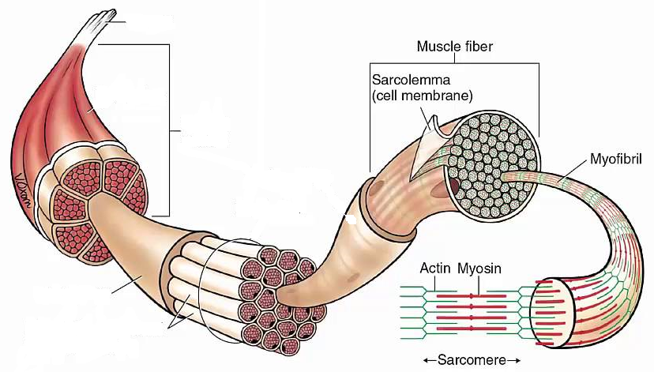
tendon
Whole skeletal muscle
Striations
nucleus
Bundle of muscle fibres
Single muscle fibres

Slide 18
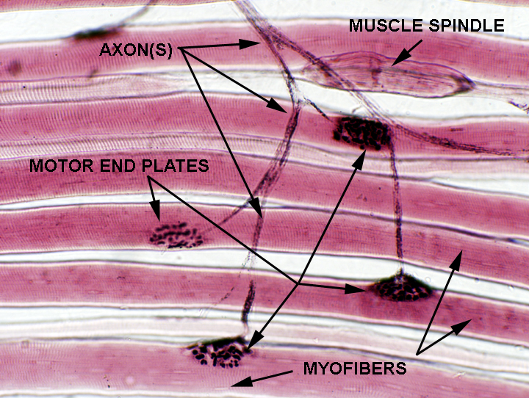
Neuromuscular junction
The nervous system controls muscle action as motor neurones are connected to muscle cells. Impulses stimulate contraction.
Definition
The neuromuscular junction is a synapse between a motor neurone a skeletal muscle fibre.

Slide 19
Task:
Use toole and toole page 369 to answer the questions on page 4 and 5 in your booklet.
Can you add the labels to the NMJ using your knowledge of synapses?
Can you also add a label for synaptic vesicles, myelin sheath and sarcolemma?

Slide 20
What would happen if there was only 1 NMJ, and what do many NMJs ensure?
One NMJ:
Takes time for a wave of contraction to travel across the muscle
Not all fibres would contract at the same time
Movement slow
Many NMJ’s:
Contraction of muscle is rapid and powerful

Slide 21
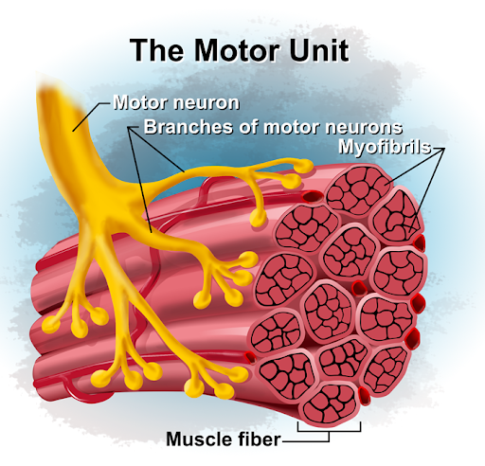
What is a motor unit?
All the muscle fibres which are supplied by a single motor neurone act together as a single functional unit.

Slide 22
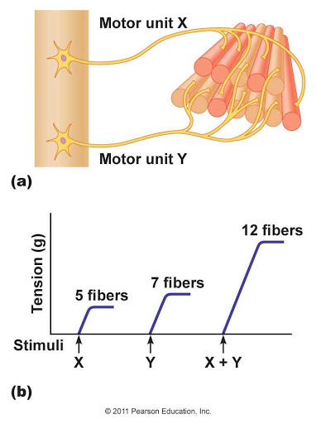
Why are they important – how does this link into the force the muscle exerts?
Slight force is required - only a few motor units are stimulated
Large force required - many motor units are stimulated.

Slide 23
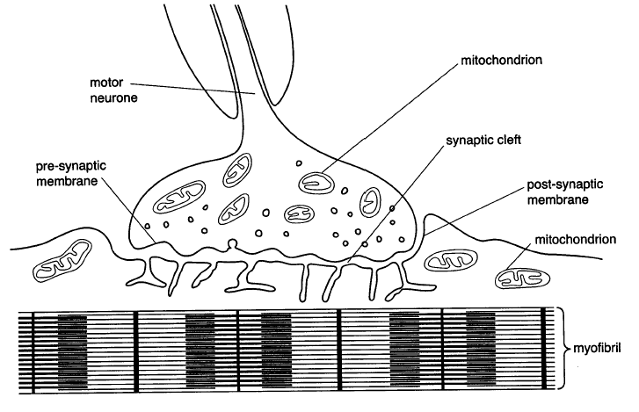
Neuromuscular Junction
Myelin sheath
Synaptic vesicle
Sarcolemma (membrane of a muscle fibre – one muscle cell )
The neuromuscular junction endplate is wavy and has a larger SA than a synapse

Slide 24
Memory task: on whiteboards/paper (MARKSCHEME PERFECT ANSWER)
Describe how a synapse works (8)
Depolarisation of membrane causes Ca ²⁺ channel to open;
Ca ²⁺ enter by (facilitated) diffusion;
Causes vesicles to fuse with presynaptic membrane;
Releasing neurotransmitter into synaptic cleft;
Neurotransmitter diffuses across cleft
Binds to receptors on postsynaptic membrane;
Causes sodium ion channels to open;
Sodium ions diffuse in and causes depolarisation of post synaptic membrane;

Slide 25
Sequence of events at NMJ
Task: Use these words to fill in the gaps on page 5 in your booklet
calcium, sodium, diffuses, sarcolemma, presynaptic, depolarisation, acetylcholinesterase, vesicles, ethanoic acid, mitochondria, synaptic, receptors

Slide 26

Sequence of events at NMJ
Depolarisation of membrane causes Ca ²⁺ channel to open;
Ca ²⁺ enter by (facilitated) diffusion;
Causes vesicles to fuse with presynaptic membrane;
Releasing acetylcholine into synaptic cleft;
Acetylcholine diffuses across cleft;
Binds to receptors on the membrane of muscle fibre/sarcolemma ;
Causes sodium ion channels to open;
Sodium ions diffuse in causes depolarisation of membrane of muscle fibre/scarclemma and muscle contracts;
The Ach is hydrolysed by acetylcholinesterase to prevent muscle being overstimulated.
The choline and ethanoic acid diffuse back into the presynaptic neurone where they are recombined to synthesise Ach using ATP produced by mitochondria.

Slide 27
On whiteboards in pairs
Task: Draw a table to compare (similarities) and contrast (differences) synapses and neuromuscular junctions.
Questions to think about:
Excitatory/inhibitory?
Connected to?
Types of neurone involved?
What happens to AP?
What does Ach bind to?
Exam tip!
Always draw a table for compare and contrast questions

Slide 28
NMJ | Cholinergic Synapse | Both
Only excitatory | May be excitatory or inhibitory | The neurotransmitter binds to the receptors on postsynaptic membrane which causes a depolarisation
Only links neurones to muscles | Links neurones to neurones, or neurones to other effector organs | Neurotransmitters are located in vesicles in the presynaptic cytoplasm
Only motor neurones are involved | Motor, sensory and intermediate neurones may also be involved | There are receptors on the postsynaptic membrane which have a specific shape
The action potential ends here (the sarcolemma does depolarise but can’t propagate past this membrane) | A new action potential may be produced along another neurone (postsynaptic neurone) | Enzymes break down the neurotransmitter to avoid continual stimulation of the post synaptic membrane
Ach bids to receptors on membrane of muscle fibres | Ach binds to receptors on membrane of post-synaptic neurone | neurotransmitter is released and travels across cleft when an action potential arrives

Slide 29
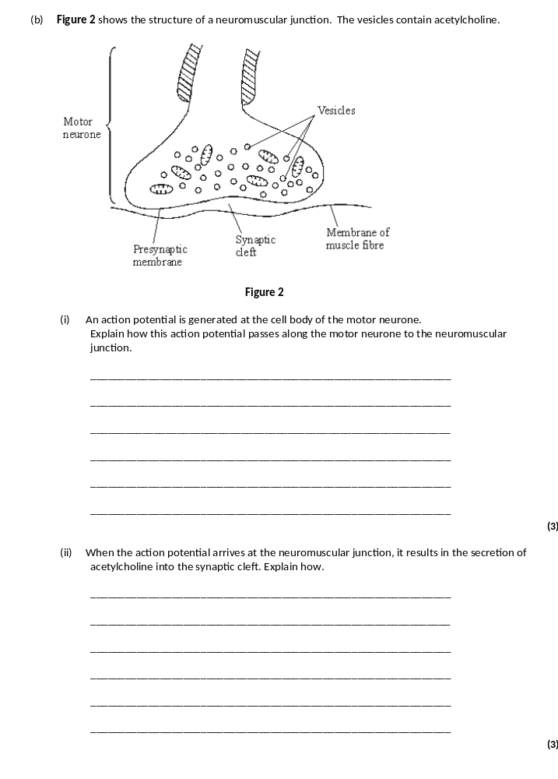
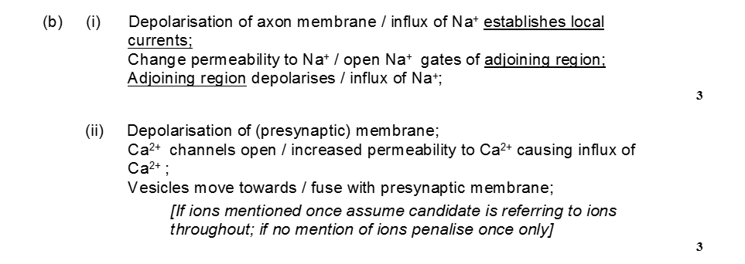
Task: Answer Exam Question 1 on page 6 and 7 of your booklet

Slide 30
Q2: Exam question: Explain why mitochondria are essential for the transmission of impulses across a cholinergic synapse/NMJ/ (4)
Mitochondria produce ATP by aerobic respiration
Required for sodium – potassium ion pump/maintain conc. grad
Used in Ach formation
Used in vesicle formation/ movement
Used in fusion of vesicles with membrane/exocytosis
Calcium ions actively transported

Slide 31
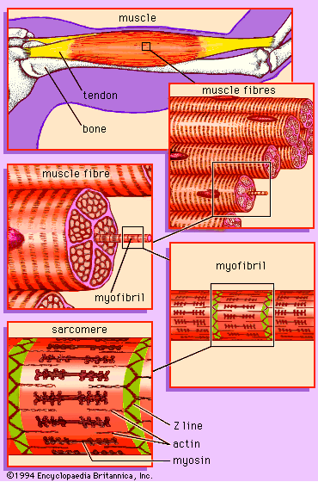
Muscle Structure
Outcome
• Describe the gross structure of skeletal muscles
• Explain what is meant by a myofibril
• Describe the microscopic structure of skeletal muscle
• Explain what is meant by a sarcomere
• Explain how actin and myosin are arranged within a myofibril, linked to isotropic bands and anisotropic bands and the thickness of each type of protein filament
• Interpret diagrams to identify I bands, A bands, the H zone and the Z line on a diagram.

Slide 32
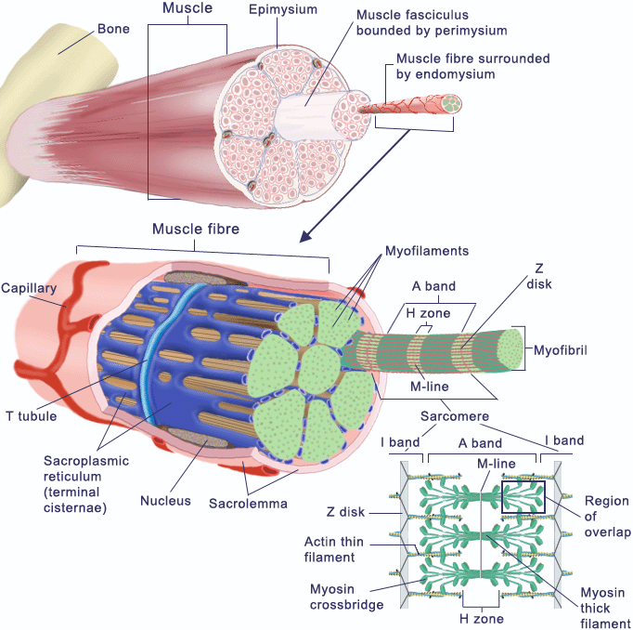
Gross muscle Structure
Task: Use text book, p. 367 and label your diagram

Slide 33
tendon
Whole skeletal muscle
Striations
nucleus
Bundle of muscle fibres
Single muscle fibres

Slide 34
Task: Fill in the gaps using the words in the box:
Use these words:
Nuclei, sarcolemma, sarcoplasm, Myofibrils, sarcomeres, filaments, actin, myosin

Slide 35
Gross Muscle structure
Individual muscles contain hundreds of MUSCLE FIBRES
Each muscle fibre is one large cell
Each cell has many nuclei
And contain many mitochondria, glycogen granules, and specialised smooth ER called sarcoplasmic reticulum
The cell membrane is called the sarcolemma.
The cytoplasm is called the sarcoplasm
In each fibre there are many MYOFIBRILS
These contain the contractile units called SARCOMERES
In each myofibril there are protein FILAMENTS made of actin & myosin

Slide 36
Structures within a muscle
Whole Muscle
Muscle Fibre
Myofibril
Sarcomere

Slide 37
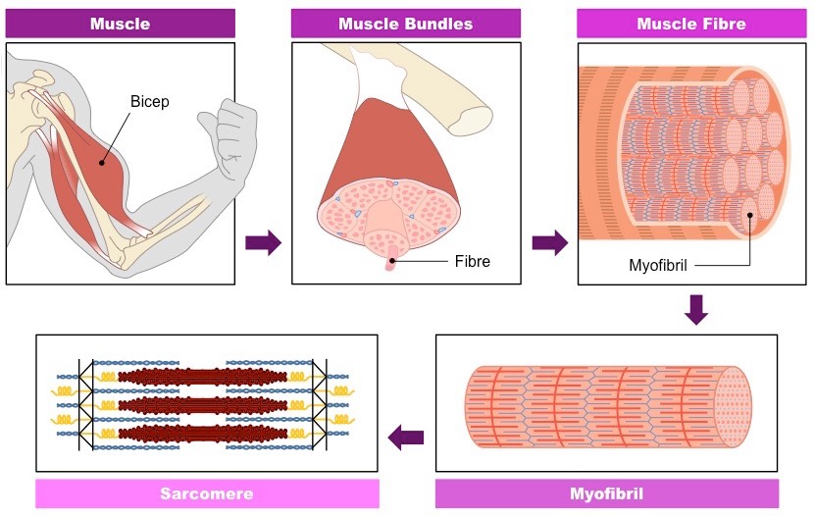
This is where we will focus

Slide 38
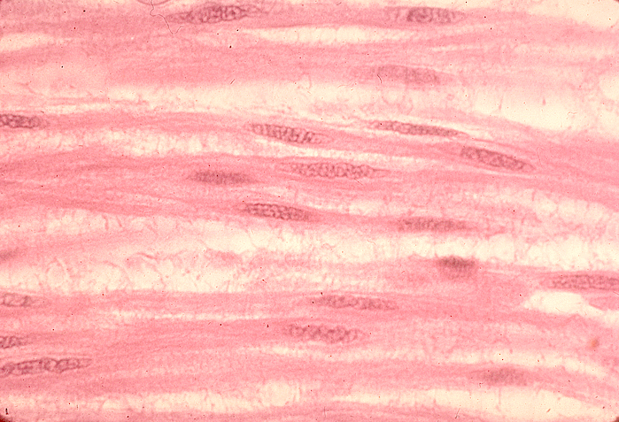
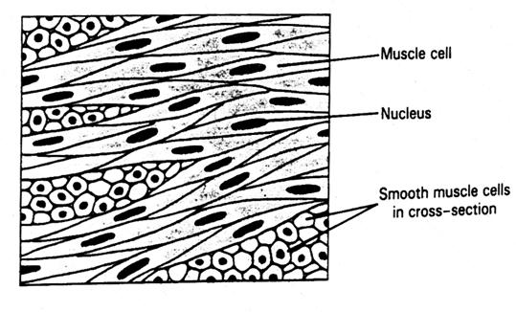
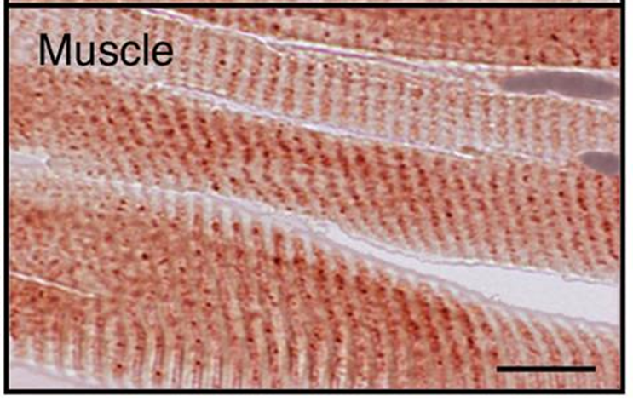
Myofibrils are made of two types of protein filaments.
A muscle fibre is actually a cell.

Slide 39

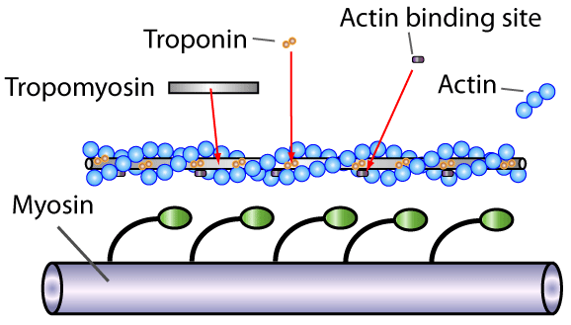
Thin filaments are made up of three proteins:
  Actin - there are two strands of actin coiled around each other like a string of beads.
  Tropomyosin - a long thin, molecule, which lies in a groove between the two chains of actin molecules.
  TROPONIN - a globular protein which binds to actin chains at regular intervals
Beyond the specification, don’t need to know this protein.

Slide 40
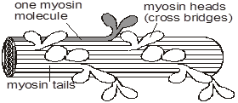
Thick filaments are made of MYOSIN
The filament is made from many myosin molecules lying side by side.
Each myosin molecule has two heads which point out to form cross bridges.
The tails of the myosin meet in the middle at the M line.

Slide 41
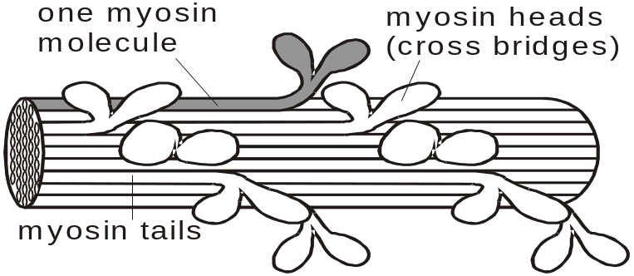
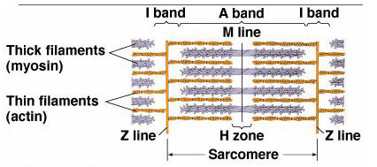
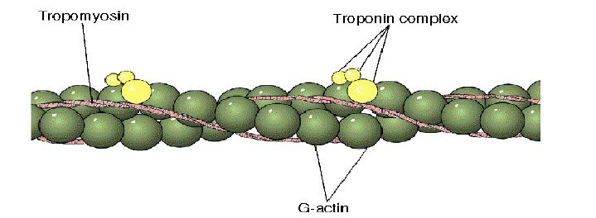
Thick filament = myosin.
Many myosin molecules who have heads (like golf clubs!) that stick out from opposite ends of the filament make this look thick
Thin filament = actin with tropomyosin and troponin

Slide 42
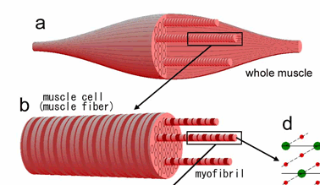
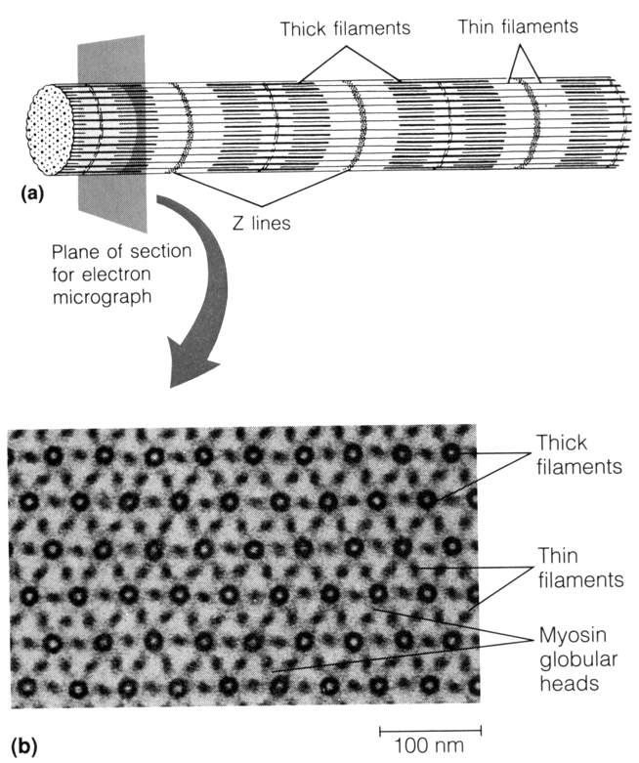
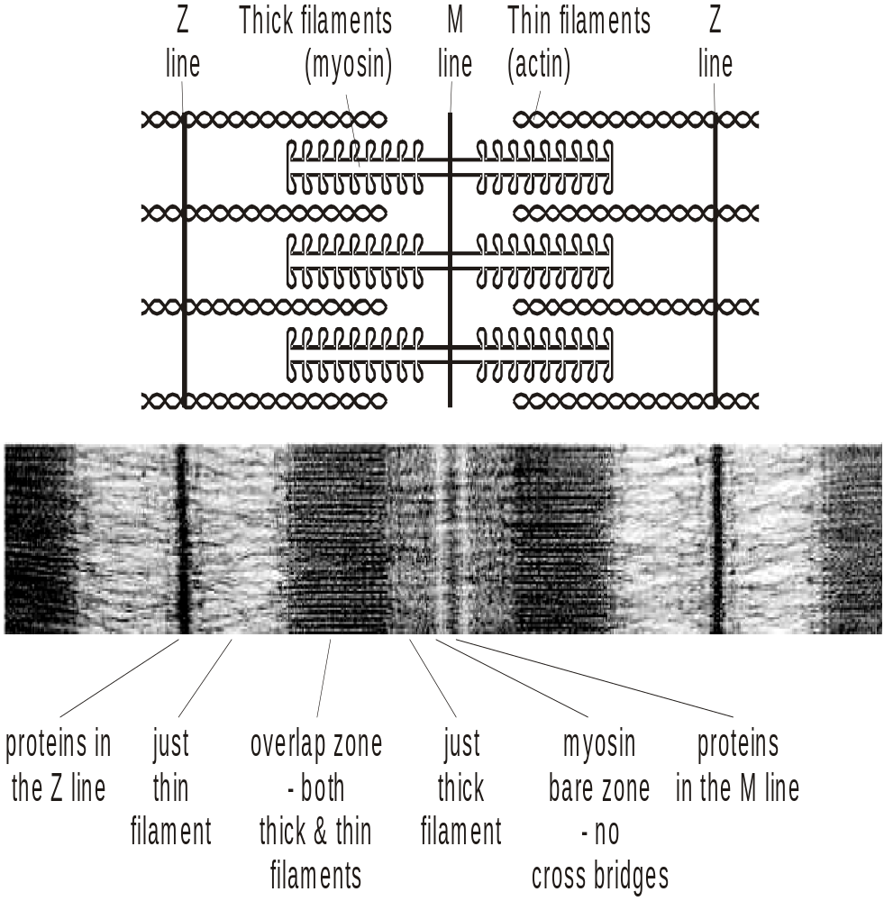
Lets magnify and look at the structure
The diagram shows how a whole muscle is built up.
Remember:
Whole muscle – Muscle fibre (1 cell) – Myofibril - Sarcomere
The thin and the thick filaments give the myofibril a striped appearance with dark and light bands. These bands are caused by the presence or absence of actin and myosin filaments.
An electron micrograph of a myofibril.

Slide 43
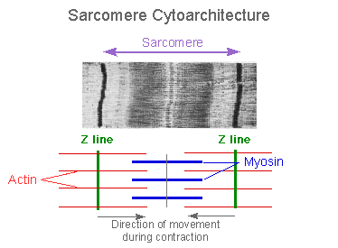
Remember – a sarcomere is the basic unit of contraction

Slide 44
Very long !
http://www.youtube.com/watch?v=XoP1diaXVCI&feature=related

Slide 45
Tasks: page 9 and 10
Colour in the thick myosin filaments and the thin actin filaments on the diagram on page 9.
Add the M line

Slide 46
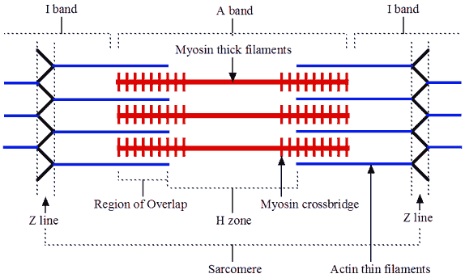
Structure of a myofibril
Memory task
What will happen to the I band when the muscle contracts?
What will happen to the A band when the muscle contracts?
What will happen to the H zone when the muscle relaxes/is lengthened?
What will happen to the M line when the muscle relaxes/lengthens?
Exam skill:
Using images to work out information

Slide 47
Structure of a myofibril
What will happen to the I band when the muscle contracts?
Only thin filaments, no overlap so will get smaller
What will happen to the A band when the muscle contracts?
Length of the Myosin filament so will not change.
What will happen to the H zone when the muscle relaxes/is lengthened?
Only thick filaments, no overlap so will get bigger
What will happen to the M line when the muscle relaxes/lengthens?
Middle of the thick filaments so will not change.

Slide 48
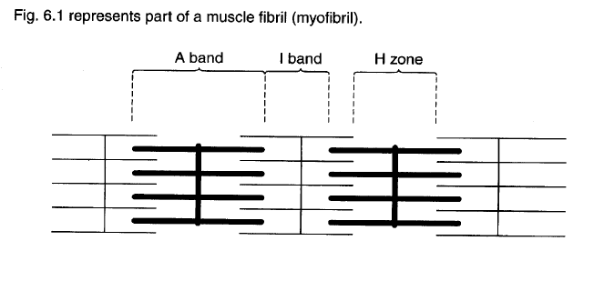
Memory Task:
3. Without your notes can you add labels to the diagram on page 8.
Can you then describe what each of these labels represent.
8 label = excellent
7 labels = good
6 labels = ok
A band
I band
H Zone
Z-Line
Actin
Myosin
Sarcocmere (contractual unit)
M-Line

Slide 49
Memory Task:
Without your notes can you add labels to the diagram on page 8.
Can you then describe what each of these labels represent.
Actin filament, no overlap
I band
Length of the myosin filament
A band
H Zone
Myosin filament, no overlap
Z-Line
Centre of the Actin filament
Thin filament
Actin
Thick filament
Myosin
Sarcomere (contractile unit)
Centre of the myosin filament
M-Line

Slide 50
4. Describe the composition of the two types of bands
a) Light bands / I bands (ISOTROPIC) are produced by:-
Only thin filaments (Actin) no overlap of Myosin (thick) and Actin (thin).
b) Dark bands / A (ANISOTROPIC) bands are produced by:-
Overlap between Myosin (thick) and Actin (thin) filaments.
Excluding H zone which isn’t as dark as only myosin is present

Slide 51
5. Consolidate your knowledge by filling in the blanks below:
Using these words: Dark A, Actin, Myosin, Z, Light I, Sarcomere, H, A, Do not.
The thick myosin filaments produce the dark A band
The thin actin filaments extend in each direction from the Z line
Where the thin do not overlap the thick filaments, the light I band is created
The H zone is that portion of the A band where the thick and thin filaments do not overlap
The entire array of thick and thin filaments between the Z lines, is called a sarcomere
The sarcomere is the CONTRACTILE UNIT of the muscle fibre

Slide 52
Exam tip: You must also be able to recognise the bands and zones on an electron micrograph of a myofibril.
6. Fully label the diagram below in your booklet on page 9.
Can you come up with a mnemonic to help you remember this?
Zack Z line
Is I band
A A band
Hungry H zone
Man M line
Z is at the end of the alphabet
M means middle
I is the thinnest letter of alphabet (thin filament)
H is thickest letter of alphabet (thick filament)

Slide 53
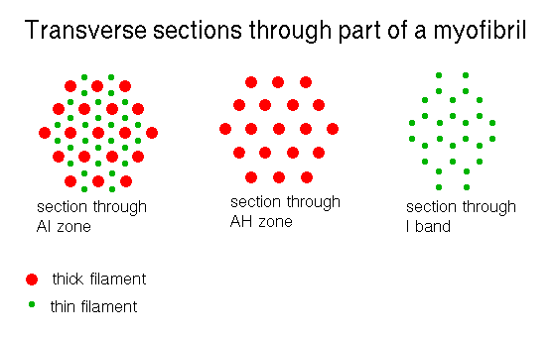
7. Protein filaments present in different parts of the sarcomere. Can you identify which is the I band, the A band and H zone?
JUSTIFY your answer
I Band
A Band
H Zone
Copy diagrams onto page 9.

Slide 54
Discuss these questions with your partner
Recap questions:
Not in booklet:
Why are there many mitochondria in a muscle cell sarcoplasm?
What is a myofibril?
In which bands/zone would you find: a) Myosin? b) Actin?

Slide 55
Events in a muscle contraction
(Sliding filament theory)
Outcomes
Recall how the release of acetylcholine across neuromuscular junctions, triggers the release of calcium ions.
Explain the importance of the release of calcium ions in causing a conformational change in tropomyosin
Explain the sliding theory filament of myofibril contraction
Explain the roles of key molecules myosin, actin, calcium and ATP in causing myofibril contraction

Slide 56
https://www.youtube.com/watch?v=ren_IQPOhJc
Good

Slide 57
Recap:
Neuromuscular Junction
Myelin sheath
Synaptic vesicle
Sarcolemma (membrane of a muscle fibre – one muscle cell )
Infoldings of the Sarcolemma

Slide 58
Muscle contraction
Muscles contraction can be explained by the sliding filament theory.
The actin and myosin filaments slide over one another to shorten the sarcomere and make the myofibrils in the muscle fibre (one muscle cell) contract.
The filaments themselves DO NOT change length/contract.

Slide 59
Events of muscle contraction - The sliding filament theory
Action potential from motor neurone depolarises the sarcolemma
Depolarisation travels deep into the muscle fibre through T-tubules
Calcium ion channels on sarcoplasmic reticulum open
Calcium ions (Ca²⁺) diffuse into the myofibril from sarcoplasmic reticulum
Ca²⁺ bind to tropomyosin on actin filament causing it to change shape and move away
Exposes the myosin binding site on the actin
Myosin heads attach to binding site on actin forming actinomyosin cross-bridge
Hydrolysis of ATP on the myosin head causes myosin head to bend
Pulling actin filament past the myosin filament
Attachment of a new ATP molecule to each myosin head causes myosin head to detach from the binding site on actin and reset
Moving further along the actin filament to form new actinomyosin cross-bridges

Slide 60
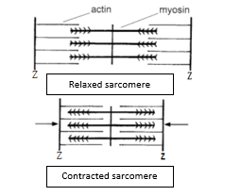

Slide 61
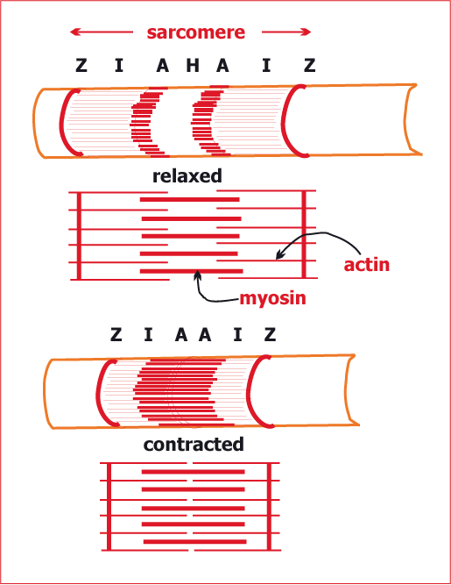
Sarcomere shortens when muscle contracts
The sliding filament mechanism causes the:
sarcomere to shorten in length
myofibril to shorten
muscle fibre to contract.

Slide 62
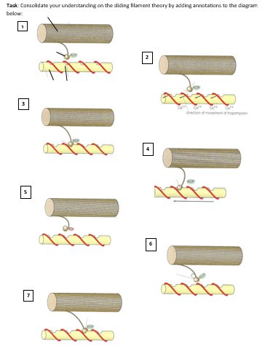
Task:
Consolidate your understanding on the sliding filament theory by adding annotations to the diagram below:

Slide 63
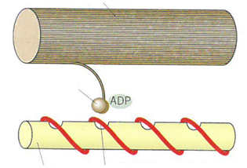
1.
Myosin Filament
Myosin head
Actin Filament
Tropomyosin, blocking myosin binding site on actin
No cross bridges

Slide 64
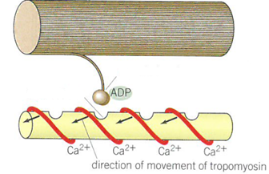
2.
Calcium ions (Ca²⁺) diffuse into the myofibril from sarcoplasmic reticulum
Ca²⁺ bind to tropomyosin on actin filament causing it to change shape and move away
Exposes the myosin binding site on the actin

Slide 65
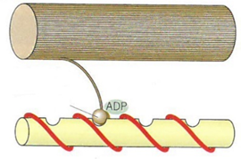
3. Myosin heads attach to binding site on actin forming actinomyosin cross-bridge
Cross bridge formed
Myosin head

Slide 66
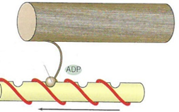
4.
Hydrolysis of ATP on myosin causes myosin head to bend
Pulling actin filament past the myosin filament
Myosin head

Slide 67
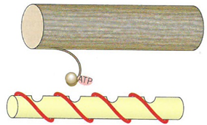
5. Attachment of a new ATP molecule to each myosin head causes myosin heads to detach and binding site on actin

Slide 68
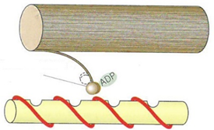
6. Myosin head resets to normal position

Slide 69
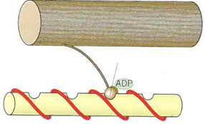
7. Head moves further along the actin filament to form new cross-bridges

Slide 70
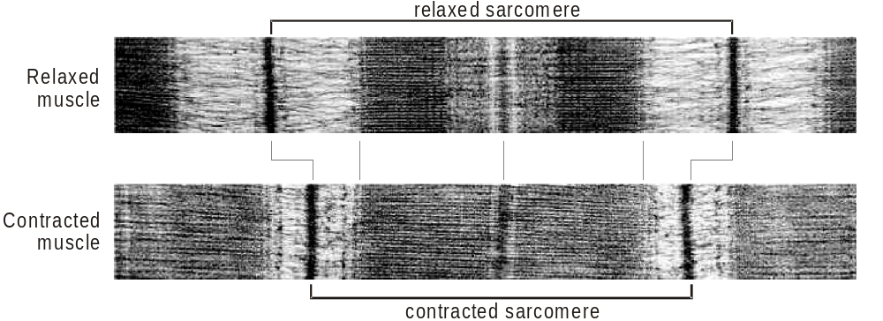
Mechanism of muscle contraction
The above micrographs show that the sarcomere gets shorter in length when the muscle fibre contracts
The light (I) bands become shorter
The dark bands (A) bands stay the same length

Slide 71
What happens to the bands/zones when the sarcomere contracts?
In a contracted sarcomere:
The light I band becomes narrower
The dark A band stays the same length
The H zone becomes narrower
The Z lines move closer together - there is more overlap of thick and thin filaments
Therefore, length of the sarcomere is shorter
The filaments remain the same length

Slide 72
Memory task:
Explain what happens within a muscle fibre after it has been stimulated. (8 marks)
( Sliding filament theory)
Action potential from motor neurone depolarises the sarcolemma
Depolarisation travels deep into the muscle fibre through T-tubules
Calcium ion channels on sarcoplasmic reticulum open
Calcium ions (Ca²⁺) diffuse into the myofibril from sarcoplasmic reticulum
Ca²⁺ bind to tropomyosin on actin filament causing it to change shape and move away
Exposes the myosin binding site on the actin
Myosin heads attach to binding site on actin forming a cross-bridge
Hydrolysis of ATP on the myosin head causes myosin head to bend
Pulling actin filament past the myosin filament
Attachment of a new ATP molecule to each myosin head causes myosin head to detach from the binding site on actin and reset
Moving further along the actin filament to form new cross-bridges

Slide 73
Combining AP and sliding filament model.
Task: On paper can you write out the markscheme perfect answer to combine neuromuscular junction and sliding filament model.
An action potential arrives at the end of a motor neurone, at the neuromuscular junction.
This causes the release of the neurotransmitter acetylcholine.
This initiates depolarisation of the sarcolemma.
Calcium ions (Ca²⁺ ) diffuse into the myofibril from sarcoplasmic reticulumCa²⁺ binds and causes tropomyosin to change shape
This causes tropomyosin to move away exposing myosin binding sites on actin.
Cross- bridges can now form between actin and myosin.

Slide 74
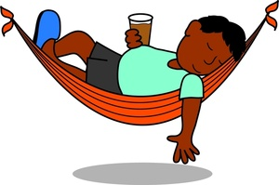
How does a muscle relax?
Ca²⁺ actively transported back into sarcoplasmic reticulum
Using energy from hydrolysis of ATP
Tropomyosin can now block myosin binding site on actin filaments again
Myosin heads now unable to bind to actin filaments and contraction stops
Muscle relaxes
Force from the antagonistic muscle can pull the actin filaments out from between myosin filaments.
Sarcomere lengthens, causing the myofibril to lengthen, causing the muscle fibre (one cell) to length.

Slide 75
Recap Questions: On paper/white boards
Task:
1. Now evaluate the following statement
“During contraction of a muscle, actin and myosin filaments contract and get shorter.”
2. Explain the roles of myosin, tropomyosin, actin, ATP and Ca2+ ions in myofibril contraction.

Slide 76
Roles of muscle fibre components
Myosin:
Myosin head binds to actin and pull the actin past
Myosin then detaches from actin and re-sets
This uses ATP
Actin:
Has binding sites for myosin head
When they are uncovered, myosin can bind and slide the actin filaments along
This shortens the sarcomere / causes muscle contraction

Slide 77
Roles of muscle fibre components
Tropomyosin:
Blocks myosin binding site on actin filament
Moves out of the way when Ca²⁺ bind
Which allows myosin head to bind
Calcium ions:
Diffuse into myofibril and cause tropomyosin to move (which is blocking binding sites)
Which exposes myosin binding site on actin filament
allows myosin head to bind to actin / cross bridge formation
Activate the ATPase on myosin
ATP:
Hydrolysis provides energy to bend myosin head
Pulling actin molecules
Attachment of ATP causes myosin head to detach and and reset the myosin head
Used in active transport of Ca²⁺ back into the SR.

Slide 78
Task:
Answer the exam questions on page 14, 15 and 16.

Slide 79
Exam question
Q3. (a) Describe the roles of calcium ions and ATP in the contraction of a myofibril.
1. Calcium ions diffuse into myofibrils from (sarcoplasmic) reticulum;
2. (Calcium ions) cause movement of tropomyosin (on actin);
3. (This movement causes) exposure of the binding sites on the actin;
4. Myosin heads attach to binding sites on actin;
5. Hydrolysis of ATP (on myosin heads) causes myosin heads to bend;
6. (Bending) pulling actin molecules;
7. Attachment of a new ATP molecule to each myosin head causes myosin heads to detach (from actin sites). 5 max

Slide 80
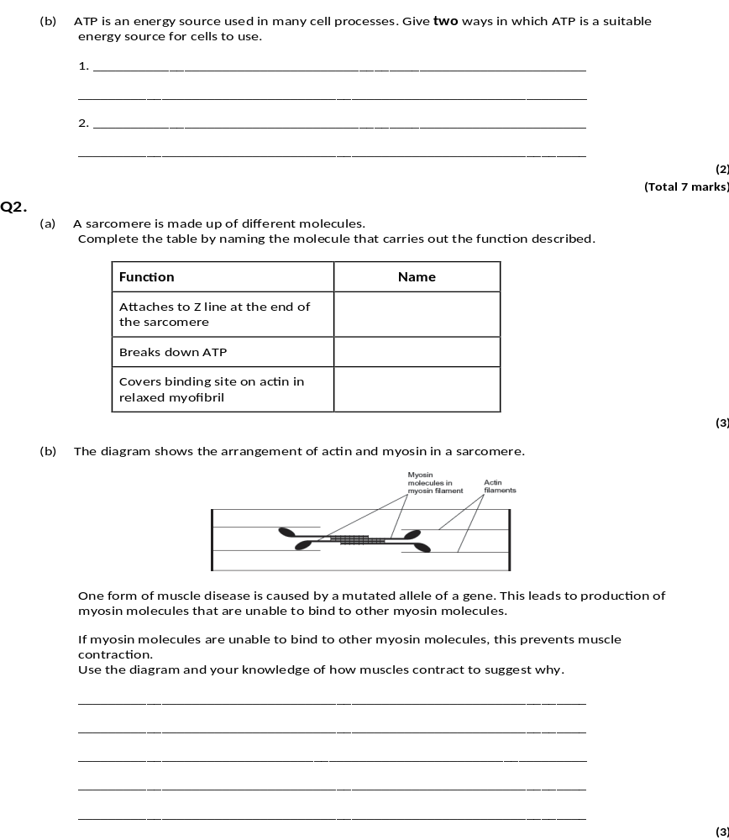
Q3.
(b) 1. Releases relatively small amount of energy / little energy lost as heat;
Key concept is that little danger of thermal death of cells
2. Releases energy instantaneously;
Key concept is that energy is readily available
3. Phosphorylates other compounds, making them more reactive;
4. Can be rapidly re-synthesised;
5. Is not lost from / does not leave cells. 2 max
[7]

Slide 81
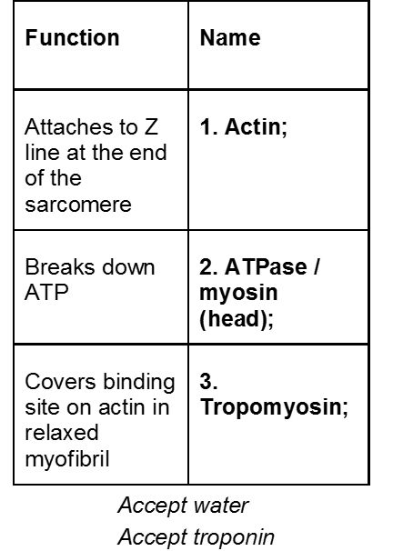
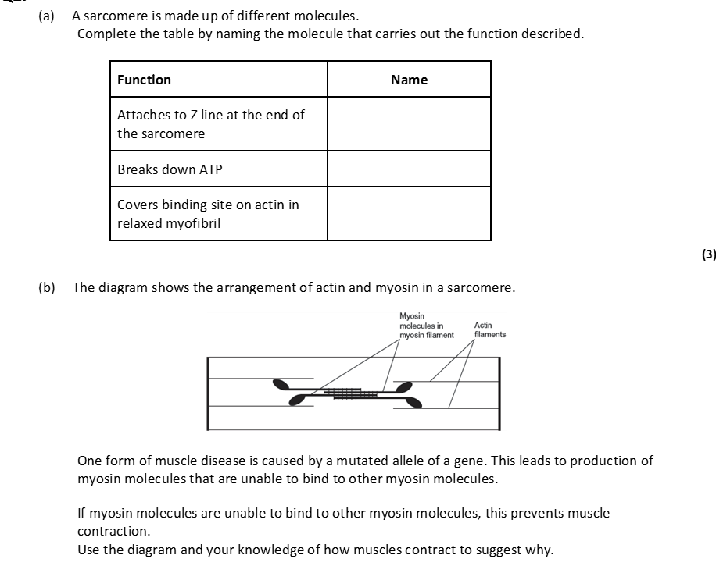
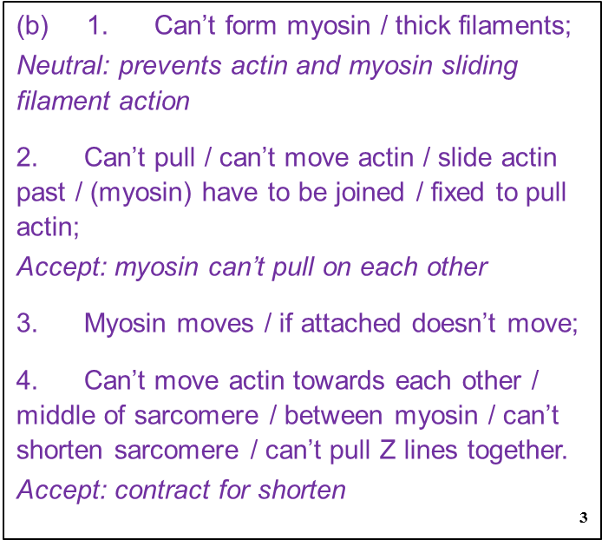
Q4.

Slide 82
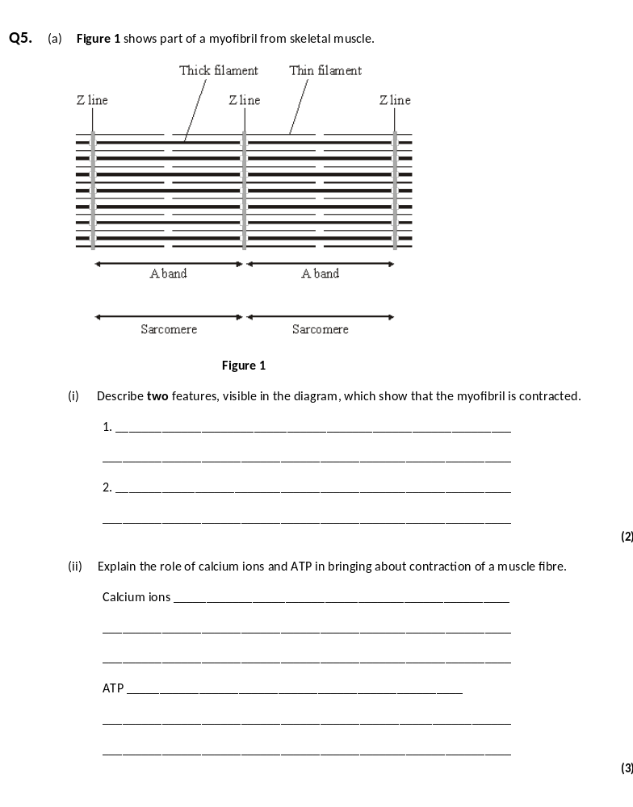
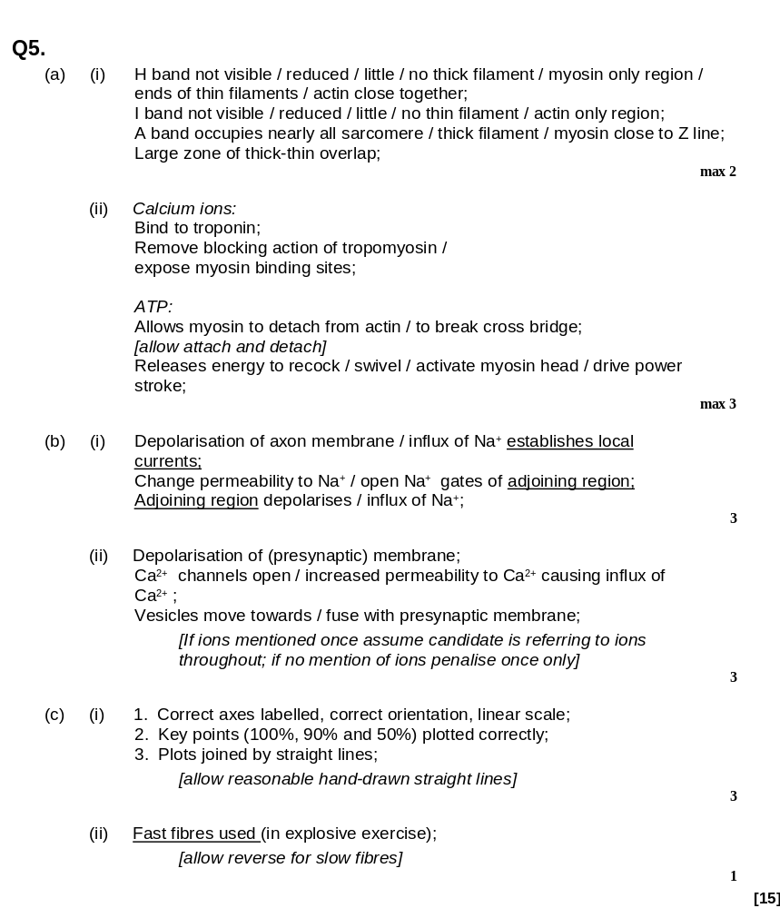

Slide 83
Types of Muscle Fibres
Outcome
• Describe the locations of slow and fast skeletal muscle fibres
• Explain differences in the structure of slow and fast skeletal muscle fibres
• Explain differences in the properties of slow and fast skeletal muscle fibres.
Explain the role of phosphocreatine in some muscle fibres.

Slide 84
There are 2 types of muscle fibres
Slow muscle fibres (slow-twitch)
Fast muscle fibres (fast twitch)
Task: Complete the table below on the properties of the 2 types of muscle using page 369 in Toole and Toole.

Slide 85
Slow-twitch | Fast-twitch
Contract slower (110ms) | Contract more rapidly (50ms)
Contractions less powerful | Contractions more powerful
Adapted for aerobic respiration by avoiding build-up of lactic acid (fatigue resistant) | Easily fatigued due to lactic acid build up
Adapted to work over a longer period e.g. maintaining posture | Adapted to a short period of intense exercise e.g. sprinting, eye movement
Most common in calf muscle | More common in biceps
Rich supply of blood vessels to deliver high conc of O2 & glucose for aerobic respiration (lower conc of anaerobic enzymes) | High concentration of enzymes for anaerobic respiration to provide ATP rapidly (lower number of capillaries)
Large store of myoglobin to store O₂ (makes them red in colour) | Small store of myoglobin (makes them pale in colour)
Numerous mitochondria – produce ATP | Store of phosphocreatine to rapidly generate ATP from ADP in anaerobic conditions (low mitochondria count)

Slide 86
Q: Suggest why there is a high concentration of glycogen required in fast muscle fibres?
A: To provide lots of glucose for anaerobic respiration

Slide 87
Q: Suggest why is a rich supply of blood vessels required in slow muscle fibres?
A:
To supply high concs of O2
To give a shorter diffusion pathway for O2
To provide a good glucose supply as there is little stored glycogen present.
Therefore give a high rate of aerobic respiration
And prevent build up of lactic acid

Slide 88
Maintenance of the ATP Supply

Slide 89
ATP needs to be regenerated for continued muscle contraction. In very active muscles the demand for ATP and O₂ is higher than the rate blood can supply O₂. Therefore there are different ways of supplying ATP
The energy is needed for
Movement of ……………………………….. heads
Reabsorption of ………… into ER by active transport
Task: Match the three mechanisms below to their description;
Aerobic respiration,
Anaerobic respiration,
Phosphocreatine (cannot enter muscle)
Myosin
Ca ²⁺

Slide 90
Completed table
Mechanism | Description
Anaerobic respiration | ATP is provided by glycolysis. Very quick supply, but produces lactic acid (toxic).
Phosphocreatine | Regenerates ATP. Phosphate group from phosphocreatine combines with ADP to form ATP.
Aerobic respiration | Respiration of pyruvate in mitochondria. Dependent on oxygen supply and respiratory substrate availability

Slide 91
Phosphocreatine
Phosphocreatine, also known as creatine phosphate (CP or PCr), is a phosphorylated creatine molecule that is stored in skeletal muscle cells and brain cells. It can be used to regenerate ATP very rapidly but runs out after a few seconds, so is used only during short intense exercise.
ADP + PCr (phosphocreatine) ATP + Cr (creatine)
Phosphocreatine generates ATP quickly by adding a phosphate to a molecule of ADP released by the contracting muscle.

Slide 92
Task: Complete exam questions 6 and 7

Slide 93
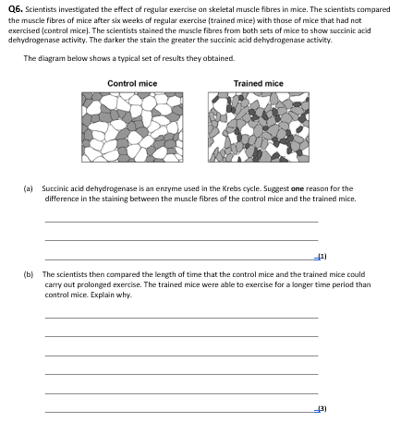


Slide 94




Slide 95


Q7

Slide 96



Slide 97


