Slide 1
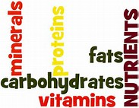

3.5.4: Nutrient Cycles
Notes:
A few weeks ago we explored energy and ecosystems and saw that energy in most ecosystems enters as sunlight and is mainly lost as heat energy. This heat energy cannot be recycled so therefore the flow of energy through an ecosystem is linear. This will continue for as long as the sun continues to supply light energy to earth.
In the topic this week we will be looking at nutrient cycles. Nutrients do not have an extraterrestrial source like sunlight does and there are only a limited number of nutrient ions on earth. Therefore the nutrients on earth must be recycled. We will be looking in more detail at the phosphorus and nitrogen cycle and how we can use knowledge of these cycles in improving crop growth and consequences of this.

Slide 2
3.5.4: Nutrient Cycles
Task:
On the next slide are some terms you will see used often in this booklet.
On page 2 of the the booklet start your GLOSSARY OF TERMS with these words.
If there are other words you think are important as you work through the booklet add them to your GLOSSARY.
Notes:
On page 2 of your booklet there are a list of keywords you must learn and be comfortable with using in your exam answers. The definitions of some of these terms are on the next slide but not all of them. Take some time to copy these down into your booklet. If there are other keywords you think could be important we have left some space so you can include these. For example organic and inorganic as you need to make sure you understand these terms. Organic molecules have carbon bound to a hydrogen and possibly other elements. In biology organic molecules are associated with living organisms.
Inorganic molecules on the other hand are not of biological origin. The usually do not contain carbon but some do such as carbon dioxide.

Slide 3
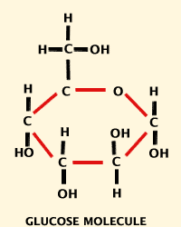
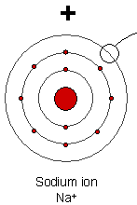
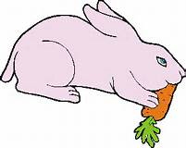
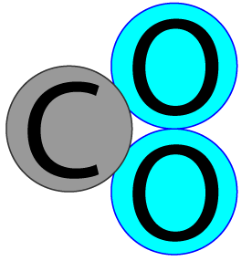
Producer: an organism that can synthesise organic molecules from simple inorganic ones.
Molecule: Group of atoms bonded together to form the smallest functional unit for the chemical
Biomass. Total mass of living material, normally measured in a specific area over a given period of time.
Ion: an atom or molecule with a net overall charge due to loss or gain of electrons.
Consumer: Organism that obtains energy by “eating” another.
Inorganic: Molecules/ions not derived from living matter.

Slide 4
NUTRIENT CYCLES
Learn the common features of all nutrient cycles
1. Nutrient taken up by PRODUCER. Absorption
2. PRODUCER uses nutrients forming into complex molecules
3. PRODUCER is eaten, nutrients passed into CONSUMER
4. CONSUMER is eaten by CONSUMER passing on nutrients
5. PRODUCER and CONSUMER die
6. SAPROBIONTIC microorganisms breakdown nutrients to be RECYCLED.
Notes:
All nutrient cycles have common features associated with them. Nutrients are always taken up by a producer as simple inorganic molecules. The producer then incorporates the nutrients into complex organic molecules such as sugars, oils or proteins. When the producer is eaten the nutrients pass into the consumers. These nutrients then pass along the food chain by consumers eating other consumers. When the producers and consumers die their complex molecules are broken down by saprobiontic microorganisms (which are decomposers) and the nutrients are released back in their simple form. The cycle is then complete and nutrients are able to reenter the cycle.

Slide 5
3.5.4: Nutrient Cycles- Common features
Add the common features to the diagram on page 3. You can just add the number of each feature.
Answer the quick fire questions
Notes:
On the diagram on page 3 of your booklet add the common features from the last slide to the diagram, after you have done this complete the quick fire questions on the same page of your booklet.

Slide 6
Common features of all nutrient cycles
Answer these quick fire questions. Just have a bash!
Why is it important that producers take up nutrients before consumers eat the producers?
Plants are producers. What is the inorganic molecule that plants take up for the process of photosynthesis? What is the organic molecule that plants make from photosynthesis?
To digest the producers consumers need enzymes. Explain the importance of enzymes in digestion.
What is the importance of saprobiontic micro-organisms in the cycle?
Why must nutrient cycles be a cycle?

Slide 7
3.5.4: Nutrient Cycles
Answer to quick fire questions
Why is it important that producers take up nutrients before consumers eat the producers? Producers take up inorganic ions/molecules and convert these into organic molecules. Consumers cannot convert inorganic ions to organic molecules so instead need to digest organic molecules from other organisms.
Plants are producers. What is the inorganic molecule that plants take up for the process of photosynthesis? What is the organic molecule that plants make from photosynthesis? Inorganic molecule: Carbon dioxide, organic molecule: Glucose
To digest the producers consumers need enzymes. Explain the importance of enzymes in digestion. Enzymes are Biological catalyst which speed up the rate of reaction (in this case digestion) by lowering the activation energy but are not used up/altered by the reaction.
What is the importance of saprobiontic micro-organisms in the cycle? Turn the organic molecules back into inorganic ions/molecules so return the nutrient back to the cycle.
Why must nutrient cycles be a cycle? Otherwise the nutrient would run out or be trapped inside the cycle so the cycle would stop.
Notes:
Here are the answers to the quick fire questions:
For the first question its important to understand that at the beginning of the cycle the nutrients are in an inorganic format which consumers cannot directly use. The producer needs to take up the inorganic ions and then convert these onto organic. Once the nutrients are in organic molecules these are then accessible to consumers.
Question 2: you need to think back to what you know about photosynthesis and the definition of organic and inorganic. The inorganic molecule plants take up is carbon dioxide and the organic molecule plants make is glucose.
Question 3: you needed to think back to biological molecules and digestion. Enzymes by definition are biological catalysts which speed up the rate of a reaction by lowering the activation energy but remain unaltered by the end of the reaction.
Question 4: Saprobiontic microorganisms are vital in the cycle as they are responsible for turning organic molecules back into inorganic so the cycle can continue.
Question 5: Nutrients have to go in a cycle or else nutrients would become locked in large molecules. They would not be broken down into smaller ones to reenter the cycle. As there are only a specific amount of each nutrient on earth this is important.

Slide 8
3.5.4: Nutrient Cycles
Common features of all nutrient cycles
Nutrient cycle video
Watch this video to tell you about the two nutrient cycles we will learn about.
We are going to look at phosphorus first.
Question: Can you remember all the molecules we have looked at that require phosphorus/phosphates?
Notes:
At the bottom of page 3 you will find a hyperlink to a video. Please press this and watch it to give an introduction too the phosphorus and nitrogen cycle.

Slide 9
3.5.4: Nutrient Cycles
Common features of all nutrient cycles
Task:
Complete Exam Question 1 on page 4 in your booklet.
This is an application question so you need to think back across everything we have covered so far and then apply this knowledge, this is not a factual recall style question.
Notes:
Now that you have watched the introduction video have ago at the exam questions on page 4.

Slide 10
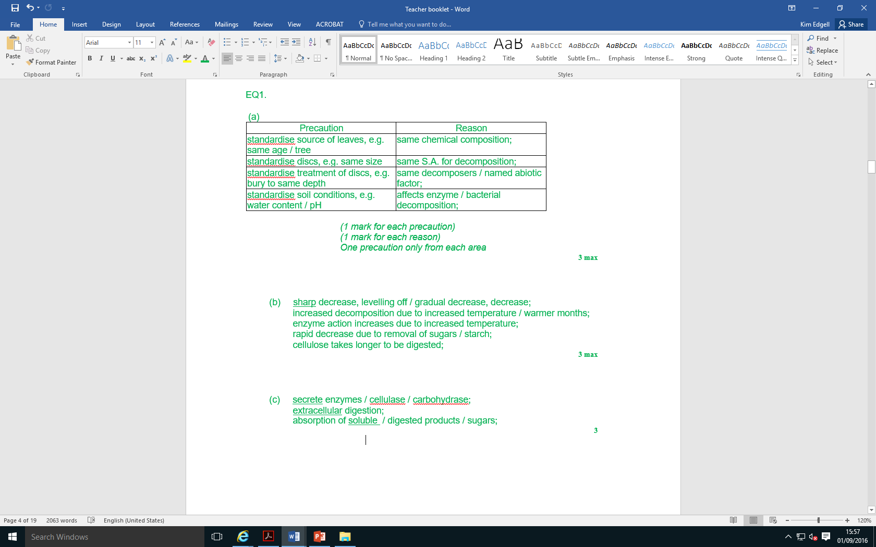
3.5.4: Nutrient Cycles
Common features of all nutrient cycles
Notes:
Question a. This question tests your understanding of practical skills. We need to make sure we can make a valid comparison between bags, therefore we need to make sure everything between the bags is the same. Make sure you give a precaution and a reason for each mark.

Slide 11
3.5.4: Nutrient Cycles
Common features of all nutrient cycles
Notes:
Question b, firstly with any graph question take some time to understand the graph. For this one which letters correspond to each month on the x axis and also thinking about what would cause the decrease in surface area of the disks over time. Next you need to describe the graph, when describing we need to try and comment on TCP (the trend, change and point), when asked to explain a graph you need to include the biological reason for the change.
Additionally for the first marking point you need to make sure to include the word sharp as it is underlined.
Question c, as cell walls are made of cellulose which are polysaccharides, these will need to be broken down outside of the microorganism which is known as extracellular digestion. For this reason the microorganism secretes an enzyme to break down the cellulose into small soluble sugars which are then absorbed.

Slide 12
The Phosphorus Cycle
Starter
Think back to the video about the two nutrient cycles then answer the questions below.
Why are sedimentary rocks so important in the phosphorus cycle?
Why is the majority of phosphates trapped inside rocks?
How do plants get the phosphates?
How many years can phosphates be trapped in a biological cycle for?
What are the main components of fertilisers?
Notes:
Now that we have looked at a generic nutrient cycle we are going to start looking at our first example in detail which is the phosphorus cycle. Think back to the video you watched and have ago at the following questions, once you have done this check them with the answers on the next slide.

Slide 13
3.5.4: Nutrient Cycles
Answer to the quick fire questions
Why are sedimentary rocks so important in the phosphorus cycle? Contains large quantities of phosphate trapped inside the rock, this is where the phosphorus nutrient cycle starts
Why is the majority of phosphates trapped inside rocks? There are very few bacteria that are able to digest rock to release the phosphate into the environment.
How do plants get the phosphates? Absorb the phosphate from the soil after it has been erodes by water/dissolved in water.
How many years can phosphates be trapped in a biological cycle for? 100,000 years on marine biological cycles.
What are the main components of fertilisers? Nitrogen and phosphates.

Slide 14
The Phosphorus Cycle
Note: When we are referring to the element itself we refer to it as phosphorus, when we are talking about the form of phosphorus that is used in the cycle we refer to it as phosphate. Phosphorus is very reactive so is rarely in its element form, it is usually reacted with O so we refer to it as phosphate.
Outcome:
Describe the stages of the phosphorus cycle, and the ions at each stage.
Explain the role of saprobionts and mycorrhizae in the phosphorus cycle.
Interpret information/data about the phosphorus cycle and apply knowledge.
Notes:
Before we start looking at the phosphorus cycle it is important to note that we call the element itself phosphorus however when we are referring to it in the cycle it is known as phosphate, this is because in the cycle it is not in element form.
Phosphorus is an important biological element as it is a component of ATP, phospholipids and nucleic acids. Life therefore depends on the ability of phosphorus to be recycled.

Slide 15
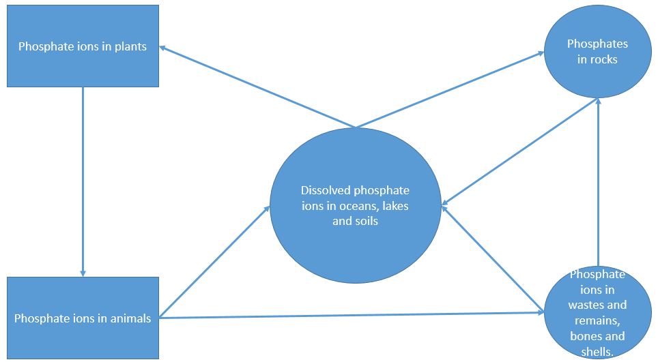
3.5.4: Nutrient Cycles -PHOSPHORUS
Learning Outcome: Describe the stages of the phosphorus cycle, and the ions at each stage, explain the role of saprobionts and mycorrhizae in the phosphorus cycle.
Task:
Read through the terms/description on page 5 and fully annotate the diagram on page 6 in your booklet.
Notes:
The following diagram you have in your booklets, you need to read through the terms and descriptions on page 5 of your booklets and also the following ppts slides and think about which arrows you would place them next too. On slide 18 we will go through the answers.

Slide 16
3.5.4: Nutrient Cycles- PHOSPHORUS
Learning outcome: Describe the stages of the phosphorus cycle, and the ions at each stage, explain the role of saprobionts and mycorrhizae in the phosphorus cycle.
Erosion/Use of fertilisers.
Phosphorus exists mostly as phosphate ions in sedimentary rocks brought to surface by geographical uplifting.
Erosion allows phosphate ions to become dissolved
2. Absorption
Dissolved phosphate ions are taken up through roots by PRODUCERS and mycorrhizae incorporating the phosphates into their biomass
3. Feeding and digestion:
PRODUCERS eaten by CONSUMERS passing on the phosphate ions.

Slide 17
3.5.4: Nutrient Cycles-PHOSPHORUS
Learning outcomes: Describe the stages of the phosphorus cycle, and the ions at each stage, explain the role of saprobionts and mycorrhizae in the phosphorus cycle.
4. Excretion and decomposition:
Excess phosphate ions are excreted by animals and may accumulate in waste products.
May also accumulate in bones or shells
Death of PRODUCER and/or CONSUMERS.
Fungi and bacteria breakdown biomass into phosphate ions.
5. Deposition:
Phosphate ions dissolve in water forming sedimentary rocks.

Slide 18
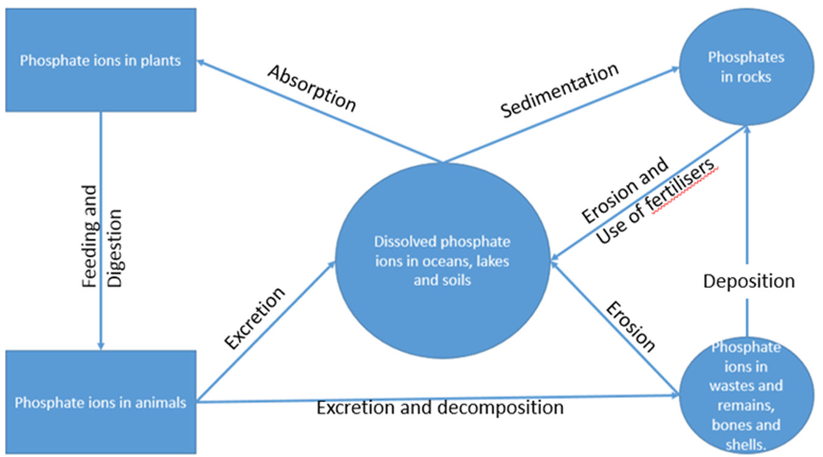
3.5.4: Nutrient Cycles-PHOSPHORUS
Learning outcomes: Describe the stages of the phosphorus cycle, and the ions at each stage, explain the role of saprobionts and mycorrhizae in the phosphorus cycle.
Notes:
On this slide we have the answers that you hopefully got from the task on the previous slide.
Phosphorus mainly exists in the form of phosphate ions (PO₄³⁻) which the majority of phosphate ions on earth found in sedimentary rock deposits. You may remember from geography that sedimentary rocks are first formed in the sea and overtime are brought to the surface by geological uplifting. As the rocks move up to the surface, weathering and erosion occurs and the phosphate ions become dissolved in oceans and lakes. Once dissolved the phosphates are available to plants which absorb them and then become incorporated into their biomass.
The phosphate ions are then moved from plants into animal bodies when they’re eaten by animals. From here one of two things can happen; they rather become part of the animals biomass or any excess phosphates are excreted. Any phosphates that are excreted will return back to the oceans, lakes or soils.
When the animal or plants die, specific species of bacteria and fungi known as decomposers break down the macromolecules of the organism into smaller molecules. This releases the phosphate ions back into the water or soil. However some phosphate ions remain in other parts of the organism which are very slow to decompose such as bones or shells. The phosphates released during decomposition and dissolved out of rocks are then transported by streams and rivers into lakes and oceans to form sedimentary rocks.

Slide 19
Task
In the box on page 6 create your own flow chart or diagram describing the stages of the Phosphorus cycle
Notes:
Now that you have labelled a phosphorus cycle have ago at summarizing it in a flow chart without the use of your notes. You can then check afterwards using your notes and improve it.

Slide 20
Outcome:
Explain the role of saprobionts and mycorrhizae in the phosphorus cycle.
There are many organisms that play a key role in nutrient cycles two common organisms are;
Mycorrhizael Fungi: Mycorrhizae is the symbiotic relationship between plant and fungi
Saprobionts: Organisms that digest their food externally and then absorb the products.
Notes:
Mycor-rhi-zae is a symbiotic relationship between certain species of fungi and plant roots. The fungi act like an extension of the plant root system, aiding the plant by increases the surface area for absorption of water and minerals. They also enable more water and minerals to be held around the plant root ready for absorption, this is useful because it enables the plant to take up the ions more readily. As phosphate ions are already scarce this is not only aids in the plants survival but also helps it resist drought. In return the fungus receives organic compounds such as sugars and amino acids from the plant.
Saprobionts are decomposers, they are rather certain species of bacteria or fungi. Saprobionts work by performing extracellular digestion. In order to do this they excrete specific hydrolytic enzymes which breakdown macromolecules into smaller soluble ones. These small soluble molecules are rather then absorbed into the saprobiont or more significantly in remain in the soil ready to move onto the next parts of the cycle.

Slide 21
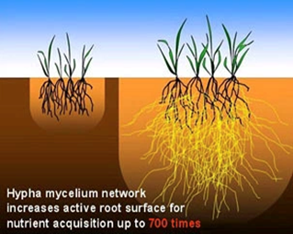
How are Saprobionts and Mycorrizhae involved in the Phosporous Cycle?
Saprobionts
Mycorrhizae
Association between fungal filaments and the roots of plants.
Fungi are extensions of the root system.
Fungi increase absorption of water and minerals.
Fungi act like a sponge around root system.
Fungi and roots have a mutualiastic relationship.
Release hydrolytic enzymes that break down dead organic matter.
Releases phosphate from phosphate containing sources such as DNA and RNA back into the soil.
Notes:
The detailed points are also written on page 7 of your booklet, they are markscheme perfect answers so you need to make sure you learn them.

Slide 22
Outcomes
Explain the role of saprobionts and mycorrhizae in the phosphorus cycle.
Quick fire questions: (page 7)
The mycorrhizae is a mutalistic relationship. What is meant by a mutalistic relationship?
Suggest the advantage of this relationship for the fungi
Suggest the advantage of this relationship for the plant?
Suggest why the fungi are wrapped around the roots like a sponge.
Suggest how the structure of the fungi could increase uptake by 700x
Suggest how the fungi are able to survive under ground with little to no light.
Notes:
Please complete the following questions and see the next slide for the answers.

Slide 23
3.5.4: Nutrient Cycles
Learning outcomes: Describe the stages of the phosphorus cycle, and the ions at each stage, explain the role of saprobionts and mycorrhizae in the phosphorus cycle.
Answer to the quick fire questions on page 5
Both organisms benefit from the relationship.
2. Fungi obtain organic compounds from plant eg sugars and amino-acids.
3. Plants obtain water and increased inorganic ions uptake eg phosphate ions
4. Reduced diffusion distance for ions into root cells.
5. Increased surface area, long and thin.
6. Obtain nutrients required from the plant through mutualistic relationship.
Notes:
Now you have completed the questions lets go through the answers.
Question 1, a mutualistic relationship is one in which both organisms benefit from the relationship. Mycorrhizae is one example but there are many in the nature.
Question 2, The advantage to the fungi is they get organic compounds from the plant such as sugars and amino acids.
Question 3, the advantage to the plant is that it can obtain a greater amount of water and increase its uptake of nutrients including phosphate ions.
Question 4, The fungi are wrapped around the roots like a sponge to reduce the diffusion distance for the ions to enters the root hair cells.
Question 5, The structure of the fungi can increase uptake as it increases the surface area.
Questions 6, The fungi themselves are unable to photosynthesise to produce their own organic compounds such as sugars and amino acids but obtain these through the plant because of the mutualistic relationship.

Slide 24

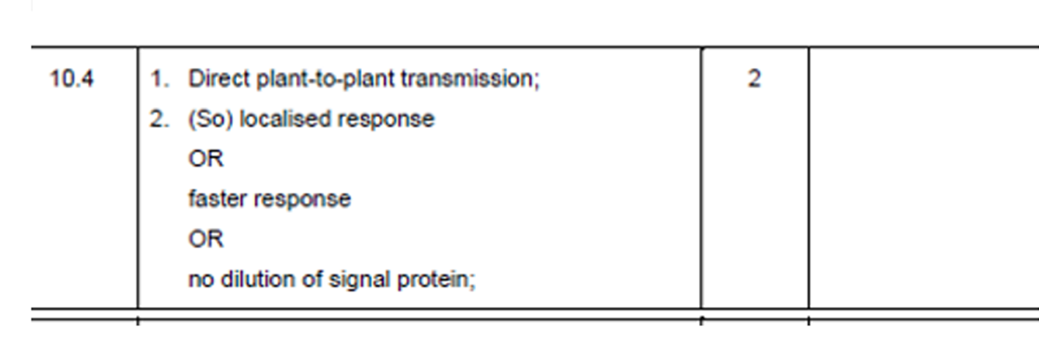
3.5.4: Nutrient Cycles- PHOSPHORUS
Learning outcomes: Describe the stages of the phosphorus cycle, and the ions at each stage, explain the role of saprobionts and mycorrhizae in the phosphorus cycle.
Notes:
For this next question you needed to consider why it is an advantage to transmit signal proteins through the mycorrhizal networks rather than releasing them into the air. Putting signaling proteins into the mycorrhizal networks means you can have direct plant to plant transmission. This will mean you can have a faster response or a localized response instead of the whole plant. You could also say for the second marking point you wouldn’t get a dilution of the signal protein which would happen if they were to diffuse through the air.

Slide 25
Lesson 2- The Nitrogen Cycle
Outcome:
Describe the stages of the nitrogen cycle, and the ions/molecules at each stage
Explain the processes of saprobiotic nutrition, ammonifcation, nitrification, nitrogen fixation and denitrfication within the nitrogen cycle
Explain the role of saprobionts in the nitrogen cycle.
Interpret information/data about the nitrogen cycle and apply knowledge.
Notes:
In this next lesson we will be focusing on the nitrogen cycle. There are some similar processes between this and the phosphorus cycle however there are more detailed process parts you are required to know.

Slide 26
Watch the video below giving an overview of the nitrogen cycle- copy the diagram and notes into the box provided on page 8
https://youtu.be/LS4rAyvmZ3U
Exam Tip: You do not need to know the names of the actual species of bacteria involved in the nitrogen cycle but it may be useful information for your out of spec knowledge required for top marks in your essays
Notes:
Before we begin please stop the powerpoint and watch the following Youtube video by clicking the link. It is important to notes that you do not need to know the names of the actual species of bacteria involved as part of the specification but you could learn this to help you gain top marks in your essay.
Once you have watched the video then copy the nitrogen cycle diagram from it into the space on page 8.

Slide 27
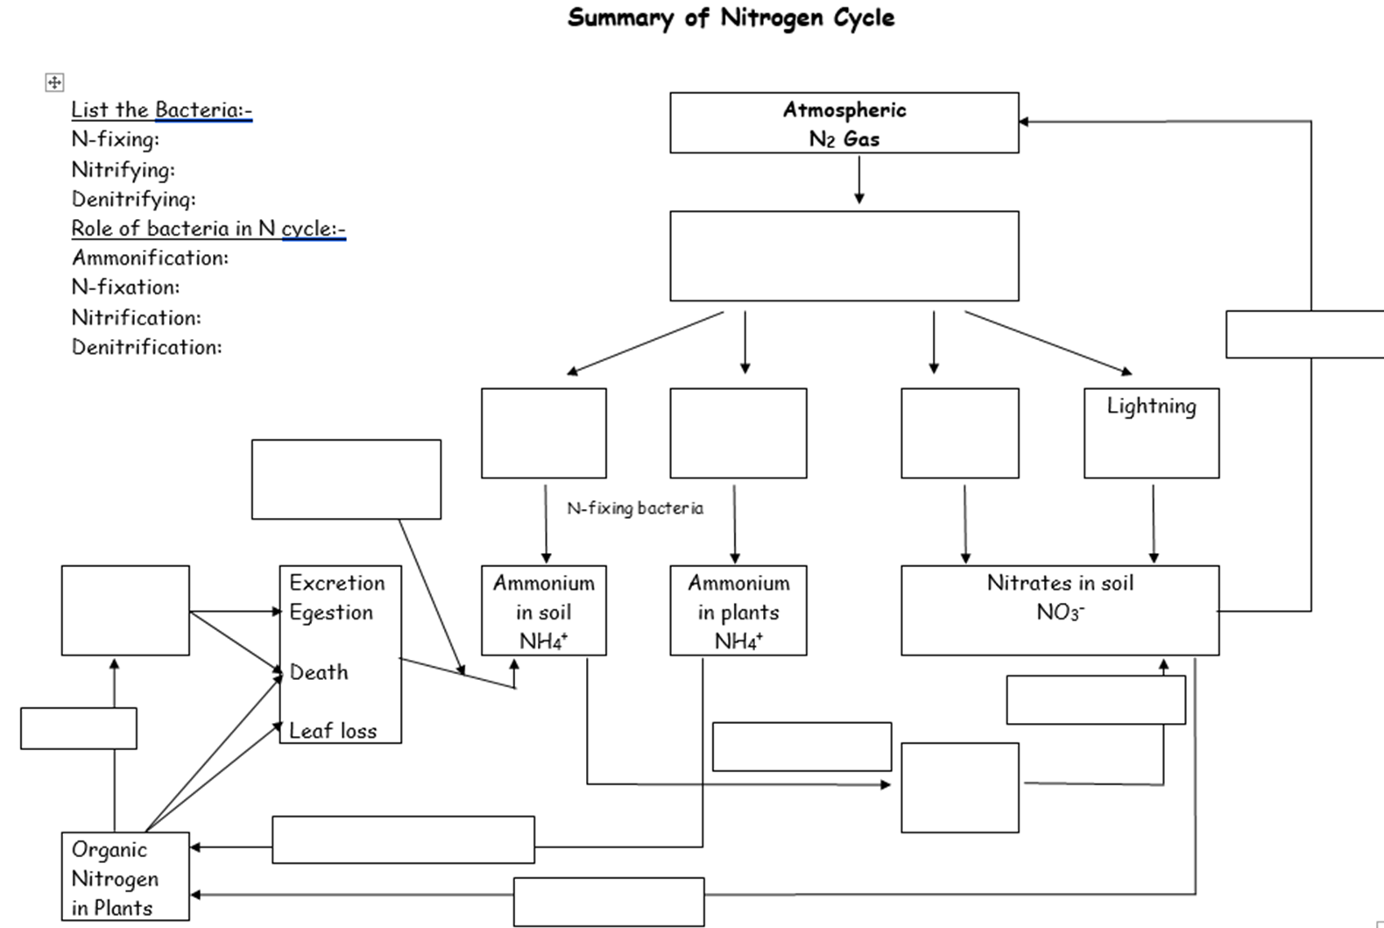
Task: Use what you have just learnt and textbook pages 307-309 to help you fill in the diagram on page 9
Decomposition & Ammonification
Free-living soil bacteria
Rhizobium in root nodules
Haber process Denitrification
Organic Nitrogen in animals
Feeding
Transport from root nodules
Uptake by roots
Nitrification
Nitrifying bacteria Nitrites in soil (NO₂₋₎
Nitrification
Denitrification
Denitrifying bacteria
Nitrogen Fixation.
Notes:
Using what you have just learnt in the video and pages 307-309 fill in the diagram on page 9 and then check your answers on the next slide.

Slide 28
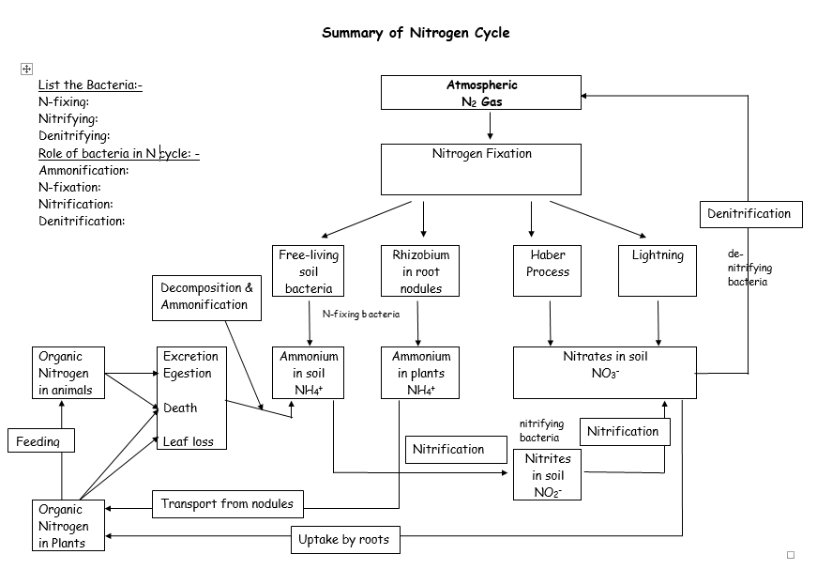

Slide 29
Stages of the Nitrogen Cycle
You could be asked to describe each of these stages
Ammonification
Nitrification
Nitrogen Fixation
Denitrification
You need to know about each stage of the Nitrogen cycle, it is important that you know the name of the group of bacteria involved. Do not confuse the bacteria with each other as you will lose marks.
Task:
Fill in the blanks on page 10 as we discuss each stage of the Nitrogen cycle
Notes:
Now that you have got some familiarity with the stages of the nitrogen cycle we need to look at some of the specific stages you could be asked about in your exam in more detail.
Fill in the blanks on page 10 as we talk through these in the next few slides, this is mark scheme perfect so you need to make sure you learn this.

Slide 30
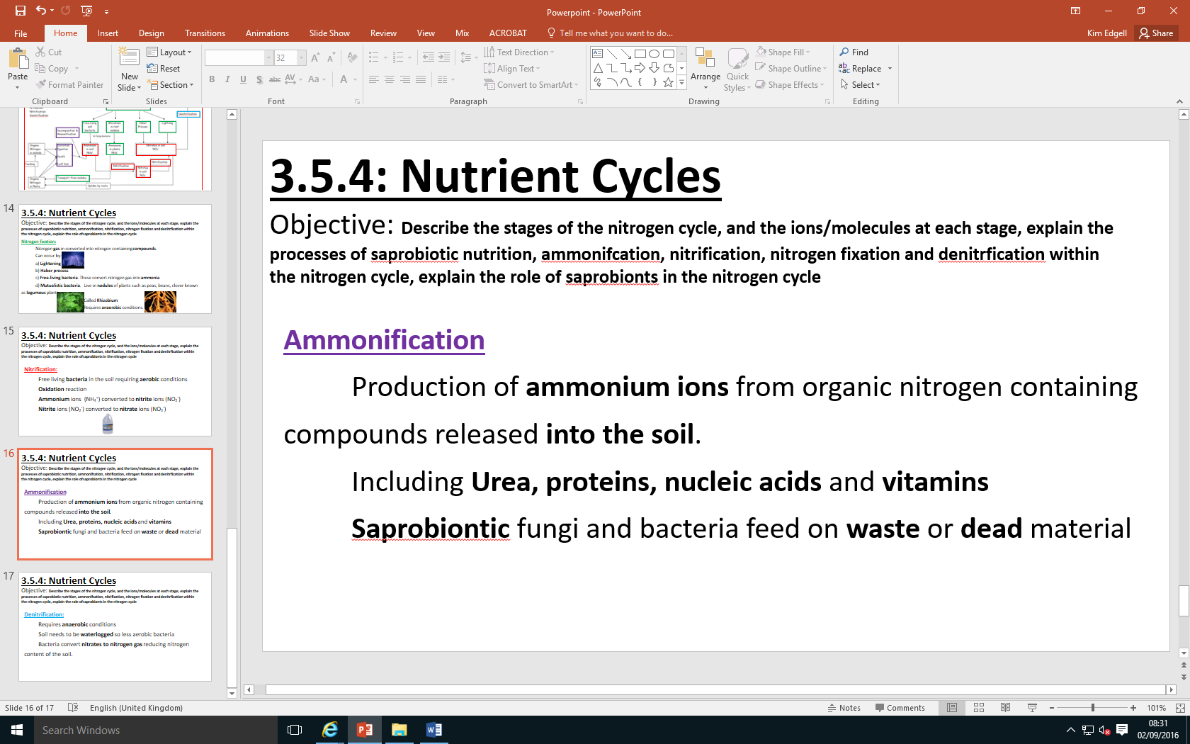
3.5.4: Nutrient Cycles NITROGEN
Learning outcomes: Describe the stages of the nitrogen cycle, and the ions/molecules at each stage, explain the processes of saprobiotic nutrition, ammonifcation, nitrification, nitrogen fixation and denitrfication within the nitrogen cycle, explain the role of saprobionts in the nitrogen cycle
Saprobiotic
Notes:
First stage we need to know about is ammonification which means producing ammonia or more specifcally producing ammonium ions that become released into the soil. Things such as urea, proteins and nucleic acids and some types of vitamins are broken down by saprobiontic bacteria and fungi that feed on waste or dead material.

Slide 31
3.5.4: Nutrient Cycles NITROGEN
Learning outcomes: Describe the stages of the nitrogen cycle, and the ions/molecules at each stage, explain the processes of saprobiotic nutrition, ammonifcation, nitrification, nitrogen fixation and denitrfication within the nitrogen cycle, explain the role of saprobionts in the nitrogen cycle
Nitrification:
Free living bacteria in the soil requiring aerobic conditions
Oxidation reaction
Ammonium ions (NH₄⁺) converted to nitrite ions (NO₂⁻)
Nitrite ions (NO₂⁻) converted to nitrate ions (NO₃⁻)
Notes:
The next step is nitrification which is a process done by free living bacteria in the soil and is completed under aerobic conditions, this is important as it is an oxidation reaction. The ammonium ions in the soil are firstly converted to nitrite ions and then nitrate ions. These two processes are performed by two different species of bacteria and it is not a specification requirement that you need to know these.

Slide 32
3.5.4: Nutrient Cycles NITROGEN
Learning outcome: Describe the stages of the nitrogen cycle, and the ions/molecules at each stage, explain the processes of saprobiotic nutrition, ammonifcation, nitrification, nitrogen fixation and denitrfication within the nitrogen cycle, explain the role of saprobionts in the nitrogen cycle
Nitrogen fixation:
Nitrogen gas in converted into nitrogen containing compounds.
Can occur by:
a) Lightning
b) Haber process
c) Free-living bacteria. These convert nitrogen gas into ammonia
d) Mutualistic bacteria. Live in nodules of plants such as peas, beans, clover known as legumous plants.
Called Rhizobium which live in aerobic conditions
Notes:
Next is nitrogen fixation which can occur in different ways. The process converts nitrogen gas into nitrogen compounds. These include lightning, free-living bacteria in the soil and mutualistic bacteria which live in nodules of legumous plants. You can also fix nitrogen artificially by the Haber process which you will come across if you study chemistry but you are not required to know this for your Biology A level.

Slide 33
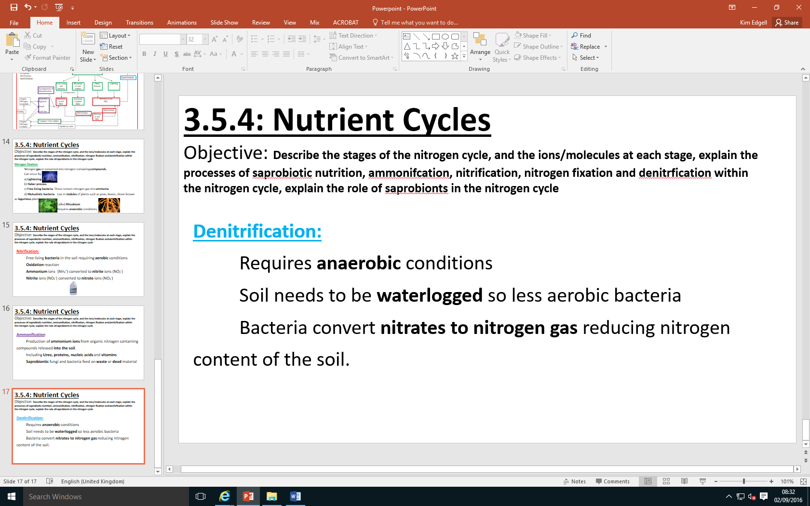
3.5.4: Nutrient Cycles NITROGEN
Learning outcomes: Describe the stages of the nitrogen cycle, and the ions/molecules at each stage, explain the processes of saprobiotic nutrition, ammonifcation, nitrification, nitrogen fixation and denitrfication within the nitrogen cycle, explain the role of saprobionts in the nitrogen cycle
Notes:
Lastly we have denitification which occurs in anaerobic conditions. Denitrification removes the availability of nitrogen for living organisms and places it back into the atmosphere. This occurs in soil which is filled with water (waterlogged) meaning that less oxygen from the air can get to the soil, creating anaerobic conditions.

Slide 34
Quick Questions
On page 11 which of the stages of the nitrogen cycle is each scenario describing
Answer
Lightening converting nitrogen gas into nitrates in the soil.
Ammonium ions in the soil being converted into nitrites in the soil by soil bacteria.
Worms digesting nitrates into nitrogen gas in the soil.
The Haber process ( if you are interested in this process remember to watch the video suggested on the nutrient cycle video you watched earlier.)
Cows urinating in a field.
Rhizobium in plant root nodules.
NITROGEN FIXATION
NITRIFICATION
DENITRIFICATION
NITROGEN FIXATION
AMMONIFICATION
NITROGEN FIXATION
Notes:
Complete the quick questions on page 11 and then check your answers here.

Slide 35
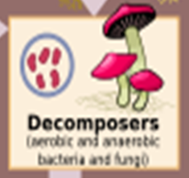
Outcome:
Explain the role of saprobionts in the nitrogen cycle.
How are Saprobionts involved in the Nitrogen Cycle?
Saprobiotic – process by which saprobionts feed.
Saprobionts – organisms that feed externally on dead or decaying organic material.
When producers/consumers die their complex molecules are digested
Digestion carried out by saprobiotic bacteria/fungi (decomposers).
Cause release of nutrients back into the soil in original simple form e.g. ammonium ions
Ensure nutrients are released for reuse

Slide 36
Exam question.
How can dead plant/animal material affect soil content/abiotic factors? (4 marks)
Use what you have learned about the organisms involved in the nitrogen cycle to answer the question. There are some key terms that you should be including in your answer on page 11
Mark scheme perfect answer:
Saprobiotic bacteria/fungi use oxygen to carry out aerobic respiration.
Proteins are hydrolysed into amino acids.
Amino acids are converted into ammonium ions (ammonification).
Nitrifying bacteria converted ammonium ions into nitrates.
Nitrates are available to plants for uptake into roots.
Notes:
There is space at the bottom of page 11 in your booklet to practice this question. This is a mark scheme perfect answers so you need to make sure you learn it.
When answering these types of questions make sure you are identifying the organisms (fungi or bacteria species) involved, the conditions required and the reactants and products made.

Slide 37
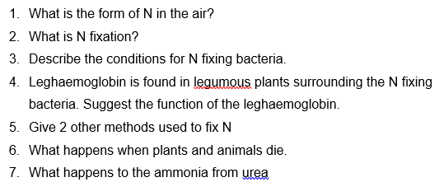
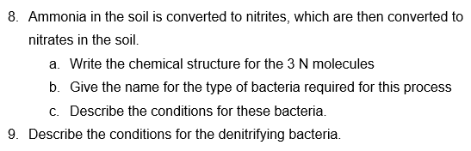
Answer the questions 1-9 on page 12
Quick fire questions:
Answer these questions to consolidate your knowledge

Slide 38
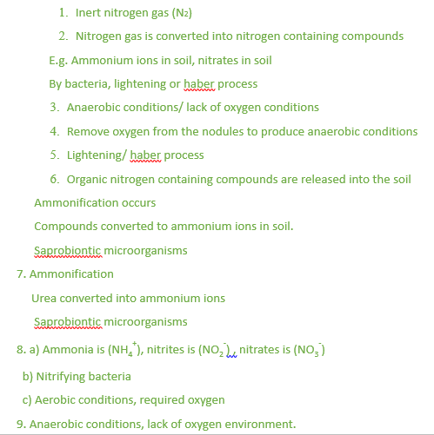
Mark and correct your answers

Slide 39
3.5.4: Nutrient Cycles NITROGEN
Outcome:
Describe the stages of the nitrogen cycle, and the ions/molecules at each stage
Explain the processes of saprobiotic nutrition, ammonifcation, nitrification, nitrogen fixation and denitrfication within the nitrogen cycle
Explain the role of saprobionts in the nitrogen cycle.
Interpret information/data about the nitrogen cycle and apply knowledge.
ANSWER THE EXAM QUESTIONS ON PAGE 12-13.

Slide 40
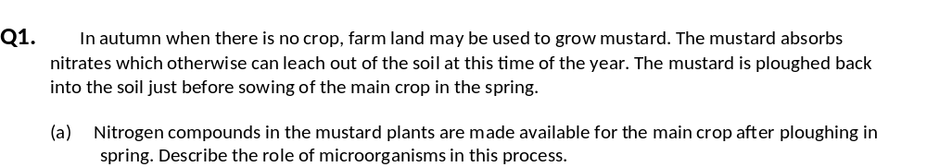
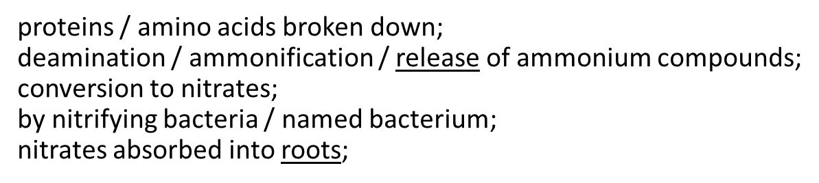
production of phospholipids;
in cell membranes;
synthesis of ATP;
production of DNA;
production of RNA;
production of NADP;
Notes:
Question 1a, you are told in the question that the nitrogen containing compounds are the in the mustard plants and this is ploughed into the soil in spring. From this you are to assume that the nitrogen is in the form of proteins and amino acids in the plant which will need breaking down to release ammonium ions; which we know is called ammonification. This occurs by nitrifying bacteria which convert the ammonium ions into nitrites and then nitrates, these can then be absorbed into the plants roots.
For the next questions you just need to give an example of a phosphate containing compound found in plants.

Slide 41
(a) Farmers who grow wheat sometimes leave a field fallow for a year by not growing a crop in it. The concentration of nitrate ions in the soil decreases when a field is left fallow.
(i) When grass is grown in the field, fewer nitrate ions are lost than when the field is left with bare soil. Explain why.
.........................................................................................................(1)
(ii) A crop of leguminous plants such as clover may be grown in the field and then ploughed in. Explain why less fertiliser would be needed for the wheat crop in the following year.
.............................................................................................................
......................................................................................................... (2)
(i) presence of grass causes less nutrients / minerals / nitrates / ammonium ions to be leached;
(do not allow references to less nitrogen)
(ii) clover contains nitrogen-fixing bacteria; (do not allow references to nitrifying bacteria) decomposition (of ploughed clover) introduces nitrates / ammonium ions into soil;
Notes:
Question ai, if you grow grass on the field then this means less nutrients can be leached. Leaching occurs when rain water carries soluble molecules out of the fields.
Question aii, by growing leguminous plants such as clover this will increase the amount of nitrogen-fixing bacteria. Whne you plough the clover into the soil the decomposition of the clover with increase the availability of ammonium ions in the soil which will then be converted into nitrates by nitrifying bacteria.

Slide 42
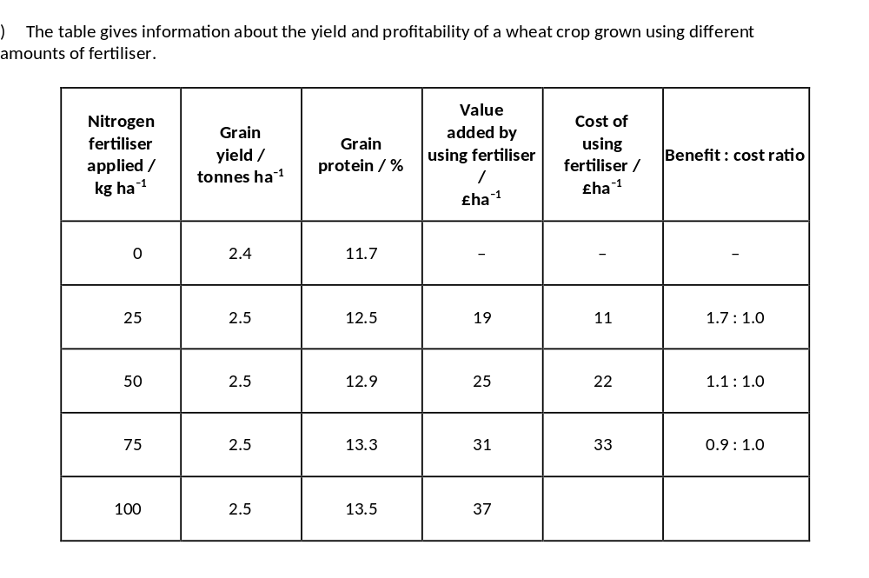
(i) Describe the effects of increasing fertiliser application on the yield and protein content of the grain produced.
(i) minimal effect / no significant effect on yield / small increase up to 25 kg ha^{–1};
increase in protein content of grain with all fertiliser applications;
ii) Use the data in the table to estimate the benefit: cost ratio for a fertiliser application of 100 kg ha^{–1}. Write your answer in the table.
(ii) (37 ÷ 44 =) 0.84 : 1.0 (allow 0.8 : 1);
Notes:
Question bi, for this question you just need to comment on the relationship between increasing the amount of fertiliser which is the first column and the yield (second column) and protein (third column). For the first marking point we can see there is a small increase from 2.4 to 2.5 between 0 and 25kg ha⁻¹ and then no effect. With regards to the protein there is an increase when you increase the fertiliser application.
Question bii, You will notice that for every extra 25kg ha⁻¹ of nitrogen fertiliser applied the cost goes up by £11. We therefore add £11 to 33 which gives us £44. Once we have calculated this we take the value added by using the fertilizer which is 37 and divide this by the cost of £44. This gives us the ratio of 0.84:1.0.

Slide 43
Lesson 3- Fertilisers and Eutrophication
Outcome:
Explain why farmers utilise natural and artificial fertilisers
Explain how eutrophication is caused, and what the impact is on the ecosystem in which it happens
Interpret information/data about eutrophication and apply knowledge
Notes:
So far we have looked at the natural nutrient cycles, in this lesson we are going to look at how humans have manipulated this process so we can increase the yield of crops we can grow for food and also the implications this can have on ecosystems.

Slide 44
FERTILISERS AND EUTROPHICATION
Fertilisers can be used to provide plants with minerals, particularly nitrates, to support their growth
In agriculture systems, the harvesting of crops prevents the reintroduction of minerals to the soil so we need to replenish those lost minerals and nutrients using fertilisers.
There are;
Natural fertilisers which consist of dead and decaying remains of plants, animals and their waste
Artificial fertilisers which are mined from rocks before being converted into different forms with their composition tailored for specific crops.
Notes:
Fertilisers are very useful in agriculture all over the world, they enable us to provide more nutrients to crops we are growing for food and other purposes. As we already know as crops are growing they absorb nutrients from the soil and they become incorporated into the plants biomass and the nutrients available in the soil reduces. When you harvest the crop you are left with soil with less nutrients and as the plant isn’t dying in the field and decomposing those nutrients are not been reintroduced back into the soil like would happen in a natural system.
For this reason it is vital we are able to put nutrients back into the soil before sowing more seeds into the field, this is why fertiliser is important. There are two types of fertiliser which are natural and artificial, you need to know some examples of each from the slide.

Slide 45
3.5.4: Nutrient Cycles - FERTILISERS
Learning outcome: Explain why farmers utilise natural and artificial fertilisers, interpret information/data about fertilisers and apply knowledge.
Explain why fertilisers are needed in an agricultural ecosystem.
Using Figure 1, determine what concentration of fertiliser you would advise a farmer to apply to a field of wheat.
Suggest a reason why, after a certain point, the addition of more fertiliser no longer improves the productivity of a crop.
Distinguish between natural and artificial fertilisers.
Use pages 311-312 to complete these questions.

Slide 46
Answers
Crops are grown repeatedly and intensively on the same area of land. Mineral ions are taken up by the crops, which are transported and consumed away from the land. The mineral ions they contain are not returned to the same area of land and so the levels in the soil are reduced, which can limit the rate of photosynthesis. Fertilisers need to be applied to replace them if photosynthesis f productivity is to be maintained.
100 kg ha 1 - although 150 kg ha- 1 gives a slightly better yield, this is marginal and the cost of using 50% more fertiliser makes it uneconomical.
Some other factor is limiting photosynthesis, e.g. light. C0₂ and only the addition of this factor will increase photosynthesis and hence productivity.
Natural fertilisers are organic and come from living organisms in the form of dead remains, urine or faeces (manure). Artificial fertilisers are inorganic and are mined from rocks and deposits.

Slide 47
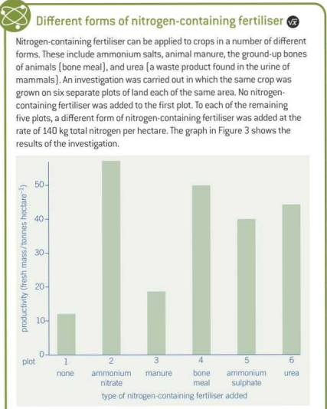
Now answer the questions below. Using the figure and data on page 312 of the text book.
State which forms of nitrogen used in the investigation are natural fertilisers.
Suggest why the investigation included a plot to which no nitrogen-containing fertiliser was added.
Suggest how the addition of nitrogen-containing fertiliser, in whatever form, increased productivity.
The mass of each fertiliser used was different in each case. Suggest why this was necessary.
It is sometimes claimed that nitrogen-containing fertilisers in the form of ammonium salts increase productivity of crops better than other forms of nitrogen-containing fertilisers. State, with your reasons, whether or not you think the results of this experiment support this view.
The increase in productivity when manure was applied was lower than for other forms of nitrogen-containing fertiliser. This is because the manure has to break down before its nitrogen is released and this process takes a few months. Suggest how a farmer who spreads manure on his/her crops, might use this information in order to improve productivity .

Slide 48
Answers
manure, bone meal and urea
To act as a control to show that any changes in productivity were the result or the nitrogen-containing fertiliser being added.
Nitrogen is needed for proteins I amino acids I chlorophyll and DNA and therefore for plant growth. Nitrogen shortage may limit the production of proteins and ONA and hence growth . Its addition increases productivity.
Some forms of fertilisers contain more actual nitrogen than others and so different masses arc added to ensure that the total nitrogen added was always the same (140 kg ha- 1).
The data do not support the view. While ammonium nitrate brings about the greatest increase in productivity, ammonium sulphate produces a smaller increase than both urea and bone meal. Therefore the investigation suggests that only some ammonium salts are better.
The farmer should spread the manure a few months before the main growing season for the crop.

Slide 49
Environmental consequences of using fertilisers
Nitrogen containing fertilisers can have detrimental effects such as:
The effects of nitrogen fertilisers
Reduced species diversity – nitrogen favours the growth of rapidly growing species such as grasses, nettles and weeds. Some species grow quickly and out compete the others.
Leaching – leads to pollution of watercourses
Eutrophication – caused by leaching of fertilisers into watercourses
Notes:
As fantastic as fertilisers are for increasing our ability to grow crops and feed the growing human population there are consequences we have seen to ecosystems especially when these nutrients end up in areas they shouldn’t.
The first problem is that for certain fast growing species the availability of these nutrients a limiting factor in normal ecosystems. When there is an abundance of these nutrients available these species can grow rapidly and outcompete other species. This then reduces the species diversity for that area destabilising the ecosystem.

Slide 50
Leaching
Rain water can dissolve soluble nitrates and carry them deeper into the soil beyond the reach of plant roots.
The nitrates may travel to water courses and into water that is used for human consumption.
High levels of nitrates in water can cause inefficient transport of oxygen to the brain.
Notes:
The next issue is leaching, this especially happens after rainfall. The nitrates in the fertilizer dissolve into the rainwater and are then carried deeper into the soil away from the plant roots. The nitrates then move into watercourses which leads to them becoming polluted both to organisms present and if it is a water course used by humans can also effect us.

Slide 51
Eutrophication
In most lakes, there are very few nitrates and so this is limiting factor on plant/algae growth
Nitrate/ Nutrient levels increase due to leaching, there is no longer a limiting factor, and so plants/algae both grow exponentially
Algae grow and cover the upper layers of the water. This is called “algae bloom”.
The algae on the top of the water, absorbs sunlight, preventing it from reaching the bottom of the lake.
Light becomes a limiting factor for plants/algae at the bottom of the lake and so they die
Saprophytic algae can now grow exponentially feeding on the decaying plant matter. More aerobic saprophytic bacteria, more oxygen used up in respiration and more nitrates produced from decaying organisms.
Oxygen is a limiting factor for aerobic organisms such as fish and so they eventually die.
Without any aerobically respiring organisms, anaerobically respiring organisms no longer have to compete and so they begin increase in number. Anaerobic organisms further breakdown other dead material thus producing more nitrates as well as some toxic wastes such as, hydrogen sulphide which makes the water putrid
Notes:
The last issue to discuss is eutrophication, this is a longer process that you need to know in detail.
Very few nitrates are naturally found in waterways so this creates a limiting factor on the natural growth of plants and algae species. When leaching occurs the nitrates from surrounding fields move into the rivers and lakes so nitrate level is no longer a limiting factor. As a result the plants and algae grow exponentially. The algae grow across the top of the water and cover and prevent sunlight from reaching the bottom of the lake. This is known as algal bloom.
The lack of light reaching the plants at the bottom of the lake means that plants are unable to photosynthesise and produce vital sugars and other compounds required for life, as a results they die. All of this dead matter now needs to decay, saprophytic bacteria and algae begin to break down plant matter using dissolved oxygen in the process. This reduces the level of oxygen in the water and increases the nitrate level even further.
The oxygen level in the water becomes so low that aerobically respiring organisms such fish die.
As there are now no aerobically respiring organisms, the anaerobically respiring bacteria and algae have no competition for resources. This means anaerobically respiring organisms increase in number, break down other dead material and further increase nitrate level. Other toxic waste products are produced such as hydrogen sulphide which makes the water putrid.

Slide 52
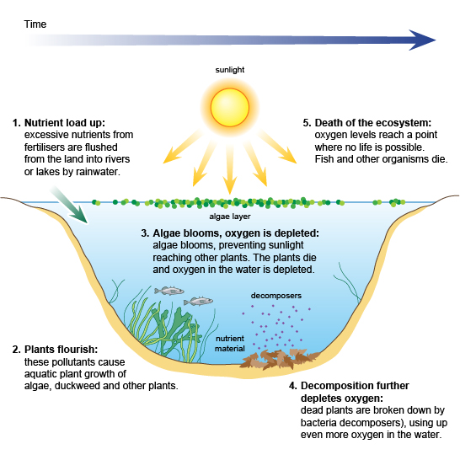
Use the box on page 16 to draw and annotate the stages of eutrophication. This can be an illustration or a flow chart

Slide 53
Now have a go at the exam questions on page 17

Slide 54
Answers
Q1. A large lake is surrounded by fields. These fields are separated from each other by hedges. One hundred years ago the lake was a habitat for many plants, invertebrates and fish. Today the lake has no fish and few plants or invertebrates. Explain how increased use of inorganic fertilisers on the fields may have led to these changes. (5)
run off / leaching of nutrients / nitrates;
leads to increased growth of algae / plants;
competition for light / effect of competition;
death of algae / plants;
increases food supply / increases microorganisms / decomposers;
respiration (of microorganisms) uses up oxygen / increases BOD;
fish / animals die due to lack of oxygen;

Slide 55
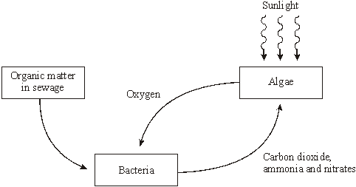
Purification ponds can be used in warm climates to break down sewage. The ponds are about 1m deep and contain bacteria and green algae. The diagram summarises the processes involved in the breakdown of sewage in a purification pond.
(a)
breakdown of organic matter / sewage by enzymes from bacteria;
nitrates / ammonia used by algae to make amino acids / proteins;
algae photosynthesise;
bacterial respiration uses O₂ / produces CO₂ for algae;
(respiration) allows for reproduction / growth of bacteria;
(a) Explain the advantage of having both algae and bacteria in a purification pond. (4)
(b)
sufficient light penetration for photosynthesis (of algae);
warm leads to faster enzyme activity;
faster bacterial respiration / decomposition;
faster photosynthesis;
increased growth / reproduction of bacteria / algae;
(b) Purification ponds only work efficiently when they are shallow and warm. Explain why. (4)

Slide 56
Final Task
Read through pages 313-314 of the Toole & Toole text book
Then complete the poster on page 18 of the booklet. The skill you are practising is to condense information into concise, precise information. MAX 50 WORDS PER B0X

