Slide 1

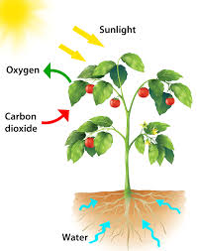
Limiting factors
6H₂O + 6CO₂ ----------> C₆H₁₂O₆+ 6O₂
Chloroplast
Sunlight
The light dependent stage/photophosphorylation, energy from sunlight is used to make ATP, splits water (photolysis) to release protons and electrons which reduce NADP to reduced NADP. Oxygen is produced which can be used in aerobic respiration or pass out of the leaf into the atmosphere.
6H₂O + 6CO₂ ----------> C₆H₁₂O₆+ 6O₂
Chloroplast
Sunlight
2. The Calvin cycle, CO_{2,} ATP and reduced NADP can be converted into glucose, amino-acids, glycerol or nucleic acids.

Slide 2
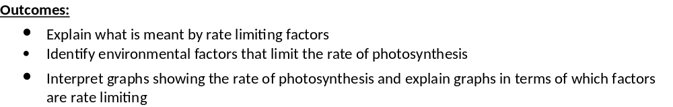
Limiting factors
http://www.bbc.co.uk/learningzone/clips/the-limiting-factors-of-photosynthesis/10657.html- 2 minute video.

Slide 3
Limiting factors
On Kahoot……..
Factors that affect photosynthesis are:
Light intensity
Carbon dioxide conc
Temperature.
Using this information and the definition for a limiting factor to complete the Kahoot: https://create.kahoot.it/share/limiting-factors/47e55ae1-fd54-45fa-a925-84ac298b35ad

Slide 4
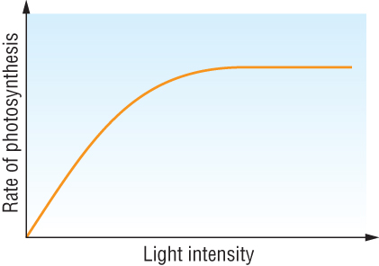
Limiting factors
b
a
At point A as you increase the factor (e.g. light intensity) the rate of photosynthesis also increases.
The graph is directly proportional.
At point A on the graph whichever factor is written along the bottom of the graph is the LIMITING FACTOR

Slide 5
Limiting factors
b
a
As you increase the factor (eg light intentisty) the rate of photosynthesis does NOT increase
This means the factor is no longer limiting the rate of photosynthesis and another factor must now be limiting the rate of photosynthesis.
Whichever factors NOT mentioned on the graph are limiting the rate of photosynthesis
Complete the true or false quiz!

Slide 6
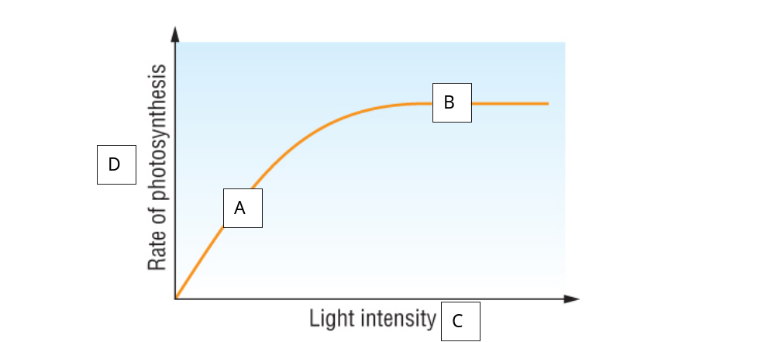
Limiting factors
On whiteboard……..
Complete the T/F quiz using the graph
B has reached a plateau because all of the substrate has been used up, this is the end of the reaction
C has no effect on D
If I increase D, C will also increase
A shows the fastest increase in rate of reaction
B is a plateau because the rate of the reaction has become constant
In A if you increase C, D will increase proportionally
In B if you increase C, D will increase proportionally.
False
False
False
True
True
True
False

Slide 7
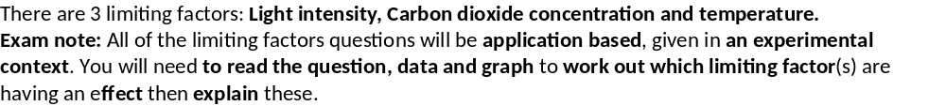
On whiteboard……..
From Year 1 write out a paragraph explaining how temperature effects the functioning of an enzyme:
Up to optimum
Above optimum.
Remember to use your enzyme key words.
Up to optimum:
Increase in Kinetic energy
Increased collisions
Between active site and substrate
More ESC’s
More EPC’s
More product
Above optimum:
Increase in Kinetic energy
Breaks H bonds in tertiary structure
Changes shape of active site
Active site no longer complementary to substrate.
Less ESC’s
Less EPC’s
Less product
Which stage of photosynthesis will be more effected by changes in temperature?
Light independent.
Enzyme controlled.

Slide 8
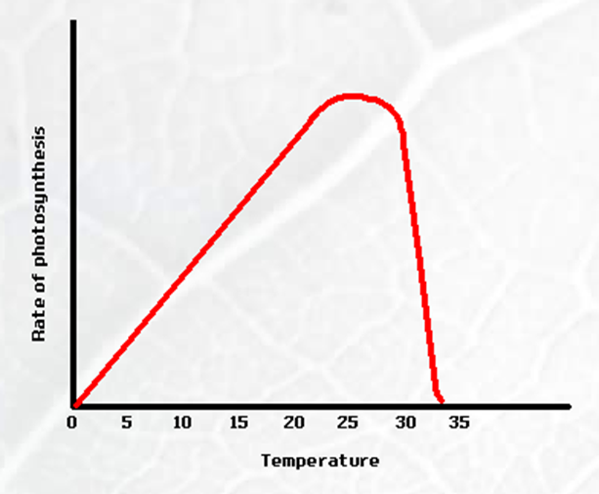
Limiting factors- Temperature
Exam tip: When describing a graph comment on gradients, quote data for each gradient and comment on both axis.
Explain part A of the graph.
As the temperature increases so does the rate of photosynthesis, the gradient is directly proportional.
Increase in Kinetic energy
Increased collisions
Between active site of RuBISCo and Carbon dioxide
More ESC’s
More EPC’s
More GP formed.
A

Slide 9
Limiting factors- Temperature
Exam tip: When describing a graph comment on gradients, quote data for each gradient and comment on both axis.
B
Explain part A of the graph.
Point A:
As the temperature increases the rate of photosynthesis decreases.
Increase in Kinetic energy
Breaks H bonds in tertiary structure
Changes shape of active site of RuBISCo
Active site no longer complementary to Carbon dioxide .
Less ESC’s
Less EPC’s
Less GP
A

Slide 10
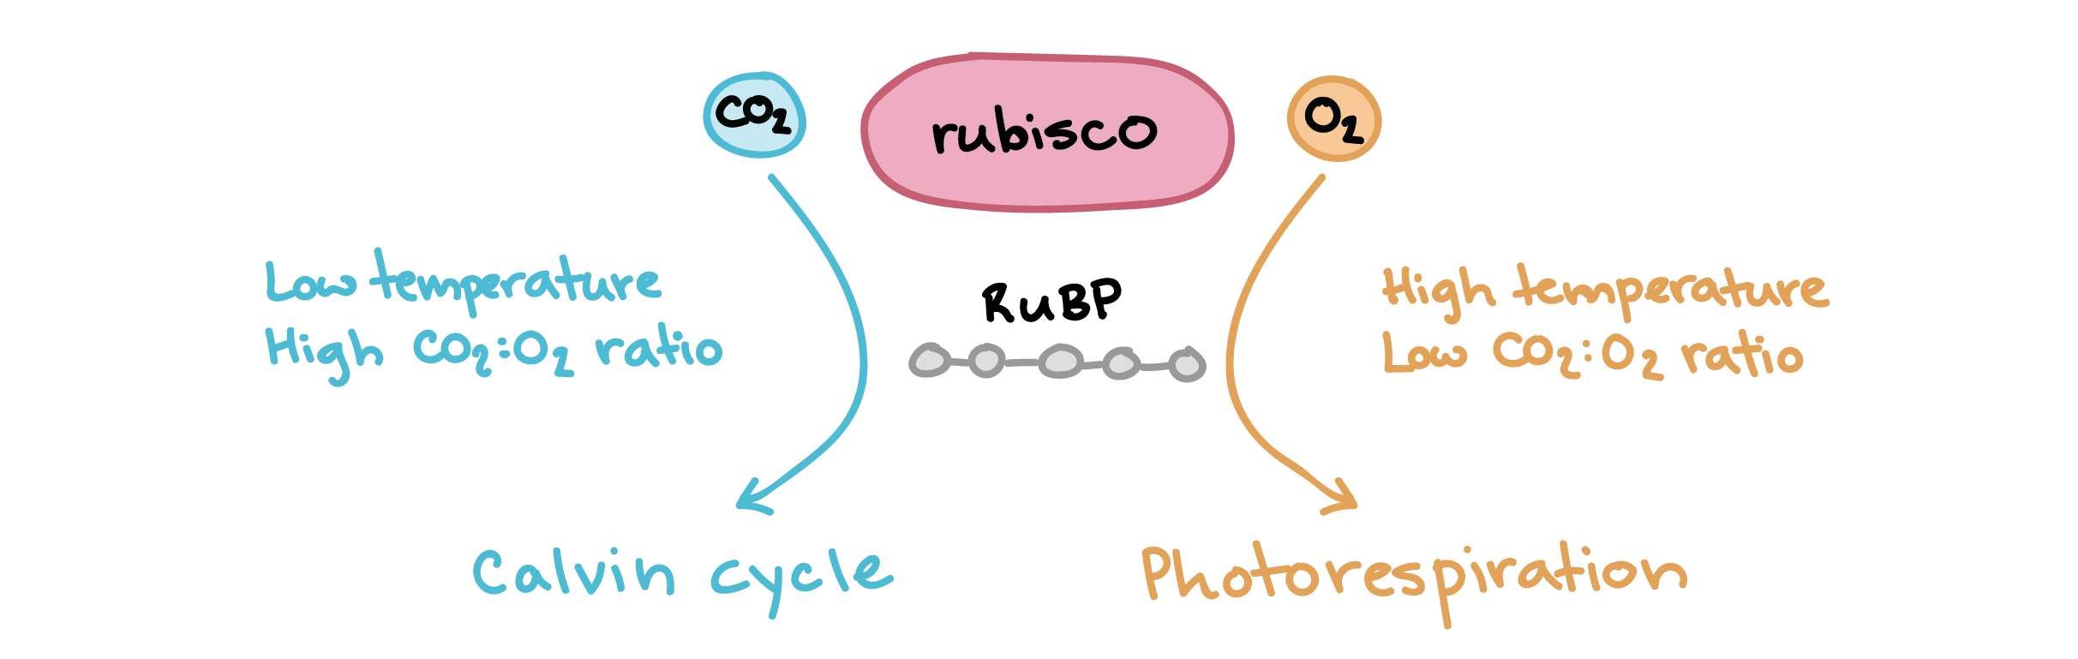
Limiting factors- Temperature
RuBISCo optimum temperature is 25ºC
Above 25ºC RUBISCO works less efficiently.
OXYGEN competes more successfully for the active site of rubisco and prevents enzyme from binding to CO₂.
ATP and reduced NADP from light-dependent stage is wasted.
PHOTORESPIRATION exceeds photosynthesis so rate of photosynthesis goes down.
Very high temperatures can damage proteins involved in photosynthesis.

Slide 11
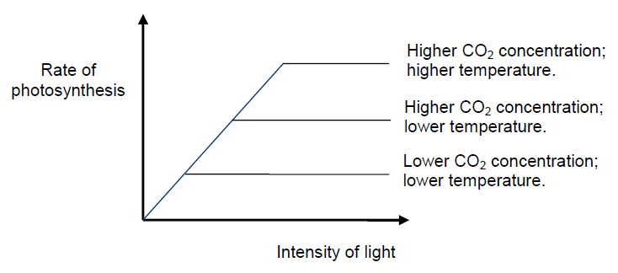

Limiting factors- Carbon dioxide
Exam tip: the graph may give multiple limiting factors, read the question carefully to check which limiting factor you need to discuss
Which stage of photosynthesis will be more effected by changes in Carbon dioxide concentration?
Light independent.
Substrate for reaction.
Atmospheric levels of CO₂ are relatively low at 0.03 – 0.06%.
Concentration and the rate at which carbon dioxide can diffuse into the leaf are both limiting factors.
Increasing the concentration means more substrate available
More collisions
More ESC’s and EPC’s
More GP produced.

Slide 12
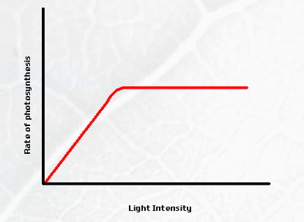
Limiting factors- Light intensity
Which stage of photosynthesis will be more effected by changes in light intensity?
Light dependent.
Explain part A of the graph.
As the light intensity increases so does the rate of photosynthesis, the gradient is directly proportional.
More light energy
Increases excitation of electrons
More photolysis
More ATP and NADPH₂.
B
A
Explain part B of the graph.
As the light intensity increases the rate of photosynthesis decreases, another factor is limiting the rate eg temperature, carbon dioxide concentration.

Slide 13
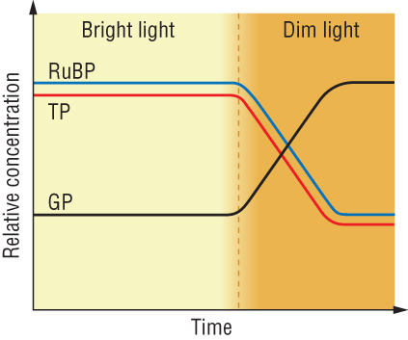
Limiting factors
Application of knowledge.
In your exam you will need to interpret data on limiting factors, the graph below is a common example. Use your knowledge about limiting factors to answer the questions.
On whiteboard……..
Prompts:
Which reaction(s) are you looking at?
What is needed for this reaction to occur?
What is produced in bright light?
What is not produced in dim light?
What is the effect of the lack of produced in dim light?
Use your answers to explain the relative concentrations of RuBP, TP and GP in dim and bright light.

Slide 14
In bright light,
Concentrations of RuBP and TP are relatively high
Concentrations of GP are relatively low.
In bright light the rate of the light dependent reactions will be high,
More ATP and reduced NADP will be produced,
Used to convert GP to TP and to regenerate RuBP.
Majority of the GP is converted to TP and RuBP.
In dim light ,
Light dependent reactions will cease,
GP cannot be changed to TP
Levels of GP will increase and levels of TP will fall,
levels of RuBP will fall as will be converted to GP and no TP available to regenerate RuBP

Slide 15
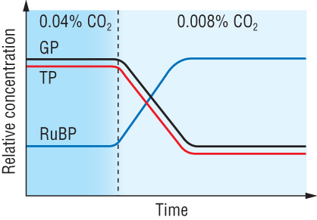
Limiting factors
Application of knowledge.
In your exam you will need to interpret data on limiting factors, the graph below is a common example. Use your knowledge about limiting factors to answer the questions.
Prompts:
Which reaction are you looking at?
What is needed for this reaction to occur?
What is considered normal CO₂ concentration in the atmosphere?
What is the affect if you are less CO₂ than normally available?
Use your answers to explain the relative concentrations of RuBP, TP and GP in high and low carbon dioxide conc

Slide 16
In high CO₂,
Concentration of GP and TP are relatively high
Concentration of RuBP are relatively low
More CO₂ fixation, more GP and therefore more TP,
RuBP which is regenerated is quickly carboxylated to GP
In low CO₂,
Concentration of RuBP increase as very little is carboxylated to GP, levels of GP and TP fall

Slide 17
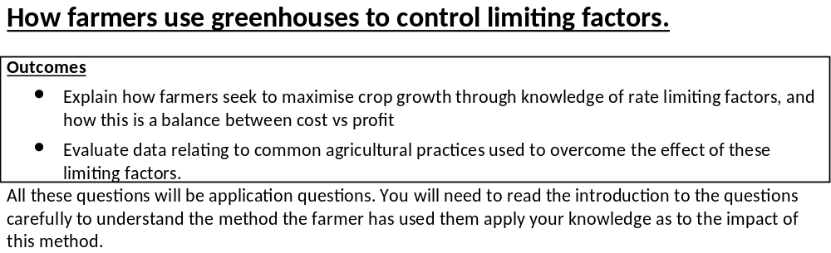
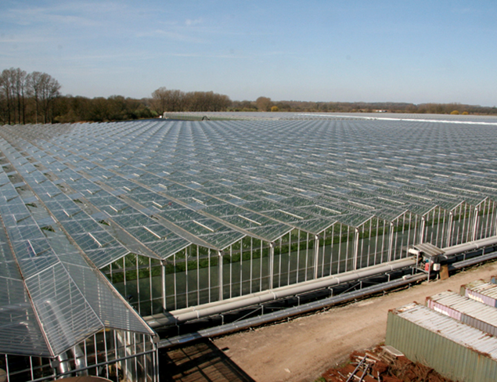
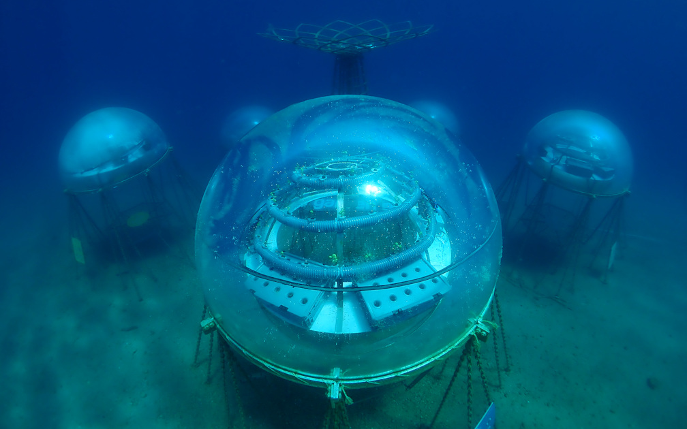

Slide 18
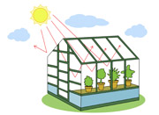
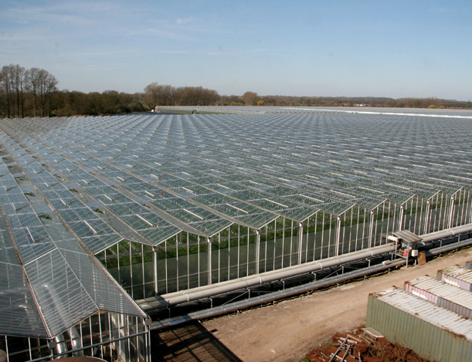
Farming techniques.
Glasshouses are used by to:
Achieve maximum yield
Grow crops out of season/all year round
Grow crops not native to the country
The faster a plant can photosynthesis the more carbohydrates the plant can make.
The carbohydrates are used to provide energy to make new cells.
This means more rapid growth.
To achieve these goals the environment inside is highly controlled.

Slide 19
Farming techniques.
Sunlight heats the inside of the glasshouse. Glass prevents a lot of the heat from escaping.
If temperatures start to drop electric or paraffin heaters can be used.
Paraffin heaters can also be burned to supply CO₂ in the concentrations are low.
If the temperature gets too hot ventilators (panels) can be opened to release heat.
Ventilators can also be opened to replenish CO₂ concentrations

Slide 20
Farming techniques.
Sunlight heats the inside of the glasshouse.
Glass prevents a lot of the heat from escaping.
Artificial light can be used when natural light intensity gets too low to specific wavelength to keep electricity costs low.
If temperature gets too high transpiration increases so plants needs to be regularly watered
If the temperature gets too hot ventilators (panels) can be opened to release heat.

Slide 21
Farming techniques.
https://www.youtube.com/watch?v=WsqbggHPn_8
Farmers always have to balance the cost of controlling the factors and the profit made from the crop.

Slide 22

The future…..
There are jobs be created now to improve how we grow food, how we store food and how we use our limited resources.
So, what jobs might you apply for in the future?
What could you research at uni?
How could you leave a positive impact on the planet?
https://www.youtube.com/watch?v=FgBUIzGJJW8
https://www.youtube.com/watch?v=X5_oNESLNlw

Slide 23
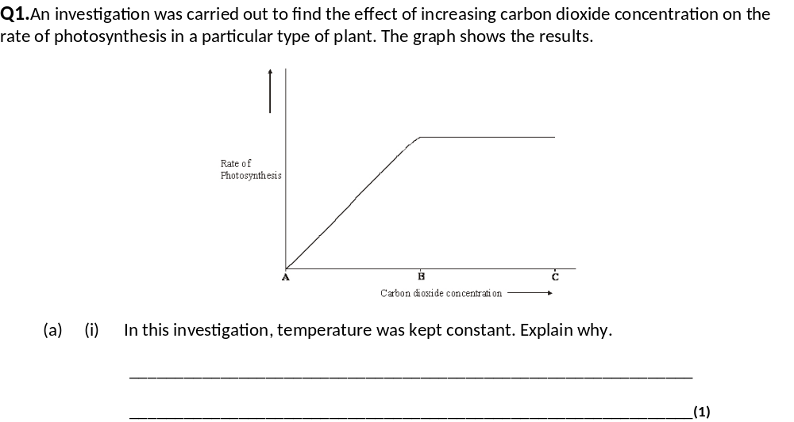
(a) (i) temperature also affects photosynthesis / rate of reaction; need to ensure the effect of only one variable is being observed;
1

Slide 24
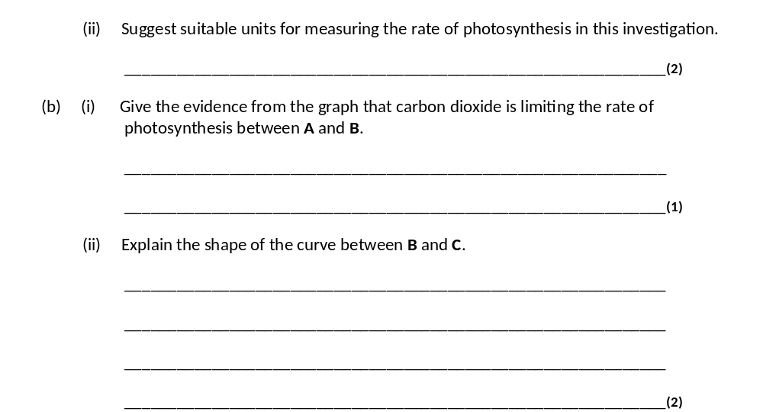
(ii) CO₂ used / O₂ produced / sugar produced / increase in mass;
per unit of time; accept any volume or mass unit; per time unit;)
(b) (i) as carbon dioxide increases, rate of photosynthesis increases;
1
(ii) carbon dioxide not limiting photosynthesis / another factor / named factor limiting;
explanation for named factor;

Slide 25
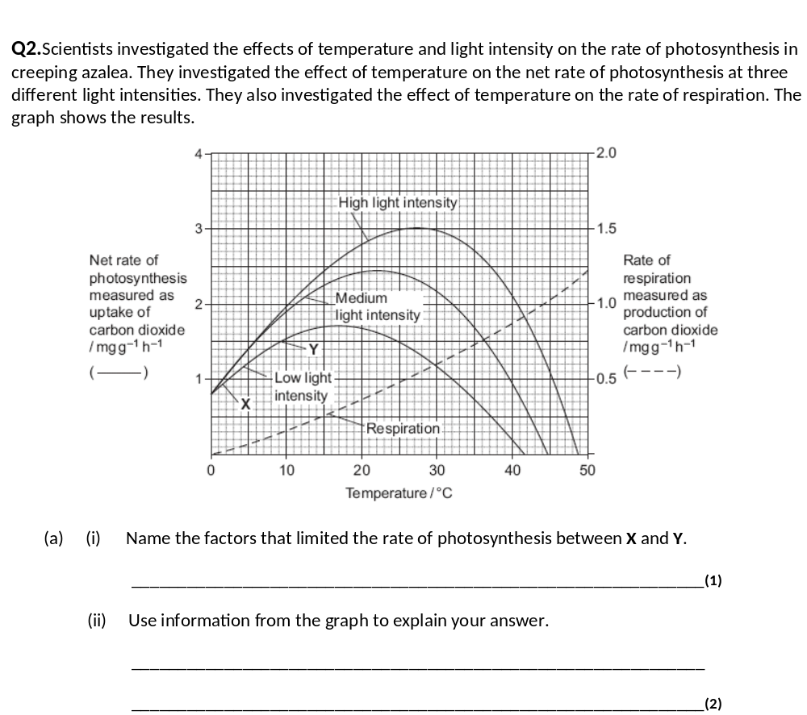
(i) Temperature and light;
1
(ii) Increase in temperature causes increase in rate of photosynthesis / uptake of carbon dioxide;
Increase in light / more / medium / high light (intensity) causes increase in rate of photosynthesis / uptake of carbon dioxide;
2

Slide 26
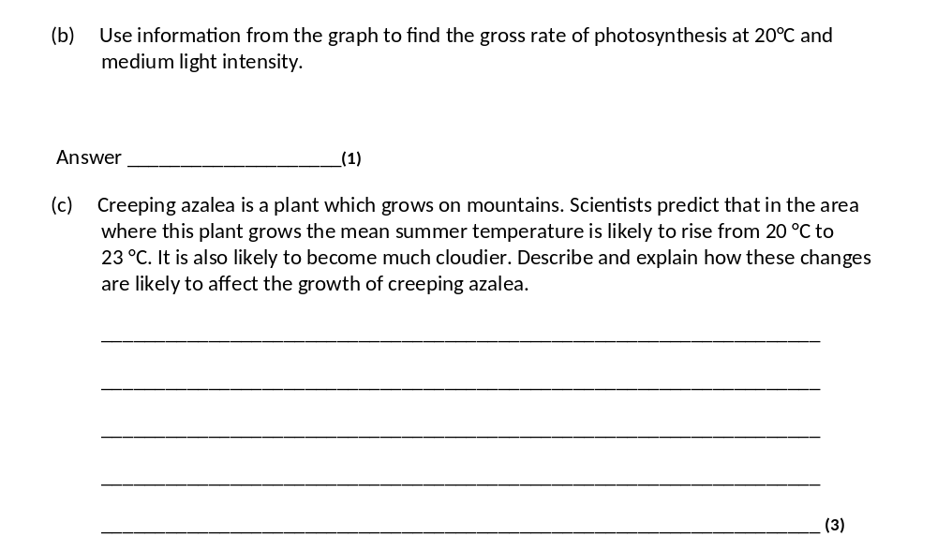
(b) 2.75 – 2.81 (mg g^{–1} hr^{–1})
Accept answers in range 2.75 – 2.81
1
(c) 1. Growth will decrease (at higher temperature);
2. Rate of respiration will increase at higher temperature;
3. Photosynthesis decreases as limited by light / as there is less light;
Ignore references to effect of temperature on rate of photosynthesis
3

Slide 27
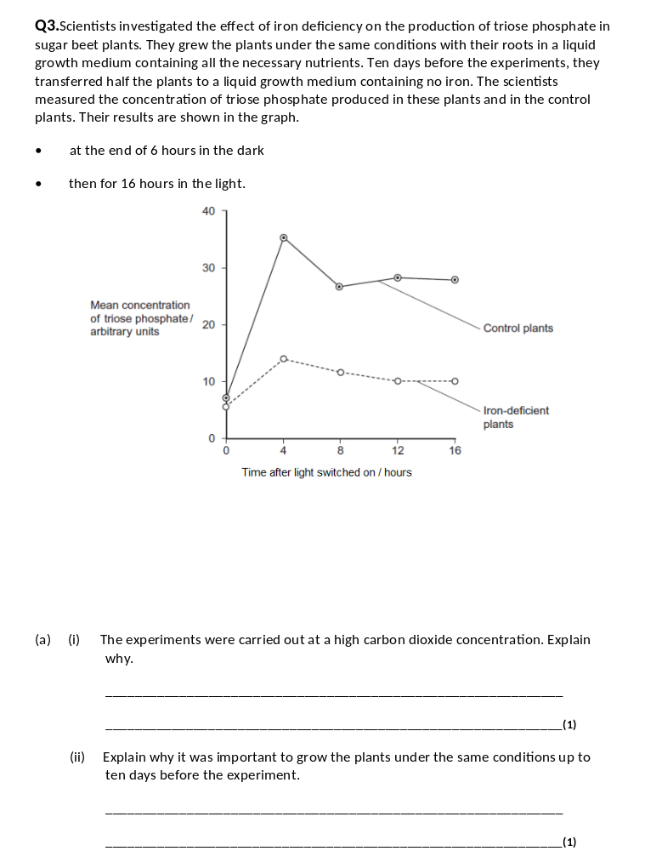
(i) So it / CO₂ is not a limiting factor (on growth / photosynthesis);
Accept: CO₂ is a limiting factor
1
(ii) So any difference is due to iron (deficiency);
Accept: iron is the variable
1

Slide 28
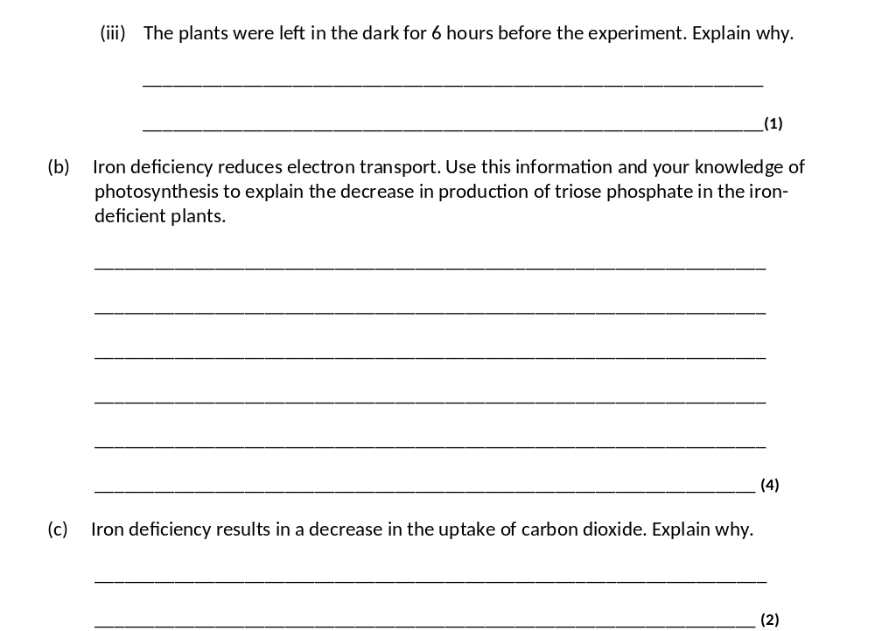
(iii) Amount of triose phosphate / TP will be similar / same / low (at start);
Accept: to allow triose phosphate to stabilise / become constant
Reject: so all triose phosphate is used up, so no triose phosphate
1
(b) 1. (Less) ATP produced;
Accept: alternatives for reduced NADP ie NADP with hydrogen / s attached
2. (Less) reduced NADP produced;
3. ATP / reduced NADP produced during light-dependent reaction;
4. (Less) GP to triose phosphate / TP;
4
(c) 1. Less triose phosphate converted to RuBP;
Accept: less triose phosphate so less RuBP
2. CO₂ combines with RuBP;
2

Slide 29
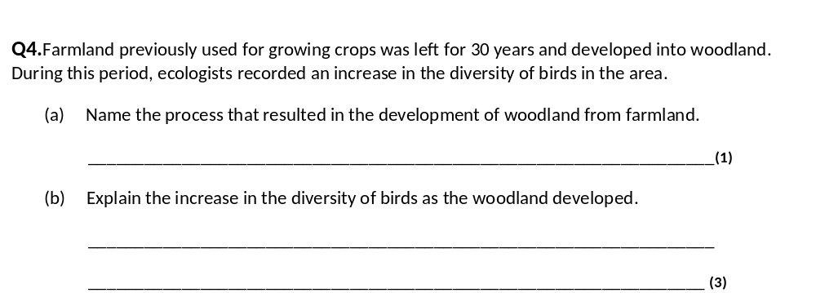
(a) Succession;
Ignore any word in front of succession e.g. secondary / ecological succession.
Neutral ‘forestation’.
1
(b) 1. Greater variety / diversity of plants / insects / more plant / insect species;
Neutral: more plants.
2. More food sources / more varieties of food;
Neutral: more food / more / greater food source (singular).
3. Greater variety / more habitats / niches;
Accept: more nesting sites.
Q Neutral: more homes / shelters.
3
2

Slide 30
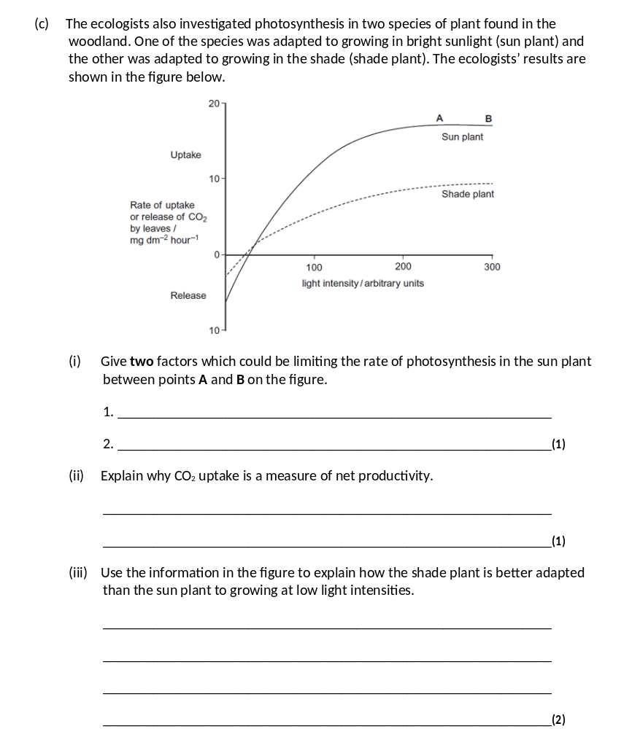
(c) (i) Temperature and carbon dioxide;
Neutral: water, chlorophyll.
1
(ii) Shows (gross) photosynthesis / productivity minus respiration / more carbon dioxide used in photosynthesis than produced in respiration;
Correct answers are often shown as: net productivity = (gross) photosynthesis – (minus) respiration.
1
(iii) 1. (Shade plant) has lower (rate of) respiration / respiratory losses / less CO2 released at 0 light intensity / in dark;
Accept use of figures.
Accept: lower compensation point.
2. Greater (net) productivity / less sugars / glucose used / more sugars / glucose available;
Neutral: any references to rate of photosynthesis.
2

