Slide 1
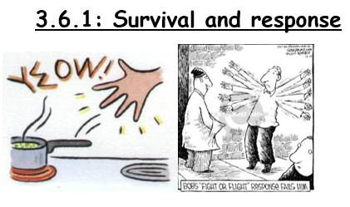

Slide 2
Have you completed the GCSE and Year 1 +2 recap activities on Connect?

Slide 3
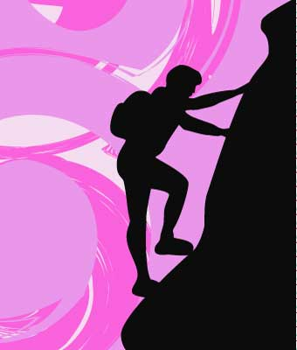
‘Cliff Climb’ Starter
To reach the top of the cliff, describe 10 things you know about the nervous system.........
Notes:
SETTLER

Slide 4
Outcome:
Explain what is meant by taxes, kineses, how they differ and how taxes & kineses aid survival.
Explain what is meant by phototropism and gravitropism, and by positive and negative tropisms and how this is caused by IAA
Watch these three videos on animal behavior.
https://www.youtube.com/watch?v=rRDovcEf_ks
https://www.youtube.com/watch?v=jSKkecFzD50
https://www.youtube.com/watch?v=cmkG3acsX0A
Can you pick up the difference between kinesis, taxis and tropisms?

Slide 5

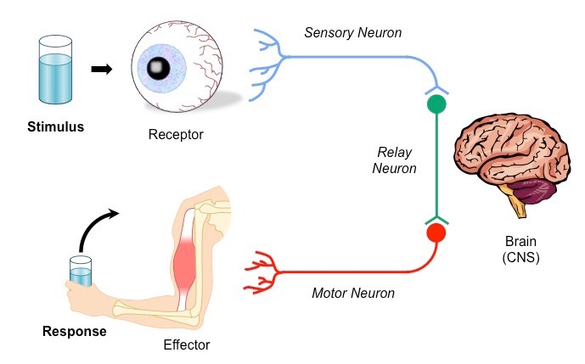
Outcome:
Explain what is meant by taxes, kineses, how they differ and how taxes & kineses aid survival.
Explain what is meant by phototropism and gravitropism, and by positive and negative tropisms and how this is caused by IAA
Term | Definition
Stimulus | Detectable change in internal/external environment that causes a change to the organism
Receptor | Cell that detects a stimulus. Receptors are specific to 1 type of stimulus
Coordinator | Formulates a suitable response to a stimulus
Effector | Organ that produces a response
Taxis | A directional response Towards the stimulus is known as positive taxis Away from the stimulus is known as negative taxis
Kinesis | A non-directional response Causes organisms to change the speed of their movement In favourable conditions movement is slow with many turns In unfavourable conditions movement is fast with few turns
Tropism (Geo, photo) | The growth of a plant in response to a directional stimulus Towards the stimulus is known as positive tropism Away from the stimulus is known as negative tropism
In your exam you are given “novel” or “unknown” examples of behaviour in different organisms, you need to be able to identify the type of behaviour shown and then justify (provide evidence for) your answer from the information the question has given you.
Do these images/descriptions show Kinesis or taxis? Can you work out if this is + or -?
Complete activity page 2-3 and APPLY your knowledge

Slide 6
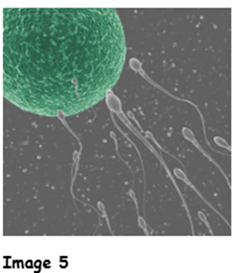
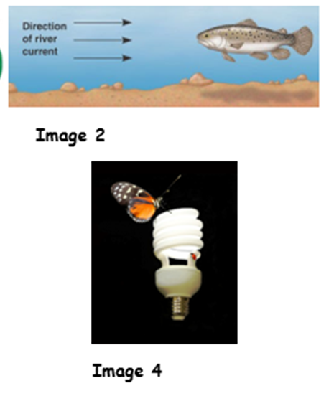
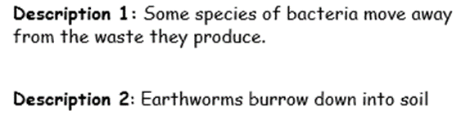
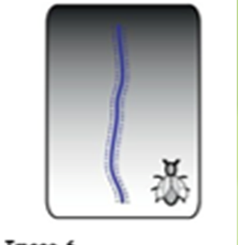
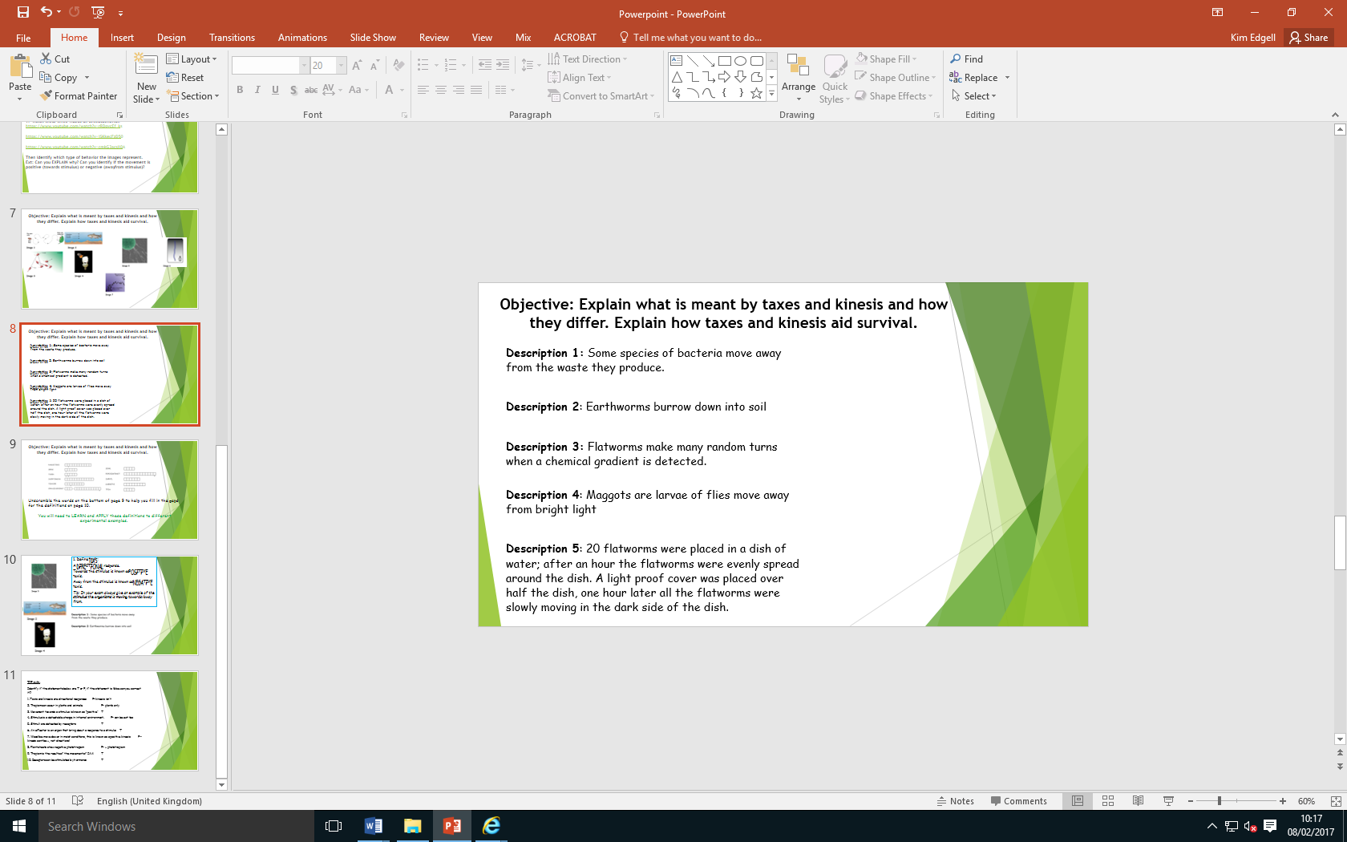
Define taxis:
A DIRECTIONAL response.
Towards the stimulus is known as POSITIVE taxis.
Away from the stimulus is known as NEGATIVE taxis.
Tip: In your exam always give an example of the stimulus the organisms is moving towards/away from.

Slide 7
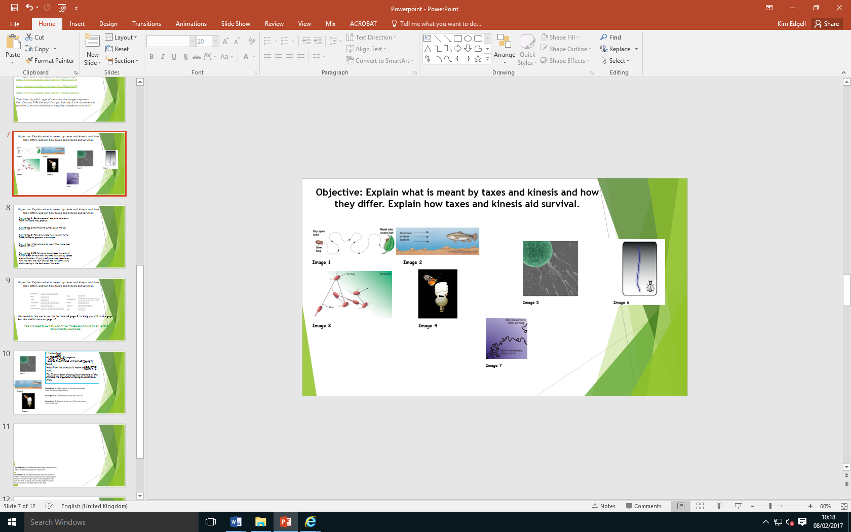
Define kinesis:
A NON-DIRECTIONAL response
Causes organism to change the SPEED of movement
In favourable conditions movement is SLOW with many TURNS
In unfavourable conditions movement is FAST with few TURNS
Tip: In your exam always give an example of the stimulus the organisms is responding to

Slide 8
Complete T/F quiz on page 4
If statement is false then you need to correct it.
1. Taxis and kinesis are directional responses F- kinesis isn’t directional
2. Tropism can occur in plants and animals. F- plants only
3. Movement towards a stimulus is known as “positive” T
4. Stimulus is a detectable change in internal environment. F- can be external too
5. Stimuli are detected by receptors T
6. An effector is an organ that bring about a response to a stimulus T
7. Woodlice move slower in moist conditions, this is known as a positive kinesis F-kinesis cant be +, not directional
8. Plant shoots show negative phototropism F- + phototropism
9. Roots show geotropism T
10. Receptors can be stimulated by hormones T
There are some exam questions to practice with in the toy box

Slide 9
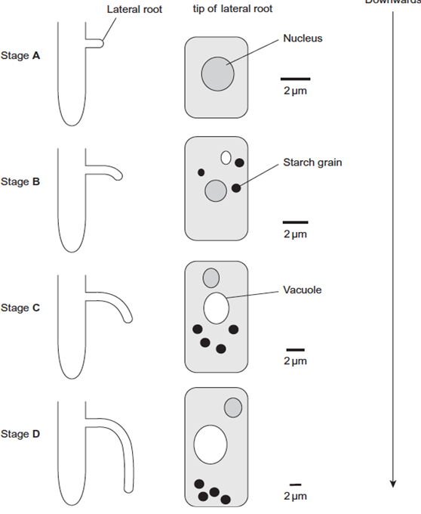
Outcome:
Describe where IAA is produced and the effect different concentrations have on root/shoot growth.
Kinesis, taxis and tropisms are responses to internal or external stimulus. You need to be able to describe the response and also be able to describe and explain how this how this response is brought about by a stimulus.
Tropism
In plants the response is a tropism, this tropism is caused by a chemical called IAA. You need to be able to describe and apply your knowledge of how IAA causes tropism.

Slide 10

Outcome:
Describe where IAA is produced and the effect different concentrations have on root/shoot growth.
Tropism
You must learn this table then apply the knowledge to data provided in the question. Read the information then add details to the diagrams on page 5
Phototropism | Gravitropism/Geotropism
Cell at shoot tip produce IAA IAA diffuses down all regions of shoot Direction of light affects diffusion of IAA. IAA diffuses away from light IAA concentration build up on shaded side of shoot. IAA causes cell elongation. Shaded side of shoot elongated faster than non-shaded side. Shoot tip bends towards light. | Cell at root tip produced IAA IAA diffuses down all regions of root. Gravity causes movement of IAA from upper to lower side of root cells. IAA concentration build up on lower side of root. IAA inhibit cell elongation. Lower side of root elongates slower than upper side of root. Root tip bends downwards deeper into soil.

Slide 11
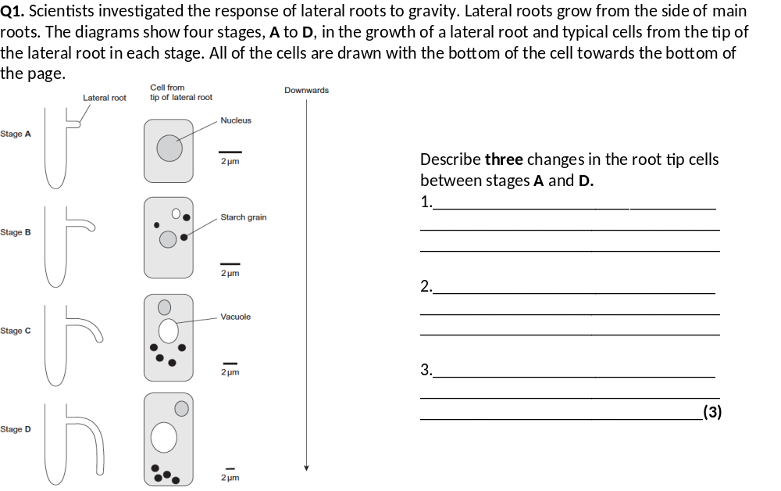
Outcome:
Apply knowledge of kineses and IAA to draw and explain conclusions with appropriate stat tests.
Complete tropism application questions on page 6-7 and taxis, kinesis application questions on page 8-9

Slide 12
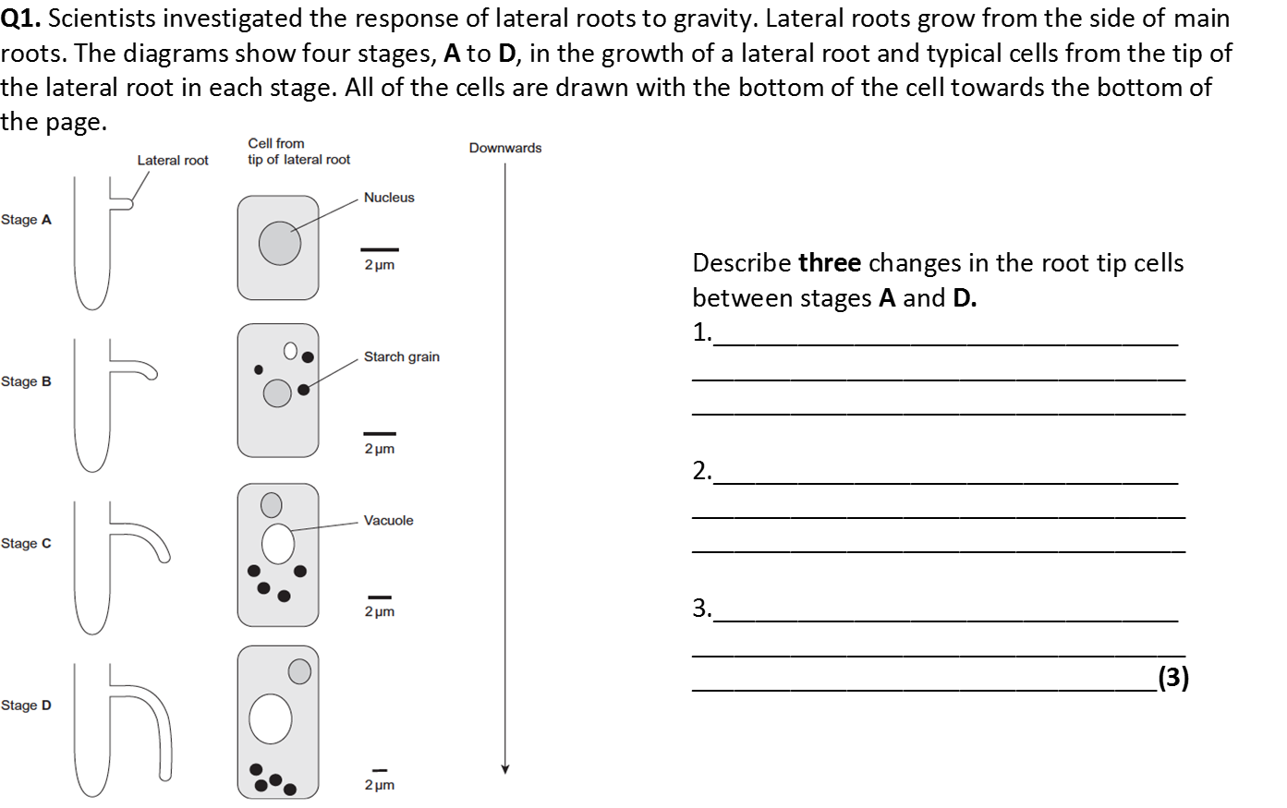
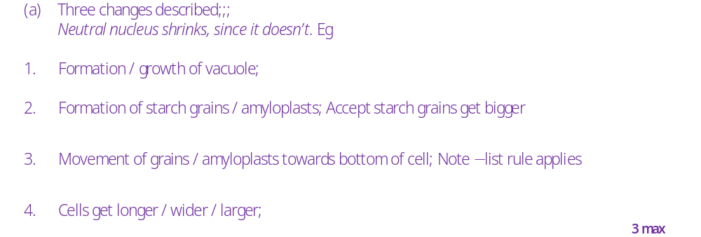

Slide 13
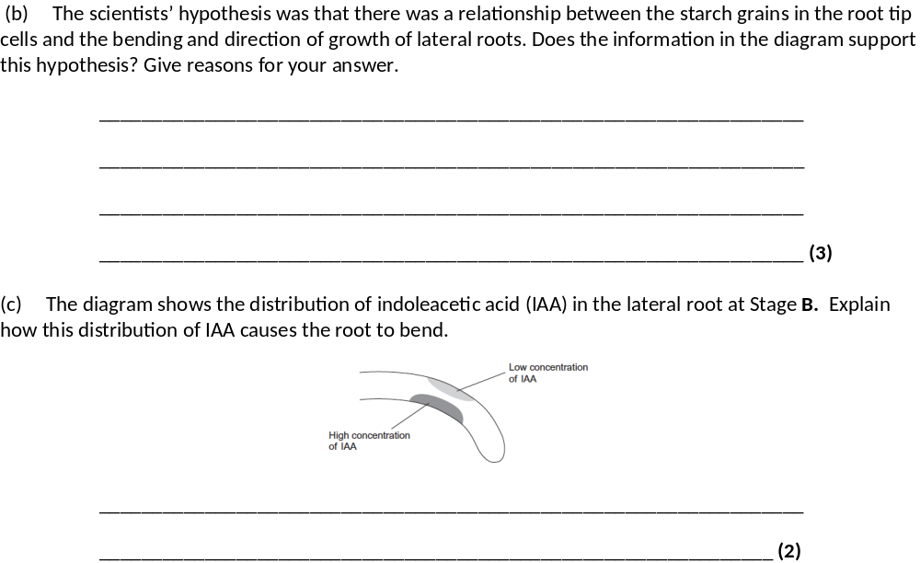
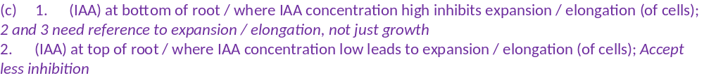
(b) 1. Grows sideways before starch grains form;
2. Bending starts when / as grains form;
3. More bending as grains increase in number; Ignore starch grain growth references
4. More elongation (of cells) / growth (of roots) downwards as starch grains increase / move;
5. Bending starts before grains move down;
6. Could be related to vacuole; Ignore references to nucleus

Slide 14
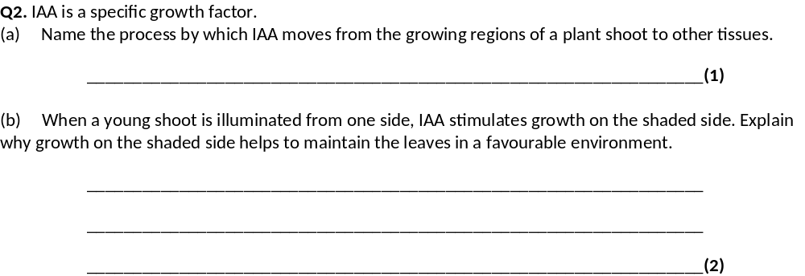
Diffusion
(b) 1. Causes plant to bend / grow towards light / positive phototropism;
2. (Light) required for photosynthesis;

Slide 15
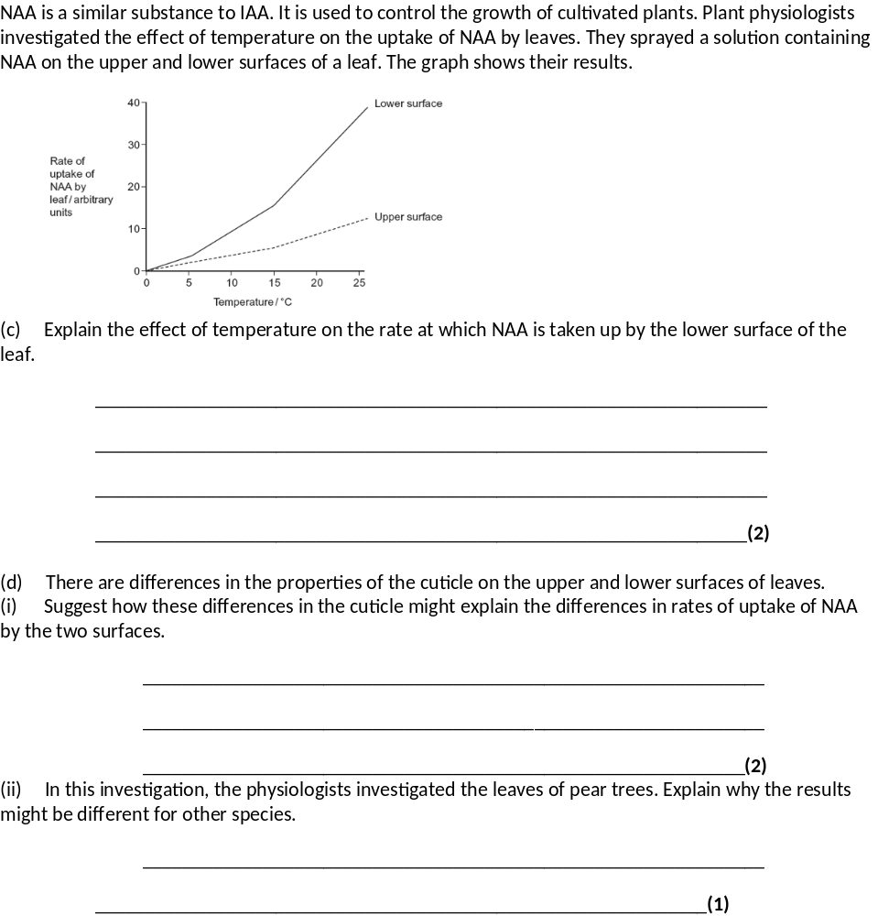
1. More kinetic energy / faster movement of molecules;
2. More diffusion;
Ignore references to opening stomata.
1. Thick cuticle on upper surface / thin cuticle on lower surface / few stomata on upper surface / no stomata on upper surface;
2. More diffusion / shorter diffusion pathway (on lower surface);
1. Ignore cuticle only on upper surface. Ignore references to more or less waxy.
Different species have different (qualified) properties;
Eg cuticle thickness, Leaf size, Number of stomata

Slide 16
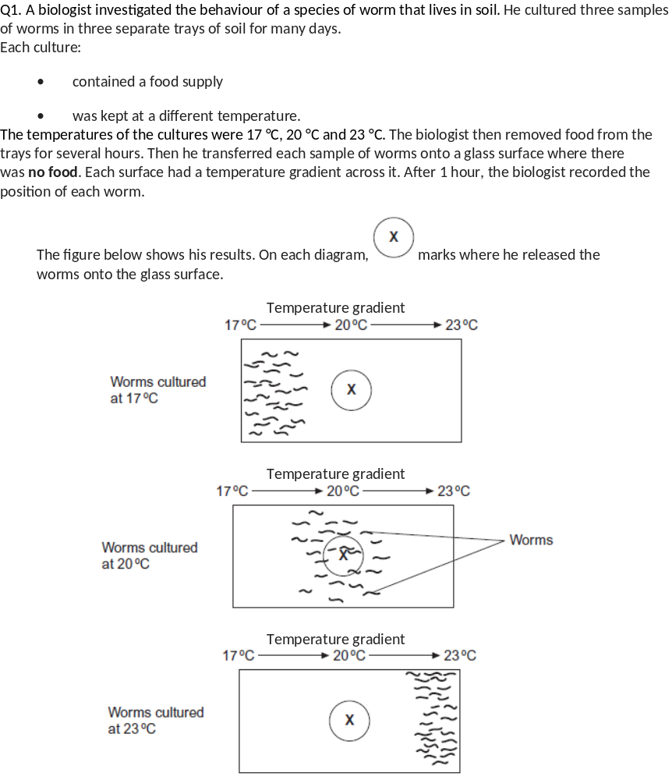
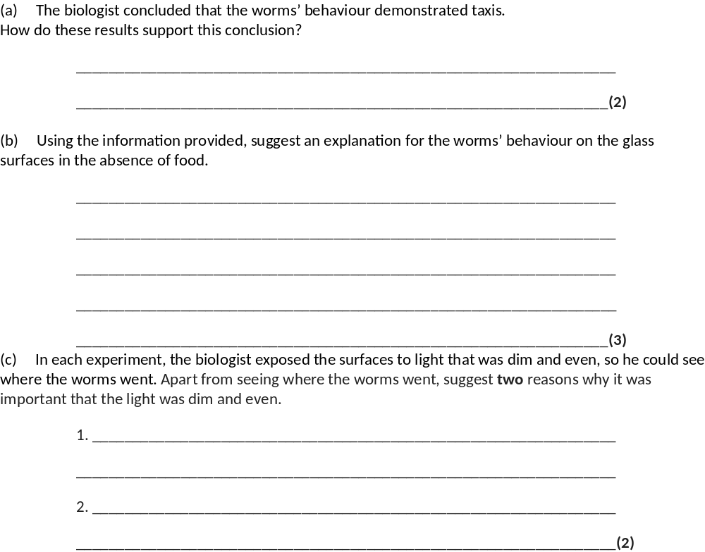
(a) 1. (Taxis is) movement towards / away from a stimulus / a directional response / movement (to a stimulus);
2. (Move towards) temperature they were used to / cultured in;
2. (Move towards) temperature they were used to / cultured in;
(b) 1. Hungry, so seeking food / in absence of food respond to temperature;
Ignore references to temperature and enzymes
Must be stated not inferred from other statements
2. Move towards temperature they were used to / cultured in;
3. Associate (this temperature) with food;
Accept they think food is here
Stated not inferred
4. (Then) stay in this temperature;
(c) 1. (Dim) worms live in soil / dark / affected by bright light / dim light is like normal environment / what they are used to;
2. (Even) because worms might move towards / away from bright light / to avoid creating light gradient / prevent worms showing phototaxis / all parts of surface exposed to same light;
Accept to avoid kinesis due to light
3. (Dim light) ensures heat from light not a variable / heat from lamp could kill / dry out worms;
Not just to control variables / factors

Slide 17
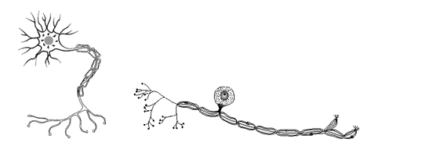
Outcome:
Explain the role of reflexes and why they are important.
Explain the role of sensory, intermediate and motor neurones in a reflex arc and explain the sequence of events which bring about a reflex action.
Explain the features of sensory reception which are common to all receptors.
Kinesis, taxis and tropisms are responses to internal or external stimulus. You need to be able to describe the response and also be able to describe and explain how this how this response is brought about by a stimulus. You also need to be able to describe and explain how more complicated organisms have more complicated response systems.
In organisms the responses are brought about by the nervous and hormonal system. You need to understand the gross structure of the nervous system.

Slide 18
Structure of the nervous system
Complete the table on page 10 by filling in the term
Add details from the definitions on page 10 to the diagrams on page 11. Helps your brain understand the definitions better by changing the form of the definition
Complete connecting sentences from page 10 in boxes on page 11. Develops your understanding of terms and connections

Slide 19
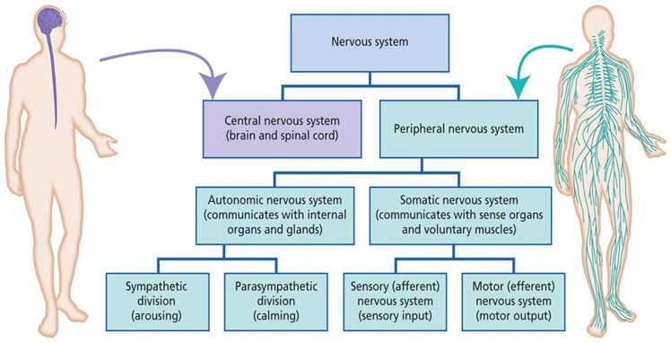
Term | Definition
Motor neuron | A neurone that transmits an action potential from the central nervous system to an effector
Somatic NS | Carries nerve impulses to body muscles which are under conscious control.
Central NS | Spinal cord and brain.
Sensory Neuron | A neurone that transmits an action potential from a sensory receptor to the central nervous system
Reflex arc | Pathway of neurones involved in an involuntary response to sensory stimulus.
Peripheral NS | Neurones radiating out from the spinal cord to the rest of the body
Autonomic NS | Carries nerve impulses to glands, smooth or cardiac muscles which are not under conscious control, involuntary.
Sympathetic NS | Increases heart rate by sending more impulses to excite the SAN
Parasympathetic NS | Decreases heart rate by sending more impulses to inhibit the SAN

Slide 20
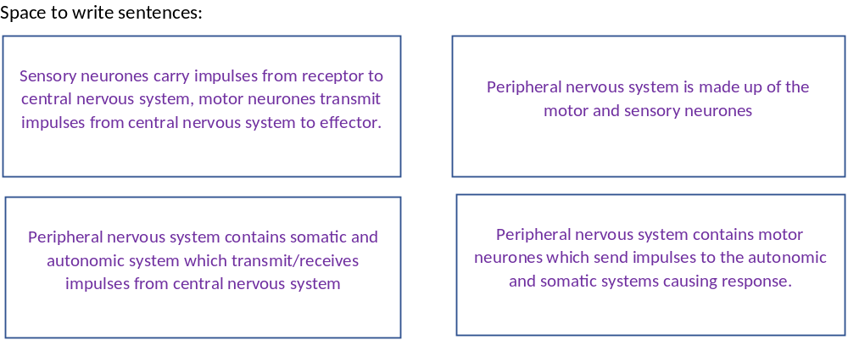
Some sentence examples:

Slide 21
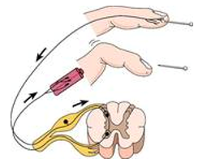
Reflex Arc
Features/importance of a reflex arc:
Rapid
Protect body tissues
Doesn’t need to be learnt/involuntary
Help escape predators/find food sources
Enables homeostasis
On other mark schemes the wording might be slightly different or including other points, these are points common to all available mark schemes
Sensory neurone
Stimulus/receptor
Complete exam question on page 12 in booklet
Effector
Motor Neuron
Inter/relay neuron
Spinal cord

Slide 22
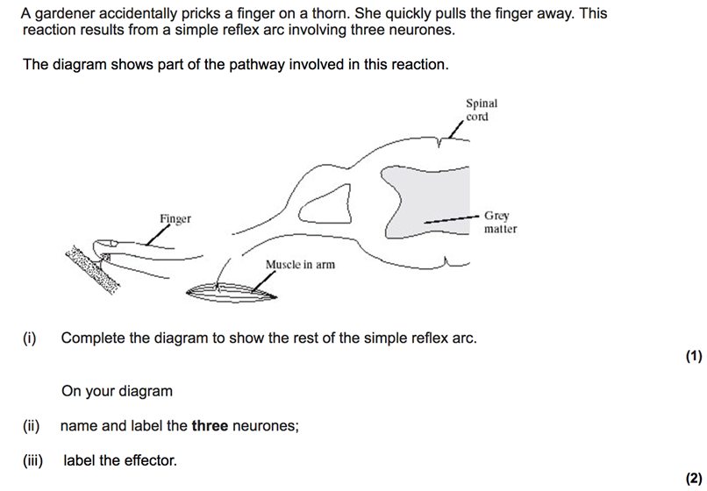
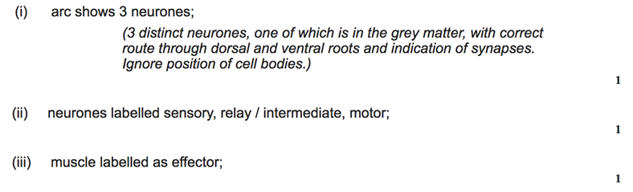
Sensory neuron
Inter/relay neuron
Motor neuron
Muscle is effector

Slide 23
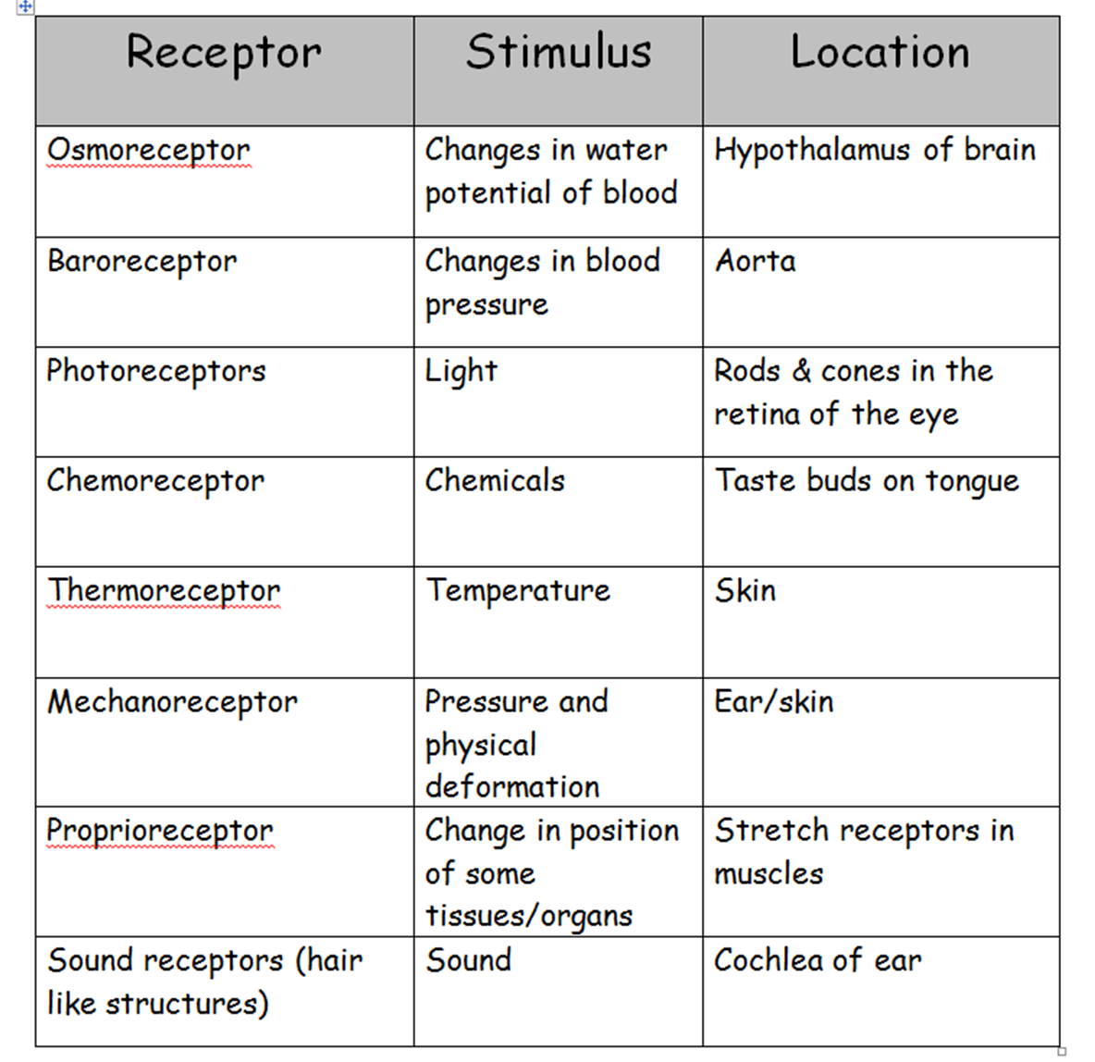

At the beginning of all responses is a receptor. Your body has lots of different types of receptors.
Have you tried the receptor sort card activity?
This is not in your booklet as there are only some of these receptors that we will learn about

Slide 24

All RECEPTORS have 2 common feature:
Specific to a single type of stimulus
Produces a generator potential by acting as a transducer.
From the nerves booklet can you remember the definitions:
Transducer: Converts between different forms of energy
Generator potential: depolarisation of the membrane of a receptor cell as a result of stimulus till threshold is reached.

Slide 25
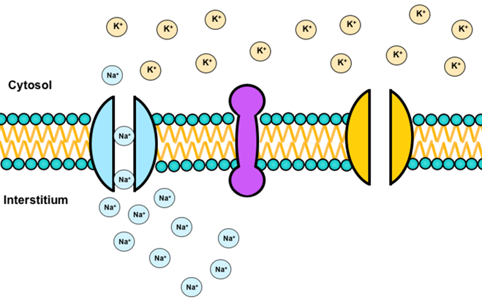
Nervous system recap activities.
From memory can you write out mark scheme perfect answers for the action potential stages below on spare paper.
Depolarisation (3 marks)
Repolarisation (3 marks)
Hyperpolarisation (3 marks)
Na+ channel open. Some Na+ diffuse into cell
Threshold potential is reached, more Na+ channels open
Membrane is depolarised, less negative inside cell than outside cell
Na+ channel close, K+ channel open, K+ diffuses out of cell
Membrane is repolarised, more negative inside cell than outside cell
More K+ channels open causing inside cell to become more negative.
K+ channels close,
Na+/K+ pump actively transport 3 Na+ out of cell and 2 K+ into cell
Re-establish concentration gradient back to resting potential.

Slide 26
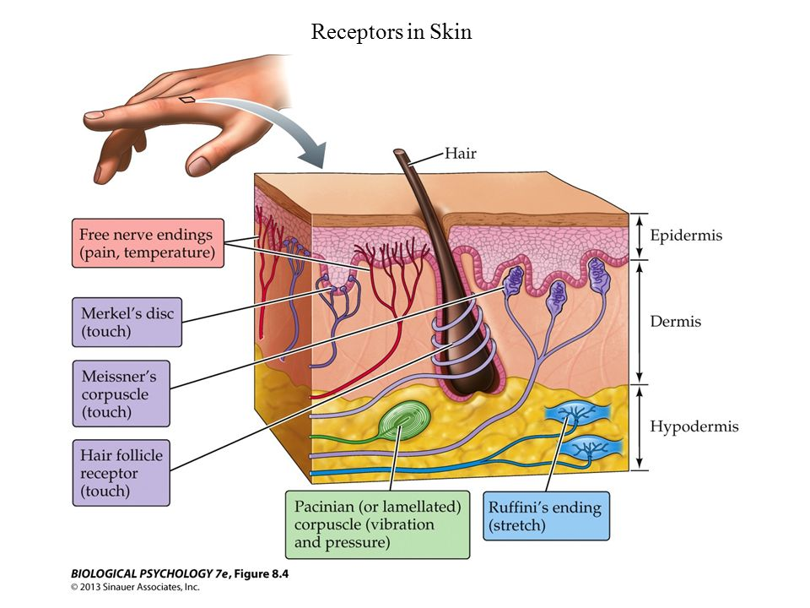
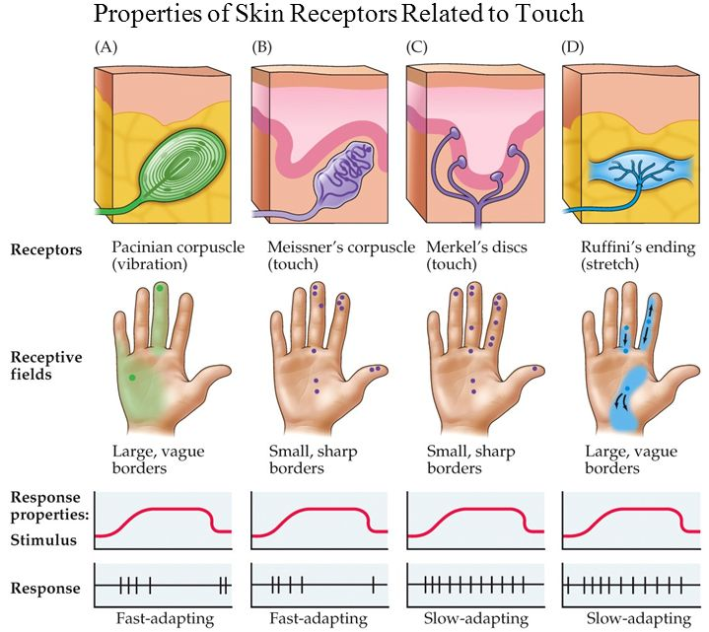
Outcome:
Describe the structure of a Pacinian corpuscle and explain the stimulus which Pacinian corpuscles respond to produces a generator potential in a response to a specific stimulus.
Pacinian corpuscle are found in the skin and are a type of pressure receptor. The images below compare different pressure receptors found in the body

Slide 27
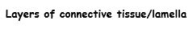
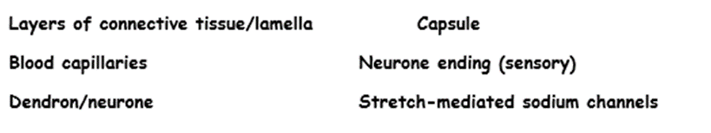
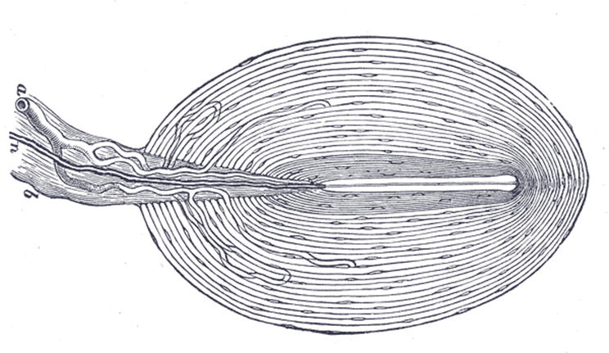
The image below is a hand drawing of what the Pacinian corpuscle looks like. Read page 337-338 in the textbook and add the following labels.
Layers of connective tissue/lamella Capsule Blood capillaries
Neurone ending (sensory) Stretch-mediated Na+ channels Dendron/neurone

Slide 28
Apply your knowledge of how neurones work.
The first sentence has been given to you and you can use page 337-338 in the textbook. Can you produce a description of how the Pacinian Corpuscle works?
Can you condense it to 60-70 words?
We will compare this to a mark scheme perfect answer
Statement
At rest stretch mediated sodium ion channels in the Pacinian Corpsule are closed
Check your description against the answer on page 14 in your booklet.
How did you do? Did you include the key terms? Was it too brief, to long?

Slide 29
Description
At rest stretch mediated Na+ channels in the Pacinian Corpuscle are closed.
Pressure applied to corpuscle.
Lamella become DEFORMED.
Membrane around neurone stretches.
Causes the stretch-mediated Na+ channels to open.
Na+ diffuses into neurone down concentration gradient.
Produces generator potential. If generator potential is sufficient an action potential passes along the sensory neurone. Greater pressure opens more Na+ channels

Slide 30
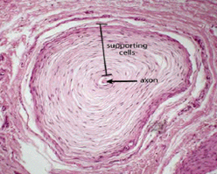
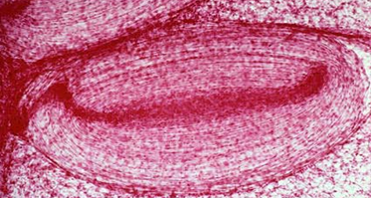
Not all images in the exam will be the same. You will need to be able to identify the corpuscle from any image. You have 2 additional images below.
Describe 2 features that would identify these are the Pacinian corpuscle.
Transverse section.
Lamella around central axon
Longitudinal section.
Oval shaped with layered lamella

Slide 31
Activity: T/F quiz. If the answer is false can you correct it?
Receptors can be triggered by multiple stimuli
Receptors are transducers so are able to convert electrical energy into chemical energy.
The generator potential means an action potential will always be the same size even if the strength of the stimulus is different.
Strength of stimulus is detected by frequency of action potential. Weak stimuli produce a large number of action potentials, strong stimuli produce a small number of action potentials.
Potassium ions channels open during depolarisation
The resting potential is maintained by the sodium/potassium pump
Sodium ions open when the Pacinian corpuscle is stimulated
Pacinian corpuscles can be found in tendons and ligaments to inform the body which joints are changing direction
Sodium and potassium ions cannot diffuse through the membrane because they are polar
Pacinian corpuscles are able to transduce mechanical energy into electrical energy.
F – specific stimuli
F – can be different forms of energy
F- Description of an action potential
F- Wrong way round.
F- Na+ channels
T
F- Stretch mediated Na+ channels open
T
T
T

Slide 32
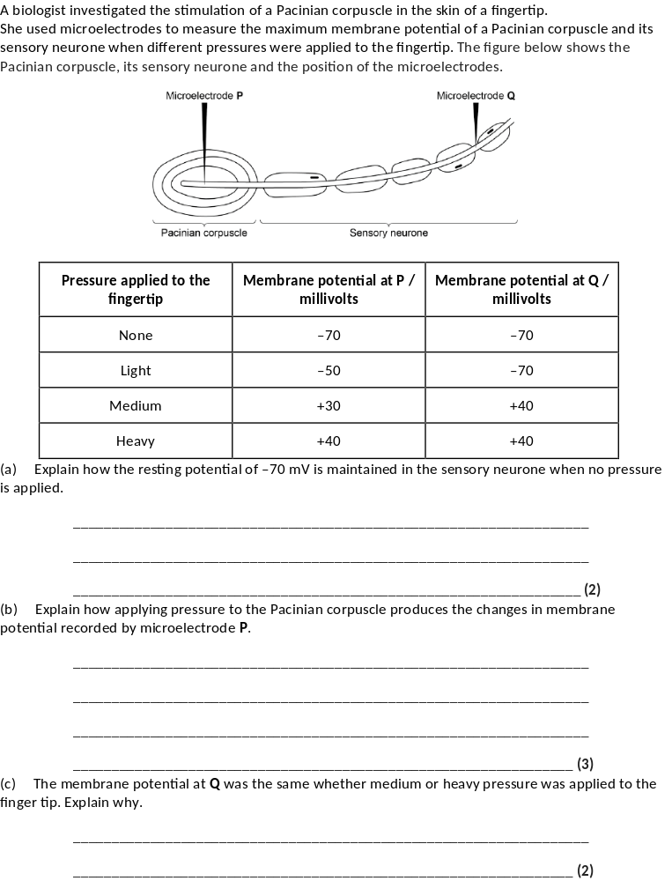
Apply your knowledge to the exam question on page 15 in your booklet.
How much can you answer without having to look at your notes?

Slide 33
1. Membrane more permeable to potassium ions and less permeable to sodium ions;
2. Sodium ions actively transported / pumped out and potassium ions in.
1. (Pressure causes) membrane / lamellae to become deformed / stretched;
2. Sodium ion channels in membrane open and sodium ions move in;
3. Greater pressure more channels open / sodium ions enter.
1. Threshold has been reached;
2. (Threshold or above) causes maximal response / all or nothing principle.

Slide 34
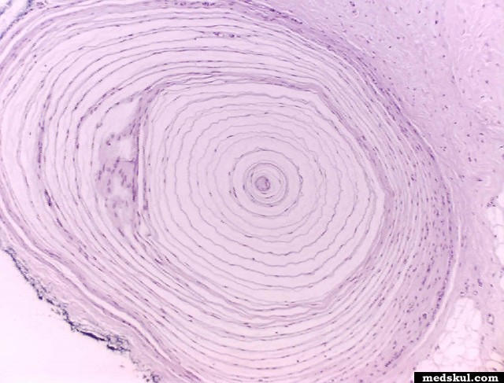
Starter
Recognise this receptor?
Remember how it works?

Slide 35
Description
At rest stretch mediated Na+ channels in the Pacinian Corpuscle are closed.
Pressure applied to corpuscle.
Lamella become DEFORMED.
Membrane around neurone stretches.
Causes the stretch-mediated Na+ channels to open.
Na+ diffuses into neurone down concentration gradient.
Produces generator potential. If generator potential is sufficient an action potential passes along the sensory neurone. Greater pressure opens more Na+ channels

Slide 36
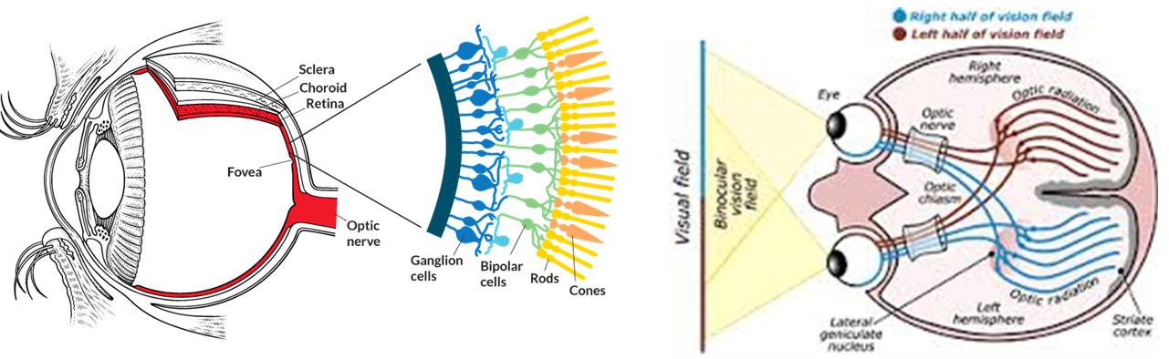
https://learn.genetics.utah.edu/content/senses/seeapp/
Photoreceptors in the retina of the eye detect light energy and transduce this into chemical energy to send impulses to the brain to be interrupted into images.
There are two types of photoreceptor
Rods: Detect light intensity using pigment called Rhodopsin
Cones: Detect light colour using pigment called Iodopsin.
You need to understand, describe and explain how the photoreceptors work.

Slide 37
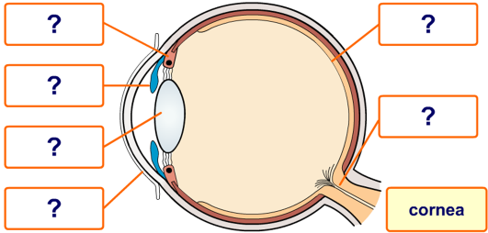
Eye structure.
You do not need to be able to label the diagram of an eye but it is important to understand its structure.
Skill practice: Comprehension skills- paper 2
Read the information on the next slide which describes the pathway of light through the structure of the eye. Use this and the labels provided on page 16 to label the diagram of the eye on page 16.
Use the labelled diagram and the comprehension to apply your knowledge to the quick fire questions on page 17. These are not exam questions so you do not need to learn them.

Slide 38
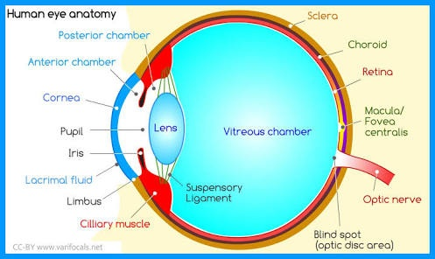
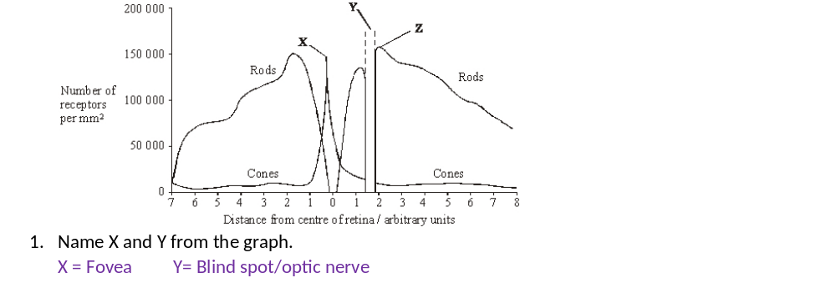

Comprehension: Pathway of light through the structure of the eye.
Light enters the eye through the Cornea, a clear curved layer at the front of the eye. This layer is used to help focus light onto the Retina where the photoreceptors are found. The light then passes through the Pupil. The Pupil is the black hole in the centre of the coloured Iris directly behind the Cornea. The Iris uses Ciliary muscles to change the size of the Pupil and control the amount of light entering the eye and hitting the Retina. If the Pupil is dilated, more light is able to pass into the eye and hits the Retina. If the Pupil is constricted, less light is able to pass into the eye and hits the Retina. The light then hits the lens which is directly behind the Pupil. The Lens changes shape using Ciliary muscles to focus light onto the Retina. To focus on objects nearby the Lens will be thicker, to focus on objects in the distance the lens will be thinner. Finally light passes through clear Aqueous humors and hits the Retina, this is where the photoreceptors are located. The Retina has Rod and Cones cells. The Cones are clustered in a region directly opposite the Lens called the Fovea, this is a dip in the Retina. The Rods are clustered around the Fovea and across the Retina, there are many more Rods than Cones. All the photoreceptors pass impulses to neurones which join into the Optic nerve. Where the Optic nerve leaves the eye is known as the blind spot as there are no photoreceptors here.
In your exam it is important to highlight the key information in the comprehension.
What do you think you should be highlighting in this comprehension?

Slide 39
Comprehension: Pathway of light through the structure of the eye.
Light enters the eye through the Cornea, a clear curved layer at the front of the eye. This layer is used to help focus light onto the Retina where the photoreceptors are found. The light then passes through the Pupil. The Pupil is the black hole in the centre of the coloured Iris directly behind the Cornea. The Iris uses Ciliary muscles to change the size of the Pupil and control the amount of light entering the eye and hitting the Retina. If the Pupil is dilated, more light is able to pass into the eye and hits the Retina. If the Pupil is constricted, less light is able to pass into the eye and hits the Retina. The light then hits the lens which is directly behind the Pupil. The Lens changes shape using Ciliary muscles to focus light onto the Retina. To focus on objects nearby the Lens will be thicker, to focus on objects in the distance the lens will be thinner. Finally light passes through clear Aqueous humors and hits the Retina, this is where the photoreceptors are located. The Retina has Rod and Cones cells. The Cones are clustered in a region directly opposite the Lens called the Fovea, this is a dip in the Retina. The Rods are clustered around the Fovea and across the Retina, there are many more Rods than Cones. All the photoreceptors pass impulses to neurones which join into the Optic nerve. Where the Optic nerve leaves the eye is known as the blind spot as there are no photoreceptors here.
In your exam it is important to highlight the key information in the comprehension.
What do you think you should be highlighting in this comprehension?

Slide 40
Comprehension: Pathway of light through the structure of the eye.
Light enters the eye through the Cornea, a clear curved layer at the front of the eye. This layer is used to help focus light onto the Retina where the photoreceptors are found. The light then passes through the Pupil. The Pupil is the black hole in the centre of the coloured Iris directly behind the Cornea. The Iris uses Ciliary muscles to change the size of the Pupil and control the amount of light entering the eye and hitting the Retina. If the Pupil is dilated, more light is able to pass into the eye and hits the Retina. If the Pupil is constricted, less light is able to pass into the eye and hits the Retina. The light then hits the lens which is directly behind the Pupil. The Lens changes shape using Ciliary muscles to focus light onto the Retina. To focus on objects nearby the Lens will be thicker, to focus on objects in the distance the lens will be thinner. Finally light passes through clear Aqueous humors and hits the Retina, this is where the photoreceptors are located. The Retina has Rod and Cones cells. The Cones are clustered in a region directly opposite the Lens called the Fovea, this is a dip in the Retina. The Rods are clustered around the Fovea and across the Retina, there are many more Rods than Cones. All the photoreceptors pass impulses to neurones which join into the Optic nerve. Where the Optic nerve leaves the eye is known as the blind spot as there are no photoreceptors here.
In your exam it is important to highlight the key information in the comprehension.
What do you think you should be highlighting in this comprehension?

Slide 41
Describe the appearance of the pupil and lens when you are driving at night. Explain your answer.
The aqueous humor is a transparent jelly like substance. Suggest why.
Transparent to let maximum light through to the Retina
Jelly to maintain pressure/eye shape/eye structure/protect retina against mechanical damage
Cones are clustered in the Fovea and are used to detect colour vision. Suggest why the cones are located directly behind the lens.
Colour vision is mostly used in the day
More light in the day to pupil will be smaller
Light more focused
Fovea is directly where the light is focused on the Retina.
X= Fovea Y= Blindspot/ Optic Nerve.
Describe | Explain
Pupil will be larger/bigger | Allow more light to pass into retina as there is less light in the dark.
Lens will be thinner | To focus on objects in the distance

Slide 42
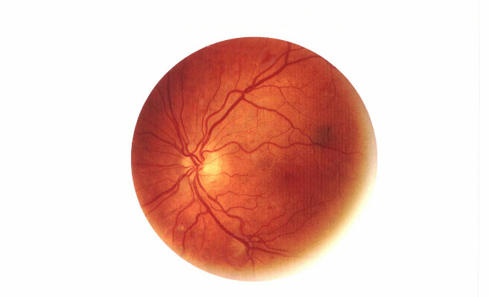
Where is the optic nerve and blind spot on this photograph?
Why is there a good blood supply?

Slide 43
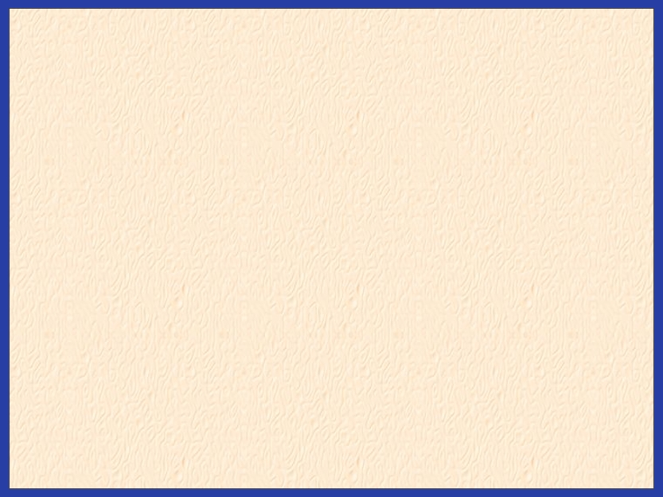
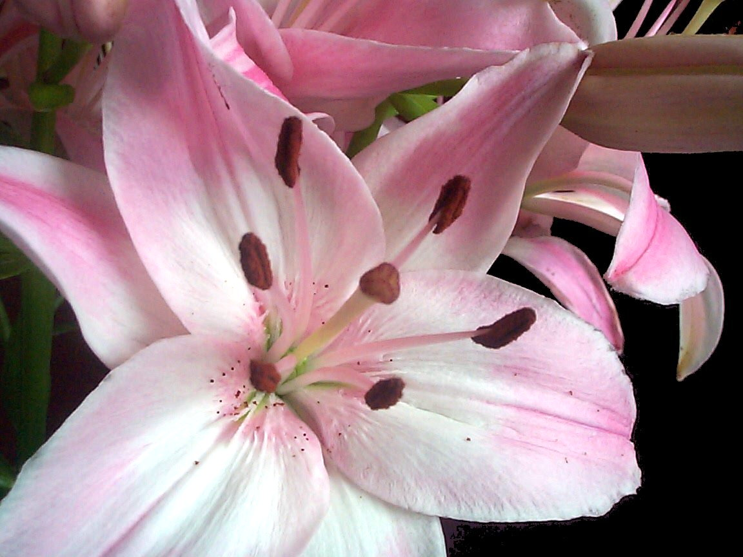
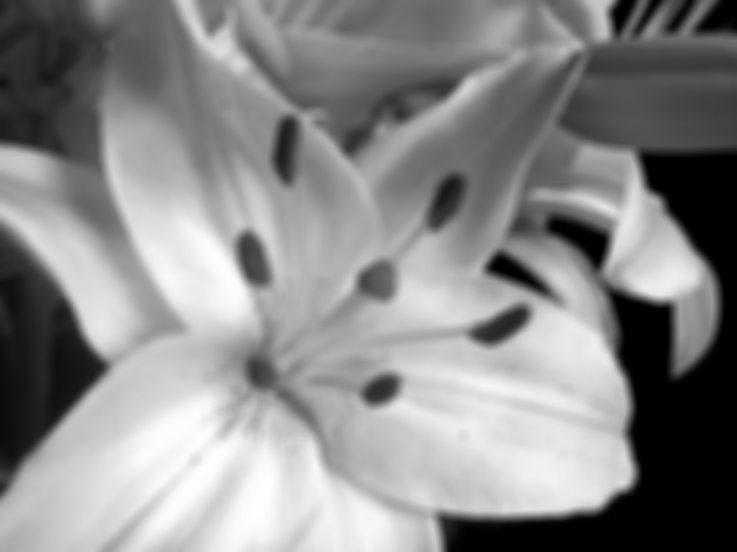

Visual Acuity and Sensitivity
Cones
Discrimination of colour
Good visual acuity
Poor sensitivity
Rods
Monochromatic vision
Poor visual acuity
Good sensitivity
Retinal convergence, summation and amplification are the features that explain these different characteristics of rods and cones

Slide 44

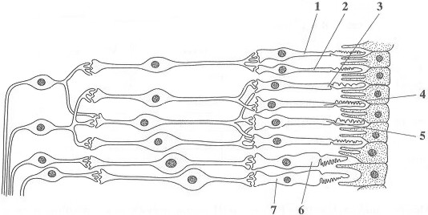
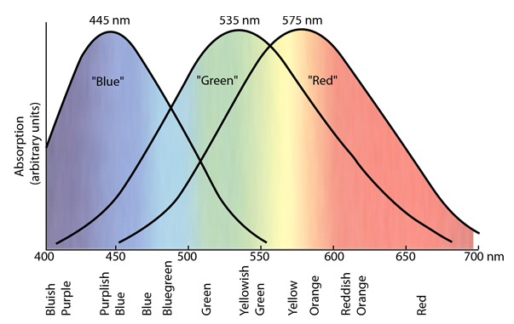
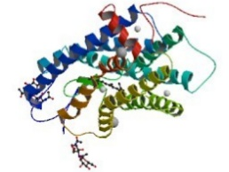
Photoreceptors:
Visual acuity?
Rods have a low visual acuity, many rods synapse onto 1 bipolar cell so many rods need to be stimulated to produce 1 action potential in 1 bipolar cell. Not able to distinguish between different points of light.
Each Cone is synapsed onto 1 bipolar cell so only 1 Cone needs to be stimulated to produce an action potential in 1 bipolar cell. Able to distinguish between separate points of light and different wavelength stimulate different cones so are able to identify colour of light.
How do the pigments work?
Iodopsin/Rhodopsin Opsin + Retinal
Light energy converts the pigment into opsin and retinal. When there is no light this reaction is reversed. When the pigment is converted the Rod/Cone is said to be bleached until the pigment is reformed.
Rhodopsin is very sensitive to all wavelength of light so is bleached during the day but effective in low light intensity at night
What are the pigments made of?
Rhodopsin and Iodopsin are proteins
How do the pigments detect colour?
There are 3 Iodopsin pigment
Red Cones
Blue Cones
Green cones
Each pigment is sensitive to different wavelength of light.

Slide 45
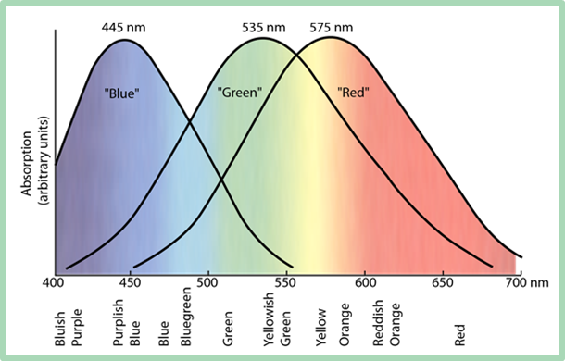
Photoreceptors:
These questions are based on exam questions
Which rods would need to be stimulated to cause an action potential in bipolar A?
Which Cone would need to be stimulated to cause an action potential in bipolar B?
These questions are not in your booklet, have a go on spare paper.
Which Cone(s) need to be stimulated to see yellow?
Which Cone(s) need to be stimulated to see light blue?
Suggest how you detect orange light.
3,4,5
Low visual acuity
7 only
High visual acuity.
Green and Red
Blue and Green
More red than green cones stimulated.
A
A
B

Slide 46
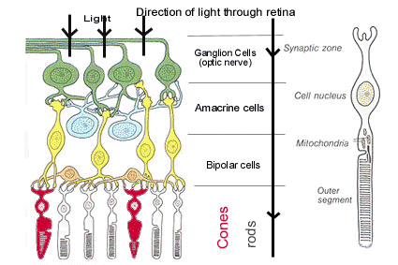
Use page 19 as a revision poster for Rods and cones.
Complete exam questions page 20 in booklet.

Slide 47
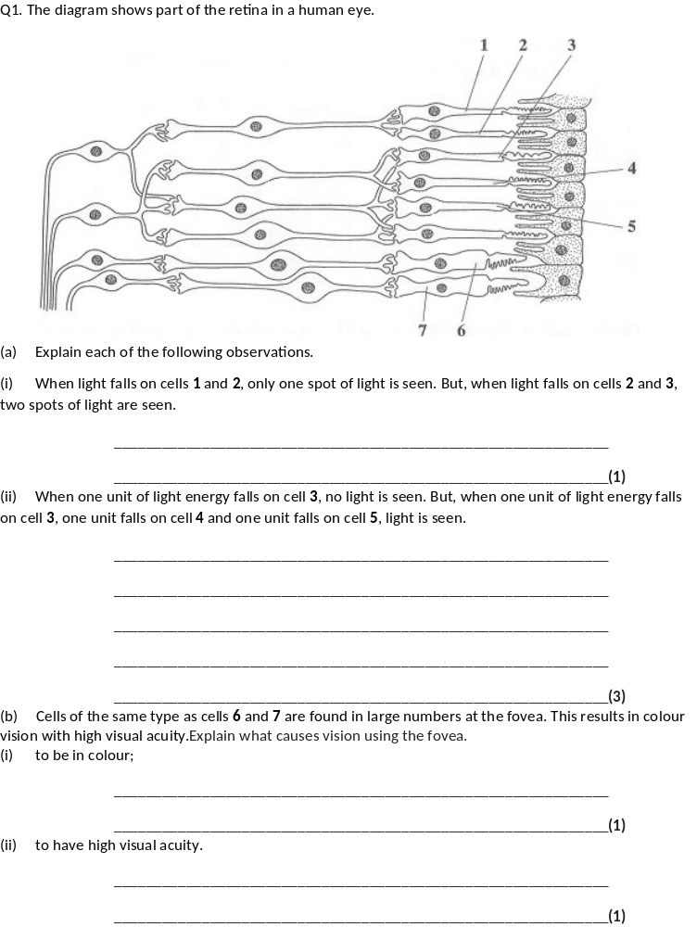


Slide 48



Slide 49

Memory task:
From Year 1 write out the cardiac cycle- Atrial systole, ventricular systole and diastole.
Use the mnemonic below to help you:
My Muscle
Parents are Pressure
Very Valves
Delightful Direction
Fill in the cardiac cycle section of the table on page 22 in your booklet.

Slide 50

On whiteboards
Can you work out how the electrical control of the heart works? The first statement has been done for you, follow the arrows looking carefully at the labels and complete the description. Check against the next slide.
Atrial Systole:
SAN sends wave of excitation across both atria causing muscle to contract
Non-conductive tissue stops excitation passing into ventricles
Wave of excitation picked up by AVN and delays excitation to allow atria to fully empty
Ventricular systole:
AVN sends wave down Purkyne fibres to apex of the heart
Wave of excitation is released by both side of the ventricles from the apex upwards causing ventricles to contract
Diastole:
Wave of excitation dissipates into the chest cavity, muscle relaxes

Slide 51
Fill in the rest of the table in your booklet.
Atrial Systole:
SAN sends wave of excitation across both atria causing muscle to contract
Non-conductive tissue stops excitation passing into ventricles
Wave of excitation picked up by AVN and delays excitation to allow atria to fully empty
Ventricular systole:
AVN sends wave down Purkyne fibres to apex of the heart
Wave of excitation is released by both side of the ventricles from the apex upwards causing ventricles to contract
Diastole:
Wave of excitation dissipates into the chest cavity, muscle relaxes

Slide 52

Sino-atrial node
Whiteboards
Without looking at your notes can you identify the mistakes below.
Wave of excitation
Atrium
Atrio-ventricular node
Bundles of His
Ventricle
Purkyne fibres
A wave of photo excitation spreads from the sinal SINO-atrial node found on the top of the left RIGHT atrium, the excitations spreads across both atria causing contraction. (3 mistakes)
A layer of non-conductive tissue between the ventricles prevents the excitation. The excitation is picked up by the atrioventicular valve NODE which passes the excitation down the septum between the atria VENTRICLES to the purky PURKINJE tissues, collectively known as the bundles of His which carry the excitation down to the apex of heart (3 mistakes).
The bundles of His release the excitation into the ventricular muscle on the left BOTH side of the heart first, this causes the ventricles to contract from the top BOTTOM upwards out of heart through veins ARTERIES. (3 mistakes).

Slide 53
Maths activity: Year 1 recap.
Complete question on page 22 of booklet.
Cardiac output = Stroke volume X heart rate.
Rearrange the equation to work out the stroke volume.
If the stroke vol = 61cm³ and the heart rate = 79 beats per minute, what is the cardiac output?
If the heart rate = 75bpm and cardiac output is 5175cm³ per min what is the stroke volume?
If stroke volume is 0.071L and cardiac output is 5538cm³ per min, what is the heart rate?
If the heart rate is 74bpm and cardiac output is 5402cm³ per min what is the stroke volume in L?
SV = CO/HR
61 X 79 = 4819 cm³/min
5175/75 = 69cm³
5538/71=78bpm
5402/74=73cm³ /1000
=0.073l
Complete exam question page 23-24 in your booklet.

Slide 54



Slide 55



Slide 56


Use page 342-343 to complete the diagrams on page 25 in your booklet

Slide 57
Complete the table on page 25 in your booklet.
Complete the revision poster on page 26
Complete the exam questions on page 27. How much can you do without looking at your notes?
Factor | Receptor and location | Effect on heart rate
Rise in blood pressure | Pressure/Baro receptors in Aorta | Increased impulse from baroreceptor to Medulla Oblongata Increased impulse via parasympethic NS to SAN Parasympathetic is inhibitory so reduces impulses from SAN Less impulses arrive to AVN Heart rate reduces
Rise in Carbon dioxide concentration/ increase in acidity of the blood | Chemoreceptors in Aorta | Increased impulses from Chemoreceptor to Medulla Oblongata Increased impulses via sympathetic NS to SAN Sympathetic is excitatory so increases impulses from SAN More impulses arrive to AVN Heart rate increases.
Remember to read the question carefully, you may need to talk about decreased heart rate or decreased carbon dioxide concentration.

Slide 58



Slide 59



