Slide 1

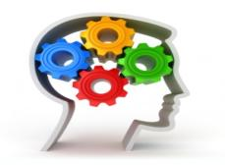
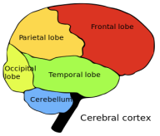
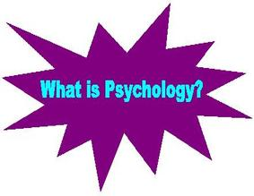
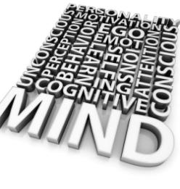
Unit 8.
Psychological perspectives for health & social care.
Understanding psychological perspectives.
( P1 & M1 )

Slide 2

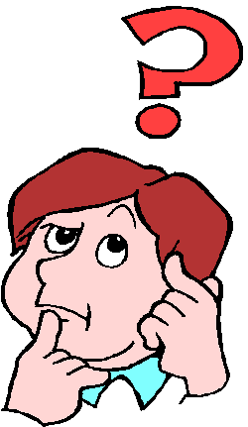


What kind of psychologist are you?
Consider the following scenario and discuss reasons for Aisha’s behaviour.
Five year old Aisha’s parents divorced a year ago. Today her dad is taking her out for the day. He arrives at the house to find his ex-wife flustered and upset because her new baby has been up all night and Aisha has refused to wear the clothes she laid out for her. The trip starts with a visit to McDonald’s, with a breakfast of chicken nuggets, chips and coke. Aisha throws a tantrum when she leaves because she wanted ice-cream but her dad refused so he promised she could have a packet of smarties in the car if she behaved well. Her mum has asked him specifically not to give her smarties because they are so sweet and sugary. Towards the end of the day, Aisha’s dad needed to get some food from the supermarket and once again Aisha throws a tantrum. He tells her if she behaves he will give her some sweets in the car on the way home.
Could Aisha’s tantrums be in anyway linked to her parents divorce? Make some suggestions about how and why their divorce may influence her behaviour.
What would you say to Aisha’s dad about giving her smarties when her mum has asked him not to?

Slide 3
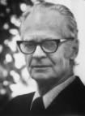

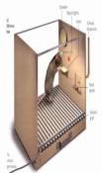
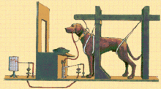
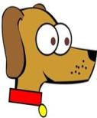
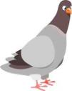
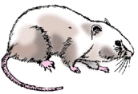
The behaviourist perspective.
The approach focuses on the fact that human behavior is learnt from experience.
Behavior is likely to be repeated if REINFORCEMENT occurs – behavior results from the consequences that we receive from that behavior.

Slide 4
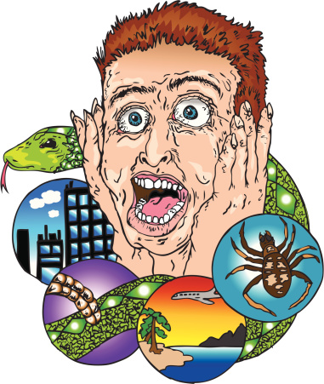
The behaviourist perspective.
Classical conditioning.
During the 1890’s, Russian psychologist Ivan Pavlov was looking into salivation in dogs in response to being fed (he was measuring the amount of saliva).
He noticed that the dogs would salivate when he entered the room, even without food!
This was the beginning of the idea of Pavlovian conditioning

Slide 5
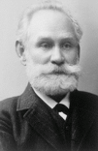
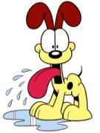
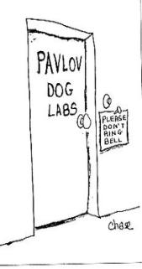
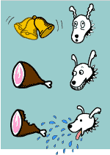
The behaviourist perspective.
Classical conditioning.
Ivan Pavlov – (1849 – 1936)
In 1927 he was working with dogs to investigate their
digestive systems.
Discovered that animal
behaviors develop through
associative learning. (Association - A mental
connection between things)
CLASSICAL
CONDITIONING
- learning to make an association
between two events

Slide 6
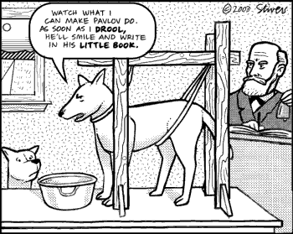
The behaviourist perspective.
Classical conditioning.
Pavlov started the idea that there are some things that a dog doesn’t need to learn.
For example, they are ‘hard wired’ to salivate whenever they see food.
This is a REFLEX response
He called this an UNCONDITIONED RESPONSE i.e a stimulus response connection that required no learning.
UNCONDITIONED STIMULUS (food)----→UNCONDITIONED RESPONSE (salivate)
Activity: Can you think of any reflexes that we as humans have? What are we born with?
https://www.youtube.com/watch?v=hhqumfpxuzI

Slide 7
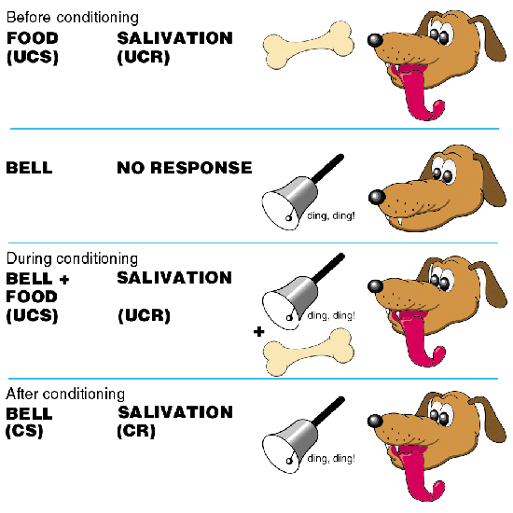
The behaviourist perspective.
Classical conditioning.
Pavlov showed the existence of the unconditioned response by presenting the dog with a bowl of food and measuring the amount of saliva it produced.
Over time, Pavlov noticed that the dog would start to salivate when the lab assistant entered the room with the food but before it actually tasted the food. Because salivation is a reflex response (which at that time was thought to be produced only when food touched the tongue), this seemed odd.
Pavlov concluded that the dog was salivating because it had learnt to associate the lab assistant with the food.
He then developed his theory

Slide 8
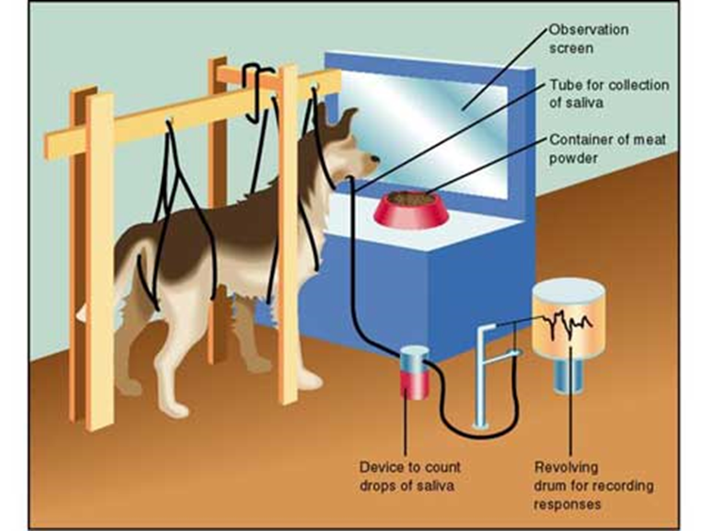
The behaviourist perspective.
Classical conditioning.
Pavlov’s experiment.

Slide 9


The behaviourist perspective.
Classical conditioning.
Key terms
Reflex | An action that is performed without conscious thought as a response to a stimulus.
Stimulus | Anything that causes a response in a human or animal
Association | A mental connection between things
Unconditioned Response. (UR) | A natural unlearned response. It is a behavior that occurs naturally (i.e. a stimulus - response connection that requires no learning)
Unconditioned stimulus. (US) | A stimulus that regularly and consistently leads to an unlearned response (natural response)
Conditioned Response. (CR) | A new learned response to what was previously a neutral stimulus
Conditioned Stimulus. (CS) | A previously neutral stimulus when paired up with a unconditioned stimulus produces a learned (conditioned) response.

Slide 10
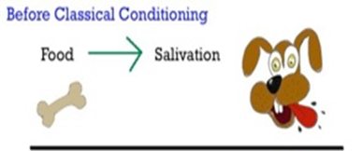
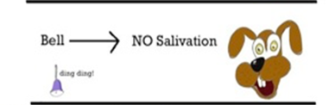
The behaviourist perspective.
Classical conditioning.
Before conditioning
UCS (Unconditioned UCR (Unconditioned
Stimulus) response )
NS (Neutral stimulus)
No response

Slide 11
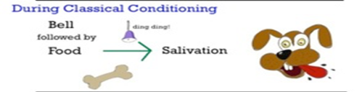
The behaviourist perspective.
Classical conditioning.
During Conditioning
UCS + NS UCR
Association

Slide 12
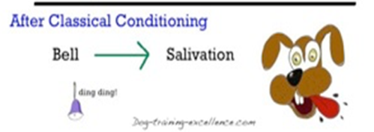
The behaviourist perspective.
Classical conditioning.
After conditioning
CS (Conditioned stimulus) CR (Conditioned response)

Slide 13
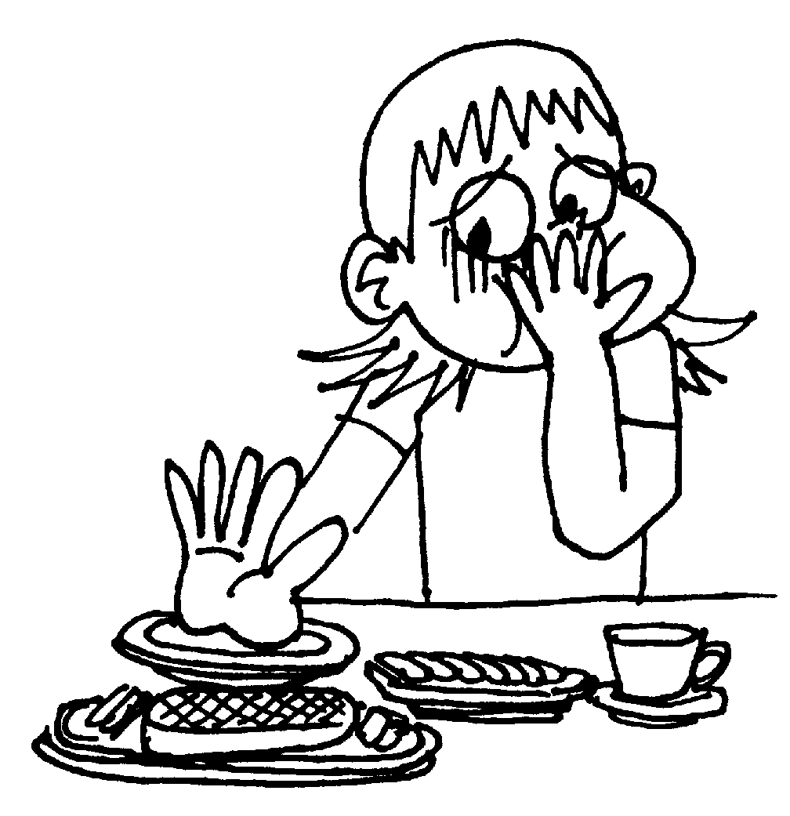
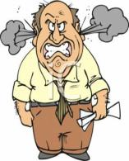
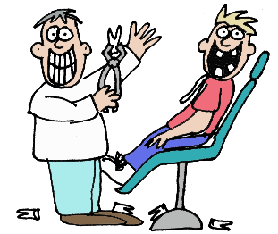
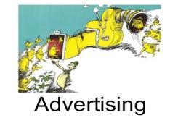


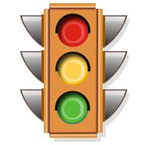
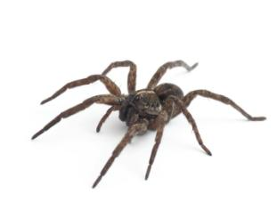
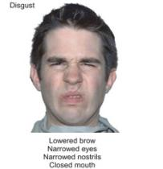
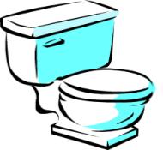
The behaviourist perspective.
Classical conditioning.
How it affects our lives.
Explain these.
Can you think of any others?

Slide 14
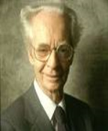
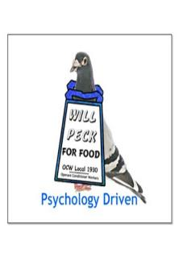
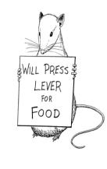
The behaviourist perspective.
Operant conditioning,
Learning Theory & Skinner.
Frederick Skinner (1904 – 1990) was a highly influential American Psychologist. He was the founder of a psychological theory called ‘BEHAVIOURISM’ (also known as ‘LEARNING THEORY’.
All behavior is learned and our behavior develops through the consequences that follow.
We are shaped by our environment – products of what happens to us

Slide 15
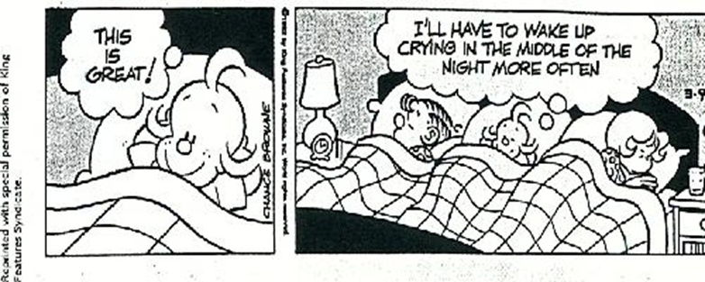
The behaviourist perspective.
Operant conditioning,
Learning Theory & Skinner.
IF behavior is rewarded or reinforced we are likely to repeat it…..

Slide 16
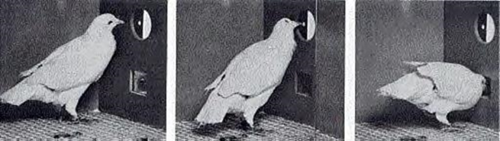
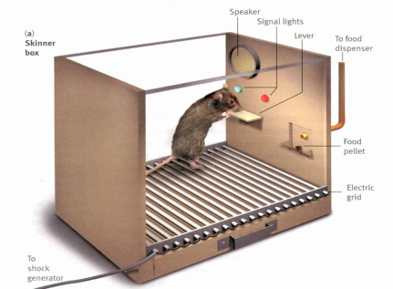
The behaviourist perspective.
Operant conditioning,
Learning Theory & Skinner.
Skinner researched his theory by using rats and pigeons. He found that they learned to press a lever that offered them food and learned to avoid a lever that punished them. He gradually trained them to distinguish between the colours of lever too using a method that is called the ‘Skinner Box’.
https://www.youtube.com/watch?v=I_ctJqjlrHA

Slide 17
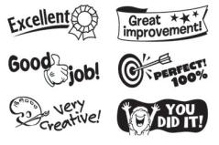


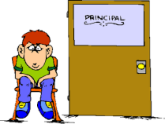
The behaviourist perspective.
Operant conditioning,
Learning Theory & Skinner.
Reinforcement
Positive reinforcement = rewarding, we are likely to repeat this behavior.
Negative reinforcement = unpleasant, we learn to avoid this.

Slide 18
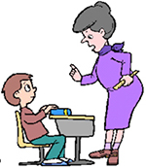
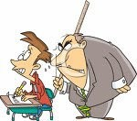
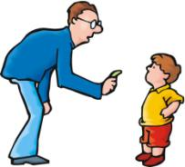
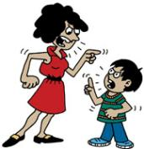
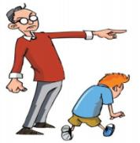
The behaviourist perspective.
Operant conditioning,
Learning Theory & Skinner.
Punishment
Punishment is the opposite of reinforcement and has the result of blocking behavior, whilst reinforcement strengthens it.

Slide 19

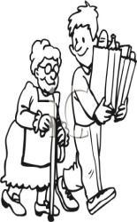
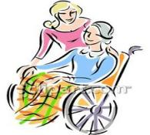

The behaviourist perspective.
Operant conditioning,
Learning Theory & Skinner.
Pro-social behaviour
Helpful behaviour intended to benefit another.
These types of behaviours develop because they are encouraged
https://www.youtube.com/watch?v=3OqkmSFO8PQ

Slide 20
The behaviourist perspective.
Assessment.
Strengths Weaknesses
Well supported by scientific research, albeit on non-humans | Ignores the role of cognition (mental processes) assumes we are shaped by our experiences and have no free will in choosing what we experience.
A powerful and plausible account of the development of human behaviour | Ignores the role of biological maturation
 | Behaviour can be learned even if it’s not rewarded.

Slide 21
The behaviourist perspective.
Assessment.
Strengths | Weaknesses
The behaviourist approach has been widely used in health care settings to successfully modify (e.g. Phobias) & motivate (e.g. Weight loss) behaviour change. | Behaviourism reduces human behaviour to a simple stimulus & response model. This fails to take into account inner mental processes or wider cultural & environmental influences on behaviour.
Behavioural assessment & treatment is relatively quick, inexpensive & solution focused. | Some care practitioners & psychologists are critical of behaviourism for being manipulative & for failing to address the underlying causes of an individual’s problems.
Changes in behaviour can be easily measured, monitored & observed. | Behavioural treatments work well in controlled environments, especially with animals. They have a limited application to the real world behaviour of human beings.

Slide 22
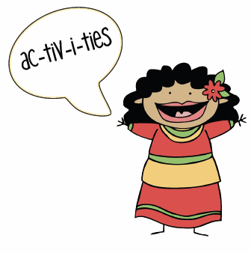
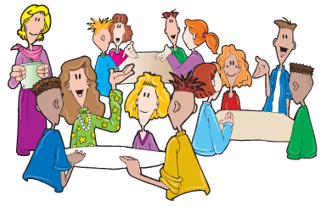




The behaviourist perspective
Complete the ‘Behaviorism in action’ handout.

Slide 23
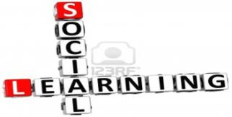
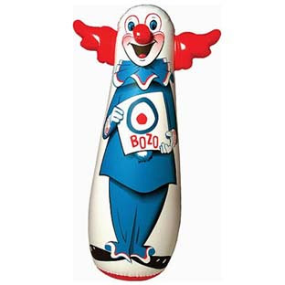
Social learning theory.
The social learning perspective (and the humanistic perspective) both focus on the psychological aspects of human relationships and on the influence other people have on our psychological development and experiences.
https://www.youtube.com/watch?v=zerCK0lRjp8

Slide 24

Social learning theory.
For learning to take place five factors must exist.
Availability: the behaviour must be performed where we can see it
Attention: must notice the behaviour to be able to remember it
Retention: must be able to remember the observed behaviour
Reproduction: must be able to perform the behaviour being observed
Motivation: must be an opportunity if we want to copy the behaviour

Slide 25



Social learning theory.
Albert Bandura.
Albert Bandura is the psychologist responsible for developing some of the principles of the social learning perspective.
He recognised that behaviourism could only explain how people learn directly through experience.
He argued that people and other animals also learn indirectly by observing and imitating the behaviour of role models such as parents, teachers, friends, peer group members, celebrities, sports performers and pop stars.
https://www.youtube.com/watch?v=6UC-4ndW0Eo

Slide 26

Social learning theory.
Albert Bandura.
Modelling
Modelling is the process of basing (modelling) our behaviour, attitude, style of dress, style of speech, even certain personality traits on someone we admire or want to be like.
The individual we base our behaviour on is known as a model, but not in the contemporary way.
https://www.youtube.com/watch?v=VBGqlflIH5s
Why do we admire people? What would we copy about someone else?

Slide 27

Social learning theory.
Albert Bandura.
Bandura argued that we learn through a process of imitating role models but we only imitate those behaviours we see as being in our interests.
For behaviour to be imitated it must be rewarded or reinforced in some way.
Bandura referred to this as vicarious reinforcement where an individual experiences reinforcement indirectly by seeing their role model being reinforced.

Slide 28


Social learning theory.
Albert Bandura.
An example of vicarious reinforcement would be when children see their favourite footballer get away with some foul play, score a goal and then get lots of congratulations and cheers from team mates and supporters, they may decide to copy this aspect of their admired role models behaviour the next time they play football themselves.
Role models are able to influence an individuals behaviour and identity if the individual is motivated to be more like their role model.
People are motivated to be more like their role models if they admire or desire the personal attributes or qualities associated with them,.

Slide 29
Social learning theory.
Similarity
To
Ourself.
Gender
Status
Features of a role model that may influence us to imitate.
Prestige
Fame
Competence

Slide 30





Social learning theory.
Albert Bandura
The Bobo doll study.
Activity.
Research Bandura’s Bobo doll study.
Explain how the study was carried out (the methodology)
Summarise the findings of the study.
Complete the ‘Social learning and Albert Bandura’ handout.

Slide 31

Social learning theory.
The effects of groups on behaviour.
At some point you have probably had the experience of feeling that others are putting pressure on you to change your mind or to behave in a particular way.
Psychologists interested in majority influence also known as group pressure, have studied how individuals’ attitudes, beliefs and behaviours tend to conform to those of the majority.
Deutch & Gerard (1955) claim that people conform to normative influences (based on the desire to be liked and accepted) and informational influences (based on the desire to be right).
A student nurse who closely observes qualified nurses to find out how to behave on the ward or in team meetings is using informational influence to change their behaviour.

Slide 32


Social learning theory.
The effects of groups on behaviour.
Solomon Asch (1956)
A group of six stooges or confederates of the experimenter (people who were secretly play acting according to instructions) were joined by a naive participant ( a genuine participant who new nothing about the true nature of the experiment) in a task that supposedly tested visual perception.
The experimenter explained to the group of seven that the task involved stating out loud whether a target line shown matched the length of one of a set of three lines (a, b, & c.) similtaneously shown to all participants.

Slide 33

Social learning theory.
The effects of groups on behaviour.
Solomon Asch (1956)
As far as the genuine participant was concerned, all those taking part in the experiment were also naive (i.e. Were genuine participants and didn’t know what was really happening).

Slide 34

Social learning theory.
The effects of groups on behaviour.
Solomon Asch (1956)
The group was seated in a horseshoe shape, with the naive participant always the last one to be asked to make a judgement.
The procedure began with the first participant stating out loud whether the target line was equal in length to one of the specified comparison lines. The next person in the horseshoe then answered, and so on, right to the end.
This was repeated 18 times but on 12 out of 18 trails the confederates all gave the same wrong answer when the correct answer was obvious.

Slide 35



Social learning theory.
The effects of groups on behaviour.
Solomon Asch (1956)
Findings
Out of 123 naive participants 32% gave an incorrect answer eight or more times despite the fact that the correct answer was always obvious.
In interview afterwards some of the naive participants claimed that the obviously wrong answer was correct while others said they didn’t want to be the only person choosing the correct answer in case they were ridiculed or excluded by the group.
Most of the naive participants who conformed by choosing the wrong answers doubted their own judgement and thought they must be wrong if everyone else had chosen a different line.

Slide 36





Social learning theory.
The effects of groups on behaviour.
Solomon Asch (1956)
Conclusion.
https://www.youtube.com/watch?v=TYIh4MkcfJA
Asch (1956) argued that the results demonstrated that majority influence, or group pressure does affect the way that people behave. His results provide evidence that an individual can be influenced by a group.
Do you agree with this conclusion?
Have you ever been influenced by group pressure?
What does it say about the personality characteristics of those who are not influenced?

Slide 37


Social learning theory.
Effects of culture & society on behaviour.
In addition to being part of different groups in society (e.g. Family, friendship & peer groups) we all contribute to and are affected by culture and the wider society in which we live.
Culture consists partly of the shared values, norms, language, customs and practices of a group.
Social learning theory suggests that we need to understand how culture can influence behaviour to understand the people we work with.

Slide 38


Social learning theory.
Effects of culture & society on behaviour.
It is important not to assume that the behaviour of the indigenous white majority population of the UK is the norm and that deviation from this by other ethnic groups is ‘abnormal’ in some way.
Watson (1970) found that the average amount of eye contact made varied between countries, with high degrees of eye contact being seen rude by some Africans and East Asians, whereas among Indians and Latin Americans this was seen as desirable.

Slide 39

Social learning theory.
The self-fulfilling prophecy.
The concept of a self-fulfilling prophecy is linked to both social roles and the idea that other people influence and develop the way we behave.
A self-fulfilling prophecy develops when a person’s belief about themselves are internalised and then expressed in the way they relate to others.
For example, if a person develops a belief that they are not very capable, don’t deserve respect or are somehow less important than others, the way they interact may reflect this (being submissive, withdrawn and accepting of personal criticism). The response of others – perhaps dominating, taking advantage of or overlooking the persons needs - then reinforces these beliefs. The belief becomes a self-fulfilling prophecy.
https://www.youtube.com/watch?v=p9Me6ZQQUqs

Slide 40








Social learning theory.
The self-fulfilling prophecy.
People with high self-esteem, who expect to be treated favourably because they believe they deserve to be, tend to generate this behaviour from others, and visa versa for people with low self-esteem.
In both cases the ways in which people present themselves and play their social roles trigger particular types of responses from others.

Slide 41
Social learning theory.
The self-fulfilling prophecy.
My behaviour:
I am sullen, aggressive, unfriendly & hostile.
My thoughts & beliefs:
I think I am worthless; the world is full of people out to get me
Other people’s response to me:
They are cool, distant & perhaps even unfriendly & hostile

Slide 42


Social learning theory.
Role theory.
Role theory suggests that because we live in a certain culture, come from a certain religion or are friends with certain types of groups, we are influenced by these factors.
We adopt certain roles as we are expected to live up to certain expectations that go with this role.
It also suggests we change our roles to suit our environment.
So during the day you are a student, during the evening you are a daughter, or a sibling, during the weekend you may be an employee or a friend.

Slide 43



Social learning theory.
Assessment.
Strengths | Weaknesses
Recognises that the influences on human behaviour are broader and more complex then simple stimulus response factors. | Ignores the role of biology and thinking (cognition) in human learning and behaviour.
Shows how other people (role models) play a key part in the way people learn behaviour, as well as attitudes and values. | Doesn’t recognise the roles of unconscious and early experiences in understanding an individuals behaviour.
Sees the person as making some active choices (through observation and imitation) in what they learn and how they behave. | Ignores the human experience of emotions and the powerful ways they can affect learning, behaviour and development.

Slide 44




The psychodynamic perspective.
Sigmund Freud.
We are animals, driven by basic biological motives.
The emergence of society required us to bring our animal impulses under control.
Freud believed that our personality, “psyche”, contained several parts that are continually at war with each other. The conflict that arises between these parts, is what drives behavior
https://www.youtube.com/watch?v=XCtm0FSGZus

Slide 45

The psychodynamic perspective.
The importance of the unconscious mind:
Sigmund Freud.

Slide 46





The psychodynamic perspective.
The importance of the unconscious mind:
Sigmund Freud.
Freud was one of the earliest thinkers to bring to public attention the idea that we are not always aware of all aspects of ourselves.
He suggested that what we are aware of is represented in our conscious mind but that many of our memories, feelings and past experiences are locked up in a part of our mind called the unconscious.
We cannot access the contents of our unconscious minds but they often leak out in dreams and slips of the tongue.

Slide 47


The psychodynamic perspective.
The importance of the unconscious mind:
Sigmund Freud.
Freud believed that the conscious mind was like the tip of an iceberg – only a small part being available to awareness.
Part of the unconscious that we can easily access he called the pre-conscious. This contains information not yet in consciousness but that can be easily retrieved (e.g. The name of a Aunt Elsie’s cat).

Slide 48

The psychodynamic perspective.
Sigmund Freud.
The tripartite view of the mind
Freud argued that the psyche (the structure of the mind/ personality) has three distinct parts.
https://www.youtube.com/watch?v=7vFf5CS27-Y

Slide 49


The psychodynamic perspective.
Sigmund Freud.
The tripartite view of the mind
The Ego – the part of the mind whose function it is to moderate the demands of the id and the superego and prevent the superego being too harsh. It is the rational part of the mind. It operates on the reality principle.

Slide 50





The psychodynamic perspective.
Sigmund Freud.
The tripartite view of the mind
2 . The id – The part of the psyche we are born with. It is totally unconscious and exists from birth. It is focused on getting what it wants and consists of aggressive, sexual and loving instincts. It is the part of us that says ‘I want it now!’ It operates on the pleasure principle.

Slide 51



The psychodynamic perspective.
Sigmund Freud.
The tripartite view of the mind
3. The superego - roughly equivalent to a conscience, the superego consists of an internalisation of all the moral values of right and wrong we have been socialised to believe in. It also contains an image of our ideal self. The main role of the superego is to try to subdue the activity of the id

Slide 52



The psychodynamic perspective.
Sigmund Freud.
The tripartite view of the mind
The Psyche (Personality)
Id Ego Superego
(Instincts ) ( Reality) (Morality)

Slide 53



The psychodynamic perspective.
Sigmund Freud.
The tripartite view of the mind
OK Guys – I’m in charge. Anything you want has to go through me.
Healthy Psyche
Ego
Id
Superego
OK.
OK.

Slide 54



The psychodynamic perspective.
Sigmund Freud.
The tripartite view of the mind
Neurotic
Id
Ego Superego
Listen up! I’m in charge, and you are not here to enjoy yourselves. Get ready for a double-size portion of anxiety with a side order of guilt!
No fun.
>whimper<

Slide 55



The psychodynamic perspective.
Sigmund Freud.
The tripartite view of the mind
Psychotic
Id
Ego Superego
Sex! Food! Drink! Drugs! NOW!
Who turned out the lights?

Slide 56


The psychodynamic perspective.
Sigmund Freud.
The tripartite view of the mind
Psychopathic
Id Ego Superego?
OK. First, gimme food. Then I want sex – lots of it and I don’t particularly care whether it’s with a willing partner. Then I want to hurt people. Badly. Probably be hungry again after that so…
OK then. Let’s go.

Slide 57

The psychodynamic perspective.
Sigmund Freud.
Defence Mechanisms.
How does the ego resolve the conflict among its demands for reality, the wishes of the id, and constraints of the superego?
Through defence mechanisms, the psychoanalytic term for unconscious methods the ego uses to distort reality, thereby protecting it from anxiety.

Slide 58




The psychodynamic perspective.
Sigmund Freud.
Defence Mechanisms.
According to Freud, the ego has developed what he calls defence mechanisms, to cover for the wild demands of the id, which would rarely be socially acceptable.
All of the defences can be described as a combination of denial or repression with different ways of rationalization.
When we rationalize, we are distorting the facts to make the event or our own impulses less threatening; that is, diluting the anxiety to a manageable level. We often come to believe our own distortions, or excuses, or even lies.
https://www.youtube.com/watch?v=rWAJ58aqHjY

Slide 59
The psychodynamic perspective.
Sigmund Freud. Defence Mechanisms.
Examples of ego defence mechanisms
Defence Mechanism | Effect | Example
Repression | Forgetting an event or experience. | Having no recollection of a serious car crash.
Regression | Reverting to an earlier stage of development. | Wetting the bed when a sibling is born, or when school begins, having been dry before.
Denial | Pushing events or emotions out of consciousness. | Refusal to accept a substance misuse problem
Projection | Personal faults or negative feelings are attributed to someone else. | Accusing a colleague of being thoughtless when feeling this way yourself.
Displacement | Redirecting desire or other strong emotions onto another person. | Kicking the cat because your boss gave you a hard time at work

Slide 60


Slide 61


The psychodynamic perspective.
Sigmund Freud.
Defence Mechanisms
Complete the ‘Defence mechanisms’ handout.

Slide 62




The psychodynamic perspective.
Sigmund Freud.
The importance of early years experience.
From a psychodynamic perspective a person’s early childhood experiences play a crucial part in their later psychological and emotional development. Traumatic and confusing events are repressed or pushed into the unconscious because they are too painful or because the child cannot deal with them. However, the distressing feelings associated with these events don’t disappear. They ‘leak out’ in dreams, irrational behaviour and in psychological distress.

Slide 63


The psychodynamic perspective.
Sigmund Freud.
The importance of early years experience.
Psychosexual stages of development
Freud believed that personality solidifies during childhood, largely before age five. He believed that early childhood influences determined the adult personality.
Parental behavior is crucial to normal development.
Personality and mental health problems in adulthood can usually be traced back to the first five years.
He proposed five stages of psychosexual development: the oral stage, the anal stage, the phallic stage, the latency stage, and the genital stage.

Slide 64








The psychodynamic perspective.
Sigmund Freud.
The importance of early years experience
.
Psychosexual stages of development
https://www.youtube.com/watch?v=-3ogJzYYlCI
He believed that at each stage of development, children gain sexual gratification, or sensual pleasure, from a particular part of their bodies. Each stage has special conflicts, and children’s ways of managing these conflicts influence their personalities (just like the conflict between the psyche and the unconscious creates defence mechanisms….Freud loved conflict!!!).
If a child’s needs in a particular stage are gratified too much or frustrated too much, the child can become fixated at that stage of development. Fixation is an inability to progress normally from one stage into another. When the child becomes an adult, the fixation shows up as a personality trait that was a direct result of their stages of development.

Slide 65
Psychosexual stages
Stage & Age | Source of Libido and Pleasure | Conflict | Consequences of Fixation
ORAL 0-1 | The mouth. The child enjoys feeding, sucking, swallowing, putting things in mouth, etc | Forceful Feeding Deprivation Early weaning | Smoking, chewing pens & fingernails, etc. Overeating & drinking. Sarcasm & verbal hostility.
ANAL 1-3 | The anus. The child derives pleasure from expelling or withholding faeces. | Toilet training: Too harsh or Too lax | Anal retentive: obsessive, tidiness, neatness, intolerance, and passive aggression Anal expulsive: sloppiness, disorganised, defiant, recklessness & excessive generosity
PHALLIC 3-5 | The penis or clitoris. The child derives pleasure from masturbation. | Abnormal family set up leading to unusual relationship with mother or father | MEN: feelings of anxiety & guilt about sex. Fear of castration. Vanity, self obsession and narcissism. WOMEN: feelings of inferiority and envy. (Penis Envy and Oedipus)
LATENCY 5-puberty | Sexual drives are repressed. | Interacting with same sex peers | Fixation does not happen at this stage.
GENITAL Puberty-death | The genitals. The adult derives pleasure from masturbation and sexual intercourse. | Establishing intimate relationships with opposite sex | Fixation at this stage is what should happen, and indicates a well-adjusted adult.

Slide 66


The psychodynamic perspective
Erik Erikson
Psychosexual theory
Erik Erikson (1968) developed a theory of psychosexual development based on the ideas of Freud.
He believed that people experience several stages of psychosexual development throughout their lifetime (not just childhood), and that social relationships play a significant part in this.
Erikson rejected Freud’s emphasis on unconscious forces. Instead he argued that an individual’s development is motivated by a human need to be accepted by society and to live a meaningful life.
Erikson’s theory is based around the idea that people face and have to tackle a series of psychological crises in life and that each stage has a different focus.

Slide 67
The psychodynamic perspective
Erik Erikson. Stages of psychosexual development
Development stage | Key focus | Positive outcomes | Negative outcomes
Stage 1 (0 – 1 yrs) | Parenting | Dependable, responsive & caring parenting leads to trust. | Lack of warmth, affection & consistency leads to mistrust.
Stage 2 (1 – 3 yrs) | Becoming more independent. | Being supported in independence leads to autonomy. | Being criticised and over-controlled leads to self-doubt about competence.
Stage 3 (3 – 6 yrs) | Engaging with the wider world | Being encouraged to try out new skills leads to initiative. | Being restricted leads to a sense of guilt and lack of confidence.
Stage 4 (6 – 12 yrs) | Understanding how things are made and work. | Ability to succeed leads to industry. | Being pushed too hard on tasks leads to inferiority.
Stage 5 (12 -18 yrs) | Identity development | Experimentation leads to a secure identity. | Inability to experiment leads to role confusion and negative identity

Slide 68
The psychodynamic perspective.
Assessment.
Strengths | Weaknesses
Effective for treating mild, anxiety based problems but less suitable for treating more serious and enduring mental health problems. | Based on a theory and concepts that are difficult for many people to grasp and which some distrust or find hard to believe.
Recognises the influence of the unconscious and the individuals ‘inner’ mental and emotional life on behaviour, emotion and development. | Places the therapist in a very powerful position – they are seen as having the expertise to analyse and treat the individual. This may lead to abuse of power or may feel disempowering for those receiving treatment.
Aims to find and resolve the root causes of an individual’s problems. | Can be very time consuming, taking a long time to resolve an individual’s problems or reduce their distress.

Slide 69



The humanistic perspective
Humanistic psychology looks at human experience from the view point of the individual. It focuses on the idea of free-will and the belief that we are all capable of making choices.
There are parallels between the humanistic perspective and the social learning perspective as both focus on the influence of other people on our development.

Slide 70











The humanistic perspective
In the 1960’s people became sick of Freud’s negativity and trait psychology’s objectivity.
The perspective became very popular and began to influence health & social care practitioners from the mid 20th century onwards
Along came psychologists wanted to focus on “healthy” people and how to help them strive to “be all that they can be”.
Abraham Maslow (1908-1970) and Carl Rogers (1902-1987) both American psychologists are now known as the pioneers of the perspective

Slide 71


The humanistic perspective
Abraham Maslow (1908-1970) and Carl Rogers (1902-1987) both American psychologists are now known as the pioneers of the perspective.
Maslow.
Maslow believed that all humans seek to become the best that they can be – spiritually, physically, emotionally, and intellectually. He called this Self-Actualisation.

Slide 72




The humanistic perspective.
Maslow
Self-actualised people
They share certain characteristics:
They are self aware and self accepting
Open and spontaneous
Loving and caring
Not paralyzed by others’ opinions.
They are secure in who they are.
https://www.youtube.com/watch?v=L5-E7R-0hvw

Slide 73






The humanistic perspective.
Maslow & self-actualised people.
Problem centered rather than self-centered.
Few deep relationships, rather than many superficial ones.
Focused their energies on a particular task.

Slide 74

The humanistic perspective
Maslow & the hierarchy of needs.
From his theory of self-actualisation Maslow developed a theory known as The hierarchy of needs.
Every human requires certain basic needs to be met before they can approach the next level.
According to Maslow we need to progress through each level before we can reach self-actualization.
https://www.youtube.com/watch?v=O-4ithG_07Q

Slide 75

The humanistic perspective
Maslow & the hierarchy of needs.

Slide 76





The humanistic perspective
Maslow & the hierarchy of needs.
Activity
Complete the ‘Application of hierarchy of needs’ handout

Slide 77




The humanistic perspective
Maslow and self-esteem.
Self-Esteem
One’s feelings of high or low self-worth.
How valuable we feel; literally the amount of esteem we give to ourselves. Someone with high self-esteem will believe they are loved and lovable and that they are important and valued. By contrast, an individual with low self-esteem may feel themselves to be worthless, of no value to anyone else, unloved and unlovable.
https://www.youtube.com/watch?v=yLklYch5Gv0

Slide 78





The humanistic perspective
Carl Rodgers
Activity
Complete the ‘Empathy, understanding and respect’ handout

Slide 79



The humanistic perspective
Rodgers & the Self-concept
The way we see ourselves. In early life this comes from what we are told about ourselves (e.g. you’re so pretty, you’re a good footballer, what a kind girl you are, etc. ) As we grow older, our ability to think about ourselves develops and we begin to incorporate our own judgements (e.g. ‘I did well at that test - I’m good at maths’, ‘ I wasn’t invited to the party – I must be unpopular’).

Slide 80







The humanistic perspective
Rodgers & the Self-concept
If our self concept is positive….
We tend to act and perceive the world positively.
If our self-concept is negative….
We fall short of our “ideal self” and feel dissatisfied and unhappy
https://www.youtube.com/watch?v=fv1Qm6eOy3E

Slide 81







The humanistic perspective
Rodgers & the Self-concept
ACTIVITY
SELF CONCEPT – The way we see ourselves.
Take a minute to write down a description of who you are. Write about 20 statements about yourself. How many of these are positive and how many negative?
What have been the influences on your self-esteem?
How well do you accept praise?

Slide 82



The humanistic perspective
Rodgers & the ideal self
Rogers said that individuals not only have their self-concept but a concept of the self which is their ideal (IDEAL SELF).
If there’s a mismatch between how the person sees themselves how they would like to be, this can cause problems and the person will be troubled and unhappy!!!
What do you think?
https://www.youtube.com/watch?v=TqO5fnbPj6E

Slide 83


The humanistic perspective
Rodgers & the ideal self
Me
Ideal Self ? (in my dreams)

Slide 84





The humanistic perspective
Rodgers
Activity
Complete the ‘Carl Rodgers and client-centred counselling’ handout

Slide 85
The humanistic perspective.
Assessment.
(Give out ‘humanistic approach summary)
Strengths | Weaknesses
Recognises that the complexity of human emotions and relationships affect the way people develop and behave. | Based on relatively vague, unscientific concepts that can’t be tested easily.
Provides useful concepts for developing supportive and ethical human relationships. | Encourages people to focus on self-fulfilment and perfecting themselves – can be seen as narcissistic.
Sees people as capable of resolving their own problems in an individual way. | Focuses on the individual rather than on the influence of others or their broader social or cultural surroundings.

Slide 86






The cognitive/information processing perspective.
The cognitive/information processing perspective compares the human mental processes taking place in the brain to software running on a computer.
Psychologists and care practitoners using this perspective now typically study or work with people experiencing perceptual memory, language and intellectual development of thinking problems:

Slide 87

The cognitive/information processing perspective.
Cognitive skills (mental processes)

Slide 88

The cognitive/information processing perspective.
The following pictures are not animated, then why do they appear to be moving?

Slide 89

The cognitive/information processing perspective.

Slide 90

The cognitive/information processing perspective.

Slide 91

The cognitive/information processing perspective.
Can you count the black dots?

Slide 92


The cognitive/information processing perspective.
Piaget
Jean Piaget (1896-1980) was one of the 20th centuries most influential researchers in the area of developmental psychology.
He recognized there was a difference between infant, child and adult understanding of the world.
Infants have simple concepts of the world and develop more complex concepts as they get older

Slide 93






The cognitive/information processing perspective.
Piaget
Assimilation & accommodation
Infants have simple ‘SCHEMAS’ – a package of information
stored in memory e.g. sucking & grasping, basic
reflexes.
More complex schemas are developed through;
ASSIMILATION – making sense of a new situation
+
ACCOMODATION - Adjusting an existing schema

Slide 94

The cognitive/information processing perspective.
Piaget
Assimilation & accommodation
Play is very important in providing the opportunity to develop new schemas.
The type of play-things that present challenges are very useful.
This allows the child to acquire many concepts such as numbers, shapes, size, spatial relationships.
A child’s innate (genetic) ability AND the environment they are born into are important

Slide 95
The cognitive/information processing perspective.
Piaget’s stages of development
Stage | Age | Key features
Stage 1: Sensori-motor | 0-2 yrs | The world is experienced through motor activity and the senses.
Stage 2: Pre-operational | 2-7 yrs | Language develops along with memory. The child is egocentric and unable to conserve.
Stage 3: Concrete operational | 7-11 yrs | The child can now understand conversation but cannot yet solve problems mentally.
Stage 4: Formal operational | 11 + | The child can now use abstract thoughts and represent problems mentally.

Slide 96



The cognitive/information processing perspective.
Piaget’s stages of development https://www.youtube.com/watch?v=4oGnvxzOqDw

Slide 97



The cognitive/information processing perspective.
Piaget’s stages of development.
Sensorimotor (0-2)
0-8m
Mainly reflex responses
8m+
Object permanence
develops
Little evidence
of thinking
processes
Child deals with the world through
sensations e.g. crying, noise, comfort

Slide 98


The cognitive/information processing perspective.
Piaget’s stages of development.
Preoperational stage (2-7 yrs)
Split into two ages 2-4yrs(preconceptual) & 4-7yrs (intuitive)
2-4 YRS – Preconceptual thinking
Start to use objects to represent another.
Attribute motives to objects
Unable to see a situation from another’s point of view – Children
Assume others see/feel the same as the child does.
This is known as EGOCENTRISM

Slide 99


The cognitive/information processing perspective.
Piaget’s stages of development.
Concrete operational stage (7-11 yrs)
Child can deal with logic but only if it is real (Concrete) not abstract e.g simple arithmetic.
There are number of tests aimed to see whether children apply logic or judge on appearance, these are called ‘Conservation’ tests.

Slide 100





The cognitive/information processing perspective.
Piaget’s stages of development.
Formal operational stage (11 +)
Children demonstrate ABSTRACT thinking – using concepts that cannot be demonstrated.
EG: Concrete thought:
This is a puppy
Abstract thought: This is a puppy, it is a mammal. Mammals give
birth to live babies and have backbones……
Abstract thinking enables us to think up complicated ideas without having to see the concrete/practical issues at first hand

Slide 101





The cognitive/information processing perspective.
Piaget’s stages of development.
Hypothetical thinking
Children demonstrate an ability to think about the possible consequences of situations that have not actually occurred.
Imagine if you were……..
What would it be like if dogs could talk?
  They would say ‘woof’ (children in earlier stages)
  They would say ‘why did you have to have kids?

Slide 102


The cognitive/information processing perspective.
Activity
Complete the ‘Jean Piaget: stages of development’ handout.

Slide 103





The cognitive/information processing perspective.
GEORGE KELLY
PERSONAL CONSTRUCT THEORY
He saw the individual as a ‘scientist’ making predictions about the future, testing them and revising or acting on them according to ‘evidence’.
People have to develop constructs to interpret and make sense of he environment in which they live.
We have to process lots of information and integrate it into the way we think about the world.
We change the way we see things all the time based on what we experience.
https://www.youtube.com/watch?v=sIrX9uWYKkM

Slide 104



The cognitive/information processing perspective.
Activity
C Complete the ‘Cognitive
Behavioural Therapy’
Handout.

Slide 105
The cognitive/information processing perspective.
Assessment
Strengths | Weaknesses
Research studies show that cognitive therapies are very effective for people suffering from mental disorders. | The cognitive approach seems to suggest that people can simply think their way out of problems and be self-sufficient. This fails to recognise the social, cultural and biological complexity of many health and social care problems.
The cognitive approach deals directly with the thoughts and emotions that are causing a person distress. | The cognitive approach doesn’t seek out or address the origins of irrational thinking or emotional problems. It simply addresses the symptoms.
The approach recognises that a person’s mental abilities develop and change over time. | People aren’t totally controlled or purely influenced by brain activity – human behaviour and experience are the result of complex interactions between a variety of nature and nurture factors.

Slide 106









The biological perspective

Slide 107

The biological perspective
The biological approach applies the principles of biology to physiological, genetic and developmental aspects of human behaviour.
The focus is on nerves, neurotransmitters, brain circuits and basic biological processes, particularly maturation.
Another strand puts the emphasis on natural selection.
Behaviours that are adaptive, are passed onto the next generation.

Slide 108









The biological perspective
BIOLOGICAL PSYCHOLOGISTS FOCUS ON:
SENSATION AND PERCEPTION
MOTIVATED BEHAVIOUR (HUNGER, THIRST, ETC)
LEARNING AND MEMORY
EMOTION
SLEEP AND BIOLOGICAL RHYTHMS
REASONING AND DECISION MAKING

Slide 109










The biological perspective
Key terms
Adaptive: behaviour that enables a person to adjust to another person or situation
Genetic: resulting from biological inheritance or heredity
Natural selection: reproduction of characteristics that increase an organism’s chances of survival

Slide 110




The biological perspective
Gessel’s theory of maturation
Development occurs as a result of MATURATIONAL processes.
The individual matures through several different but linked stages of growth.
A biologically based ‘programme’ of maturation unfolds
The programme is ‘hard-wired’ and the environment plays a supporting role rather than a leading role.

Slide 111




The biological perspective
Gessel’s theory of maturation
Physical and mental growth are determined by heredity.
Maturation sequence occurs in a predictable stable and orderly way.
Growth is genetically determined from birth.
Two vital points to remember.
1. The sequence of development is universal, the rate at which a child moves through the stages varies tremendously.
2. Growth is uneven – children grow in spurts.

Slide 112

The biological perspective
Gessel’s theory of maturation https://www.youtube.com/watch?v=90zFKuITTFo

Slide 113

The biological perspective.
The influence of the nervous & endocrine systems on behaviour.
The autonomic nervous system produces its effects through activation of nerve fibres throughout the nervous system, brain and body or by stimulating the release of hormones from endocrine glands (such as the adrenal and pineal glands).
Hormones are biochemical substances that are released into the bloodstream and have a profound effect on target organs and behaviour.

Slide 114
The biological perspective.
The influence of the nervous & endocrine systems on behaviour.
The nervous system.
Central nervous system | Autonomic nervous system.
Consists | Regulates organs of the body & processes such as heart rate & blood pressure; only one branch is activated at any time.
of the
brain | Sympathetic branch | Parasympathetic branch
& spinal | Associated with arousal & the flight or fight response. | Associated with rest & relaxation.
chord | Person may appear agitated, with a fast pulse & heavy, rapid breathing. | Person will appear calm & relaxed, with a slow pulse.

Slide 115

The biological perspective.
The influence of the nervous & endocrine systems on behaviour.
The nervous system.

Slide 116
The biological perspective.
The influence of the nervous & endocrine systems on behaviour.
Linking neurotransmitters to mental sate.
Neurotransmitter | Psychological effects
Low serotonin levels | Increased risk of depression, suicide, impulsive aggression and alcoholism.
High serotonin levels | Fearfulness, obsessive behaviour, shyness and lack of self confidence.
High dopamine levels | Increased risk of schizophrenia and experiencing hallucinations.

Slide 117
The biological perspective.
The influence of the nervous & endocrine systems on behaviour.
The endocrine system.
Hormone | Function
Melatonin | Released by the pineal gland and acts on the brainstem sleep mechanisms to help synchronise the phases of sleep and activity.
Testosterone | Released in the testicles and may influence aggressiveness.
Oxytocin | Released by the piuitary gland and stimulates milk production and female orgasms.

Slide 118



The biological perspective.
The importance of genetic influences on behaviour.
Genes can affect behaviour in many ways. Some disorders, such as Huntington’s disease are caused by a single dominant gene, which either parent can pass on to their child. Others such as cystic fibrosis and sickle cell anaemia are caused when both parents pass on the gene for the disorder.
Disorders that occur regardless of environmental influences, such as those listed above, are genetically determined disorders. This means that the individual who inherits the gene is certain to develop the disorder, regardless of environmental factors

Slide 119


The biological perspective.
The importance of genetic influences on behaviour.
Research the genetic component in susceptibility to one of the following diseases;
Breast cancer
Bowel cancer
Diabeties
Stroke

Slide 120
The biological perspective.
Assessment.
Strengths | Weaknesses
Biological processes can be observed (e.g. Brain scans) and measured (e.g. Serotonin levels) enabling causes of psychological problems to be identified. | Complex human behaviour can’t always be reduced to physical causes. Other environmental factors and inner mental processes may play a part too.
The claims and theories of biological psychology apply to all human beings, making them very useful to practitioners working with diverse groups. | This approach doesn’t explain why individuals from different ethnic and cultural backgrounds may have different patterns of behaviour. As human beings with the same physiology, according to the biological approach, we should all behave in a similar way.
Treatments that correct physiological problems and imbalances can be developed and used in a precise, evidence – based way | Biological explanations of psychological problems tend to lead to biological treatments. These are not always successful and may have side effects (medication) or cause physical damage (psycho-surgery)

