Slide 1


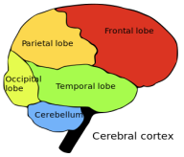
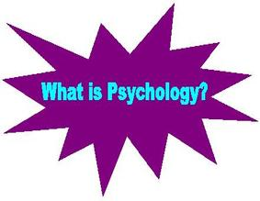
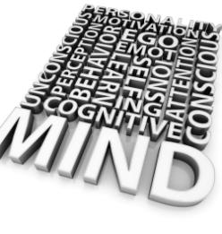
Unit 8.
Psychological perspectives for health & social care.
Understanding psychological perspectives.
( P1 & M1 )

Slide 2
Principal Psychological Perspectives
There are many different ways of thinking about human behavior.
Psychologists utilise a variety of perspectives when studying how people think, feel, and behave.
Some researchers focus on one specific school of thought, such as the biological perspective, while others take a more eclectic approach that incorporates multiple points of view.
There is no single perspective that is "better" than another; each simply emphasises different aspects of human behavior.

Slide 3
Principal Psychological Perspectives:
Behaviourist (role of reinforcement, conditioning, Pavlov, Skinner)
Social learning (effects of other individuals, groups, culture and society on behaviour of individuals, self-fulfilling prophecy, role theory, Bandura)
Psychodynamic (importance of the unconscious mind, importance of early experiences, Freud, Erikson)
Humanistic (Maslow’s hierarchy of needs, self actualisation, self-concept, self esteem, Rogers)
Cognitive/information processing (Piaget, Kelly)
Biological (maturational theory, importance of genetic influences on behaviour, influence of nervous and endocrine systems on behaviour, Gesell)

Slide 4
Principal Psychological Perspectives
You may wonder why there are so many different psychology perspectives and whether one approach is correct and others wrong.
Most psychologists would agree that no one perspective is correct, although in the past, in the early days of psychology, the behaviorist would have said their perspective was the only truly scientific one.
Each perspective has its strengths and weaknesses, and brings something different to our understanding of human behavior.
For this reason, it is important that psychology does have different perspectives on the understanding and study of human and animal behavior.

