Slide 1
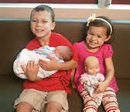
IMPACT OF LIFE EVENTS

Slide 2
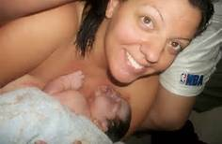
BIRTH

Slide 3

Not getting enough sleep
So finding it hard to concentrate.
Tired and drained
Learn new skills e.g making up a
Bottle and how to care for a baby
(if it’s the parent).
Feel love towards the new child or sibling.
May feel jealousy or angry at the birth of a sibling. May feel unwanted or not loved by the mother. Loss of attention
Opportunities to meet with other mothers socially.
Other family members may be relied upon for support
Could be a financial impact because of the extra cost.

Slide 4

STARTING AND LEAVING SCHOOL/COLLEGE/UNIVERISTY

Slide 5

Disturbed eating or sleeping patterns due to anxiety. This can lead to lack of concentration
Not eating properly If not used to cooking for oneself e.g. uni.
Opportunity to learn lots of new things if starting a place of education.
Feeling happy at the thought of starting something new
Achieving independence
Anxiety and stress thinking that you might not be able to cope with the change. (school/uni). Loss of the past life.
Feeling unsafe (school/coll/uni)– loss of support from parents (uni)
Opportunity to make new friends.
Leaving school/college/uni – loss of social circle of friends

Slide 6
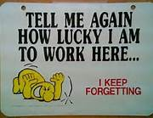
STARTING WORK/MOVING JOBS

Slide 7

Disturbed eating or sleeping patterns from anxiety of new role
Lots of stimulation from new role/ learning new skills
Potential for stress from new demands of job – difficulty in adapting.
Loss of past life and social opportunities at previous work. New opportunities to find friends in new job.
Having an income from employment
Difficulty in family relationships if demands of job make it difficult to juggle work/life.

Slide 8

REDUNDANCY

Slide 9

Disturbed eating or sleeping because of the stress of losing job – weight loss and fatigue
Difficulty in concentrating. Lack of stimulation .
Learning to adapt to changes in income and lifestyle
Grief at the loss of the job. Lowered self-esteem. Anger or depression. Failure to cope with the loss of income and lifestyle.
Loss of social opportunities because of leaving work colleagues.
Becoming withdrawn and isolating oneself from others.
Limited social opportunities because of loss of income.
A reduced income which impacts the individual and their family. Change of lifestyle, can’t buy the things they did before.

Slide 10

RETIREMENT

Slide 11

Disturbed sleeping patterns if not adjusting to new life.
Opportunities to take up more physical exercise
Controlling own life. Opportunities to learn new skills and take up stimulating hobbies
Happiness at having more time to do own thing.
Loss of previous work role – cold impact self concept and confidence. Grief at loss of worker role and moving into a new life stage.
Difficulty establishing new lifestyle and routine can cause anxiety.
Loss of contact with previous work colleagues and social opportunities.
Opportunity for different social experiences and hobbies
Financial impact if on a reduced income

Slide 12

DIVORCE

Slide 13
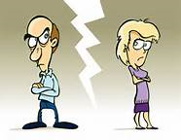
Disturbed eating or sleeping – weight loss due to stress
Learning to cope with a new lifestyle
Difficulty concentrating due to stress and anxiety
Depression
Grief at the loss of a relationship
Change in social opportunities
Potential reduced income

Slide 14
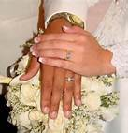
MARRIAGE

Slide 15
Research shows a positive correlation between being married and health, wellbeing and life expectancy
Making emotional attachments and experiencing intimacy
Feeling happy/unhappy
Feeling threatened by having to share possessions
Possible loss of independence
Making new friends and socialising as a couple
Potentially more financial security

Slide 16
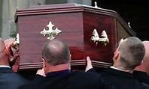
BEREAVEMENT

Slide 17

Disturbed eating habits – loss of appetite
Difficulty in sleeping
Loss of physical and sexual comfort (if a partner)
Difficulty in concentrating
Grief – loss of person emotionally attached to
Anxiety
Depression
Loss of friends and social opportunities if no longer a couple – could become isolated and withdrawn
Potential reduced income if person provided financial support in the household

Slide 18
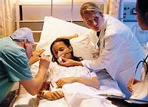
SERIOUS ILLNESS OR ACCIDENT

Slide 19
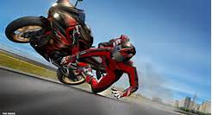
Potential loss of mobility.
Disturbed eating patterns –
If ill, loss of apetite.
Learn to adapt to any changes to body
or lifestyle.
Grief at the loss of good health
Anxiety.
Anger or depression and possible
failure to adapt to the new situation.
Possible social isolation if unable to get out.
Potential reduced income if unable to work.

Slide 20

ACQUIRED DISABILITY

Slide 21
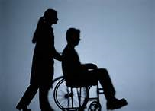
Learning to adapt to physical change
Grief at the loss of physical ability
Anger and depression and failure to adapt to the disability
Loss or change of social opportunities – might not be able to access places in the same way
Reduced income if can no longer work

Slide 22

BEING A VICTIM OR WITNESS OF A CRIME

Slide 23
If violent crime – physical impact which could cause injury affecting health and well-being
Disturbed eating or sleeping patterns due to anxiety and fear
Could have difficulty in concentrating if anxious and fearful
Depression – reliving the crime
Satisfaction at making a difference to society (witness)
Fear could cause withdrawal from social opportunities

Slide 24
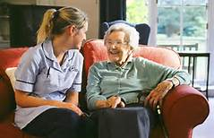
MOVING HOME/MOVING INTO RESIDENTIAL CARE HOME

Slide 25

Changed eating and sleeping patterns if care home.
Physically looked after
Opportunity to learn new skills in the home e.g. card games
Sad at loss of old home
Depressed
Anxious
Loss of friends and neighbours
Potential to make new friends
Could see more/less of family

