Slide 1
Starter
As we saw in unit 4 life has a habit of pushing us through changes at particular points.
On a post it / white board
Write a list of the changes you can think of that occur during a persons life.
Time allowed 3 minutes
We will use these later in the lesson

Slide 2
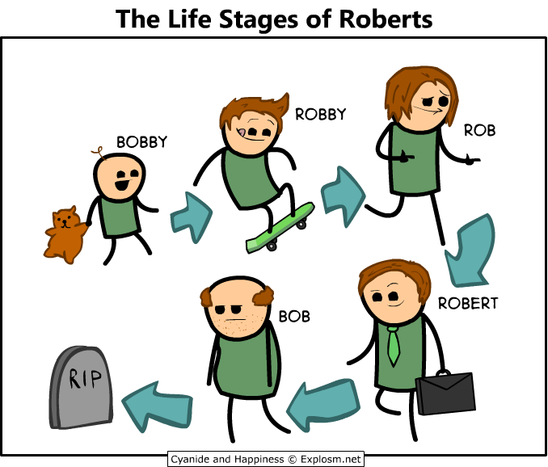
LIFE EVENTS

Slide 3
FOCUS/OUTCOMES
All of you should be able to identify major life events and give some information on the PIES impacts of these events.
Most of you should be able to identify the specific life events and give detailed explanations of the PIES impacts of these events.
Some of you will be able to describe the connections between the life events and lifestyle choices and behaviours.

Slide 4
INTRODUCTION
Change is inevitable for most people.
Society expects us to take on new and different roles.
Change may be painful but it is necessary. Why?
We would be locked in one stage.
We would cease thinking.
We would become bored.
These periods of change or transition are counter-balanced by periods of calm or equilibrium

Slide 5
5 minute Paired activity
Find out about the Holmes & Rahe scale.
What is it?
When was it developed?
What does it cover?
Be ready to feedback to the group discussion.

Slide 6

Lets talk about the Holmes and Rahe Scale
As a group share what you have learned.
What is it?
When was it developed?
What does it cover?
Lets vote
Do you think it is an effective tool? Yes/No

Slide 7

Individual Activity
https://www.mindtools.com/pages/article/newTCS_82.htm
Use the above link to try out the Holme Rahe scale for yourself.
You might also want to explore other areas of this site based on your results especially the stress tools and time management areas.

Slide 8
Major changes in life will have an impact on us in all the areas that we looked at last year:
For example, retirement, redundancy, divorce, bereavement or serious injury could all result in a loss of income or having to live on a low income which would affect our PIES.
Leaving home, marriage or parenthood might all involve changes in your home or in your community and friendship networks.
Many life events will involve some kind of loss. For example, bereavement can involve a whole range of other losses and changes.
Some life events may have both positive and negative effects.

Slide 9
IMPACTS
PHYSICAL: E.g. Disturbed eating or sleeping patterns
INTELLECTUAL: E.g. Skills acquisition or difficulty in concentrating
EMOTIONAL: E.g. Enhanced happiness, anxiety, grief or depression
SOCIAL: E.g. Loss or change of social opportunities and interactions, becoming withdrawn and isolated, changes in income
FINANCIAL: E.g. Reduced income

Slide 10
Activity -Consider how the life change you have been given may affect someone positively and negatively using PIESF
Birth, e.g. of a sibling / having a family
Starting and leaving school/college/university
Starting work/moving jobs
Redundancy
Retirement
Marriage
Serious illness or accident
Acquired disability
Being a victim or witness of crime
Moving home/moving into residential or nursing care
Be ready to feedback to the rest of the class in 5 minutes!

Slide 11
LIFE EVENTS
Event | Positive effect | Risk of stress
Birth, e.g. of a sibling or having a family | Learning to make new emotional attachments. | Jealousy and rivalry – emotional tension because your role within the family has changed. You may lose attention from parents. Tiredness and feeling drained from hard work.
Starting and leaving school/college/ university | Learning to make new friends and cope with change. Achieving independence. | Feeling unsafe – withdrawing from others. Loss of support from parents. Feeling unable to cope in a new situation.

Slide 12
Event | Positive effect | Risk of stress
Starting work/moving jobs | Choosing a work role and having an income from employment. | Feeling pressured by new demands on time and mental energy. Finding difficulty in adapting. Loss of past life.
Redundancy | Learning to adapt to changes in income and lifestyle. Opportunity for change of role/ career | Refusal to accept change. Anger or depression. Failure to cope with a loss of income and lifestyle

Slide 13
Event | Positive effect | Risk of stress
Retirement | Controlling own life – disengaging from work. Ability to pursue leisure activities. | Loss of previous work role. Loss of contact with work colleagues. Difficulty establishing new lifestyle.
Marriage | Making emotional attachments and experiencing intimacy | Feeling threatened by intimacy and sharing possessions. Possible loss of independence.

Slide 14
Event | Positive effect | Risk of stress
Divorce | Learning to cope with a new lifestyle | Resentment or depression. Grief at the loss of the relationship. Failure to adapt to a new lifestyle. Possible financial hardship.
Bereavement | Learning to cope with loss and new lifestyle | Grief at the loss of the relationship. Failure to adapt to an unwanted lifestyle

Slide 15
Event | Positive effect | Risk of stress
Serious illness or accident | Learning to adapt to any changes to the body or lifestyle | Grief at the loss of good health. Anger or depression and failure to adapt to the situation
Acquired disability | Learning to adapt to physical change. | Grief at the loss of ability. Anger and depression and failure to accept and adapt to the disability.

Slide 16
Event | Positive effect | Risk of stress
Being a victim or witness of crime | Satisfaction at making a difference to society | Fear and possible depression.
Moving home/moving into residential or nursing care | Learning to adapt to a new situation. Learning to cope with a new lifestyle. | Loss of previous situation. Depression if having to move out of home against own will. Anger and depression. Failure to adapt to an unwanted lifestyle

Slide 17
Individual Activity – 2 minutes
Write down your ideas of how divorce or bereavement may affect someone
Be ready to feed back

Slide 18
Possible ideas of how divorce or bereavement may affect someone.
Loss of friends because you are no longer a couple
Loss of income that the person brought into the household
Loss of physical and sexual comfort
Loss of practical help with daily living activities
Loss of leisure and social activities if you do not like doing things on your own
Loss of person that you were emotionally attached to
Loss of self confidence if there is no one to reassure you
Loss of home if you cannot cope on your own
Loss of a person who provided emotional support.

Slide 19

Anticipation of Life Events
Some major events we experience have been anticipated through our socialisation experience.
This provides a kind of script.
Lets Discuss the following transitions and work out how they may be prepared for:
Starting work
Leaving home Marriage
Parenthood Changing Jobs
Moving house Retirement

Slide 20
Unexpected Life Events
Some life events can never be prepared for because they are unexpected.
Redundancy
Disability
Divorce/Relationship breakdown
Death of someone close.
Terminal Illness
It is these events that are most likely to have the greatest effect on the individual.

Slide 21

Extension work & Homework
Access the pdf file on Connect – Moonie 1996
Read the file and make your own set of notes.

