Slide 1
Reaction to Life Events
Understand the potential impact on self concept of major life changes.
Theories of transition, grief & loss

Slide 2




Reactions to life events.
Many changes involve a loss or a letting go of attachments.
Sometimes this loss can cause a threat to our sense of self.
A single event or a combination of losses may cause people to become threatened. (Holmes & Rahe).

Slide 3

Change can
Create uncertainty –
Almost every change raises questions about the future. When we don’t know the answers this can cause stress.
Alter a persons self concept –
What is a key component of self concept?
When we change the people we mix with may change. New people may see us differently & treat us differently.
Our ideas about our skills, social status or
our importance might have to change.

Slide 4
Create a need for new learning
All life events involve some degree of learning. Eg Parenthood. Unexpected major life events may force us to learn quickly eg redundancy, serious illness or bereavement might mean learning a whole new lifestyle
Many people enjoy learning at their own pace.
Major or unexpected changes in our lives may not allow people time or chance to go at their own pace.
A person may become stressed with the amount of learning and adapting they need to do.

Slide 5

Create a sense of loss
Life changes can create a serious sense of loss.
Major life changes can involve multiple losses.
A person might also feel threatened or attacked by what has happened
Use up time, money and emotional resources
It takes time to develop new skills / form new relationships etc.
Planned life changes can be costly in terms of time, money and emotional commitment.
Unplanned changes may involve extra expense, work and emotional involvement to sort out things that are unwanted.

Slide 6
Transitions
A transition is any event, that results in changed relationships, assumptions & roles.
(Schlossberg, 1995)
Most transitions are associated with significant life events and involve changes to the individual’s role or environment that require radical restructuring of the individual’s view of themselves and their world.
The process takes longer than most people expect typically 6-12 months, sometimes longer.
Positive life events e.g. marriage, birth of a child or new job have as much potential for psychological disruption as negative events.

Slide 7
Theories of Transition
Try to explain how individuals respond to change, either in their own lives or environment.
Adams & Hopson
Schlossberg

Slide 8
Adams & Hopson 1976
A general way of understanding transitions.
Seven phases when facing change – believes the phases apply equally to situations involving a sudden shock or where there is a slow growing awareness of the change.
Immobilisation
Minimisation
Depression
Letting go
Testing
Search for meaning
Internalisation

Slide 9
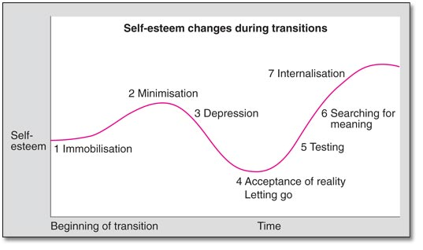
Hopson & Adams 1976 continued
The key to successful adjustment to change is to work through this cycle of reactions.
Not everyone will experience all these stages and some people may become stuck along the way, for example experiencing on-going depression.

Slide 10
More detail about the stages (Adapted from Adams and Hopson)
Immobilisation - Sense of being overwhelmed, unable to act. Unfamiliar
transitions & negative expectations, may intensify this.
Minimisation - Common way of coping - deny that it is happening.
A reaction to a crisis which is too difficult to face.
Depression - People often get depressed when they face up to the
implications of change.
Accepting reality -Begin to let go of their old state of being, accepting
what is happening to them.
Testing. - Having begun to accept the situation, now possible to test out new behaviours to cope with the change.
Seeking meanings -Reflective stage where people try to work out how and
why things are different.
Internalisation - Understanding of the situation & new meanings
internalised & accepted. Now become part of the
person's behaviour.

Slide 11
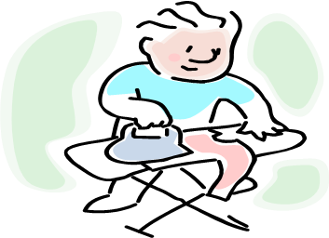
Application of Adams & Hopson’s theory
In your group look at the case study of Jack
Can you identify aspects of Adams and Hopsons theory?
Be ready to feedback to the class.

Slide 12
Schlossberg (1995)
Schlossberg defined a transition as any event, or non-event, that results in changed relationships, routines, assumptions, and roles.
A persons perception plays a key role in transitions. The event or non-event, only meets the definition of a transition if the person experiencing it perceives it as such.
In order to understand the meaning that a transition has for a particular individual the following must be considered: Type
Context
Impact of the transition

Slide 13
Type of transition
  Anticipated transitions: ones that occur predictably, such as leaving school
  Unanticipated transitions: ones that are not predictable, such as divorce or sudden death of a loved one.
  Non-events: transitions that are expected but do not occur, such as failure to be admitted to university
    Personal non-event: related to individual aspirations
    Ripple non-event: felt due to a non - event of someone else
    Resultant non-event: caused by an event
    Delayed non-event: anticipating an event that might still happen
Context
Refers to one's relationship with the transition and to the setting in which the transition takes place.
Impact
Determined by the degree to which a transition alters one's daily life.

Slide 14
Factors that influence a person’s ability to cope with a transition according to Schlossberg. The 4 S’s
Situation – what is happening?
Triggers: What precipitated the transition?
Timing: Is it "on time" or "off time" in terms of one's social clock?
Control: What aspect of the transition does the individual perceive as being within his/her control?
Role change: Is a role change involved? If so, is it seen as a gain or a loss?
Duration: Permanent, temporary, or uncertain?
Previous experience with a similar transition: How did the person cope then?
Concurrent stress: Other sources of stress
Assessment: Who or what is seen as responsible for the transition? How is the individual's behaviour affected by this?
Self:
Factors considered important in relation to the self are classified into two categories
Personal and demographic characteristics affect how an individual views life
eg. Age, gender, stage of life, socioeconomic status, state of health, and ethnicity.
Psychological resources
include ego development, outlook, and commitment and values.

Slide 15
Factors that influence a person’s ability to cope with a transition according to Schlossberg. The 4 S’s
Strategies - What is the person’s range of coping resources?
People navigate transitions in different ways.
Social support -What help is available?
Level & type of support (internal & external)
  Intimate relationships
  Family units
  Networks of friends
  Institutions and communities
Stretch & Challenge - Further information on Schlossberg’s theory http://www.youtube.com/watch?v=LqekfDI4j0U

Slide 16
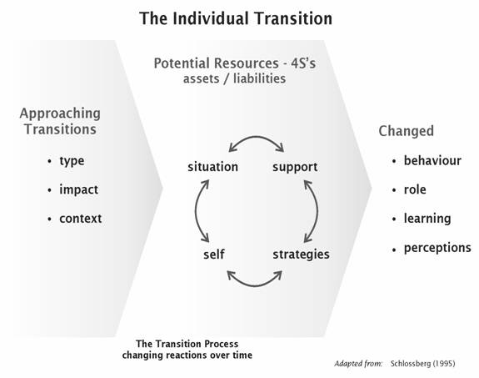

Slide 17
Application of Schlossberg's theory
In your group look at the case study of Jack
Can you identify aspects of Schlossbergs theory?
Be ready to feedback to the class.

Slide 18
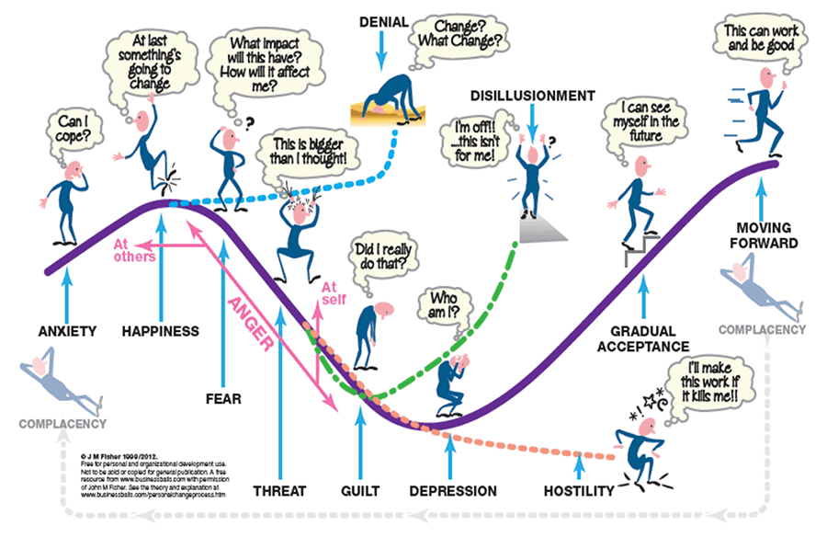
Fisher transition curve

Slide 19
Fishers Transition Curve
Change, however small can potentially impact on us, creating conflict between existing values and beliefs and anticipated altered ones.
It can be seen from the transition curve that it is important for a person to understand the impact that the change will have in order to work through the potential for their self perception.
The danger is that once we are caught up in the emotion of the change we may miss the signs of threat, anxiety, etc.
We progress through all the phases in sequence. Each stage builds on the last stage incorporating both the positive & negative learning of the experience. There are no clear boundaries to the stages, more a gradual realisation that things have subtly changed.

Slide 20
Our perception of the situation could be increasing in 'severity' of impact and importance to our sense of self as we go through the phases. We descend into the trough of depression via a small impact on our sense of self (anxiety), speed up through a greater realisation of impact and meaning (fear, threat) and then comes the realisation that (potentially) our core sense of self has been impacted and our 'self belief system' undermined to a large extent (guilt, depression) which contradicts who we thought we were.
If someone is going through multiple transitions at the same time; these could have a cumulative impact on them as individuals.
Each person will experience transition through the curve at slightly different speeds – depending on their self perception and past experiences, these combine to create their anticipation of future events.
The more positive you see the outcome, the more control you have or believe you have over both the process and will find the process less difficult.

Slide 21
The stages of Fishers transition curve 2012
ANXIETY
Results from the awareness that events lie outside one's range of understanding or control.
We are unable to picture the future because we do not have enough information to anticipate behaving differently.
HAPPINESS
The awareness that our viewpoint is recognised and shared by others. There is a feeling of relief that something is going to change, whether the event was positive or negative there is anticipation at the possibility of improvement.
This phase may be passed through without us being aware of it.
FEAR
There is an awareness of an imminent change. People will need to act in a different manner, impacting on both their self-perception and on how others externally see them. Most people see little change in their normal behavior and believe they will be operating in much the same way but choosing a more appropriate, but new, action.
How we deal with this determines how we progress through the rest of the curve and the extent of the impact on our core sense of self.

Slide 22
THREAT
The person is aware/perceives a major change on what they believe to be their core identity or sense of self. There is realisation that this will impact on who we are and how we see ourselves. This is the shock of suddenly discovering you're not who you thought you were! It is a radical alteration to our future choices and other people's perception of them as individuals. In this phase, people are unsure as to how they will be able to cope/react in this new environment - one where the 'old rules' no longer apply and there are no 'new' ones established as yet.
GUILT
An awareness that we are changing - We are not who we thought we were! The person begins to explore their self-perception and their past behaviour using different interpretations & begins to re-define their sense of self.
Recognition of the inappropriateness of previous actions and the implications can cause guilt as they realise the impact of their behaviour. Shame may also be a factor here - the awareness of a negative change in someone else's opinion of you from what you think it should be. This recognition of a shift in our and other peoples opinion then leads into the next stage.
DEPRESSION
The awareness that our past actions, behaviours and beliefs are incompatible with our core construct of our identity. The belief that our past actions mean we're not a very nice person after all! This phase is characterised by a general lack of motivation and confusion. Leads to uncertainty as to what the future holds and how they can fit into the future 'world'. Their representations are inappropriate and undermine their sense of self leaving them with no clear sense of identity or vision of how to operate.

Slide 23
GRADUAL ACCEPTANCE
We now begin to make sense of our environment and of our place within the change.
We begin to get some validation of our thoughts and actions and can see that where we are going is right. We are at the start of managing our control over the change, make sense of the 'what' and 'why' and seeing some successes in how we interact - there is 'a light at the end of the tunnel!' This links in with an increasing level of Self-confidence, i.e., we feel good that we are doing the right things in the right way.
MOVING FORWARD
We begin to exert more control, make more things happen in a positive sense and are getting our sense of self back. We know who we are again and are starting to feel comfortable that we are acting in line with our convictions, beliefs, etc. and making the right choices.
DISILLUSIONMENT
There is awareness that your values, beliefs and goals are incompatible others. The person becomes unmotivated, unfocused & increasingly dissatisfied and gradually withdraws mentally by just 'going through the motions', doing the bare minimum.

Slide 24
HOSILTY
The continued effort to validate social predictions that have already proved to be a failure. The problem here is that individual's continue to operate processes that have repeatedly failed to achieve a successful outcome and are no longer part of the new process or are surplus to the new way of working. The new processes are ignored at best and actively undermined at worst.
DENIAL
There is a lack of acceptance of any change and denial that there will be any impact. People keep acting as if the change has not happened, using old practices and processes, ignoring evidence or information contrary to their belief systems. In many ways when we are faced with a problem, or situation, we don't want, or one that we believe is too challenging to our sense of self we 'constrict' or narrow our range of construction. In this way we eliminate the problem from our awareness. The 'head in the sand' syndrome - if I can't see it, or acknowledge it then it doesn't exist!
ANGER
There seems to be some anger associated with moving through the transition curve, especially in the earlier stages as the person starts to recognise the wider implications of change. This is not always present, it is dependant on the amount of control people feel they have over the overall process and the focus of the anger changes over time. In the first instance, for those where change is 'forced' on them, the anger appears to be directed outward at other people. They are 'blamed' for the situation and for causing stress to the individual etc. As time progresses and the implications grow for the individual the anger moves inwards and there is a danger that this drives us into the 'Guilt' and 'Depression' stages. We become angry at ourselves for not knowing better and/or allowing the situation to escalate outside our control.

Slide 25
The Final Stage?
It has also been suggested that there is also actually a final stage of Complacency (King 2007).
People have survived the change, rationalised the events and incorporated them into their new construct and become used to the new reality. - comfort zone
They are operating well within their comfort zone and in some respects can't see what all the fuss has been about. Even though the process may have been quite traumatic for them at the time!
Think about Jack in the case study is he at this stage?

Slide 26
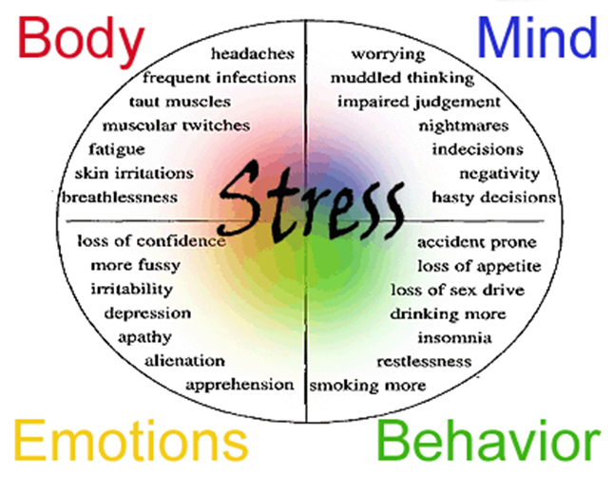
Stress
Some changes are forced upon us. Other changes are the result of choices we make but both can present challenges and can create stress.
A state of mental or emotional strain or tension resulting from adverse or demanding circumstances.
Oxford Dictionary

Slide 27


Individual Activity
Research
The signs & symptoms and triggers of stress.
The physical and psychological effects of stress
The management and treatment of stress
Present your findings as a leaflet.

Slide 28
What is Grief?
Grief is a natural response to loss.
It’s the emotional suffering you feel when something or someone you love is taken away.
The more significant the loss, the more intense the grief will be.
Grief is often associated with death but any loss can cause grief, including:
Relationship Breakdown Death of a pet
Losing a job Loss of Health
Loss of financial security A loved one’s serious illness
Retirement Loss of a friendship
Loss of safety after a trauma A miscarriage

Slide 29
The more significant the loss, the more intense the grief. However, even subtle losses can lead to grief. For example, grief may be experienced after moving away from home, graduating from college, changing jobs, selling your family home, or retiring from a career you loved.
Everyone grieves differently depending on many factors,
Personality
Coping style
Life experience
Faith
The nature of the loss.
The grieving process takes time but tends to follow a pattern of stages.
http://www.youtube.com/watch?v=mq00IqO7Lvs 11mins – 5 stages of Grief explained

Slide 30
The Stages of Grief
In 1969, psychiatrist Elisabeth Kübler-Ross introduced the “five stages of grief.”
Denial: “This can’t be happening to me.”
Anger: “Why is this happening? Who is to blame?”
Bargaining: “Make this not happen, and in return I will ____.”
Depression: “I’m too sad to do anything.”
Acceptance: “I’m at peace with what happened.”
Not everyone will go through each stage.
Some people resolve their grief without going through any of these stages.
Also people don’t need to go through these stages of grief, in a neat, sequential order.

Slide 31
Application of Grief theory to the case study.
In your group look at the case study of Jack
Can you identify aspects of the Grief theory?
Be ready to feedback to the class.

Slide 32
References & Sources
Adams, J. Hayes, J. & Hopson, B. (1976) Transition - Understanding and Managing Personal Change, London, Martin Robertson.
Hopson, B. Scally, M. Stafford, and K. (1991) Transitions: The Challenge of Change. London Lifeskills Personal Development Series, Lifeskills Communication Ltd.
Moonie N (1996)
Kübler-Ross, E. (1969) On Death and Dying, Routledge
Schlossberg, N.K., Waters, E.B. & Goodman, J. (1995) Counselling Adults in Transition: Linking Practice with Theory, New York, Springer.
http://www.helpguide.org/mental/grief_loss.htm

