Slide 1

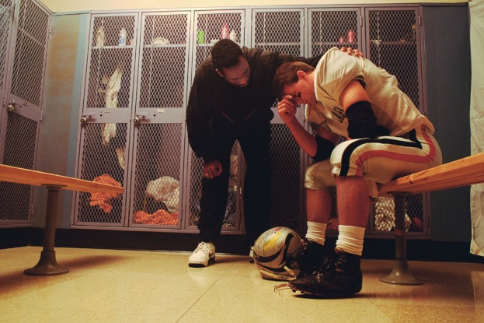
The role of the health and social care professionals in supporting transition and change

Slide 2
Sources of Support
social workers
counsellors,
cognitive
therapists
family therapists
Macmillan & Marie Curie nurses
specialist practitioner nurses

Slide 3

Specialist Nurses
Provide care and support for people suffering from long-term conditions.
Provide care dedicated to a particular area of nursing; caring for patients suffering from long-term conditions and diseases such as cancer, diabetes, Parkinson’s, chronic heart failure and dementia.
Take a leading role in making sure patients get the best care possible.
Provide direct patient care and can play a vital role in educating patients on how best to manage their symptoms, as well as offering support following diagnosis.

Slide 4

The benefits of Specialist Nurses
The involvement of a specialist nurse can prevent patients being re-hospitalised.
Several studies have shown that as a substitute for other health care professionals, including doctors, specialist nurses are both clinically and cost effective, reducing referral times, the length of hospital stays and the risks of complications post-surgery. (RCN 2010)

Slide 5

Macmillian & Marie Curie Nurses
Specialist nurses who support people when they are first diagnosed with cancer and throughout their illness.
Offer help and information to families, friends, carers and local communities.
Provide much-needed advice, information and support to people with cancer.
Help people make informed decisions about their treatment, and guide them through the maze of different services.
Offer emotional support and help people with cancer deal with their symptoms and pain.

Slide 6

Social workers
Work with people who have been socially excluded or who are experiencing crisis. - young people and their families, young offenders, mentally ill, drug and alcohol abusers, people with learning and physical disabilities, the homeless and the elderly.
Work in a variety of settings within a framework of relevant legislation and procedures, supporting individuals, families and groups within the community - service user's home, schools, hospitals, other public sector premises, voluntary organisations.
Provide support to enable service users to help themselves, acting as a professional guide, advocate or critical friend

Slide 7

Social Workers continued:
Support given typically involves:
Offering information and counselling support to service users and their families;
Organising and managing packages of support to enable service users to lead the fullest lives possible;
Recommending and sometimes making decisions about the best course of action for a particular service user;
Participating in multidisciplinary teams and meetings regarding, for example, child protection or mental health;

Slide 8

Counsellors
Help people to explore feelings and emotions that are often related to their experiences using various models of counselling.
They may work with groups or individual clients.
They may specialise in particular fields – addiction, bereavement, health, relationship guidance and sexual abuse.
Offer clients the time, empathy and respect they need to express their feelings and perhaps understand themselves from a different perspective. The aim is reduce their confusion and enable them to cope with challenges or to make positive changes in their life where necessary.

Slide 9

Counsellors do not give advice, but help clients to make their own choices.
They do this by:
establishing a relationship of trust and respect with clients;
encouraging clients to talk about issues they feel they
cannot normally share with others;
actively listening to client concerns and empathising with
their position;
helping clients towards a deeper understanding of their
concerns;
challenging any inconsistencies in what clients say or do;
helping clients to make decisions and choices regarding
possible ways forward;

Slide 10
Family Therapists
Family therapists will often work with relatives and the person who is unwell to develop strategies to cope better with the illness and its symptoms, leading to a more supportive and warm atmosphere.
This can help people who have been unwell to make better progress and help relatives to feel more positive about and be more effective in, their supporting roles.
A family therapist can play a significant role of resolving serious issues and conflicts within the family , for example - divorce, financial crisis, stressed environment.
Sometimes, the therapists will invite family members join a relatives’ group where they can meet other people who are in a similar situation. Usually these supportive groups are for relatives on their own to share their experiences.

Slide 11
Types of Support Offered
Support
Financial
Emotional
Counselling
Support groups
Practical
-Managing a health Condition
-Managing terminal illness
Specific,
eg grief therapy,; dealing with family dysfunction
Education

Slide 12
Bibliography
http://www.rcn.org.uk/__data/assets/pdf_file/0008/302489/003581.pdf

