Slide 1
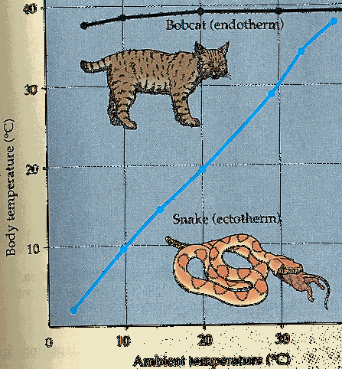
Topic 6: Stimuli and response - 3.6.4.1 Principles of homeostasis and negative feedback
Define the terms:
Homeostasis
Positive feedback
Negative feedback
Optimum point
Receptor
Coordinator
Effector
With an example describe negative feedback
With an example describe positive feedback.

Slide 2
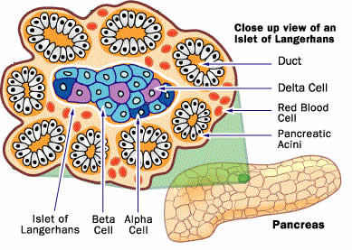
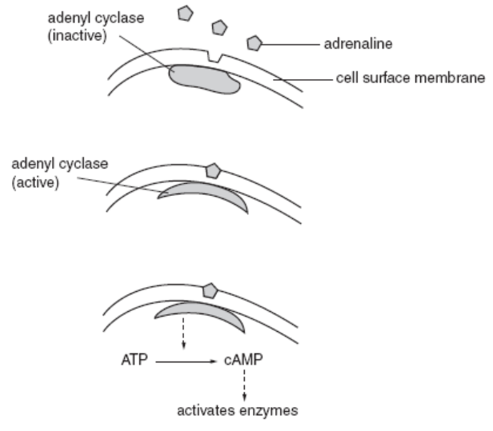
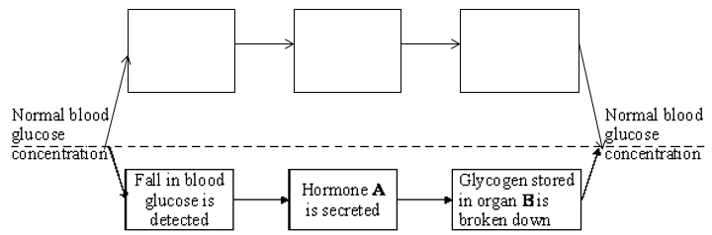
Topic 6: Stimuli and response - 3.6.4.2 Control of blood glucose concentration
Explain how a hormones works using adrenaline as an examples.
Describe how the structure of alpha cells are specialized for producing insulin. (Year 1)
Describe the role of the liver in regulating blood glucose. You must include Glycogenesis, glycogenolysis and gluconeogenesis.
Describe the role of adrenaline in regulating the blood glucose levels.
Define: Glycogenesis Glycogenolysis Gluconeogenesis

Slide 3
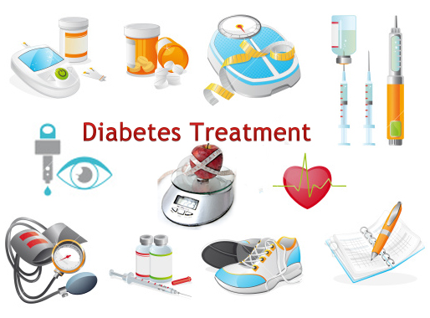
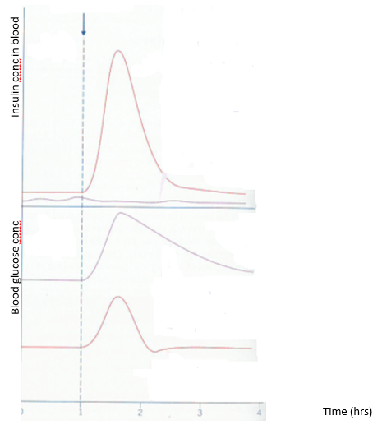
Topic 6: Stimuli and response - 3.6.4.2 Control of blood glucose concentration
Describe type 1 and type 2 diabetes.
Describe the causes for type 1 and type 2 diabetes
Add notes to the graph explaining the effect of glucose meal on blood glucose conc
Describe the treatments for type 1 and type 2 diabetes.

Slide 4
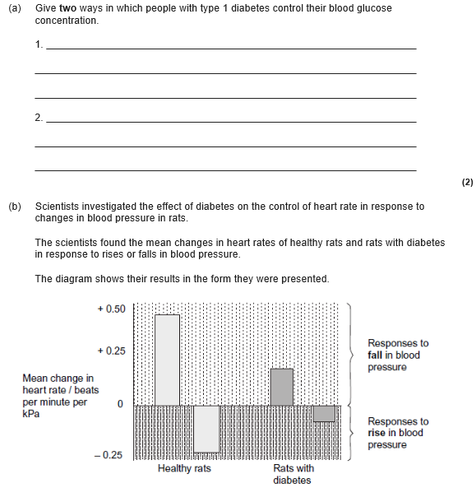
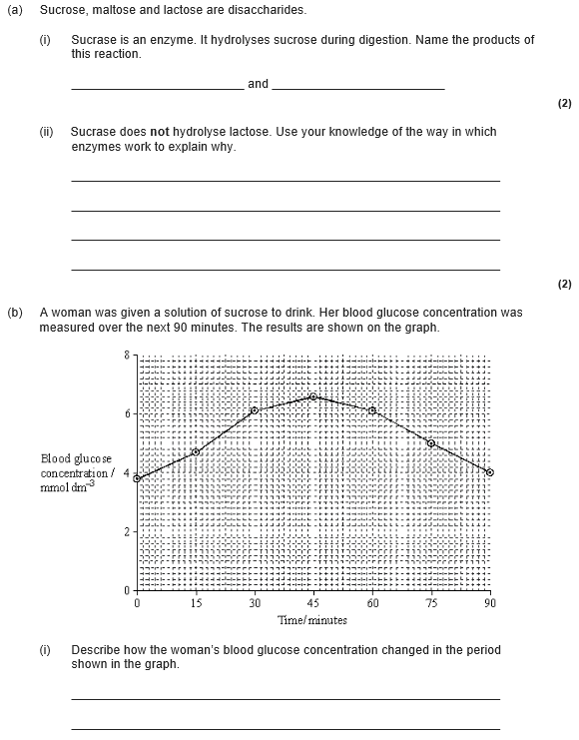
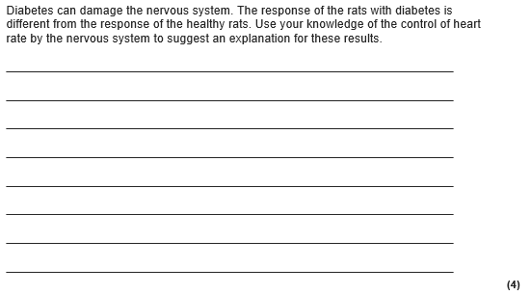
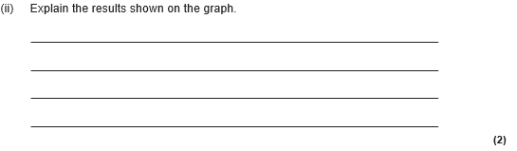

Slide 5
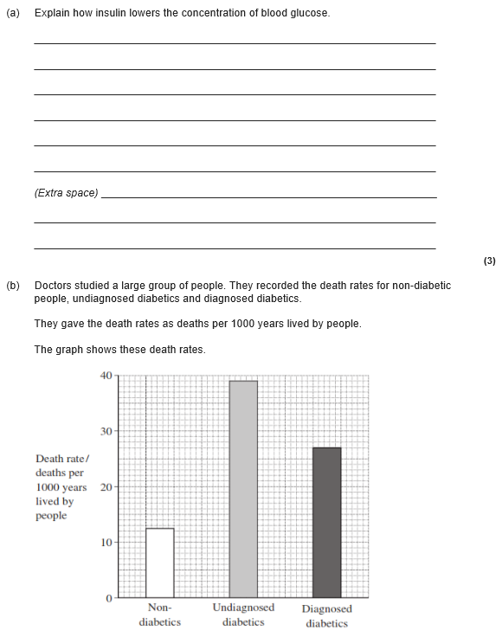
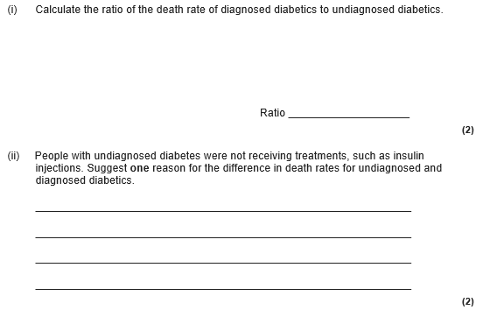

Slide 6
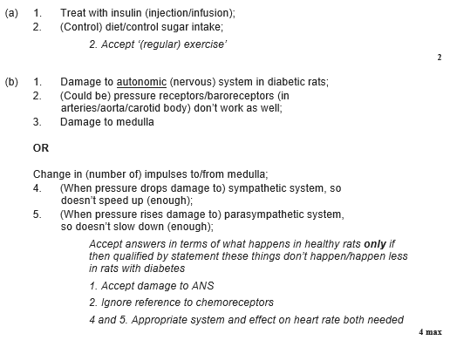
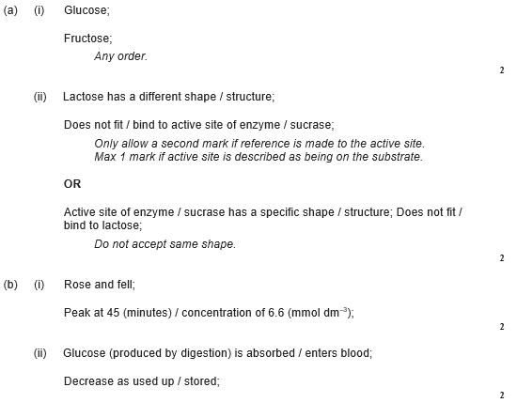

Slide 7
