Slide 1
AS Level Paper 1 and 2. A2 Level Paper 1 and 3 - Topics 1-4
Section 3.1: Biological Molecules
3.1.1 Monomers and Polymers
3.1.2 Carbohydrates
3.1.3 Lipids
3.1.4.1 Proteins
3.1.4.2 Enzymes
3.1.5.1 Nucleic acid structure
3.1.5.2 DNA Replication
3.1.6 ATP
3.1.7 Water
3.1.8 Inorganic Ions
Section 3.3 Organisms exchange substances with their environment
3.3.1 Surface area to volume ratio
3.3.2 Gas exchange
3.3.3 Digestion and absorption
3.3.4.1 Mass transport in animals
3.3.4.2 Mass transport in plants
Section 3.4 Genetic information, variation and relationships between organisms
3.4.1 DNA, genes and chromosomes
3.4.2 DNA and protein synthesis
3.4.3 Genetic diversity - mutations and meiosis
3.4.4 Genetic diversity and adaptation – natural selection
3.4.5 Species and taxonomy
3.4.6 Biodiversity
3.4.7 Investigating biodiversity
Section 3.2: Cells
3.2.1.1 Eukaryotic cells
3.2.1.2 Prokaryotic cells and viruses
3.2.1.3 Studying cells
3.2.2 Mitosis
3.2.3 Transport across cell membranes
3.2.4 Cell recognition and the immune system

Slide 2
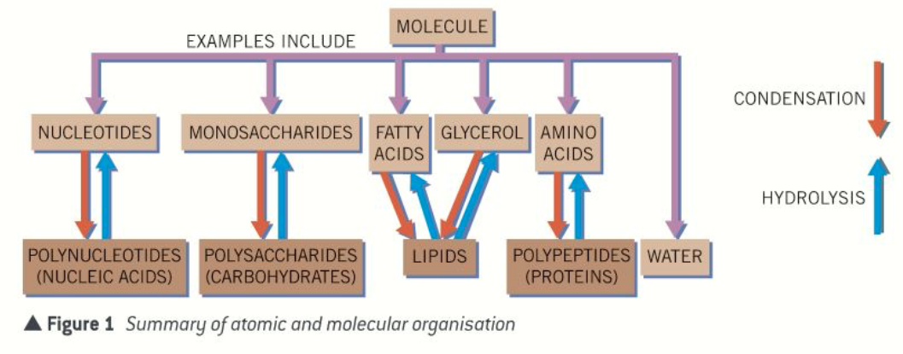
Topic 1: Biological Molecules - 3.1.1 Monomers and Polymers
Name the 5 biological molecules.
What is a monomer?
Can you describe and draw what a condensation reaction is?
What is a polymer?
Can you describe and draw what a hydrolysis reaction is?

Slide 3
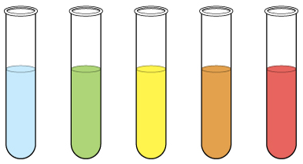
Topic 1: Biological Molecules - 3.1.2 Carbohydrates – monosaccharides and disaccharides
Draw the 4 carbohydrate monomers
What are maltose, sucrose and lactose formed from?
Define an isomer.
Draw the formation of Sucrose
Draw the formation of Lactose
Explain how you would test for reducing and non-reducing sugars and the results you would expect:
Draw the formation of Maltose.

Slide 4
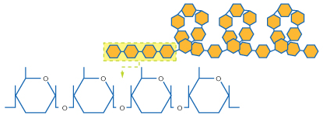
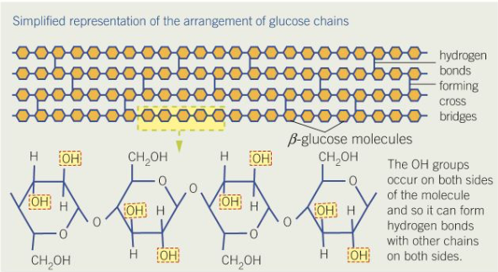
Topic 1: Biological Molecules - 3.1.2 Carbohydrates – polysaccharides
Can you describe how polysaccharides are formed?
Can you explain how you would test for starch and what result you would expect to see?
Can you explain how glycogen and starch are formed? Label the diagram.
Can you draw a contrast table for starch, glycogen and cellulose with at least 4 differences.
List the features that make Starch and glycogen good storage molecules, explain the importance of these features.
Can you explain how cellulose is formed? Label the diagram.
Can you describe the relationship of structure to function of cellulose?

Slide 5
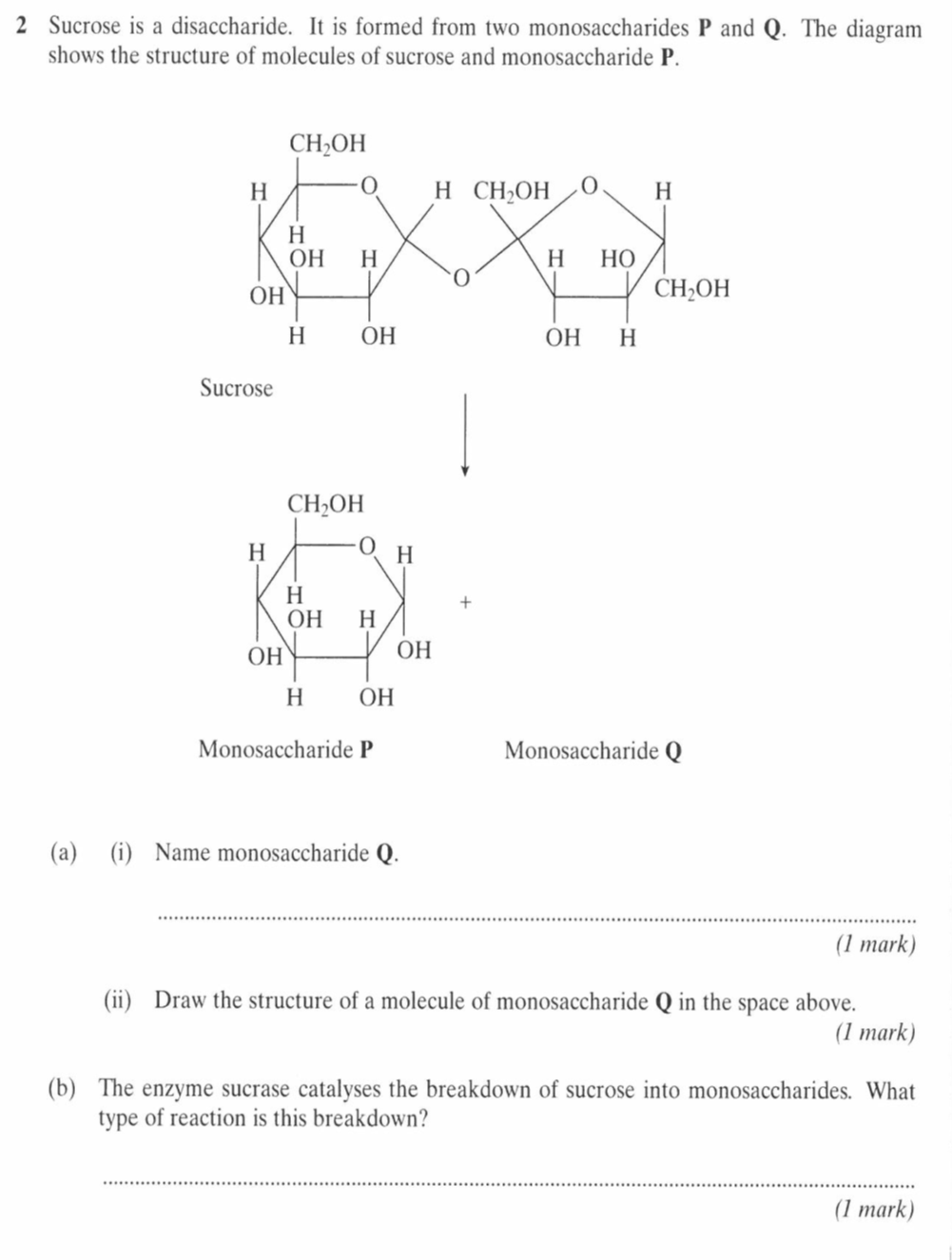
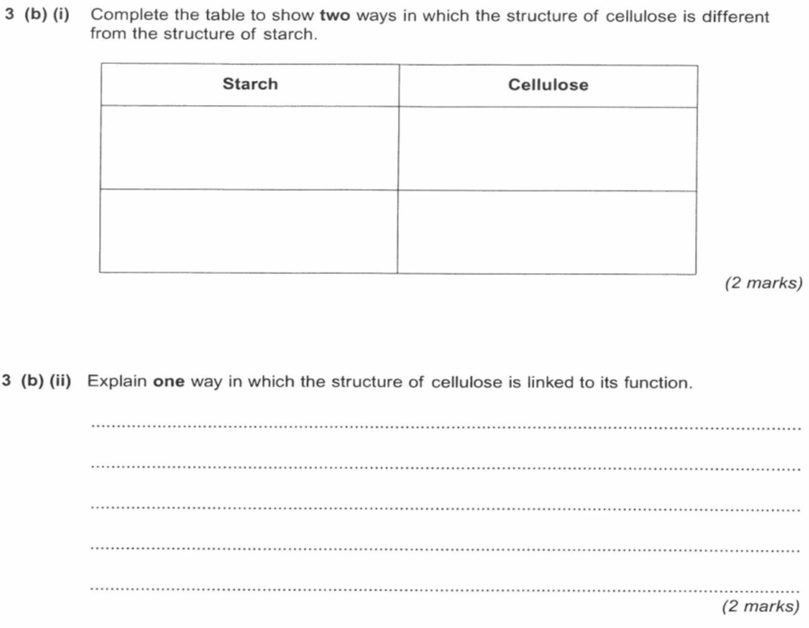

Slide 6
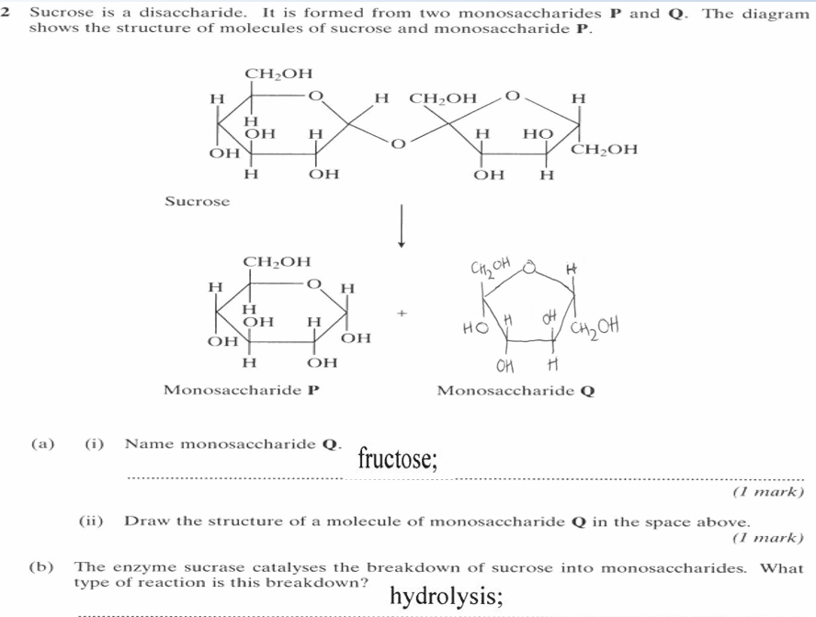
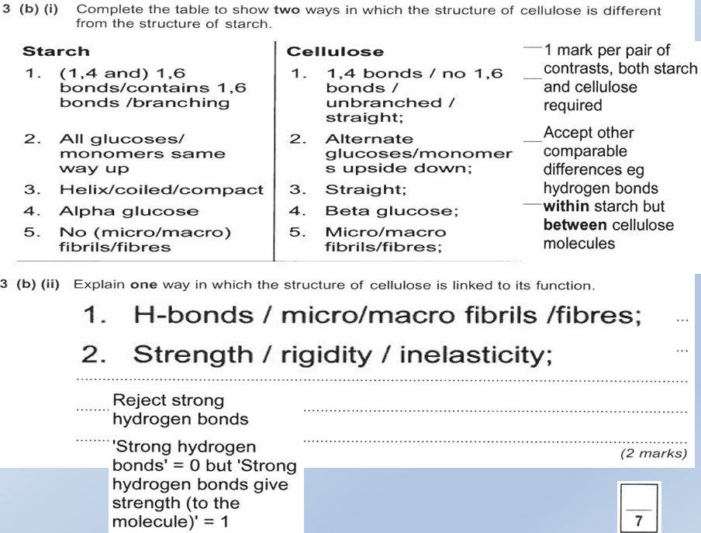

Slide 7
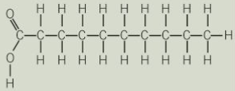
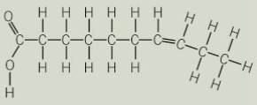
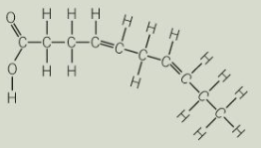
Topic 1: Biological Molecules - 3.1.3 Lipids (p16-17)
What are lipids?
Can you explain how triglycerides are formed? Draw a diagram to show this happening. Label the molecules involved, the type of reaction and the types of bonds formed.
Can you explain how the structure of triglycerides relates to their properties?
What are their roles?
Can you explain that the R-group of a fatty acid may be saturated or unsaturated? What do these terms mean?
Can you explain how phospholipids are formed? Draw a diagram to show this happening. Label the molecules involved and name the type of reaction. Label the hydrophilic and hydrophobic part of the molecule and explain what those terms mean.
Can you explain how the structure of phospholipids relates to their properties?
Can you describe how you would test for lipids?

Slide 8
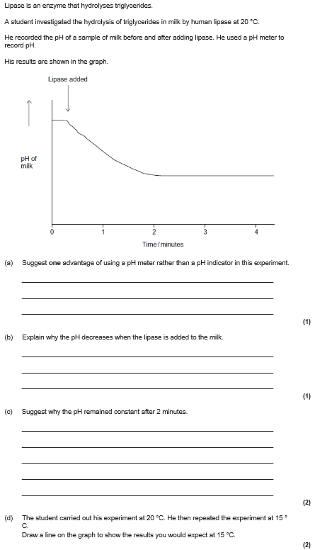
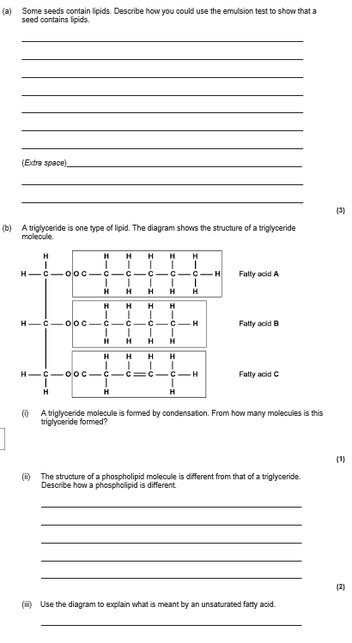

Slide 9
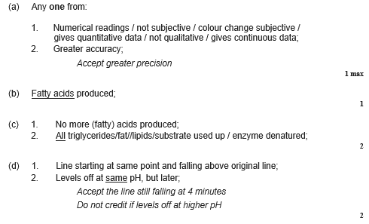
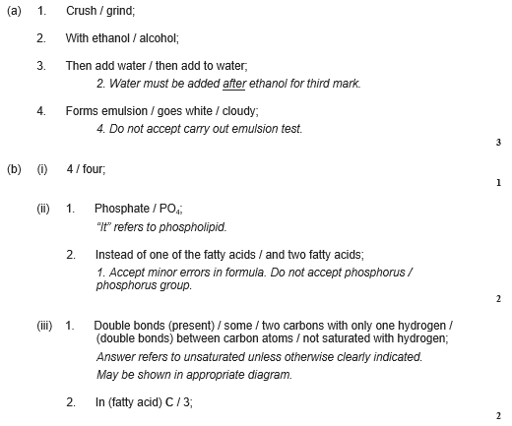

Slide 10
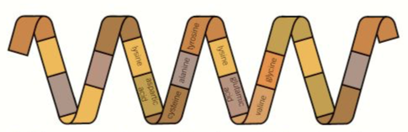

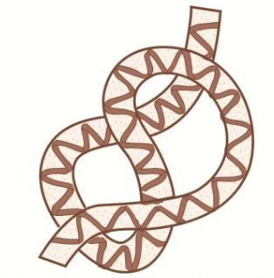
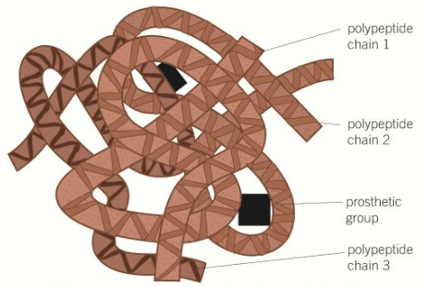
Topic 1: Biological Molecules - 3.1.4.1 Proteins (p19-22)
What is the general structure of an amino acid? Add labels
Can you describe how you would test for proteins?
Can you describe the relationship between primary, secondary, tertiary and quaternary structure, and protein function? Remember the bonds.
How many different types of amino acid are there? How are they different?
How do two amino acids form a dipeptide?

Slide 11
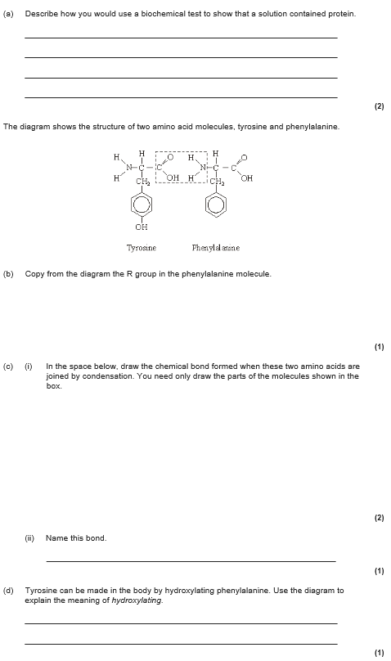
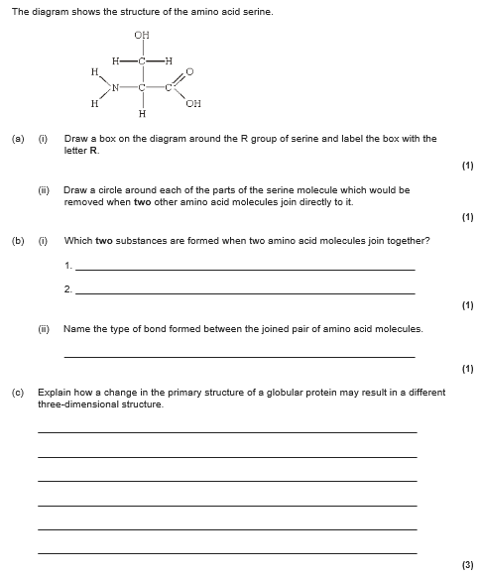

Slide 12
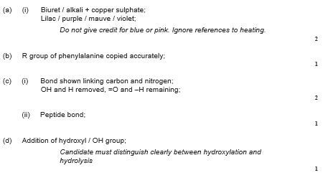
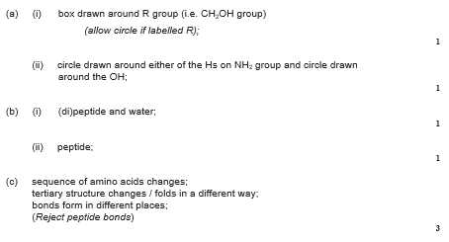

Slide 13
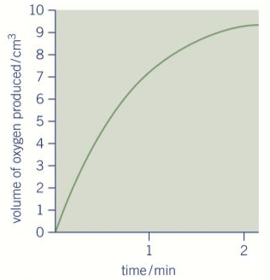
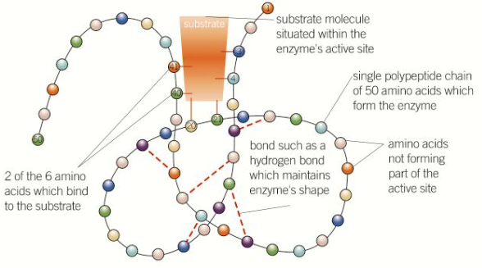
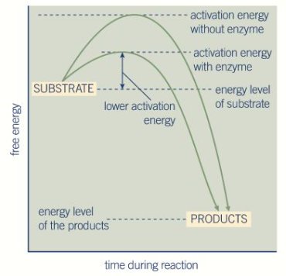
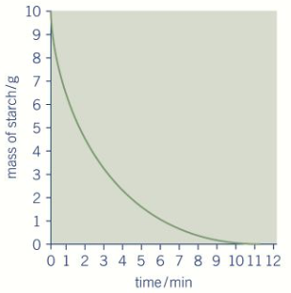
Topic 1: Biological Molecules - 3.1.4.2 Enzymes (p23-33)
Can you explain how each enzyme lowers the activation energy of the reaction it catalyses?
How does an enzyme’s structure relate to it’s function?
Describe how you could measure the rate of an enzyme-catalysed reaction from a graph
Can you draw a diagram to describe the induced-fit model of enzyme action ?
Can you describe lock and key model

Slide 14
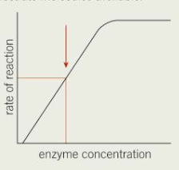
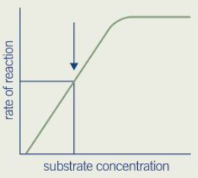
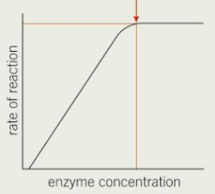
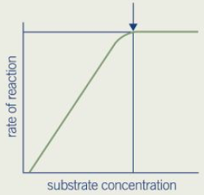
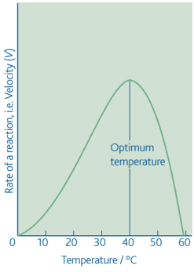
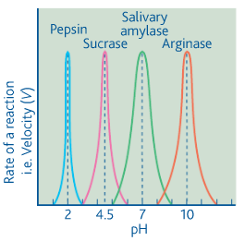
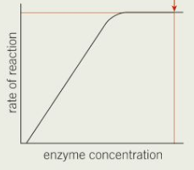
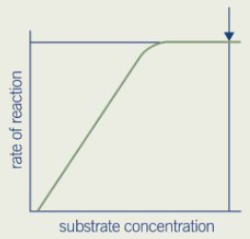
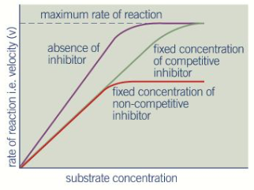
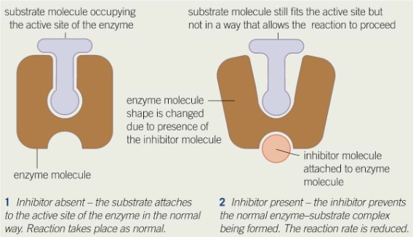
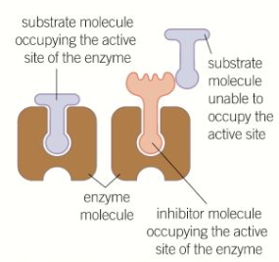
Topic 1: Biological Molecules - 3.1.4.2 Enzymes (p23-33)
How does the temperature affect the rate of an enzyme-controlled reaction?
How does the pH affect the rate of an enzyme-controlled reaction?
How does the substrate concentration affect the rate of an enzyme-controlled reaction?
How does the enzyme concentration affect the rate of an enzyme-controlled reaction?
How does the concentration of competitive inhibitor affect the rate of an enzyme-controlled reaction?
How does the concentration of non-competitive inhibitor affect the rate of an enzyme-controlled reaction?

Slide 15
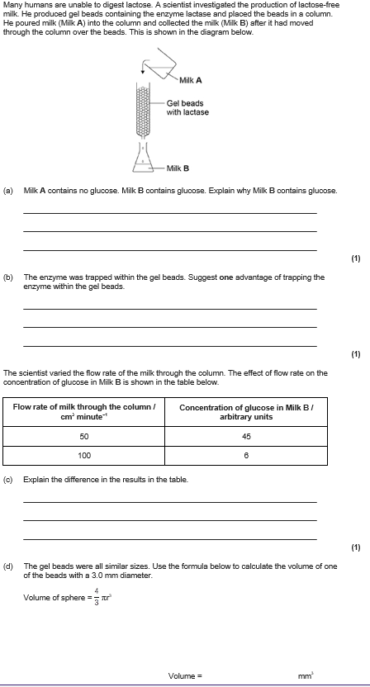
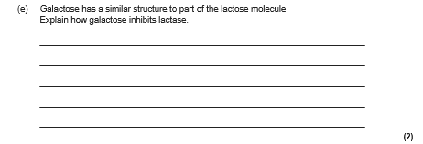
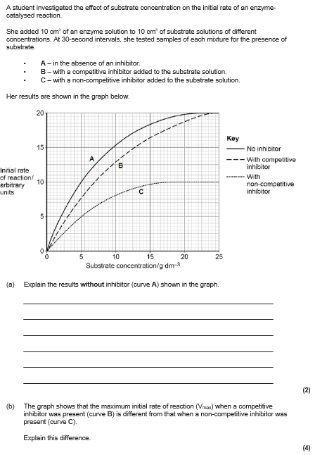

Slide 16
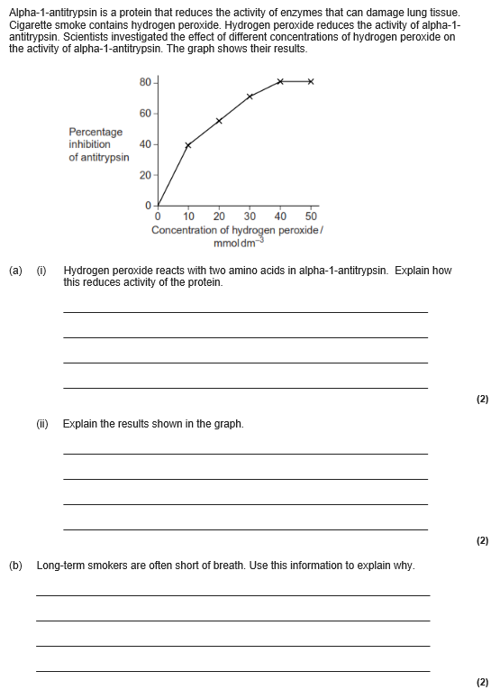
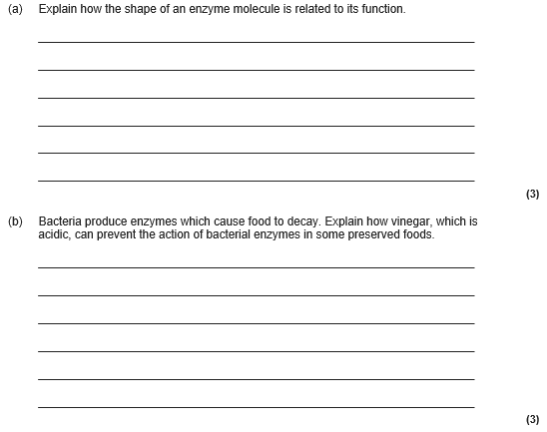

Slide 17
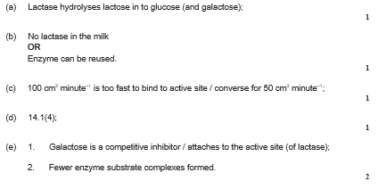
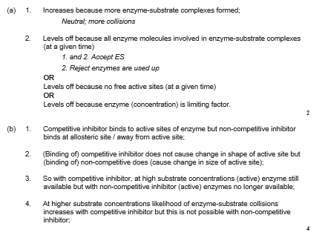

Slide 18
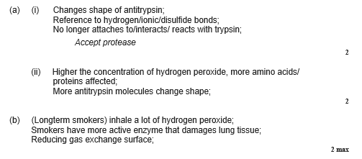
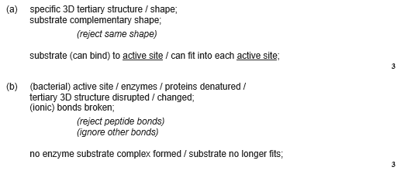

Slide 19
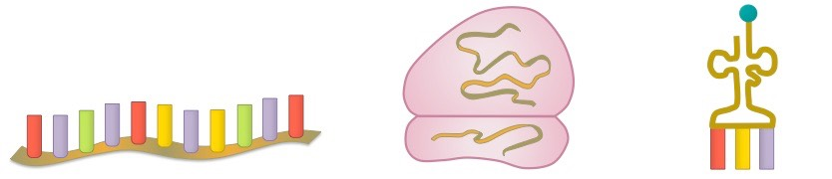
Topic 1: Biological Molecules - 3.1.5.1 Nucleic acid structure
What is the structure of a nucleotide? Draw and label a nucleotide.
Explain the complementary base pairing rules:
How is the structure of DNA related to its function?
Name the 3 types of RNA, give their roles and where they are found.
What is a phosphodiester bond, how and where is it formed?
Can you compare and contrast the components of a DNA and RNA nucleotide(draw a table):
Can you compare and contrast the structure of DNA and RNA molecules?

Slide 20
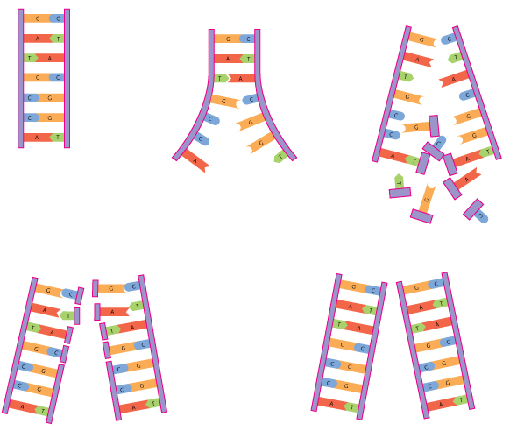
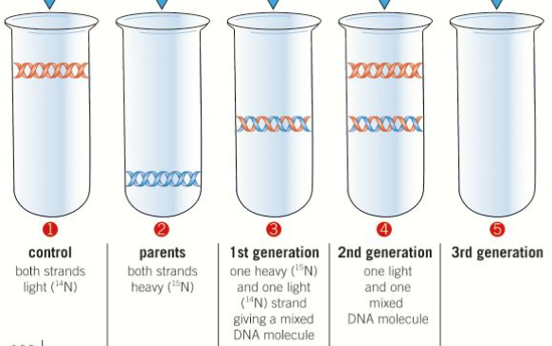
Topic 1: Biological Molecules - 3.1.5.2 DNA Replication
Can you describe the semi-conservative method of DNA replication? Include the enzymes and their roles
Can you evaluate the work of scientists in validating the Watson–Crick model of DNA replication?

Slide 21
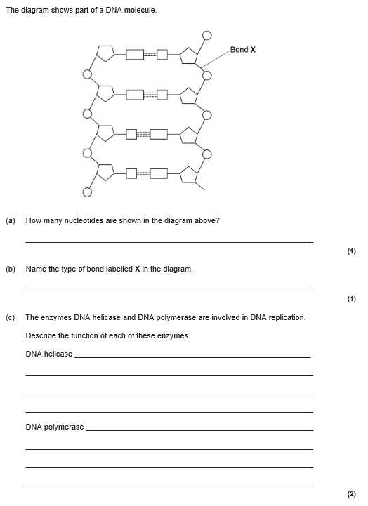


Slide 22


Slide 23




Slide 24
Topic 1: Biological Molecules - 3.1.6 ATP
Can you describe how a single molecule of adenosine triphosphate (ATP) is a nucleotide derivative?
Can you explain how ATP is converted to ADP? Include the type of reaction that it is and the enzyme that catalyses it.
Can you explain how ATP is resynthesised from ADP? Include the type of reaction that it is and the enzyme that catalyses it.
Draw a labelled molecule of ATP:
How is ATP adapted for its function? Explain these adaptions.
Name the processes ATP is needed for.

Slide 25



Slide 26



Slide 27

Topic 1: Biological Molecules - 3.1.7 Water and 3.1.8 Inorganic Ions
Draw a water molecule and explain what is meant by dipolar:
Explain how water hydrogen bonds:
Inorganic ions occur in solution in the cytoplasm and body fluids of organisms. Each ion has a specific role, depending on its properties.
Can you recognise the role of the following ions:
hydrogen ions and pH
iron ions as a component of haemoglobin
sodium ions in the co-transport of glucose and amino acids
phosphate ions as components of DNA and of ATP
What are the properties that are important in water? How are these properties linked the the polar nature of the molecule? What is the significance of these properties to living organisms and processes?
Try to use the following terms in your answer: solvent, specific heat capacity, latent heat of vaporisation, cohesion, metabolite, density, transparent.

