Slide 1
AS Level Paper 1 and 2. A2 Level Paper 1 and 3 - Topics 1-4
Section 3.1: Biological Molecules
3.1.1 Monomers and Polymers
3.1.2 Carbohydrates
3.1.3 Lipids
3.1.4.1 Proteins
3.1.4.2 Enzymes
3.1.5.1 Nucleic acid structure
3.1.5.2 DNA Replication
3.1.6 ATP
3.1.7 Water
3.1.8 Inorganic Ions
Section 3.3 Organisms exchange substances with their environment
3.3.1 Surface area to volume ratio
3.3.2 Gas exchange
3.3.3 Digestion and absorption
3.3.4.1 Mass transport in animals
3.3.4.2 Mass transport in plants
Section 3.4 Genetic information, variation and relationships between organisms
3.4.1 DNA, genes and chromosomes
3.4.2 DNA and protein synthesis
3.4.3 Genetic diversity - mutations and meiosis
3.4.4 Genetic diversity and adaptation – natural selection
3.4.5 Species and taxonomy
3.4.6 Biodiversity
3.4.7 Investigating biodiversity
Section 3.2: Cells
3.2.1.1 Eukaryotic cells
3.2.1.2 Prokaryotic cells and viruses
3.2.1.3 Studying cells
3.2.2 All cells arise from other cells
3.2.3 Transport across cell membranes
3.2.4 Cell recognition and the immune system

Slide 2
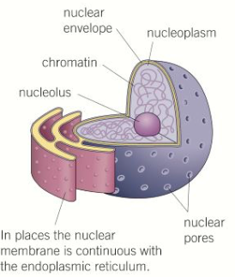
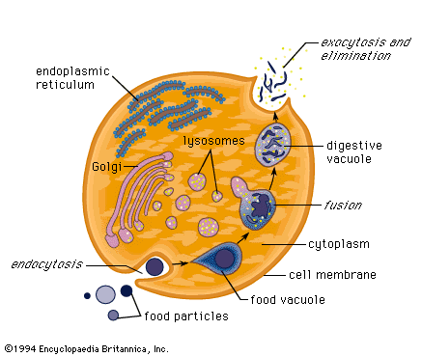
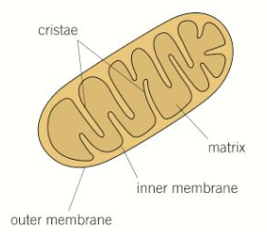
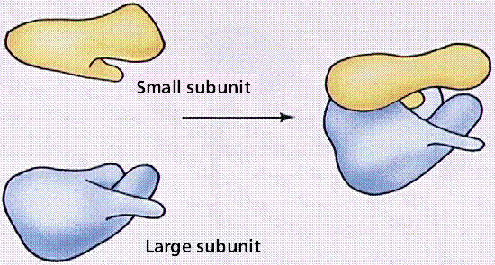
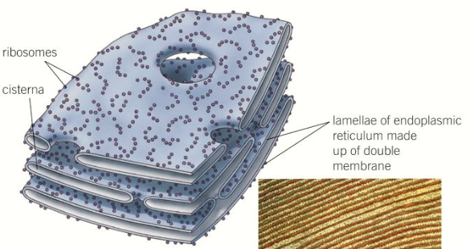
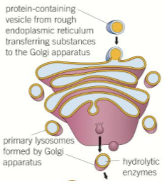
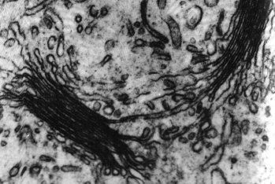
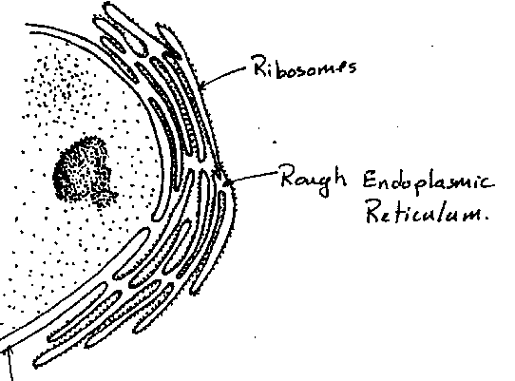
Topic 2: Cells - 3.2.1.1 Eukaryotic cells (p67-74)
Can you describe the structure and function of eukaryotic cells, including the:
Nucleus
Mitochondria
Golgi apparatus and Golgi vesicles
Can you describe the structure and function of eukaryotic cells, including the:
Lysosomes/vesicles
Ribosomes
Rough endoplasmic reticulum and smooth endoplasmic reticulum

Slide 3
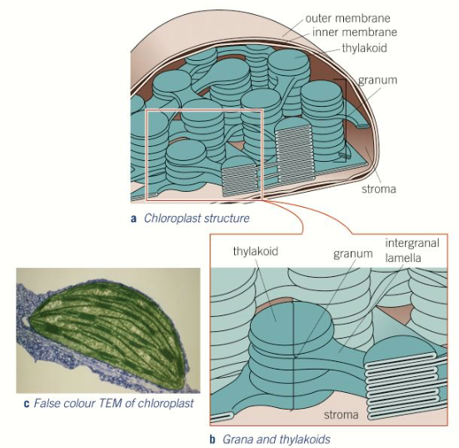
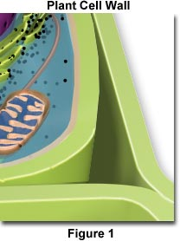
Topic 2: Cells - 3.2.1.1 Eukaryotic cells (p67-74)
Can you describe the structure and function of eukaryotic cells, including the:
Chloroplasts
Cell wall
Cell vacuole
Can you explain the adaptations of eukaryotic cells? Suggest organelles that you would expect to be numerous and well developed in the following cells:
Muscle cells
A sperm cell
Phagocytes
Liver cells
Describe any other specialised cells and suggest the cell ultrastructure you would expect them to have to carry out their function efficiently.

Slide 4
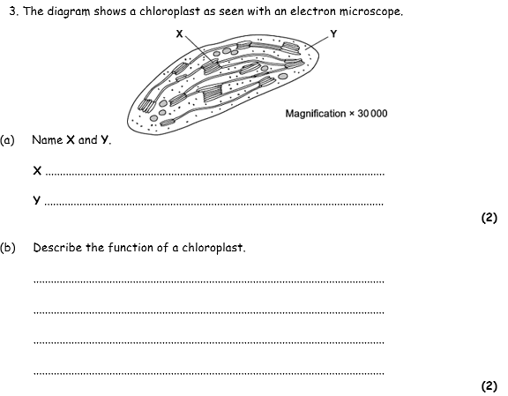
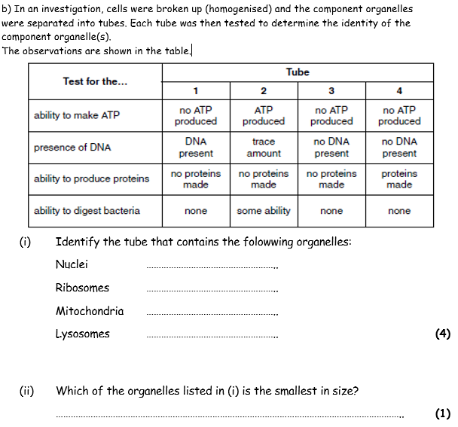
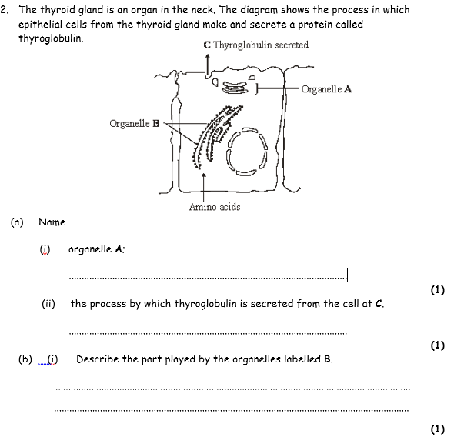

Slide 5
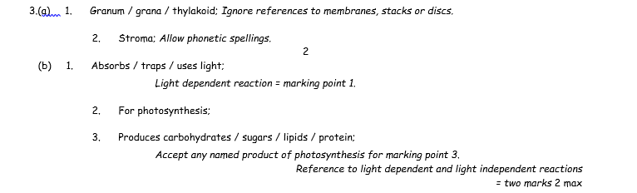
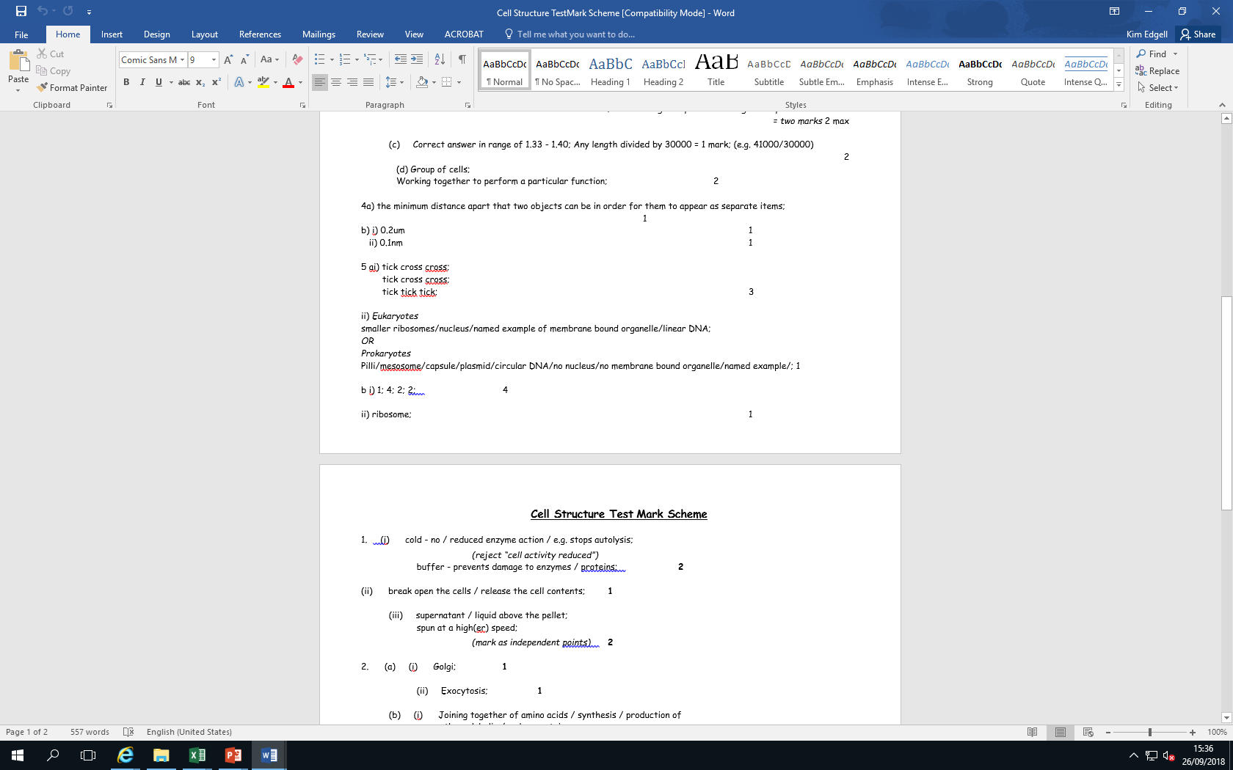


Slide 6
Topic 2: Cells - 3.2.1.1 Eukaryotic cells (p67-74)
What is cell differentiation and what are its advantages?
How are tissues are arranged into organs? Give some examples of organs in a plant and in an animal.
How are cells are arranged into tissues? Give some examples of tissues in a plant and in an animal.
How are organs arranged into organ systems? Give some examples of organ systems in a plant and in an animal.

Slide 7
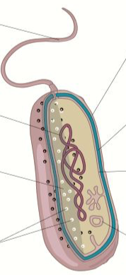
Topic 2: Cells - 3.2.1.2 Prokaryotic cells and viruses (p75-76)
Can you explain how prokaryotic cells differ from eukaryotic cells?
Label this prokaryotic cell and explain the role of each part: Highlight which features are ALWAYS present.
Make a COMPARE and CONTRAST table for Prokaryotic Vs Eukaryotic cells

Slide 8
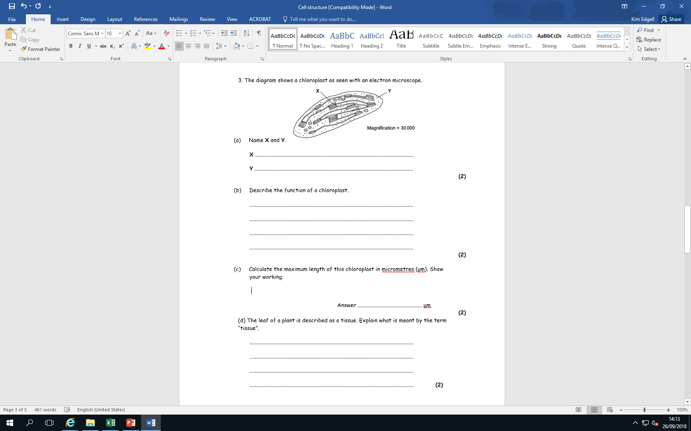
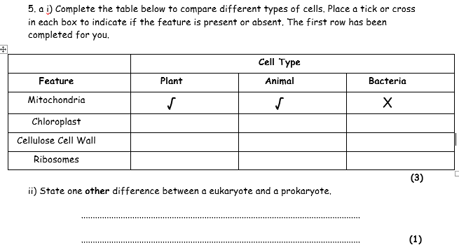

Slide 9
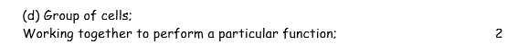

Slide 10
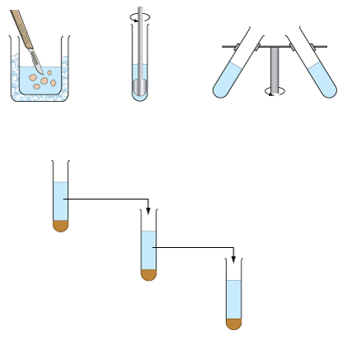
Topic 2: Cells - 3.2.1.3 Studying cells (p58-66)
Can you explain the difference between magnification and resolution?
Before cell fractionation, the tissue is placed in what type of solution (3 key words)?
Can you describe the principles of cell fractionation and ultracentrifugation in separating cell components?
How do you calculate magnification and the size of the real object? How do you work out magnification using a scale bar?
Unit | Symbol | Conversion
millimetre
micrometre
nanometre

Slide 11
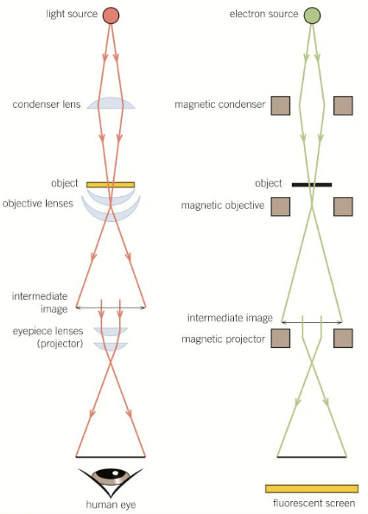
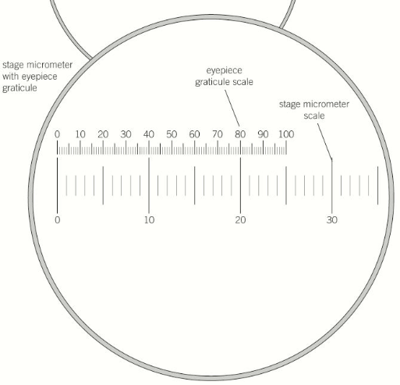
Topic 2: Cells - 3.2.1.3 Studying cells (p58-66)
Can you describe how a light microscope works and explain the limitations of it:
Make a COMPARE and CONTRAST table for Scanning Vs Transmission electron microscopes.
Can you explain how you would use an eyepiece graticule to measure cells:
How would you set up a temporary mount?

Slide 12
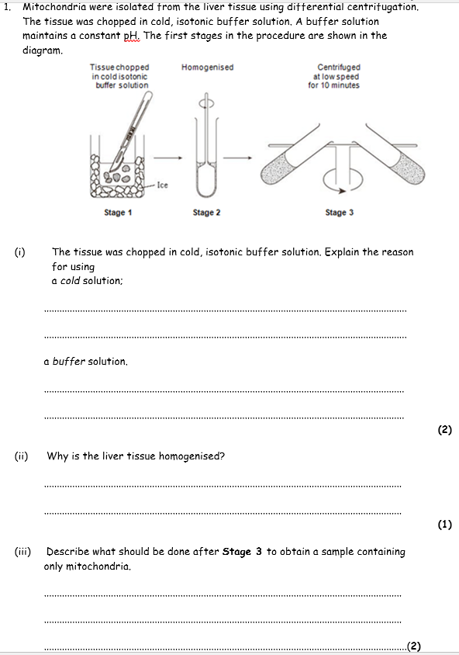
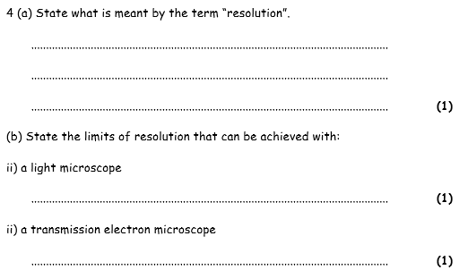

Slide 13
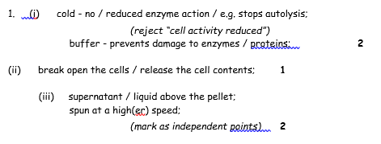


Slide 14
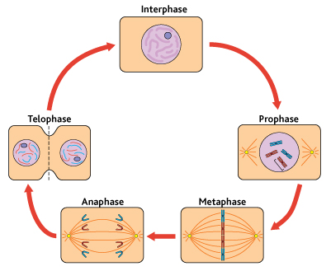
Topic 2: Cells - 3.2.2 All cells arise from other cells – Mitosis
Draw a chromosome before interphase and after interphase.
Draw and label the structure in the nucleus. You should have 5 labels and functions.
Can you describe the behaviour of chromosomes during interphase, prophase, metaphase, anaphase and telophase of mitosis?
What is the importance of mitosis?

Slide 15
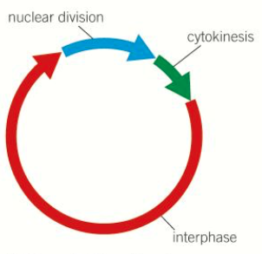
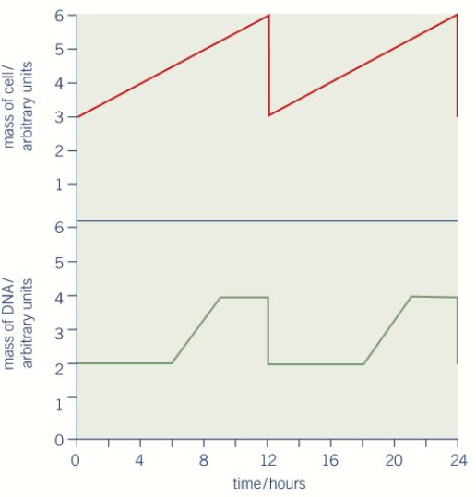
Topic 2: Cells - 3.2.2 All cells arise from other cells – Cell cycle (p77-79)
Describe the three stages of the cell cycle:
What can uncontrolled cell division lead to? Explain why.
Some cancer treatments are directed at controlling the rate of cell division. How might they disrupt the cell cycle? What is the problem with these types of drugs?
How do prokaryotic cells divide?
How do viruses replicate?

Slide 16
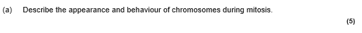
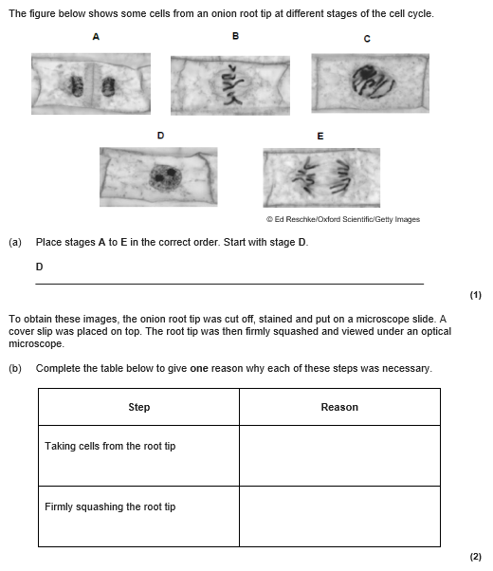
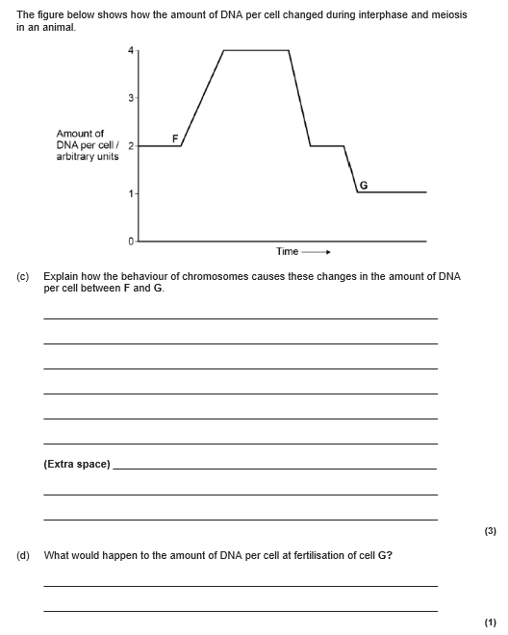

Slide 17
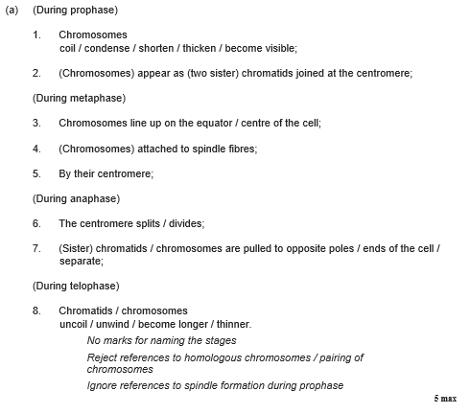
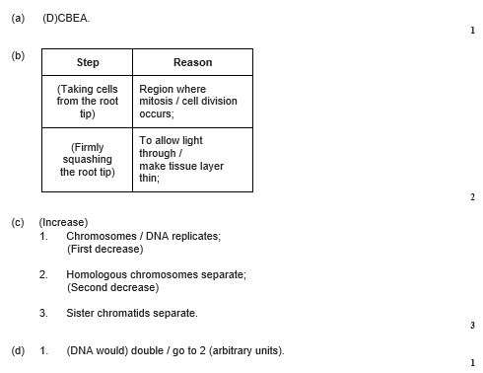

Slide 18
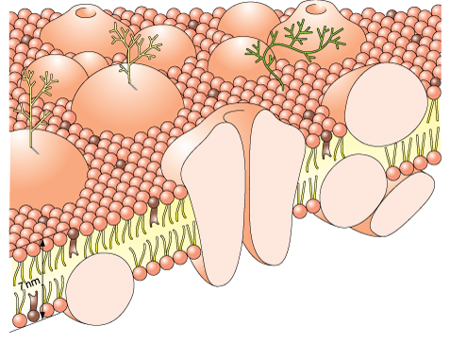
Topic 2: Cells - 3.2.3 Transport across cell membranes – Cell-surface membrane
Can you describe and label the fluid-mosaic model of membrane structure?
Why are phospholipids present in cell membranes?
Why are proteins present in cell membranes?
Why are glycoproteins present in cell membranes?
Why are glycolipids present in cell membranes?
Why is cholesterol present in cell membranes?
Explain the permeability of the cell-surface membrane:

Slide 19
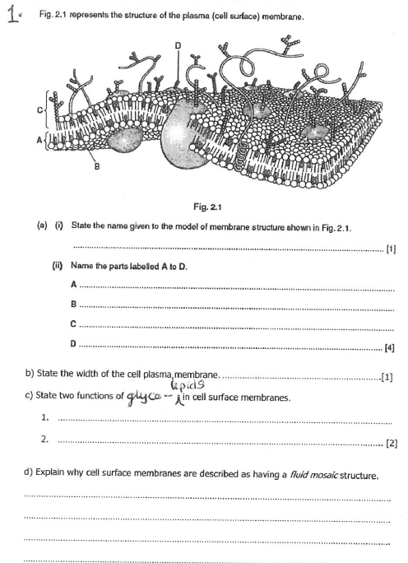

Slide 20
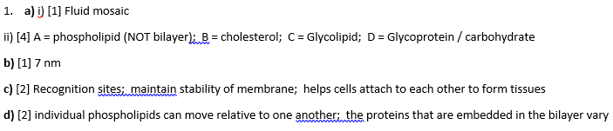

Slide 21
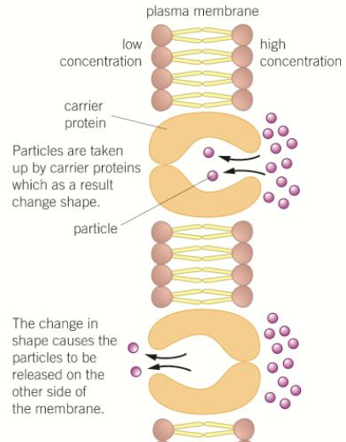
Topic 2: Cells - 3.2.3 Transport across cell membranes – Diffusion
What is diffusion? Draw a diagram to help you explain.
What is facilitated diffusion? Name the proteins used and the type of mols with examples.
Why does simple diffusion happen?
What affects the rate of diffusion?

Slide 22
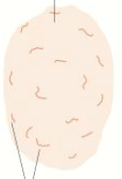
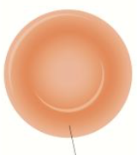

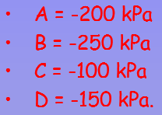
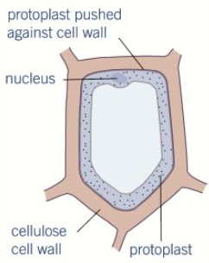
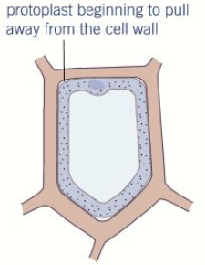
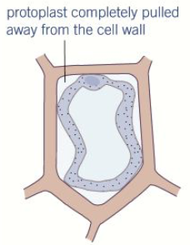
Topic 2: Cells - 3.2.3 Transport across cell membranes – Osmosis
What is osmosis? Draw a diagram to help you explain.
How does osmosis affect animal cells? Give the terms for the cell shapes
Explain what is meant by the terms solute, water potential and solution:
Why does osmosis happen?
How does osmosis affect plant cells? Give the term for the cell shapes. Why don’t plant cells burst?
What is the symbol for WP and give the highest water potential

Slide 23
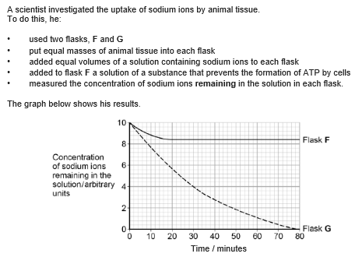
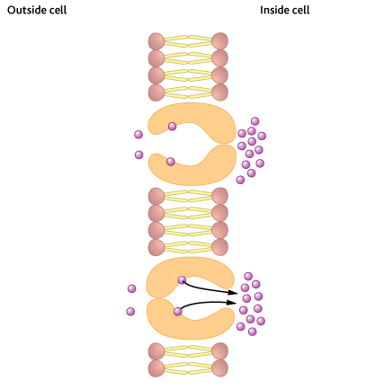
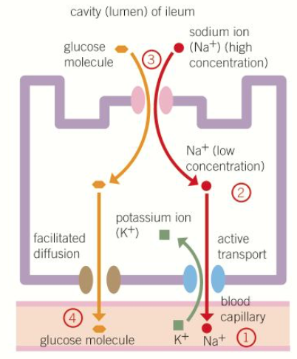
Topic 2: Cells - 3.2.3 Transport across cell membranes – Active Transport & Co-transport
What is active transport? What does active transport require?
Describe the graph showing different types of transport.
How could cells be adapted for rapid transport across their internal or external membranes?
Label the diagram to explain active transport: Name the types of protein and the types of mols with examples
What is co-transport? Use the diagram to explain how the process happens in the intestine:

Slide 24
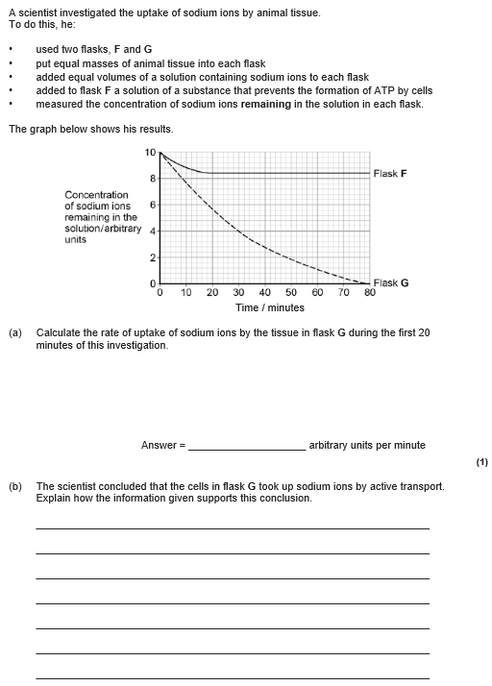
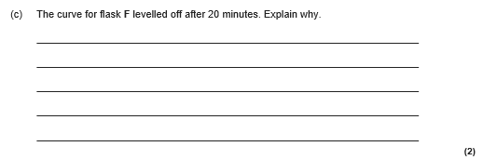

Slide 25
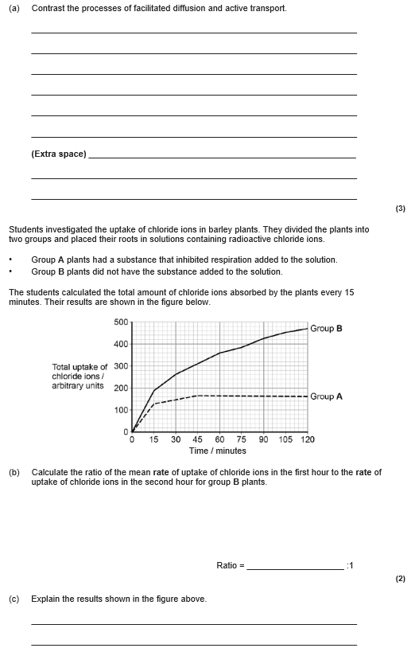
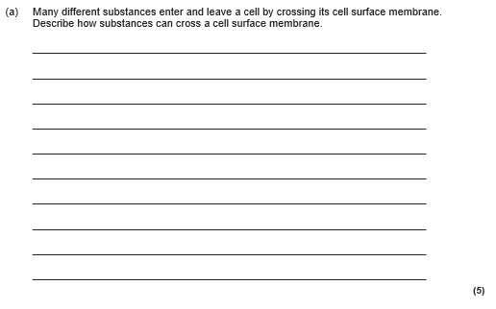

Slide 26




Slide 27

Topic 2: Cells - 3.2.4 Cell recognition and the immune system – Defence mechanisms & Phagocytosis
What are non-specific responses?
How does the body distinguish between its own cells and foreign material? Give some examples of foreign material.
Label the diagram to explain the process of phagocytosis:
What are specific responses?
Draw a diagram and label the Antigen, antibody, pathogen. Add definitions to the terms

Slide 28

Topic 2: Cells - 3.2.4 Cell recognition and the immune system – T lymphocytes and cell-mediated immunity
What are the 2 different types of lymphocytes?
What is cell-mediated immunity? Use the diagram to explain the five steps:
What is the role of antigen-presenting cells in the cellular response?
How do cytotoxic T cells kill infected cells?

Slide 29


Topic 2: Cells - 3.2.4 Cell recognition and the immune system – B lymphocytes and humoral immunity
Can you describe the role of helper T cells (TH cells)?
What is humoral immunity? Use the diagram to explain:
Can you describe the response of B lymphocytes to a foreign antigen?
What are plasma cells, describe their function.
What are memory cells? What type of immune response do they produce?

Slide 30





Slide 31





Slide 32
Topic 2: Cells - 3.2.4 Cell recognition and the immune system – Antibodies
Draw and label the structure of an antibody:
What are monoclonal antibodies? How are they produced?
How can monoclonal antibodies be used to target specific cell types?
Can you describe the ethical issues associated with the use of monoclonal antibodies?
How can monoclonal antibodies be used in medical diagnosis?
Can you explain the formation of an antigen-antibody complex? Draw and label a picture.

Slide 33

Topic 2: Cells - 3.2.4 Cell recognition and the immune system – Vaccination
What is passive immunity? Give an example
What is active immunity? Give an example
Contrast active and passive immunity? Make a table
What is a vaccination?
What is natural immunity? Give an example
What is active immunity? Give an example
What is herd immunity?
Can you describe the ethical issues associated with the use of vaccines?

Slide 34



Slide 35



Slide 36

Topic 2: Cells - 3.2.4 Cell recognition and the immune system – H.I.V
Can you describe the structure of the human immunodeficiency virus (HIV) and its replication in helper T cells?
Can you explain how HIV causes the symptoms of AIDS?
Can you explain how antibodies are used in the ELISA test?
Can you explain why antibiotics are ineffective against viruses?
Can you explain why viruses are non-living?

