Slide 1
A2 Level Paper 2 and 3 - Topics 5-8
Section 5: Energy transfer in and between organisms
3.5.1 Photosynthesis
3.5.2 Respiration
3.5.3 Energy and ecosystems
3.5.4 Nutrient Cycles
Section 7: Genetics, populations, evolution and ecosystems
3.7.1 Inheritance
3.7.2 Populations
3.7.3 Evolution may lead to speciation
3.7.4 Populations in ecosystems
Section 8: Control of gene expression
3.8.1: Alteration of sequence of bases in DNA can alter the structure of proteins
3.8.2.1 Most of cell’s DNA is not translated
3.8.2.2 Regulation of transcription and translation
3.8.2.3 Gene expression and cancer
3.8.3 Using genome projects
3.8.4.1 Recombinant DNA technology
3.8.4.2 Differences in DNA between same species can be exploited for identification and diagnosis
3.8.4.3 Genetic fingerprinting
Section 6: Stimuli, both internal and external, are detected and lead to a response.
3.6.6.1 Survival and response
3.6.1.2 Receptors
3.6.1.3 Control of heart rate
3.6.2.1 Nerve impulses
3.6.2.2 Synaptic transmission
3.6.3 Skeletal muscles
3.6.4.1 Principles of homeostasis and negative feedback
3.6.4.2 Control of blood glucose concentration
3.6.4.3 Control of blood water potential.

Slide 2
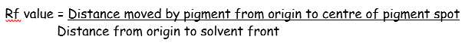
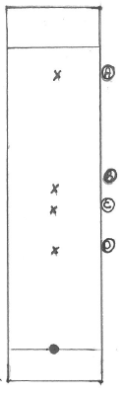
Topic 5: Photosynthesis - 3.5.1: Required prac 7 and 8
Write a method for how you extracted photosynthetic pigments from leaves
Write a method for how you would investigate the effect of temperature on the rate of photosynthesis.
Calculate the Rf values using equation below:
Describe how you would make the results more accurate and more precise.

Slide 3
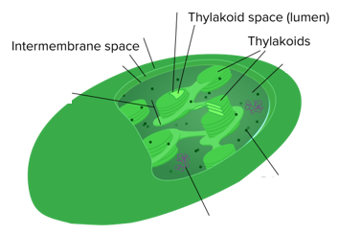
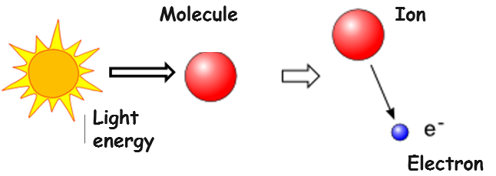
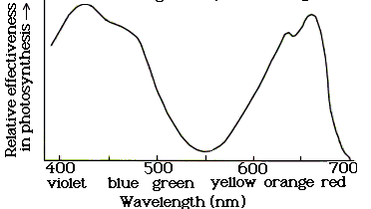
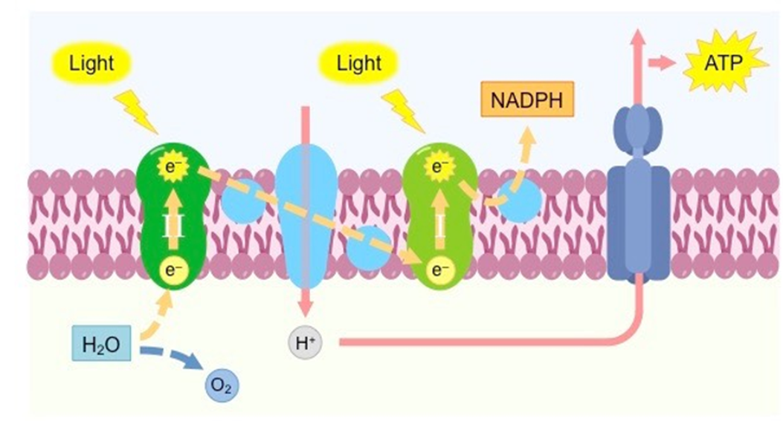
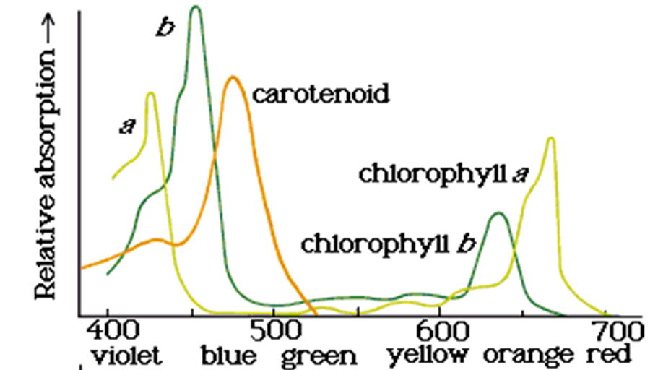
Topic 5: Photosynthesis - 3.5.1: Light dependent reaction
Label the structure and function of a chloroplast. Label where the light dependent and light independent reactions occur.
Define photoionization
Describe and explain the action spectrum:
Describe the light dependent stage:
Describe and explain the absorption spectrum:

Slide 4
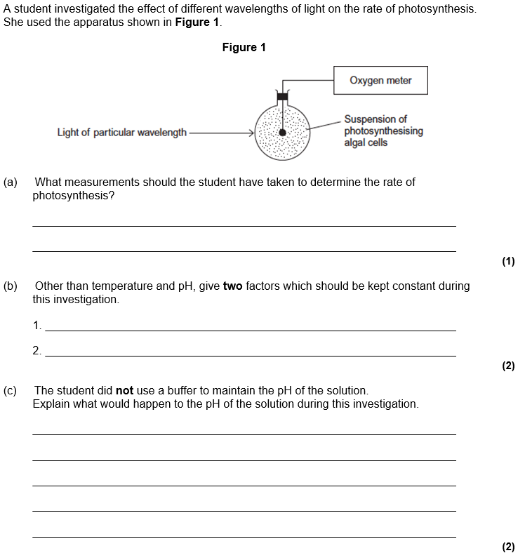
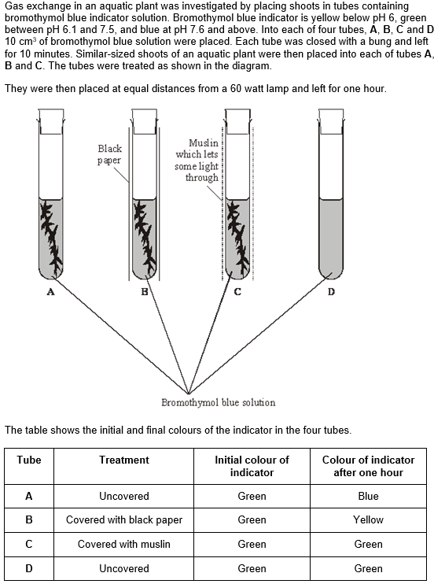
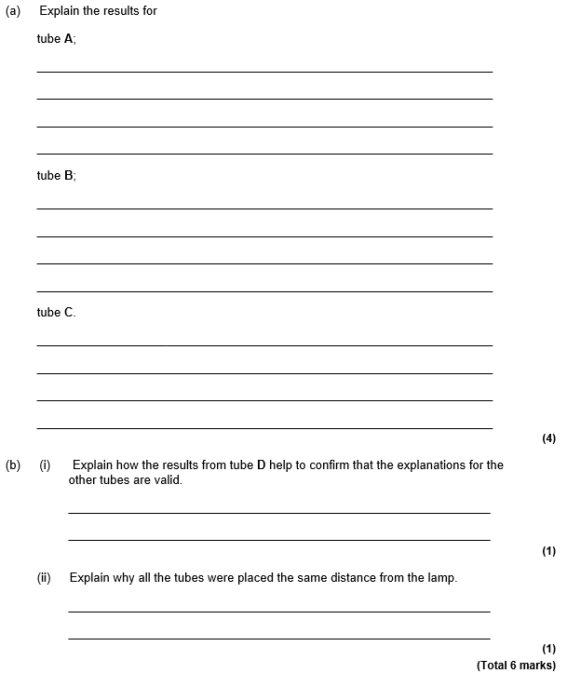
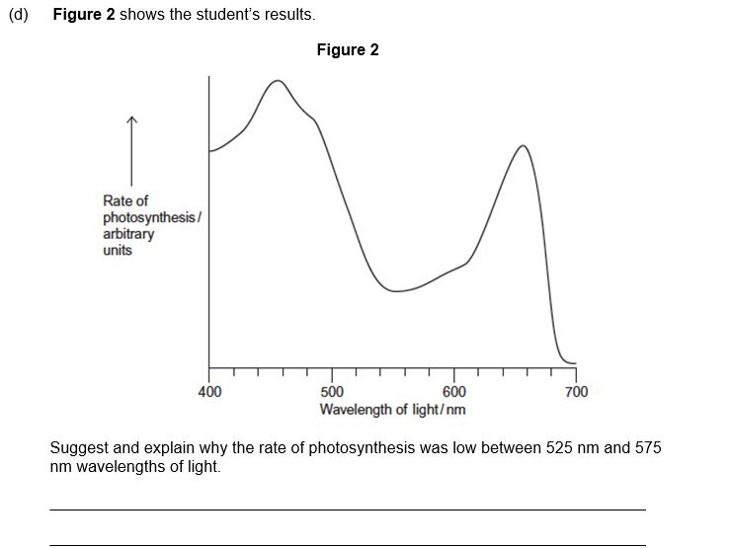
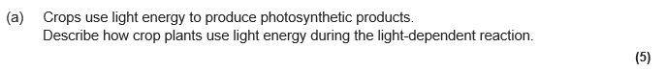

Slide 5
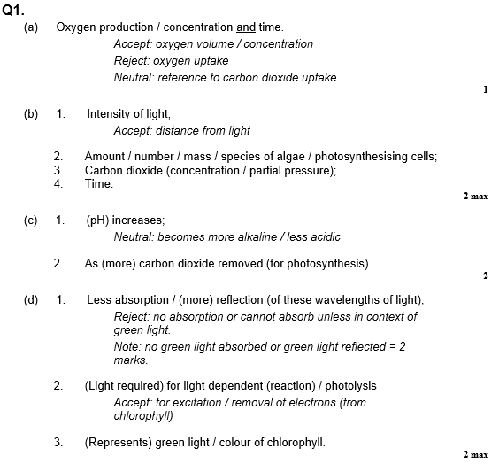
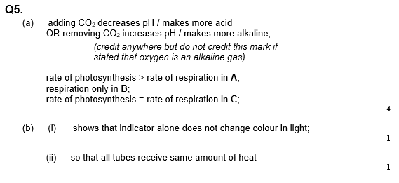
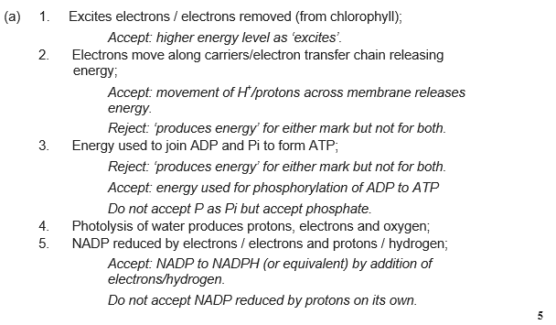

Slide 6
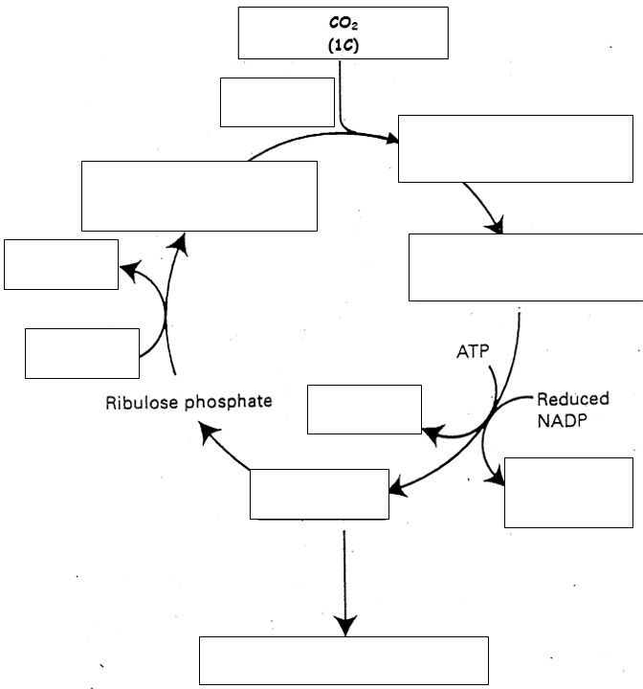
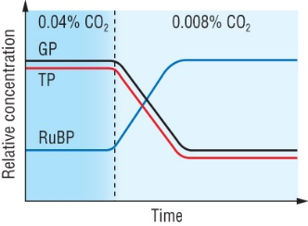
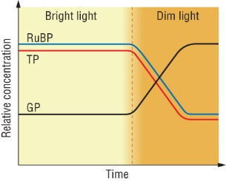
Topic 5: Photosynthesis - 3.5.1: Light independent reaction
Describe the Calvin cycle/Light independent reaction:
Define and list the different “limiting factors”
Describe and explain the effect of CO2 on the rate of photosynthesis:
List and describe how farmers control these limiting factors.
Describe and explain the effect of light intensity on the rate of photosynthesis:

Slide 7
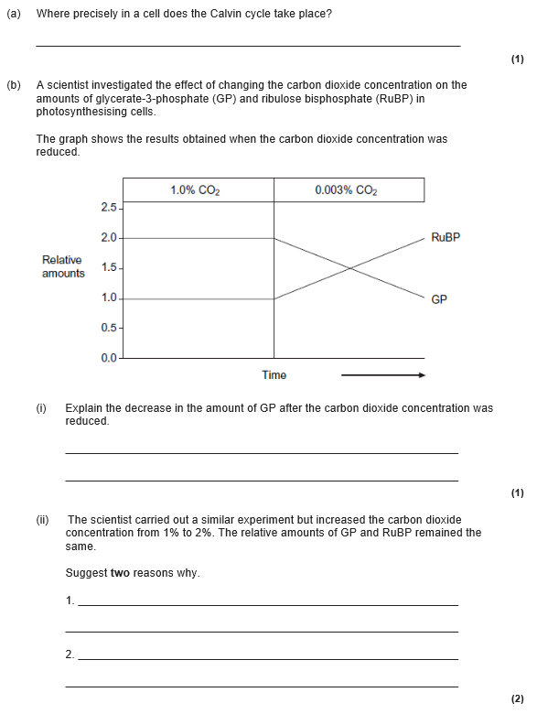
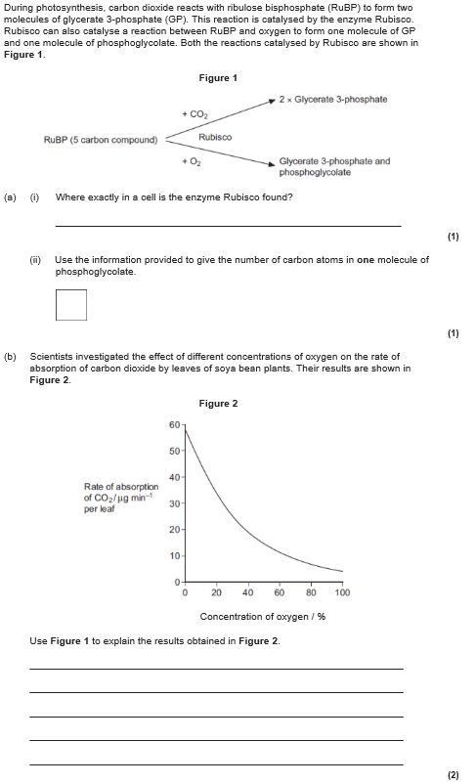
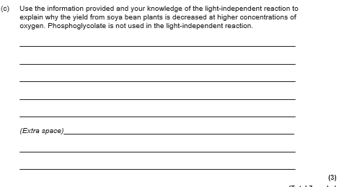
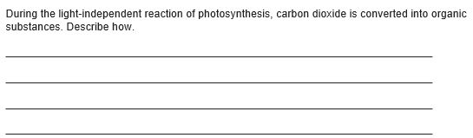

Slide 8
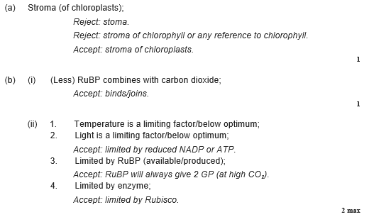
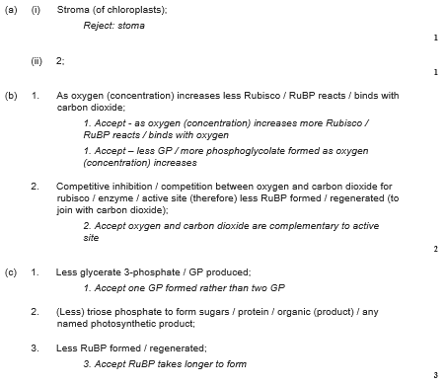
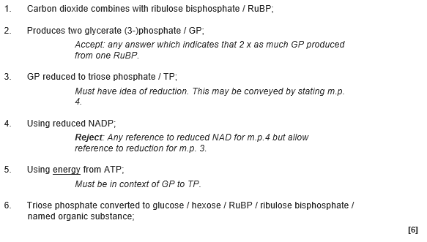

Slide 9
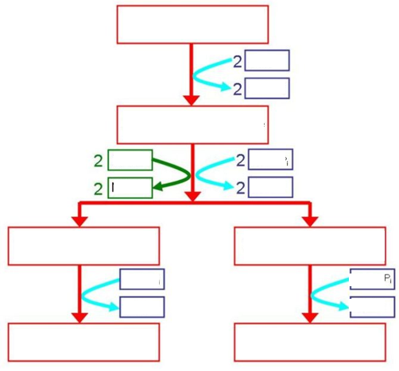
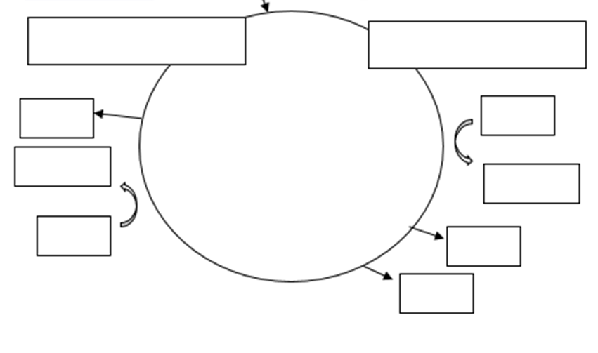
Topic 5: Respiration - 3.5.2: Glycolysis, link, krebs
Can you label glycolysis and state where it occurs:
Draw and label the structures of the mitochondria. Label where the stages occur
Draw and label the link reaction.
Label the Kreb cycle and state where it occurs
Draw and label a molecule of ATP from Year 1 revision.

Slide 10
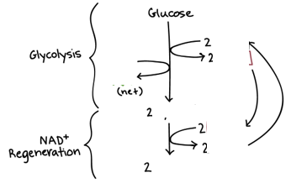
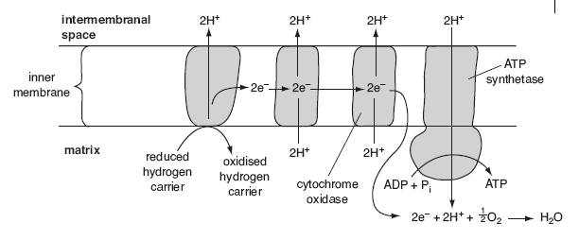
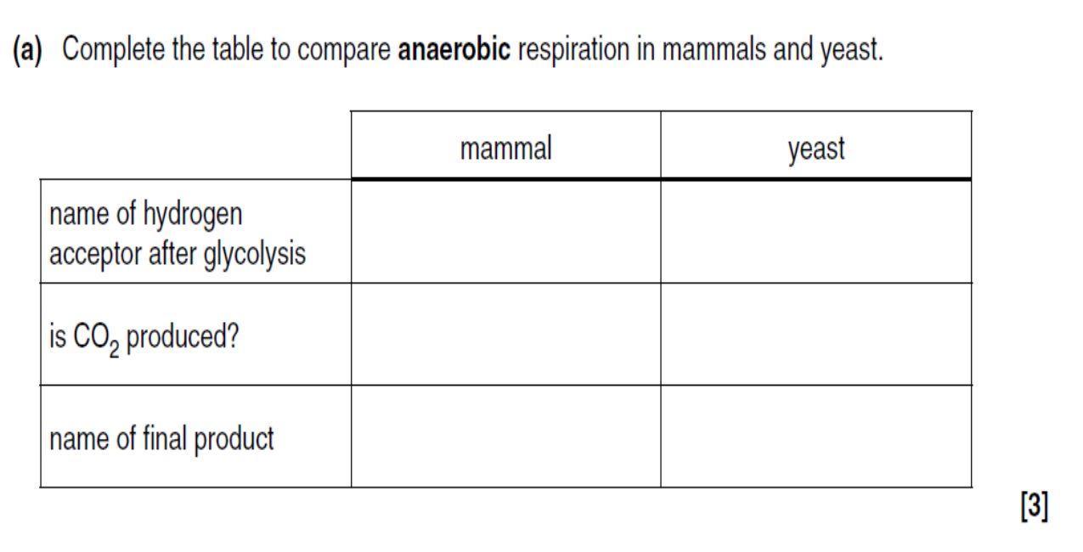
Topic 5: Respiration - 3.5.2: Oxidative phosphorylation, anaerobic respiration
Add labels to the diagram below.
Complete the lactate pathway:
Draw the ethanol pathway:
1
2
13
12
11
3
4e)
6 (process)
10
5
7
9
8
Can you describe why some cells respire proteins instead of glucose?
Can you describe why some cells respire lipids instead of glucose?

Slide 11
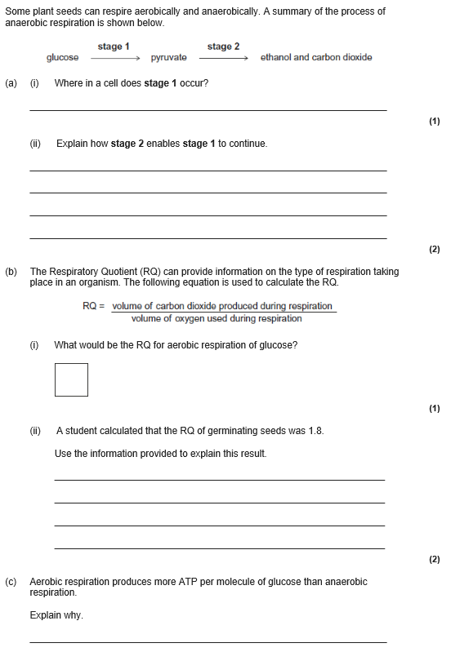
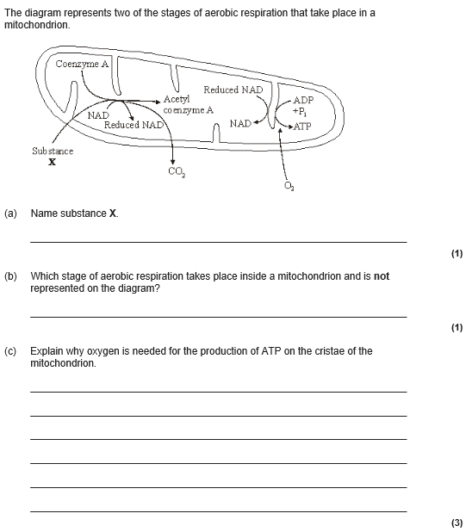

Slide 12
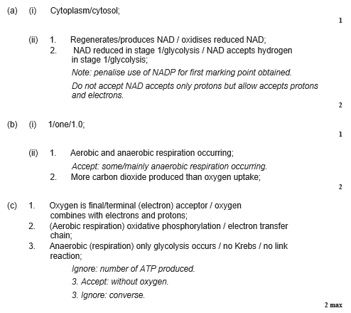
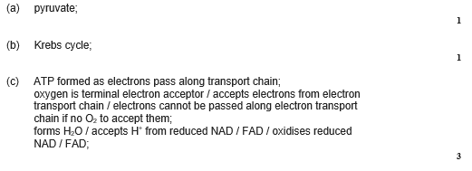

Slide 13
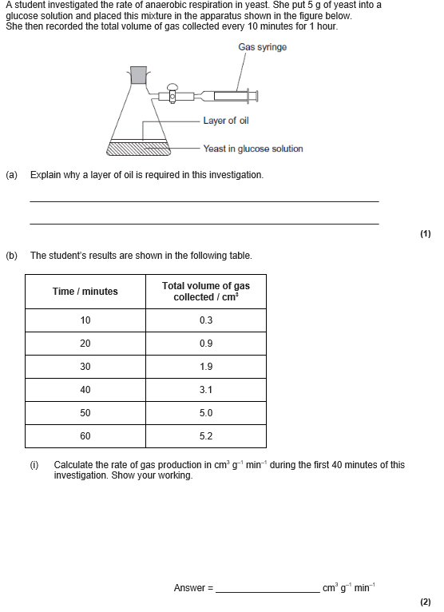
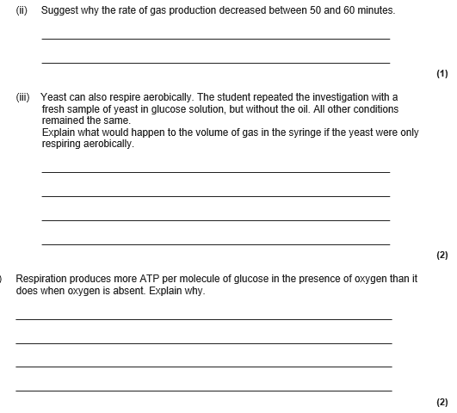

Slide 14
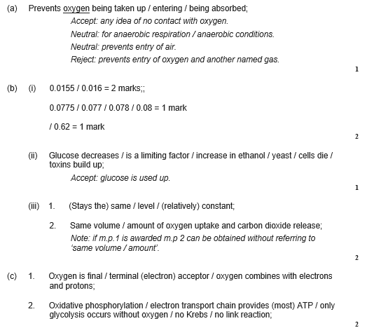

Slide 15
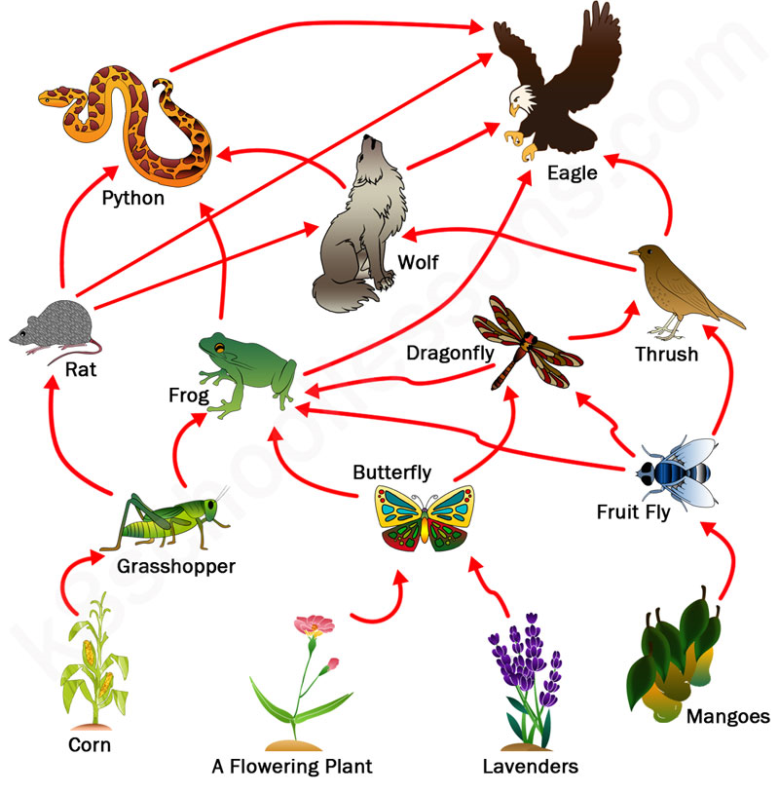
Topic 5: Energy and ecosystems- 3.5.3: food chains and webs.
Describe the connection between photosynthesis, respiration and Biomass
Add the definitions to the diagram below.
Complete the definitions:
Producer
Consumer
Saprobionts
Food chain
Food web
Trophic level
Biomass
Write a method for Calorimetry include suitable units for biomass:

Slide 16
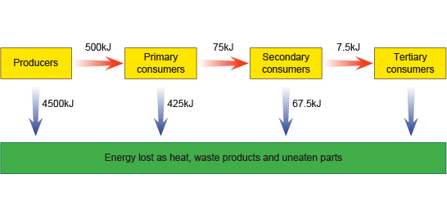
Topic 5: Energy and ecosystems- 3.5.3: NPP, GPP and efficiency
Show the equation that links NPP, GPP and respiratory losses.
Show the equation for the net production between consumers
Define:
NPP
GPP
NPP calculation shows the amount of energy available from the producer to the 1st consumer ONLY. Explain why ~10% of the NPP is actually passed onto the 1st consumer.
Explain ~10% of the energy available is actually passed between consumers. You need at least 3 points.
Explain why plants are only able to convert 1-3% of the sun’s energy into organic matter. You need at least 4 points.
Add labels showing how you would calculate energy efficiency at the different levels in a good chain.
Write out the % energy efficiency calculation

Slide 17
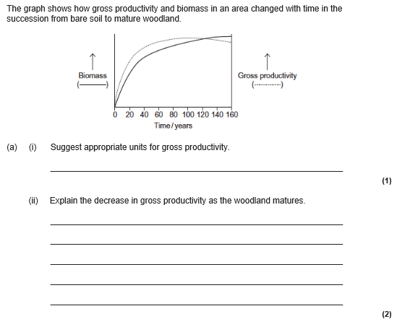
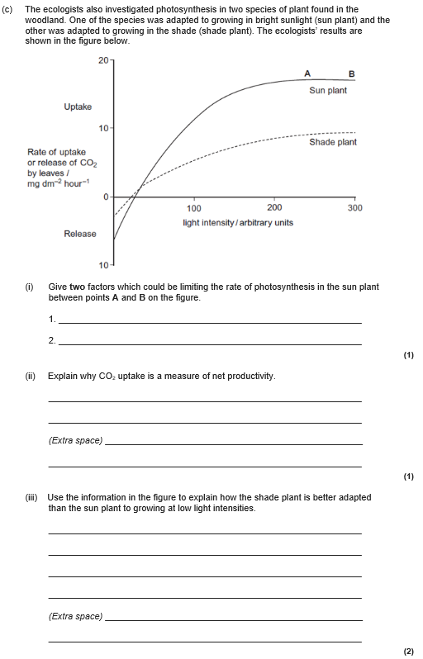

Slide 18
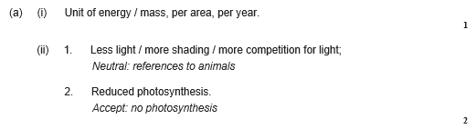
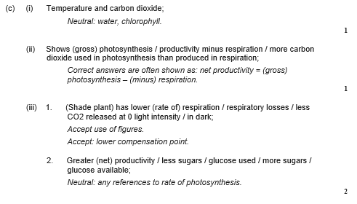

Slide 19
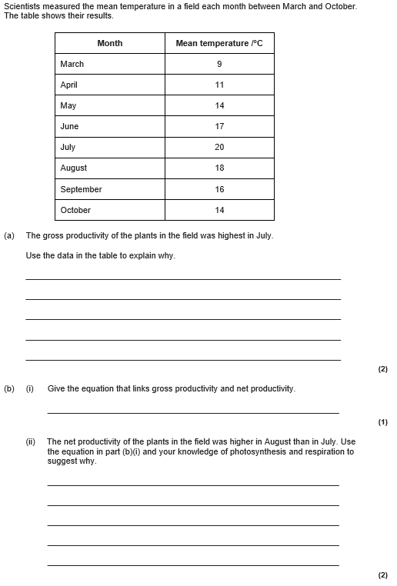

Slide 20
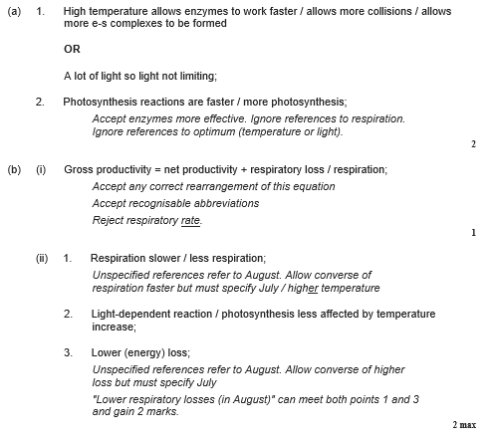

Slide 21
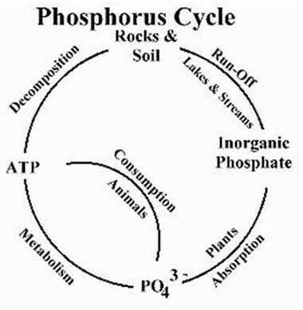
Topic 5: Nutrient Cycle- 3.5.4: Phosphorus and Nitrogen cycle
Describe the stage of the phosphorus cycle: The phosphorus cycle rocks!
Draw and describe the stage of the Nitrogen cycle include the names of the stages (ammonification, nitrification, nitrogen fixation and denitrification), the bacteria and if they are aerobic or anaerobic:
Describe the role of the mycorrhizae and explain why they are important to plants.

Slide 22
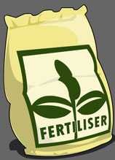
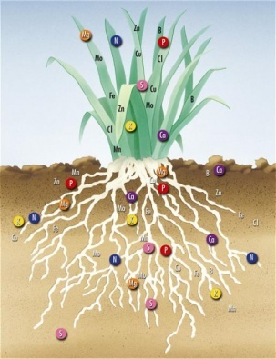
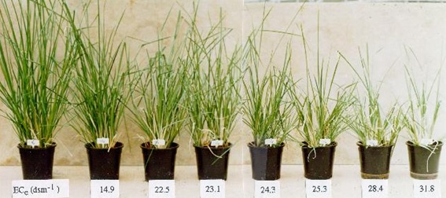
Topic 5: Nutrient Cycle- 3.5.4: Fertilizer and environmental issues
Describe the process of leaching:
Describe the difference between natural and artificial fertilisers:
Draw and describe the steps in eutrophication:
Describe the effect of using fertilisers on biomass, link this to your ecosystem work:

Slide 23
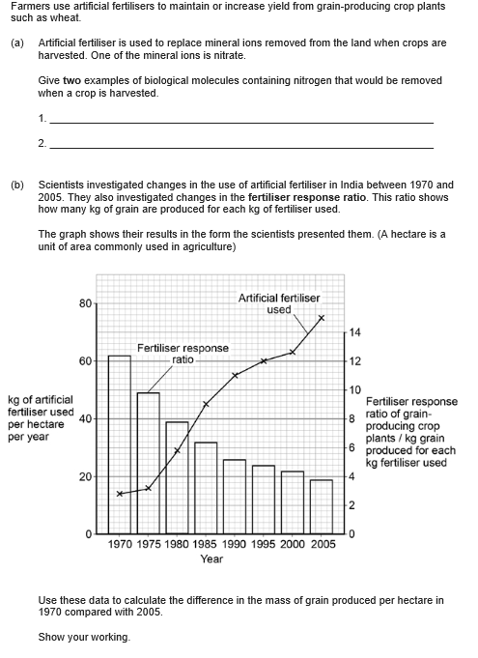


Slide 24


Slide 25



Slide 26


