Slide 1
A2 Level Paper 2 and 3 - Topics 5-8
Section 5: Energy transfer in and between organisms
3.5.1 Photosynthesis
3.5.2 Respiration
3.5.3 Energy and ecosystems
3.5.4 Nutrient Cycles
Section 7: Genetics, populations, evolution and ecosystems
3.7.1 Inheritance
3.7.2 Populations
3.7.3 Evolution may lead to speciation
3.7.4 Populations in ecosystems
Section 8: Control of gene expression
3.8.1: Alteration of sequence of bases in DNA can alter the structure of proteins
3.8.2.1 Most of cell’s DNA is not translated
3.8.2.2 Regulation of transcription and translation
3.8.2.3 Gene expression and cancer
3.8.3 Using genome projects
3.8.4.1 Recombinant DNA technology
3.8.4.2 Differences in DNA between same species can be exploited for identification and diagnosis
3.8.4.3 Genetic fingerprinting
Section 6: Stimuli, both internal and external, are detected and lead to a response.
3.6.6.1 Survival and response
3.6.1.2 Receptors
3.6.1.3 Control of heart rate
3.6.2.1 Nerve impulses
3.6.2.2 Synaptic transmission
3.6.3 Skeletal muscles
3.6.4.1 Principles of homeostasis and negative feedback
3.6.4.2 Control of blood glucose concentration
3.6.4.3 Control of blood water potential.

Slide 2
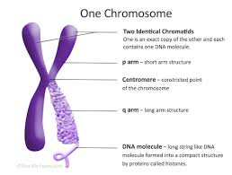
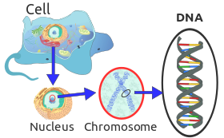
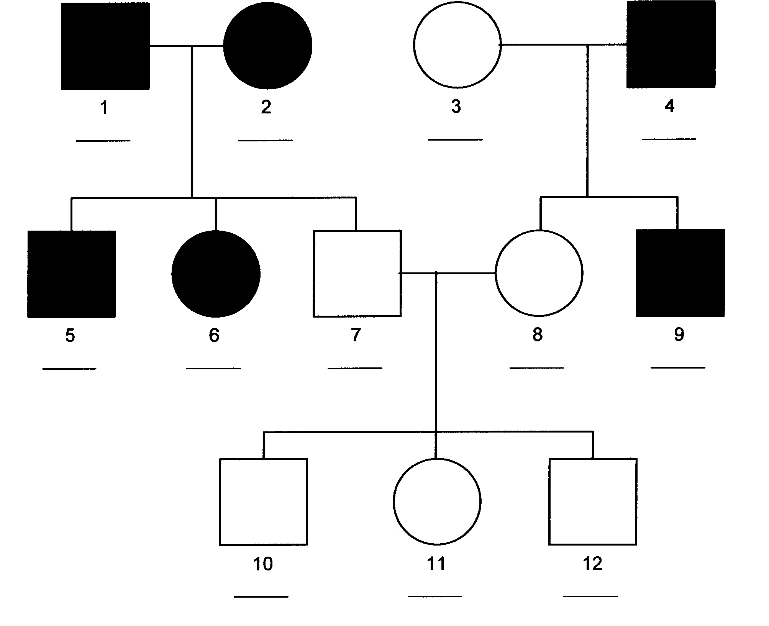
Topic 7: Inheritance - 3.7.1: Terms and monohybrid
Label the chromosome structure below and define each term:
Gene, allele, genotype, phenotype, chromosome, chromatid, sister chromatids, homozygous, heterozygous
Define dominant, recessive, co-dominant, multiple alleles, sex-linkage dihybrid, linkage, epistasis.
Draw a monohybrid cross. Green pea pods are dominant over yellow pea pods. 2 heterozygote green pea pods are cross. Show the potential offspring.
Explain why this pedigree shows the expression of a dominant allele:

Slide 3
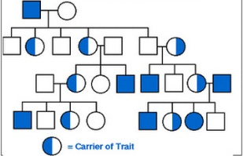
Topic 7: Inheritance - 3.7.1: Co-dominance, multiple alleles, sex-linkage
Draw a co-dominance cross. A white flower is crossed with a red flower producing pink offspring. Draw a cross showing how this is possible.
Draw a monohybrid cross- Multiple alleles. Blood group A and B are codominant over O, it is possible for 2 parents of different blood groups to have a children showing all 4 possible blood groups. Prove it.
Draw a monohybrid cross- sex-linked. A mum who is a carrier for hemophilia had a son with non hemophiliac male. Show the cross.
Explain the pattern of inheritance for this disease using a pedigree: Hint: it is one of the examples of this sheet.

Slide 4
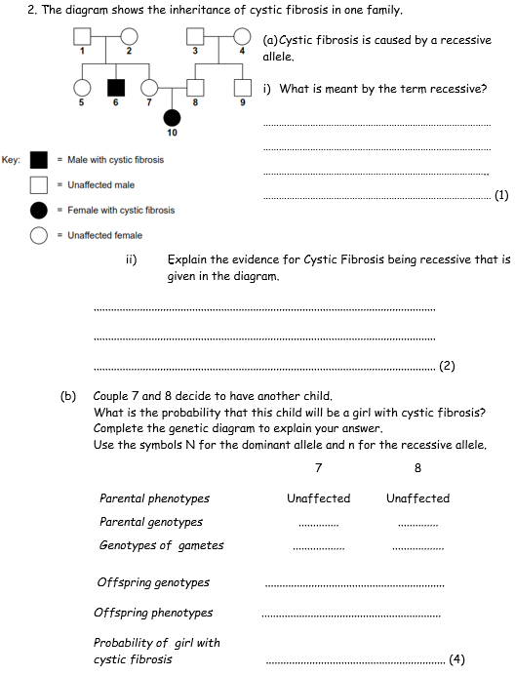
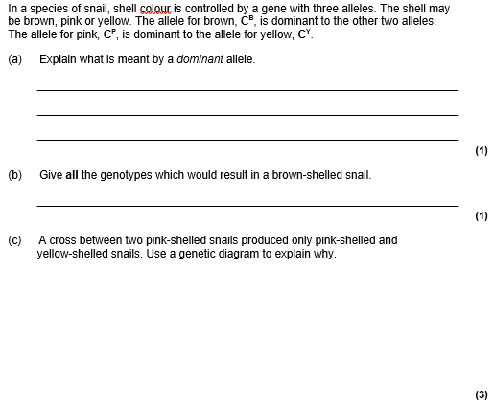
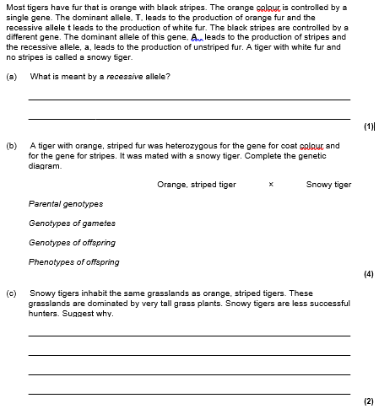

Slide 5
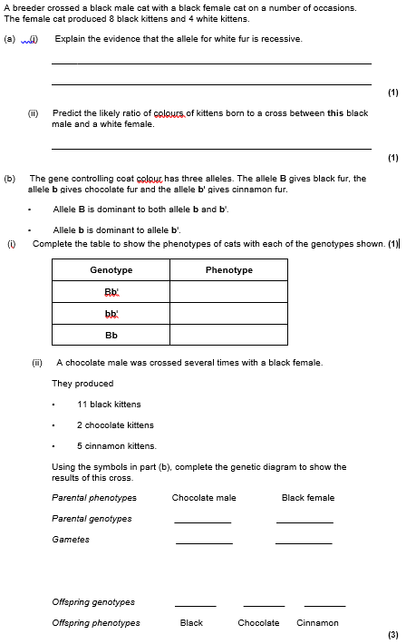
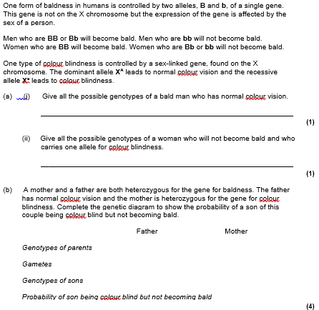

Slide 6
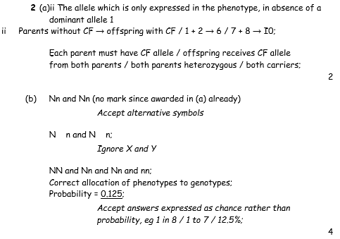
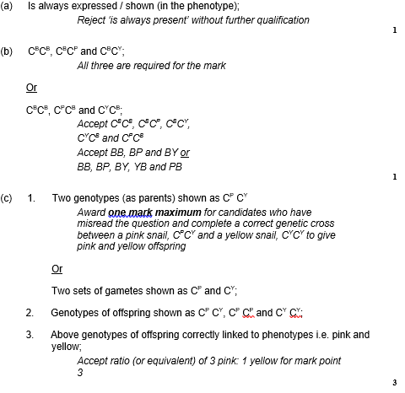
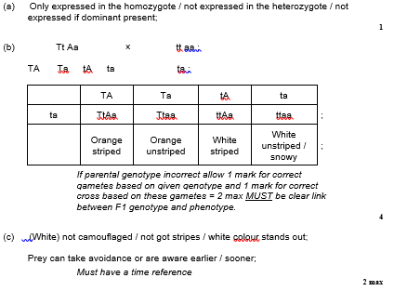

Slide 7
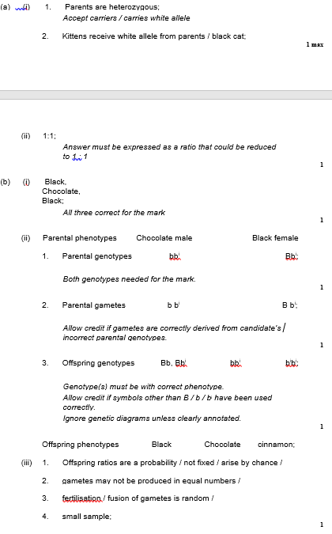
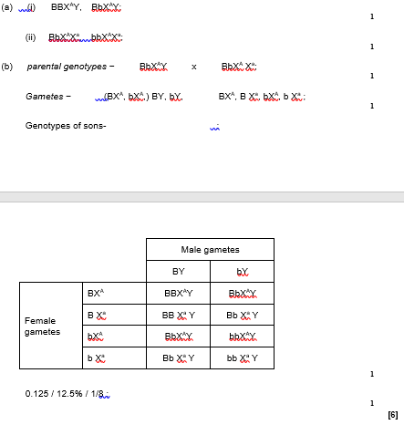

Slide 8
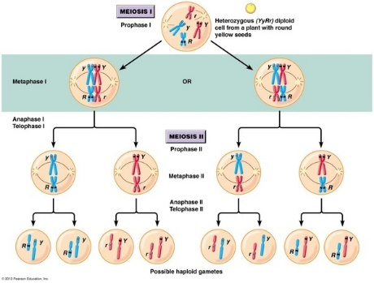
Topic 7: Inheritance - 3.7.1: Dihybrid.
Describe the processes that cause variation during meiosis, explain how these processes lead to variation.
Draw a dihybrid cross. Grey body is dominant to white body in fruit flies, straight wing is dominant to bent wings. A homozygous grey, straight winged fly was crossed with a heterozygous grey, straight winged fly.
Parental genotype | Possible gamete combo
AABB | (1)
AAbb | (1)
AaBB | (2)
AaBb | (4)

Slide 9
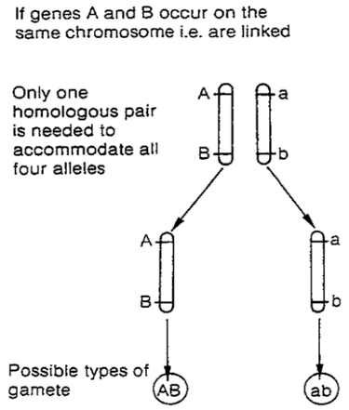
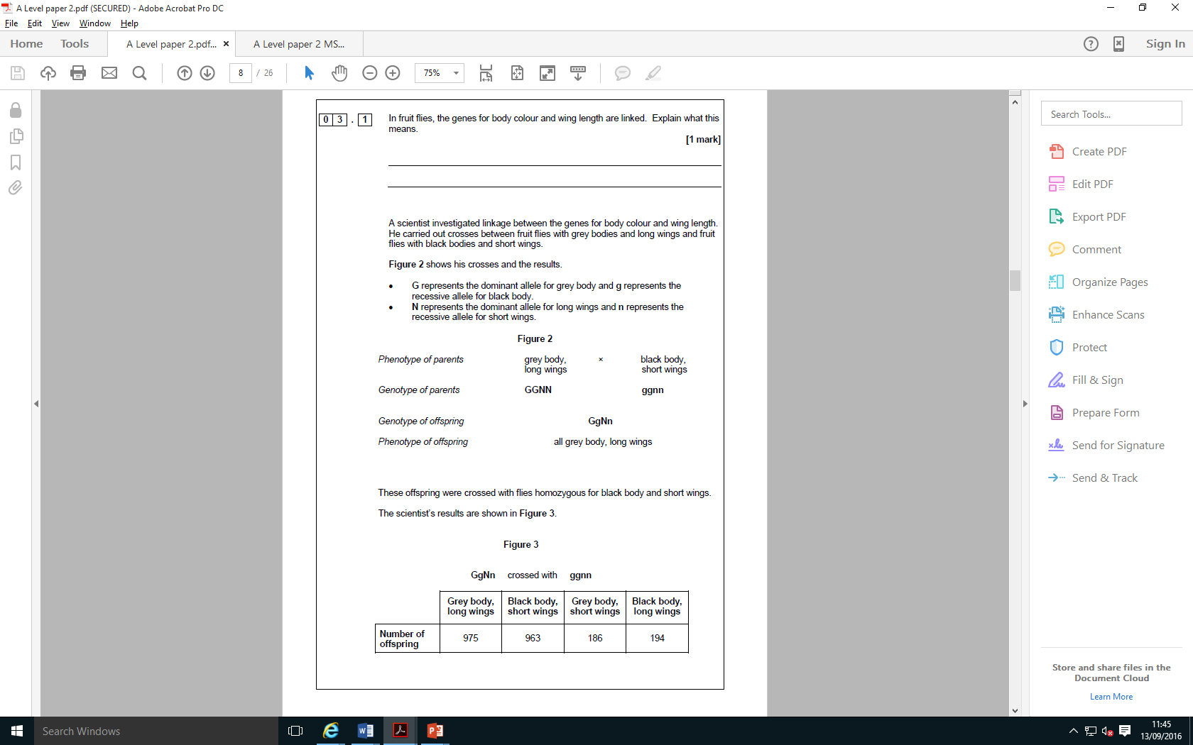
Topic 7: Inheritance - 3.7.1: Epistasis, autosomal linkage .
Define Dominant Epistasis
Define autosomal linkage:
The dom A allele masks the expression of the B allele. A= Purple fruit, E= Pink fruit, e= green fruit. Complete the table.
AaBb
AAbb
aaBB
aaBb
aabb
Describe how linkage affect allele combinations
Define Recessive Epistasis
Explain how linkage affects phenotypes. The expected results for this cross should be 1:1:1:1, the observed results do not show this explain why.
The homo rec allele dd masks the expression of the E allele. aa= white leaves, A= allows expression of E allele, E= red leaves, e=yellow leaves
DdEe
DDee
ddEE
ddEe
ddee

Slide 10
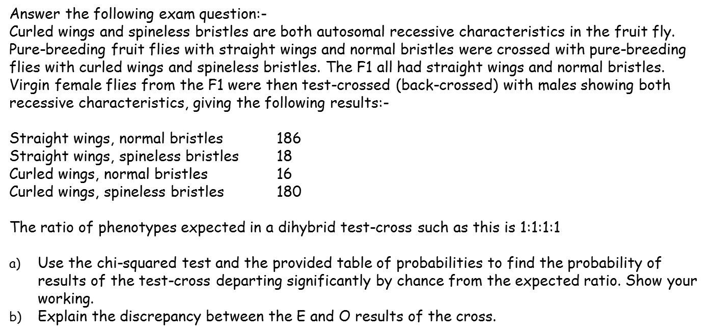
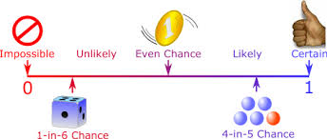
Topic 7: Inheritance - 3.7.1: Chi-squared.
What is Chi-squared actually used for.
How do you work out the degrees of freedom.
If the P value is greater than the critical value what does this mean? You must use the words significance, chance and probability
Class | Observed (O) | Expected (E) | O-E | (O-E)² | (O-E)² E
If the P value is less than the critical value what does this mean? You must use the words significance, chance and probability

Slide 11
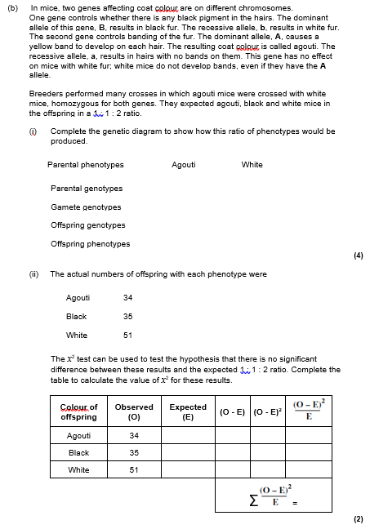
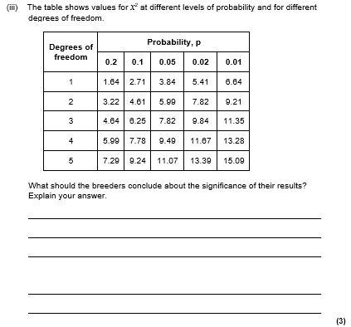
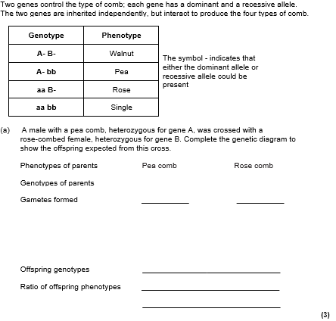

Slide 12
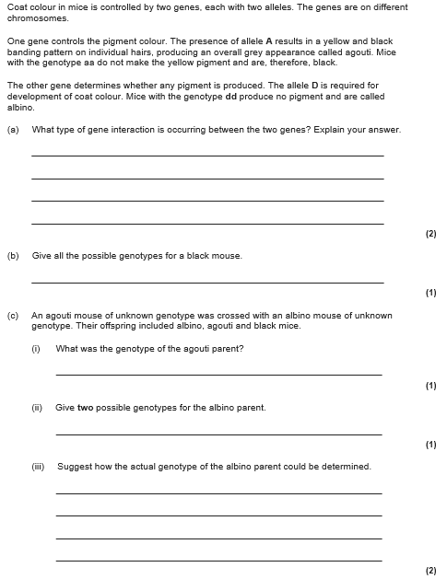

Slide 13
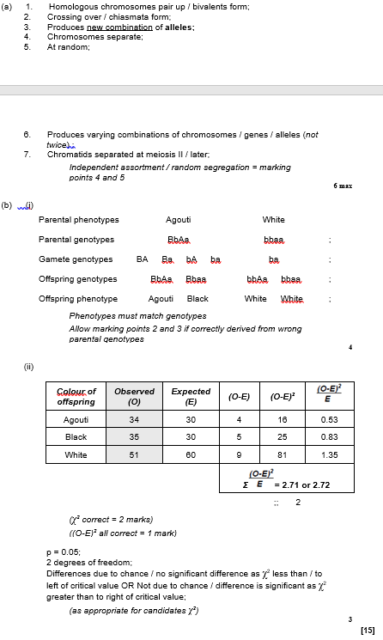
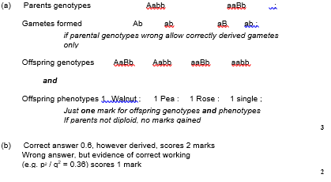
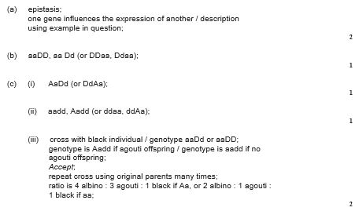

Slide 14
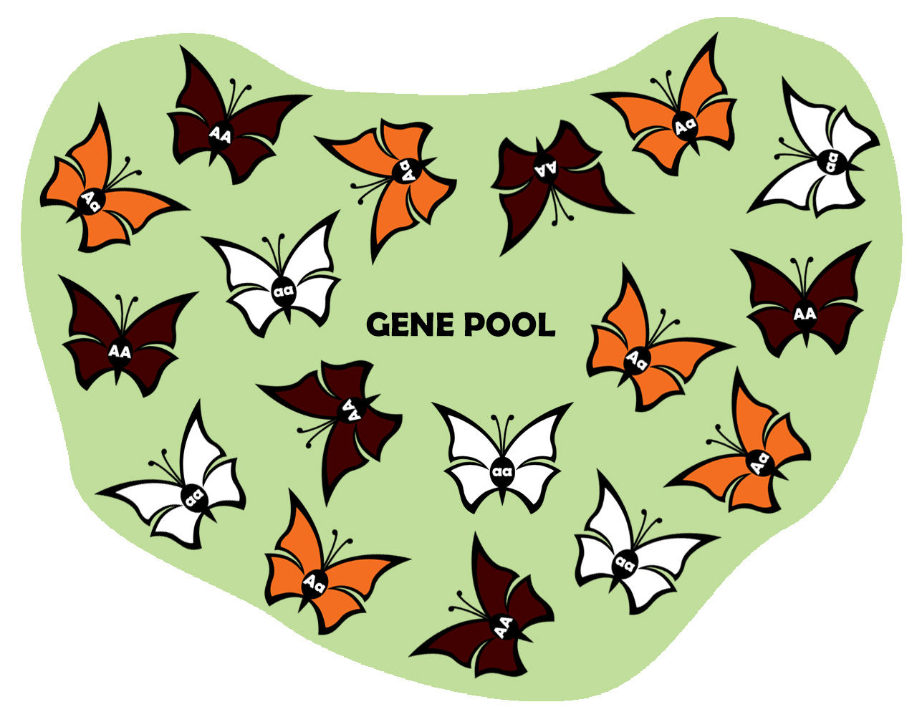
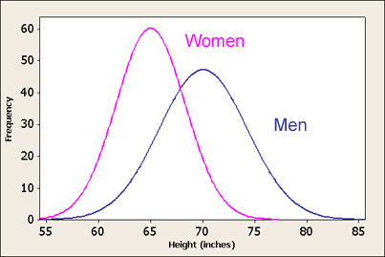
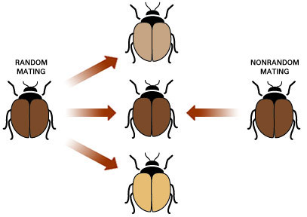
Topic 7: Inheritance - 3.7.2 Populations
Define:
Gene pool:
Allele frequency
Selection pressure
Population
Natural selection
Stabilising selection
Directional selection
Disruptive selection
Write out the 2 hardy Weinberg equations, add details to help you understand what the letter represent.
Explain how variation is due to genetic factors.
DNA mutations
Chromosomal mutations
Meiosis
Random fertilization
Use the graph to explain how variation is due to environmental factors.

Slide 15
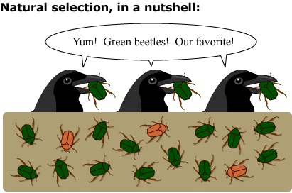
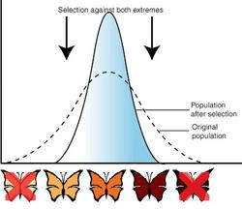
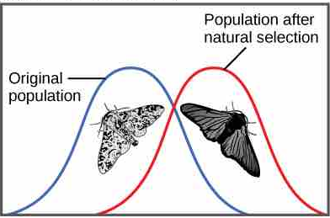
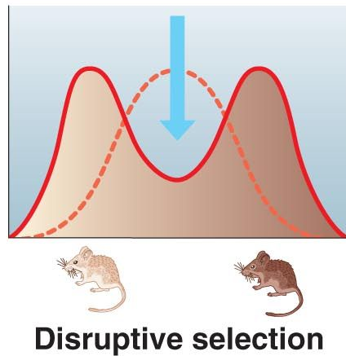
Topic 7: Inheritance - 3.7.2 Populations
Use the graph example to explain stabilizing selection.
Use the graph example to explain directional selection
Use the graph example to explain disruptive selection

Slide 16
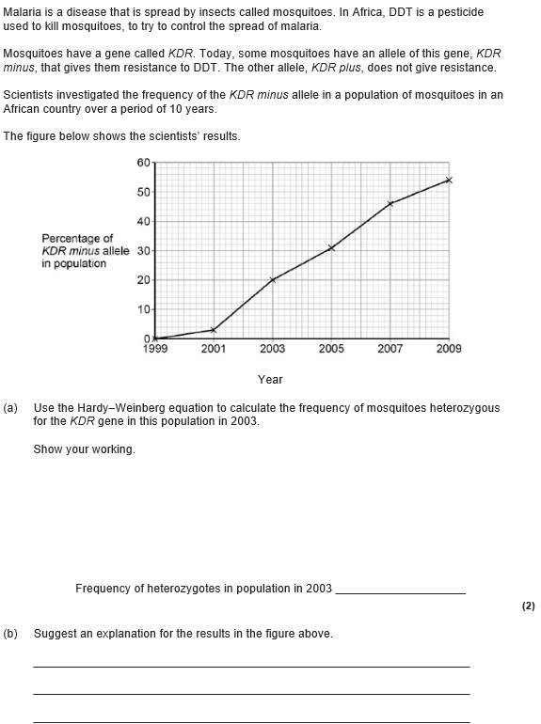
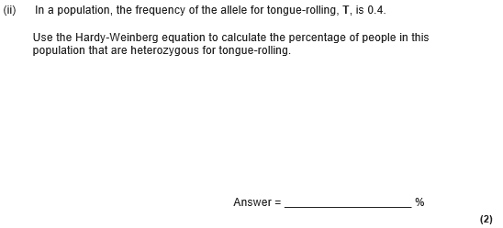

Slide 17
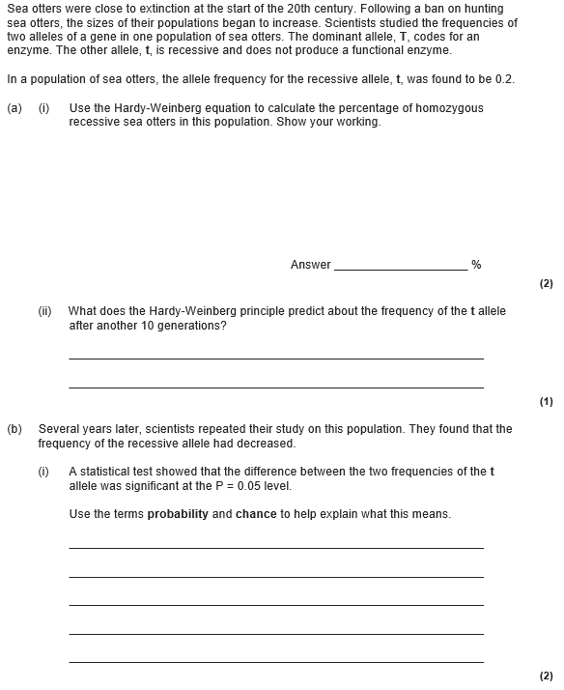
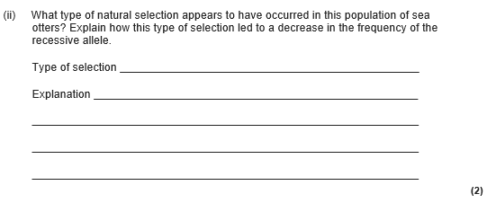

Slide 18
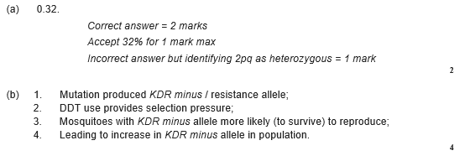
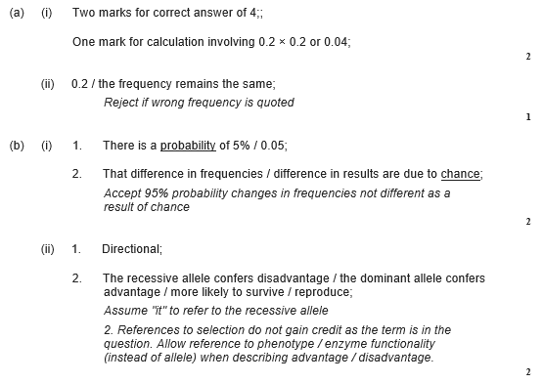
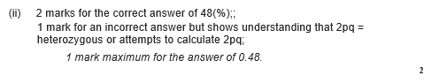

Slide 19
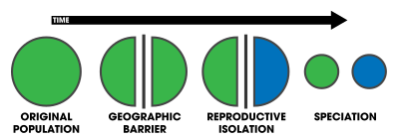
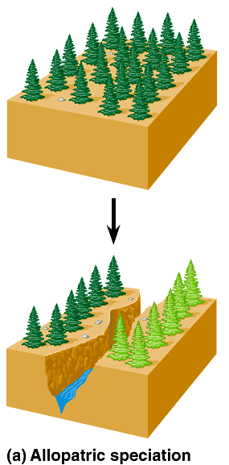
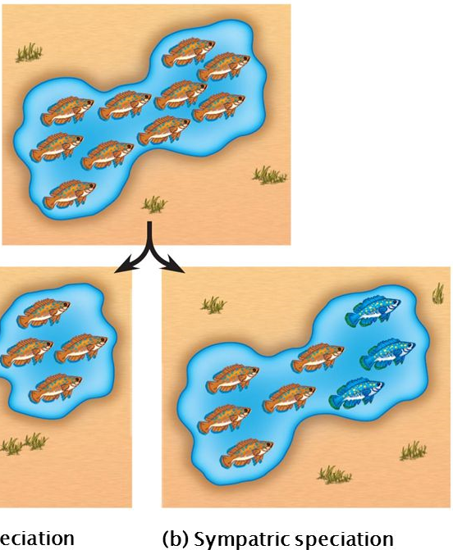
Topic 7: Inheritance - 3.7.3 Evolution may lead to speciation
Describe allopatric speciation
Describe the process of speciation
Describe sympatric speciation
Describe the process of natural selection.

Slide 20
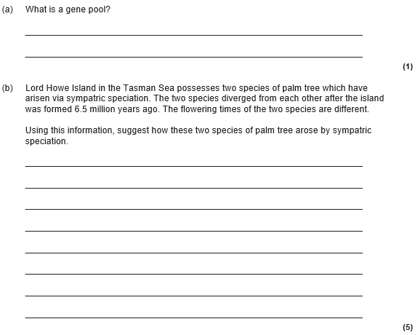
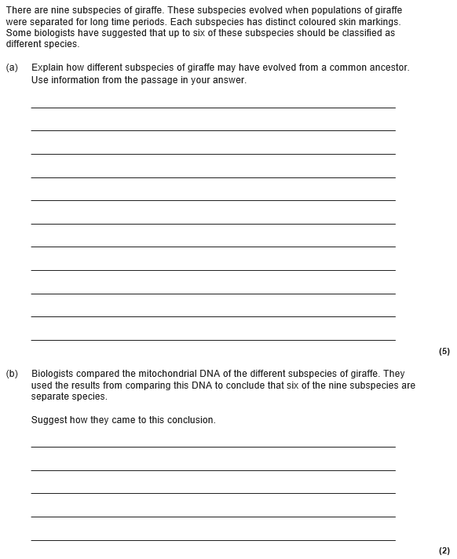

Slide 21
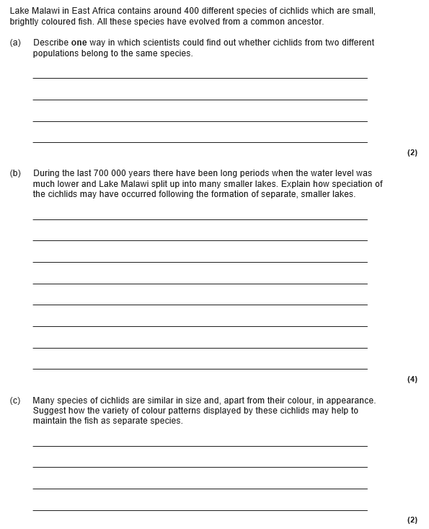

Slide 22
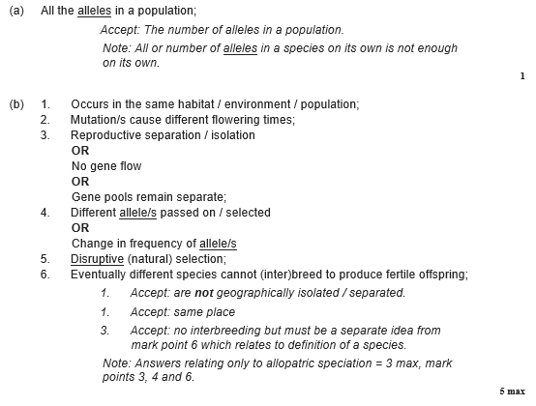
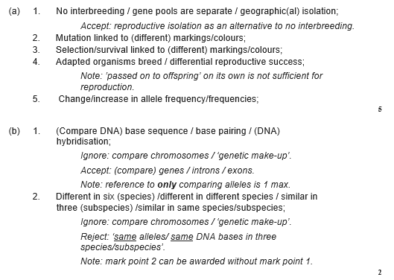

Slide 23
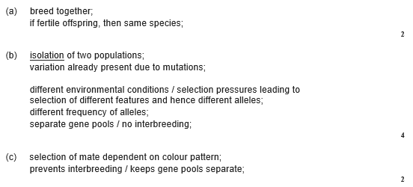

Slide 24
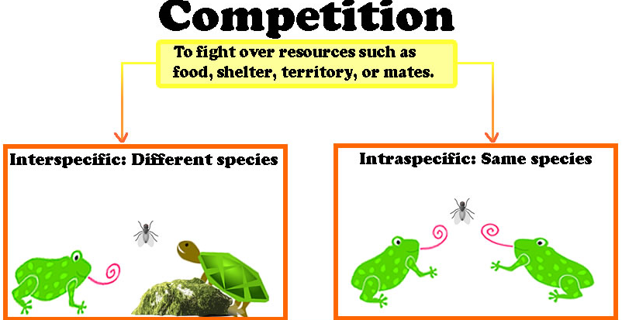



Topic 7: Inheritance - 3.7.4 Populations in ecosystems
Define and give examples of:
Abiotic factors
Biotic factors
Ecosystems
Population
Community
Carrying capacity
Habitat
Ecological niche
Limiting factors
Use the graph to explain the interactions of the predator prey relationship, comment on the sizes of the populations.
Explain intra and interspecific competition including examples of factors
Describe and explain the different stages of a population growth curve. Include limiting factors, carry capacity, birth rate, death rate.

Slide 25




Topic 7: Inheritance - 3.7.4 Populations in ecosystems
Describe how to use a frame and point quadrat. Name the factors to be considered when using a quadrat
Write a method for how to carry out random sampling.
Write a method for how to carry out random sampling.
Describe how you work out frequency
Describe how you work out % cover

Slide 26


Topic 7: Inheritance - 3.7.4 Populations in ecosystems
Write the calculation for mark release recapture
Describe succession, include factors which affect the population at each stage.
List the assumptions for mark release recapture.
Describe how these features change during succession
Abiotic factors
Habitats/niches
Biodiversity
Biomass
Show a worked example for mark release recapture

Slide 27



Slide 28


Slide 29



Slide 30



Slide 31


