Slide 1
AS Level Paper 1 and 2. A2 Level Paper 1 and 3 - Topics 1-4
Section 3.1: Biological Molecules
3.1.1 Monomers and Polymers
3.1.2 Carbohydrates
3.1.3 Lipids
3.1.4.1 Proteins
3.1.4.2 Enzymes
3.1.5.1 Nucleic acid structure
3.1.5.2 DNA Replication
3.1.6 ATP
3.1.7 Water
3.1.8 Inorganic Ions
Section 3.3 Organisms exchange substances with their environment
3.3.1 Surface area to volume ratio
3.3.2 Gas exchange
3.3.3 Digestion and absorption
3.3.4.1 Mass transport in animals
3.3.4.2 Mass transport in plants
Section 3.4 Genetic information, variation and relationships between organisms
3.4.1 DNA, genes and chromosomes
3.4.2 DNA and protein synthesis
3.4.3 Genetic diversity - mutations and meiosis
3.4.4 Genetic diversity and adaptation – natural selection
3.4.5 Species and taxonomy
3.4.6 Biodiversity
3.4.7 Investigating biodiversity
Section 3.2: Cells
3.2.1.1 Eukaryotic cells
3.2.1.2 Prokaryotic cells and viruses
3.2.1.3 Studying cells
3.2.2 All cells arise from other cells
3.2.3 Transport across cell membranes
3.2.4 Cell recognition and the immune system

Slide 2
Topic 3: 3.3.1 Surface area to volume ratio
Can you describe the relationship between the size of an organism and its surface area to volume ratio?
Show how you calculate SA of a cube
Show how you calculate V of a cube
What are the 5 features of specialised exchange surfaces?
What molecules need to be transferred between an organism and its environment?
How is surface area to volume ratio calculated?
Compare a 1cm³ and 6cm³ cube.
Show how you calculate V of a sphere
Show how you calculate SA of a sphere

Slide 3
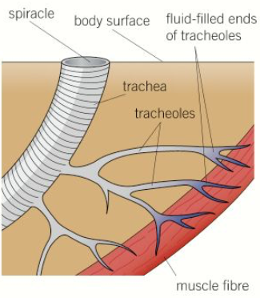
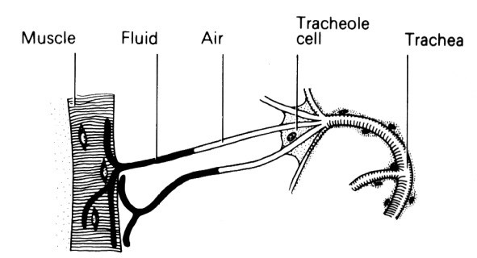
Topic 3: 3.3.2 Gas exchange in single celled organisms & insects
How do single celled organisms exchange substances?
How are insects adapted for efficient gas exchange?
What three ways to respiratory gases move in and out of the tracheal system?
How do insects reduce water loss?

Slide 4
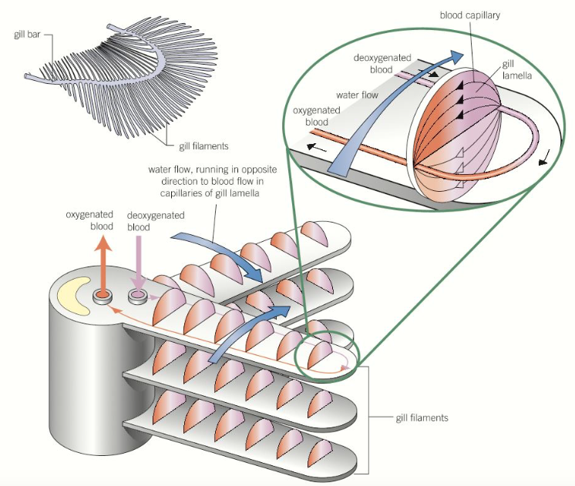
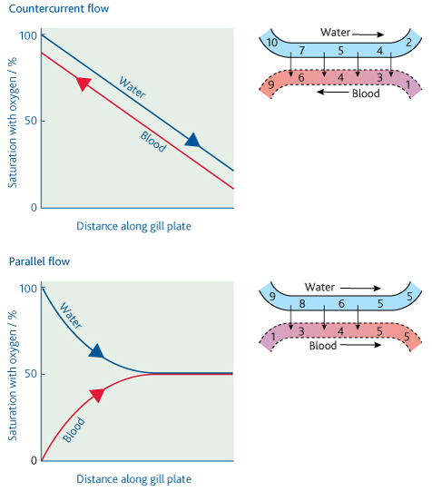
Topic 3: 3.3.2 Gas exchange in fish
Describe the structure of the gill and how gills are specialized for gas exchange.
Explain countercurrent flow and parallel flow:

Slide 5
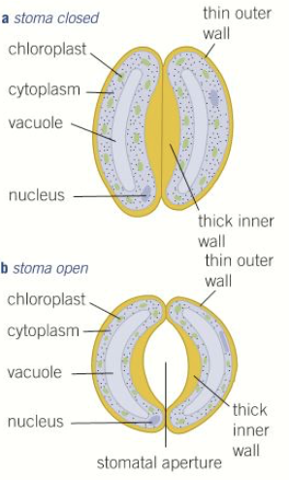
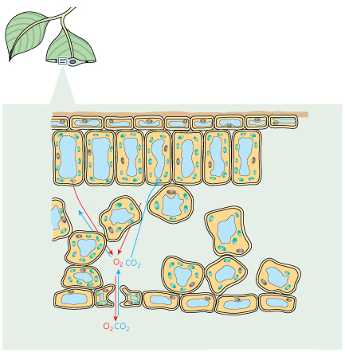
Topic 3: 3.3.2 Gas exchange in plants
How are plants adapted for efficient gas exchange? Label the tissues in the leaf
Describe how the stomata open and close and explain why this happens:
List the 5 adaptations xerophytic plants have to try and limit water loss and explain how these work.

Slide 6
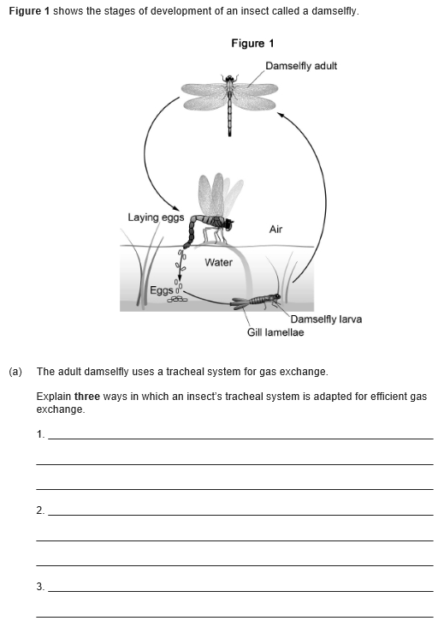
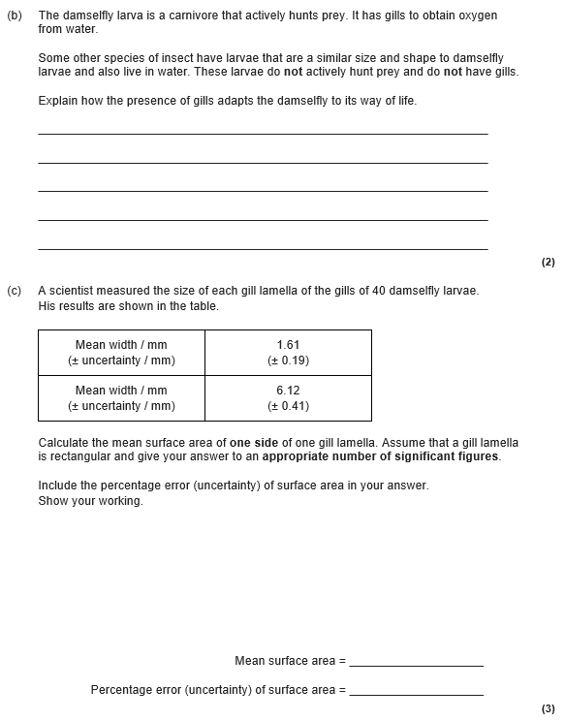

Slide 7
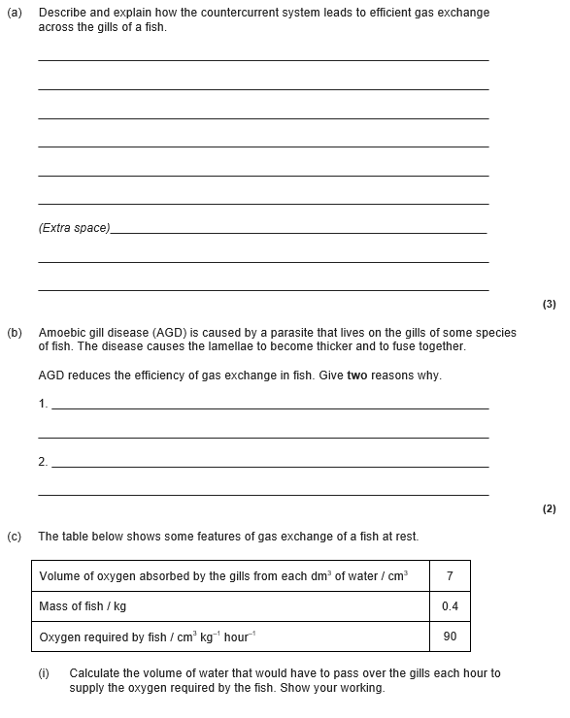
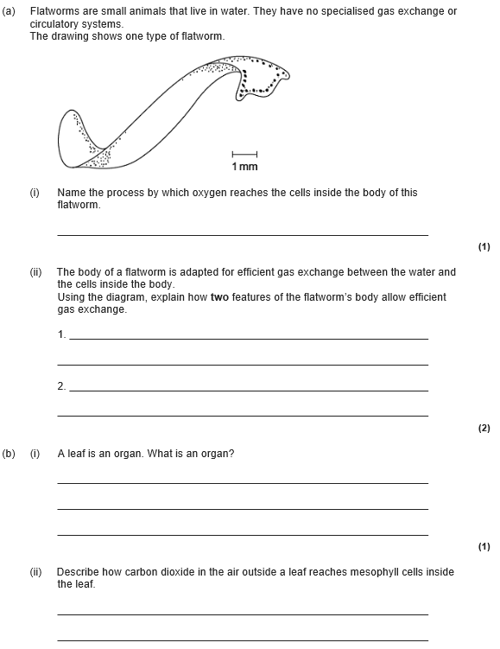

Slide 8
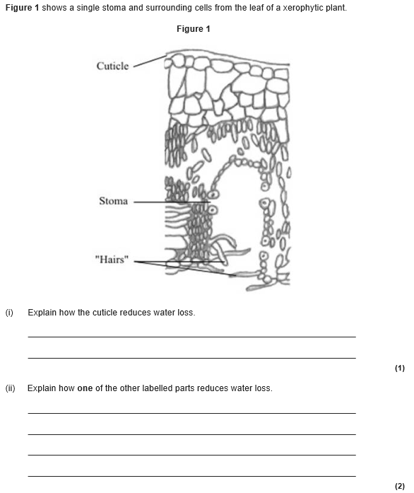

Slide 9
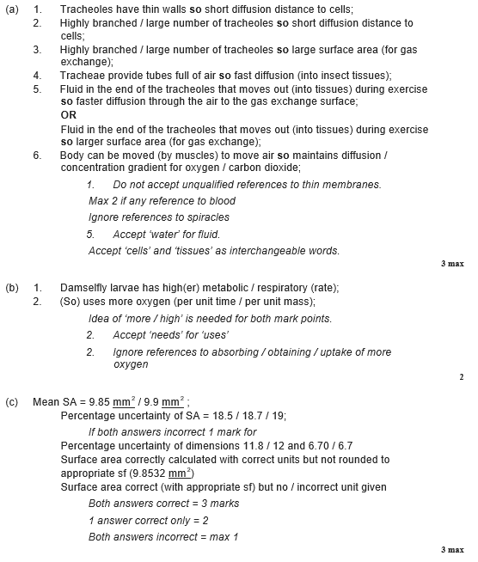
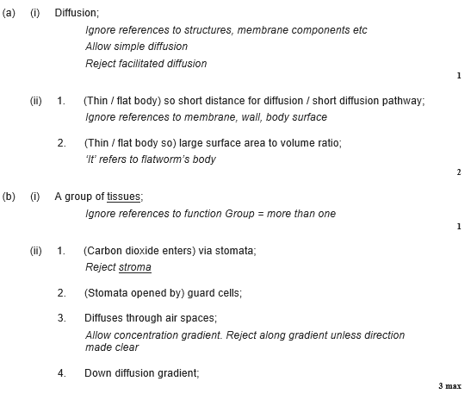

Slide 10
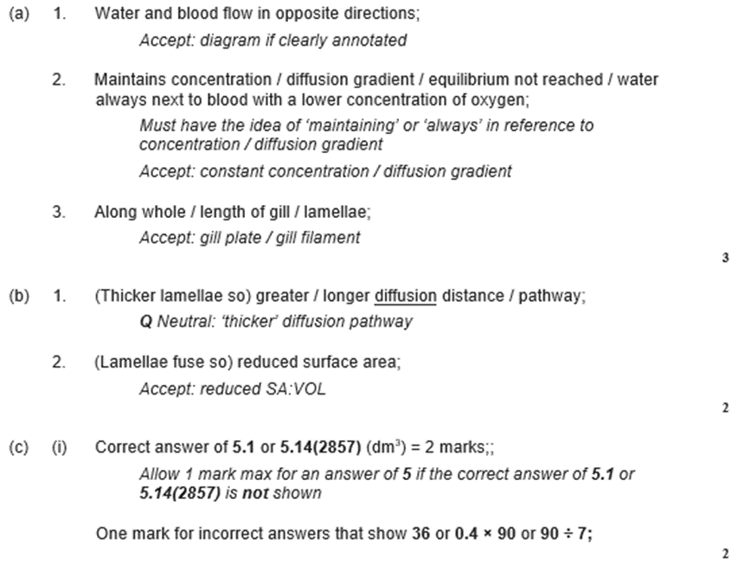
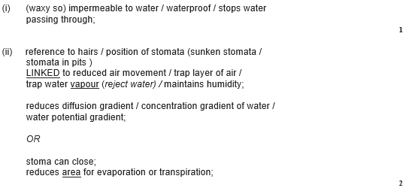

Slide 11
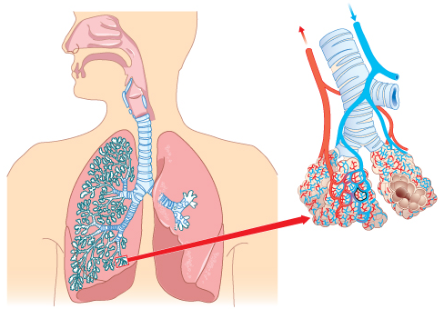
Topic 3: 3.3.2 Gas exchange in lungs
Can you label the structures of the human gas exchange system and give functions of the main parts?

Slide 12
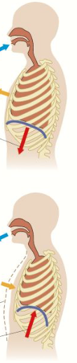
Topic 3: 3.3.2 Gas exchange in lungs
Can you describe what happens during ventilation? You must refer to the internal and external intercostal muscles.
What is ventilation?
How do you calculate pulmonary ventilation rate?

Slide 13
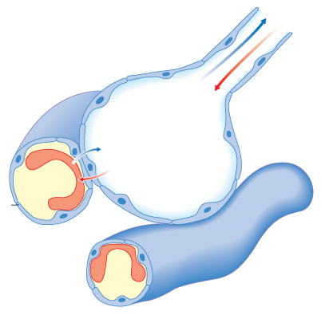
Topic 3: 3.3.2 Gas exchange in lungs
How are the alveoli adapted for efficient gas exchange?
What is the difference between correlation and causation?
What are some risk factors for lung disease?
Could you interpret information relating to the effects of lung disease on gas exchange and/or ventilation?
E.g. Pulmonary fibrosis is a lung disease that causes the epithelium of the lungs to become irreversibly thickened and leads to reduced elasticity of the lungs. Suggest what symptoms would arise and why.

Slide 14
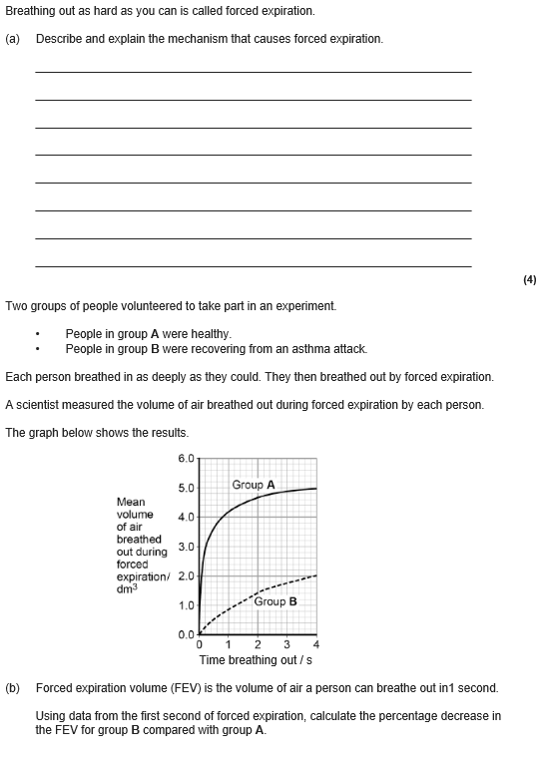
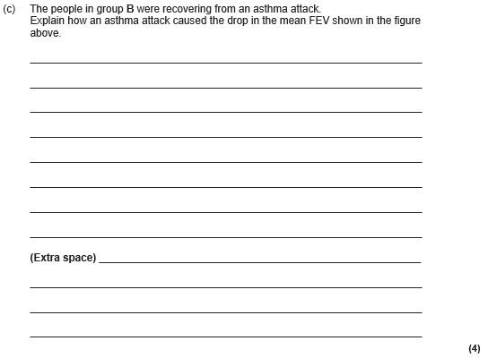

Slide 15
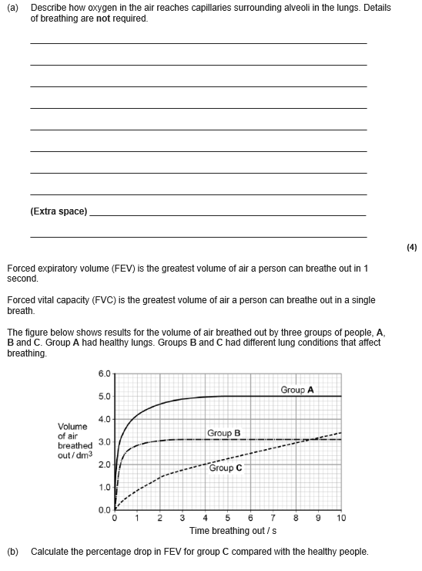
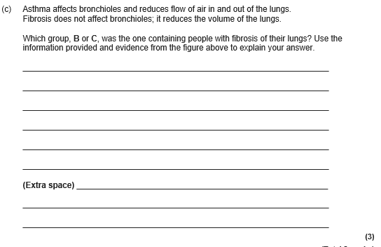

Slide 16
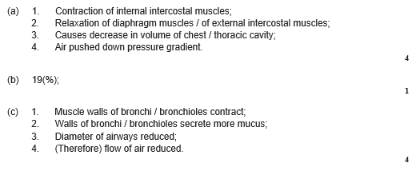
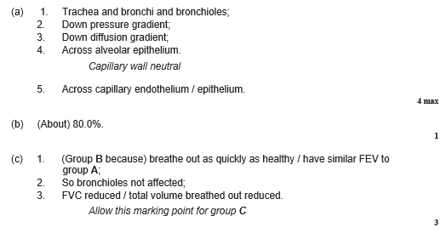

Slide 17
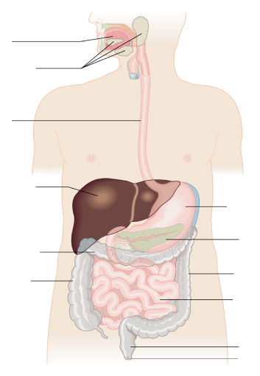
Topic 3: 3.3.3 Digestion and absorption
Describe the structure and function of the major parts of the digestive system? Include the names of the enzymes, their substrates and their products.
Define physical and chemical digestion and where they take place?

Slide 18
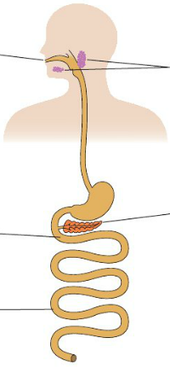
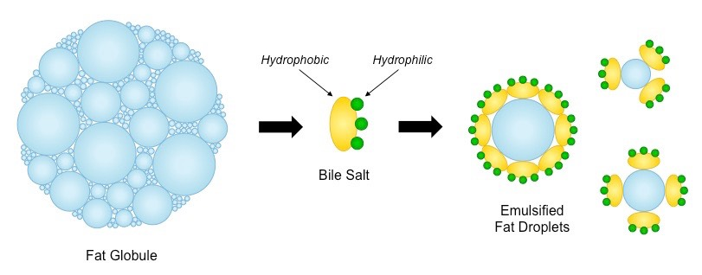
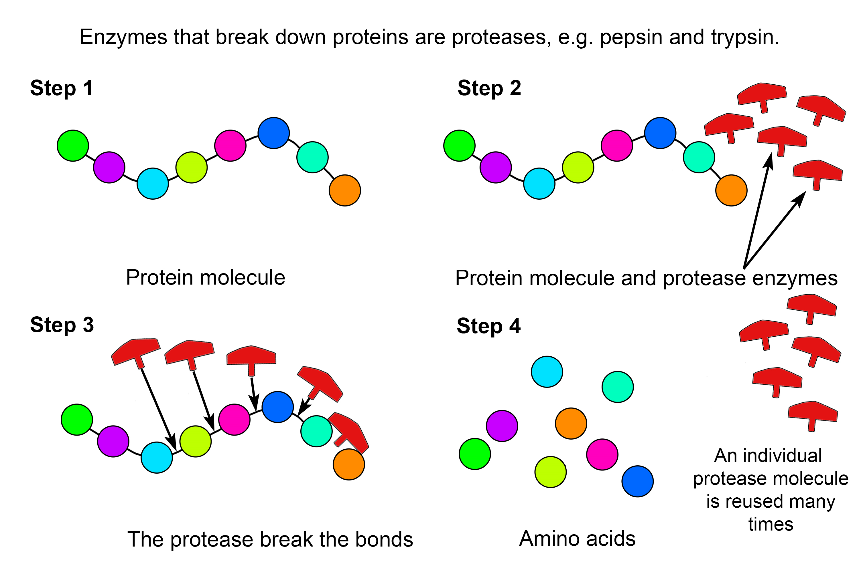
Topic 3: 3.3.3 Digestion and absorption
Can you describe how starch is digested by amylases and membrane-bound disaccharidases?
Can you describe digestion of lipids by lipase, including the action of bile salts in mammals?
Can you describe digestion of proteins by endopeptidases, exopeptidases and membrane-bound dipeptidases in mammals?

Slide 19
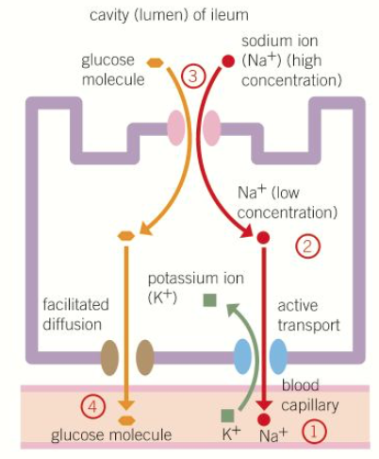
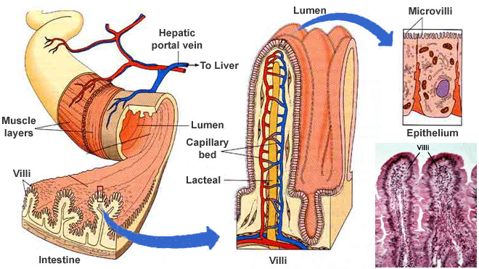
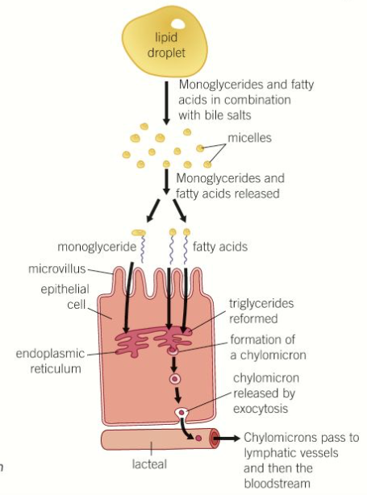
Topic 3: 3.3.3 Digestion and absorption
Can you describe the structure of the ileum and explain how it is adapted for the function of absorption?
Explain how co-transport allows the absorption of amino acids and monosaccharides?
Explain how triglycerides are absorbed?

Slide 20
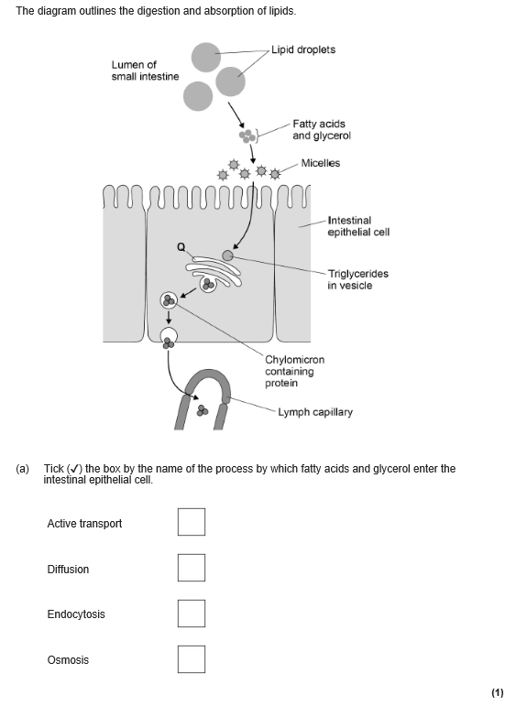
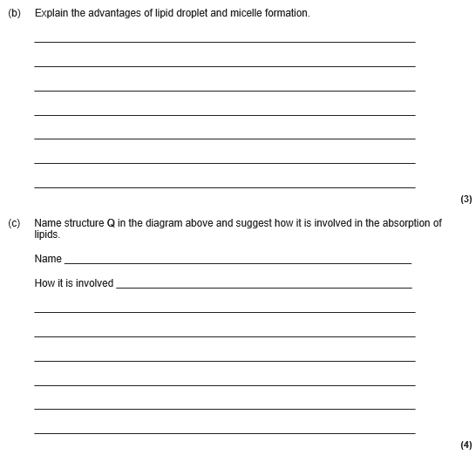
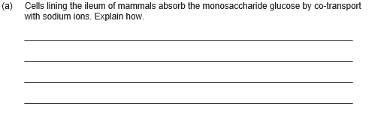

Slide 21
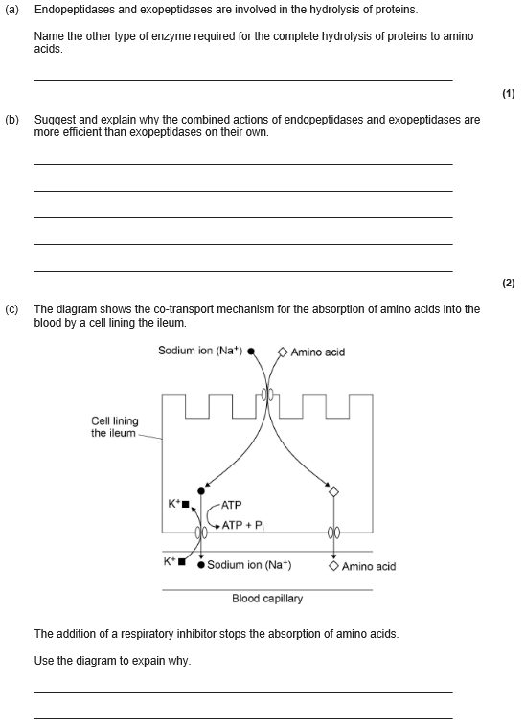

Slide 22
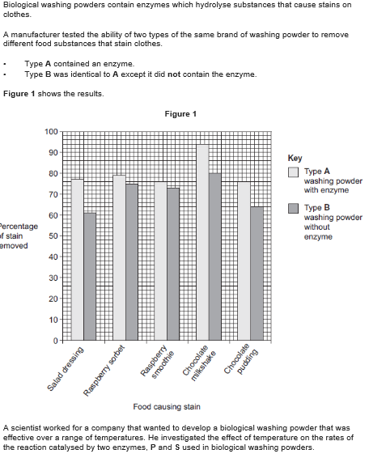
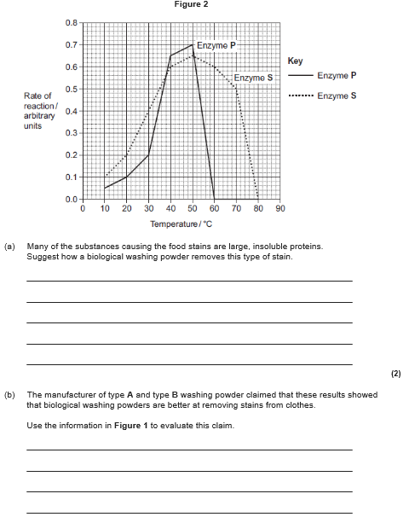
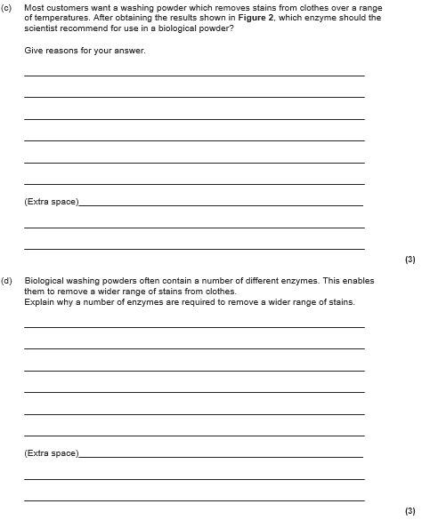

Slide 23
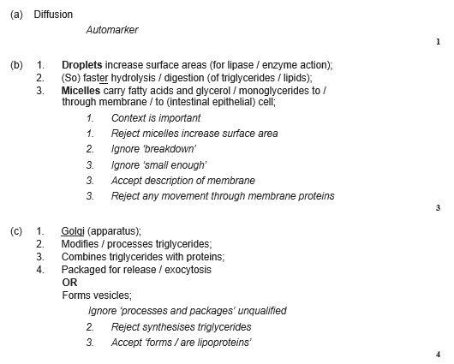
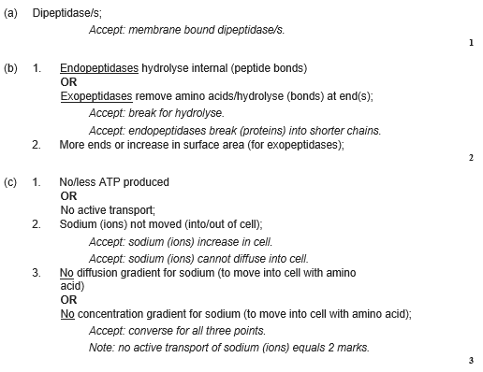
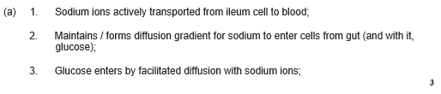

Slide 24
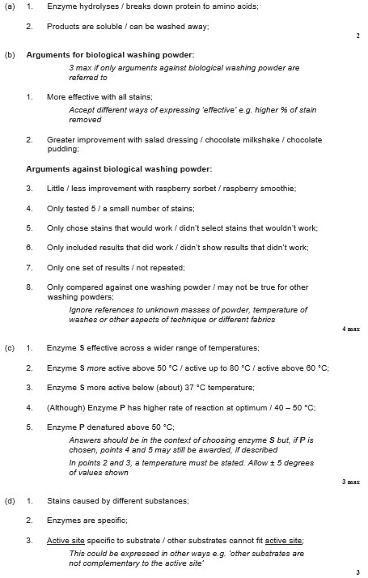

Slide 25
Topic 3: 3.3.4.1 Mass transport in animals: Haemoglobin
Draw and label a haemoglobin molecule.
What are the differences between haemoglobins in difference organisms and what are the reasons for these differences?
Define:
Primary structure
Secondary structure:
Tertiary structure:
Quaternary structure:
What is meant by the loading and unloading of oxygen?

Slide 26
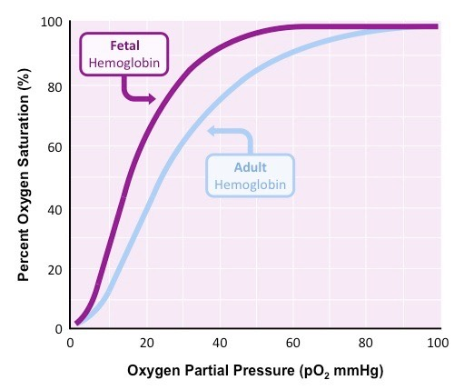
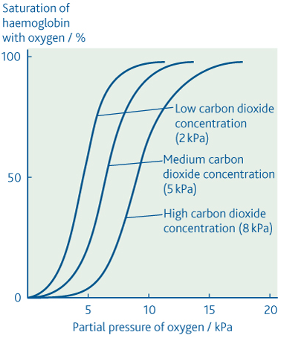
Topic 3: 3.3.4.1 Mass transport in animals: Haemoglobin
Can you explain the fetal haemoglobin graph?
Can you explain the Bohr effect using the graph to help?
What does a shift to the left mean?
What does a shift to the right mean?
Can you explain how low oxygen concentration has affect the oxygen dissociation curve.

Slide 27
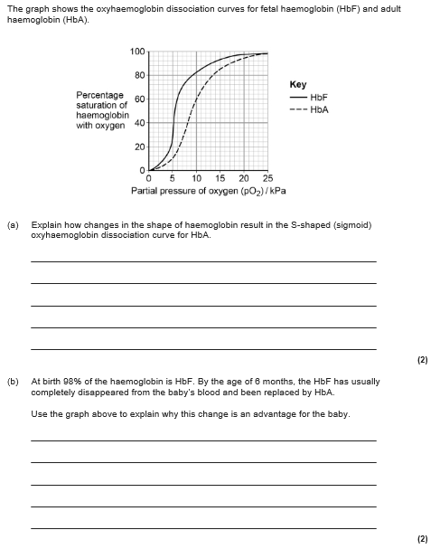
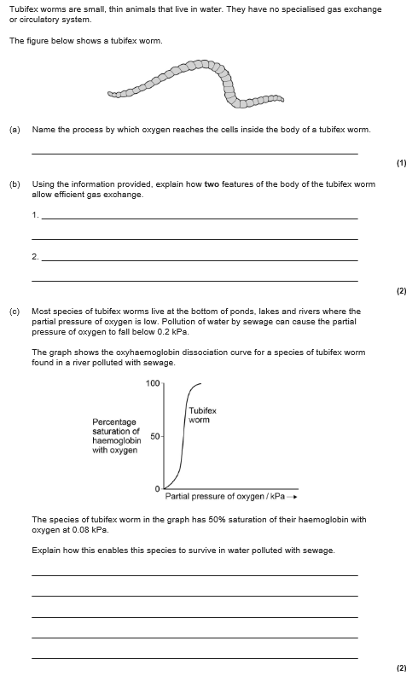

Slide 28
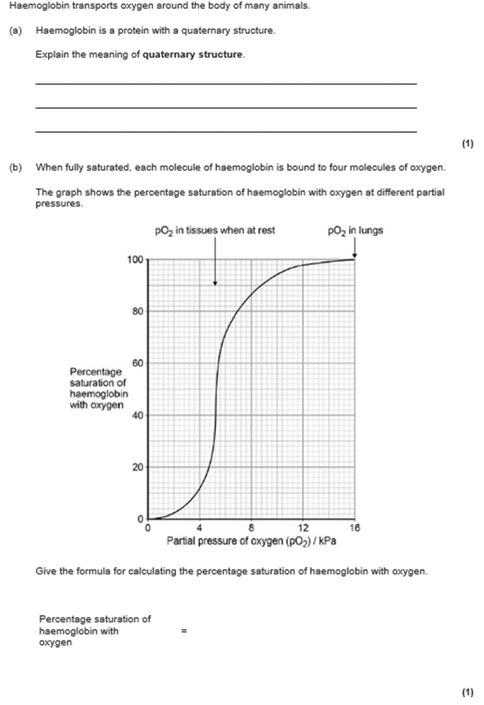
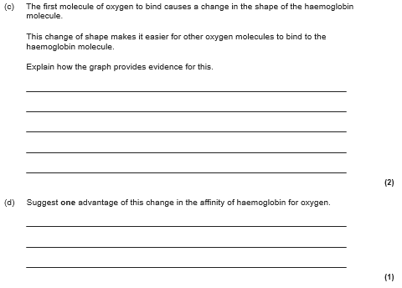

Slide 29
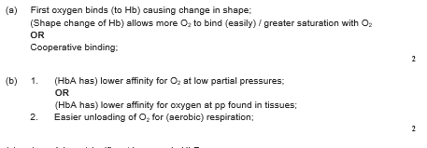
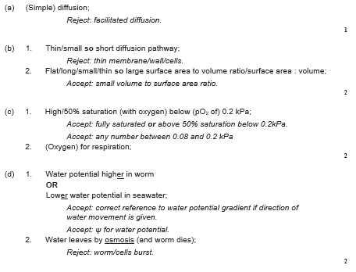

Slide 30


Slide 31

Topic 3: 3.3.4.1 Mass transport in animals: Circulatory system in a mammal
Why do large organisms need a transport system?
Can you label the major veins and arteries in the circulatory system below.
What are the features of this transport system?
Define double circulatory system?
Define closed circulatory system?

Slide 32

Topic 3: 3.3.4.1 Mass transport in animals: Heart structure
Can you label the structure of the heart?
How does the structure of the heart relate to its function? Discuss the chambers, valves and blood vessels.
How do we supply the heart muscle with oxygen?
What are risk factors associated with cardiovascular disease?
Can you explain, using diagrams, how valves control the flow of blood?

Slide 33




Topic 3: 3.3.4.1 Mass transport in animals: Cardiac Cycle
Can you explain the stages in the cardiac cycle and what happens at each stage: Refer to Muscle, pressure, valves, flow
How do you calculate cardiac output? Draw the triangle
Define and give the units for:
Cardiac output
Heart rate
Stroke volume
Describe the pressure and volume changes and associated valve movements during the cardiac cycle that maintain a unidirectional flow of blood?

Slide 34





Slide 35



Slide 36




Slide 37



Slide 38


Topic 3: 3.3.4.1 Mass transport in animals: Blood vessels
Label the blood vessels and their structures, stating the function of the structure and how this relates to the function of the blood vessel? Can you put this into a table?
How is the arteriole structure related to its function?
Can you describe the formation of tissue fluid and its return to the circulatory system?

Slide 39




Slide 40



Slide 41


Topic 3: 3.3.4.2 Mass transport in plants: Xylem
Define is transpiration?
Label the layers of a leaf
How does water move out of the leaf through the stomata
How does water move from the xylem through the leaf?
How does water move into and up the xylem?
What is the cohesion-tension theory?
How are root hair cells adapted for its function?
How are xylem vessels adapted for their function?

Slide 42

Topic 3: 3.3.4.2 Mass transport in plants: Xylem
Label the parts of the potometer. Describe and explain how to set up a potometer.
What does the photometer actually measure?
Draw a table to describe and explain how different environmental factors affect the rate of transpiration.

Slide 43




Slide 44


Slide 45




Slide 46


Slide 47


Topic 3: 3.3.4.2 Mass transport in plants: Phloem
Describe the role of the phloem?
Can you explain the use of tracers and ringing experiments to investigate transport in plants?
Can you explain the mass flow hypothesis for the mechanism of translocation in plants?
Transfer of sucrose into sieve elements from photosynthesising tissue
Mass flow of sucrose through sieve tube elements
Transfer of sucrose from the sieve tube elements into storage or other sink cells

Slide 48



Slide 49



