Slide 1
A2 Level Paper 2 and 3 - Topics 5-8
Section 5: Energy transfer in and between organisms
3.5.1 Photosynthesis
3.5.2 Respiration
3.5.3 Energy and ecosystems
3.5.4 Nutrient Cycles
Section 7: Genetics, populations, evolution and ecosystems
3.7.1 Inheritance
3.7.2 Populations
3.7.3 Evolution may lead to speciation
3.7.4 Populations in ecosystems
Section 8: Control of gene expression
3.8.1: Alteration of sequence of bases in DNA can alter the structure of proteins
3.8.2.1 Most of cell’s DNA is not translated
3.8.2.2 Regulation of transcription and translation
3.8.2.3 Gene expression and cancer
3.8.3 Using genome projects
3.8.4.1 Recombinant DNA technology
3.8.4.2 Differences in DNA between same species can be exploited for identification and diagnosis
3.8.4.3 Genetic fingerprinting
Section 6: Stimuli, both internal and external, are detected and lead to a response.
3.6.1.1 Survival and response
3.6.1.2 Receptors
3.6.1.3 Control of heart rate
3.6.2.1 Nerve impulses
3.6.2.2 Synaptic transmission
3.6.3 Skeletal muscles
3.6.4.1 Principles of homeostasis and negative feedback
3.6.4.2 Control of blood glucose concentration
3.6.4.3 Control of blood water potential.

Slide 2
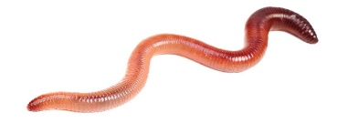
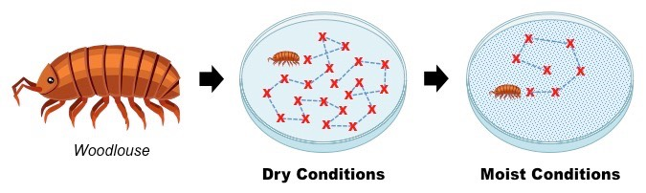
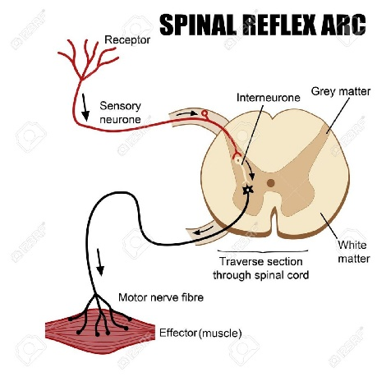
Topic 6: Stimuli and response - 3.6.1.1: Survival and response
Define the terms:
Stimulus
Response
Receptor
Co-Ordinator
Effector
Explain the advantage of responding to stimulus for an organism. Link to alleles and selection pressures.
Describe and explain a taxis using a specific organisms as an example.
Describe and explain a Kinesis using a specific organisms as an example.
Explain how a reflex arc works using a specific example :
Draw a diagram to show the organization of the nervous system including definitions. Include CNS, PNS, VNS, ANS and motor, sensory neurons.

Slide 3
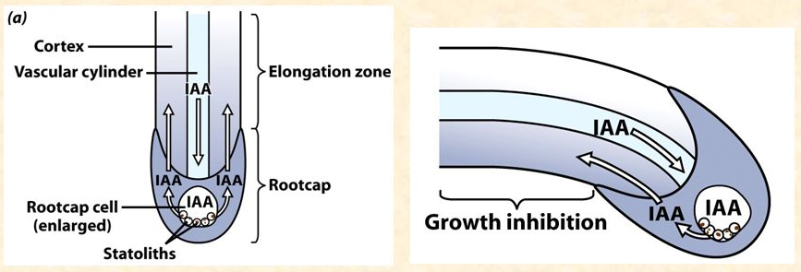
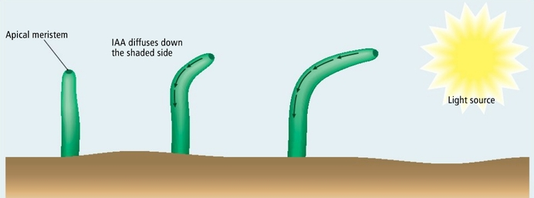
Topic 6: Stimuli and response - 3.6.1.1: Survival and response
Explain gravitropism in flowering plants controlled by IAA
Explain phototropism in flowering plants controlled by IAA
Describe and explain a tropism with specific stimuli examples
Describe the effect of IAA on cell elongation

Slide 4
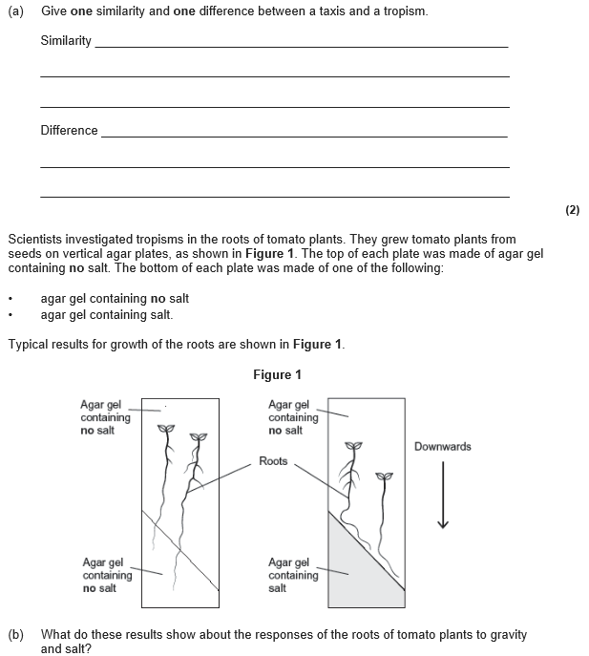
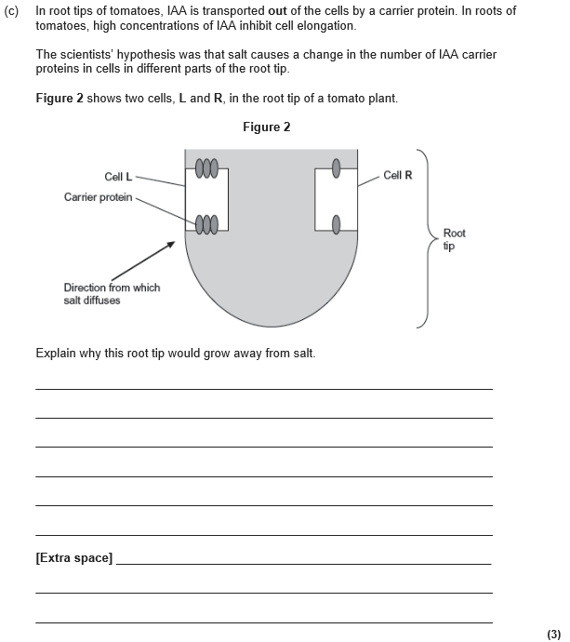

Slide 5
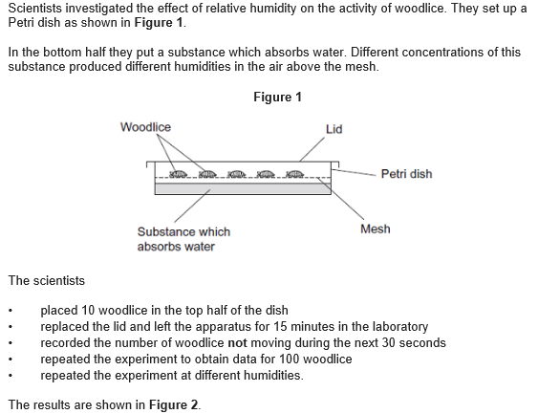
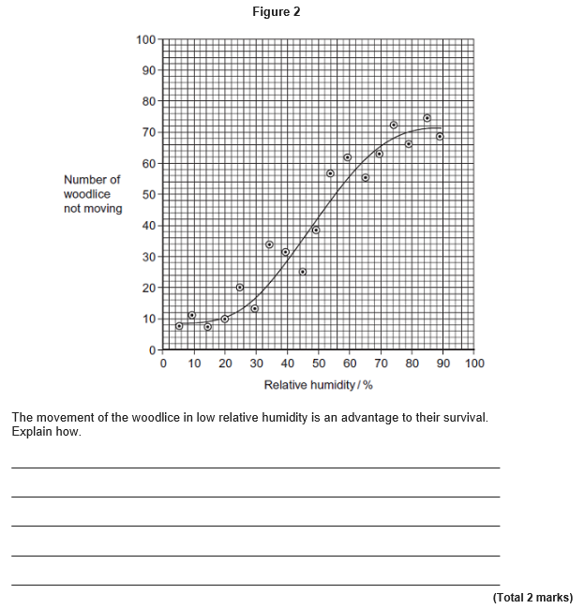

Slide 6
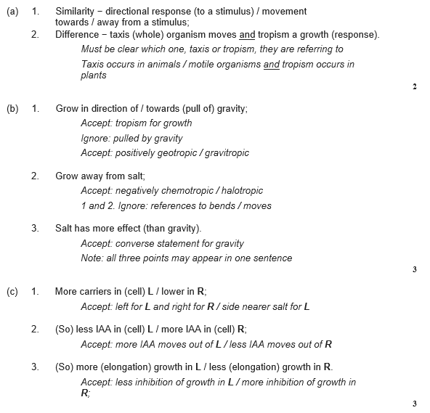
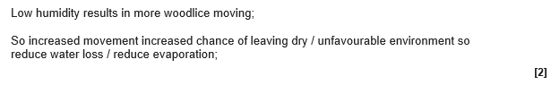

Slide 7
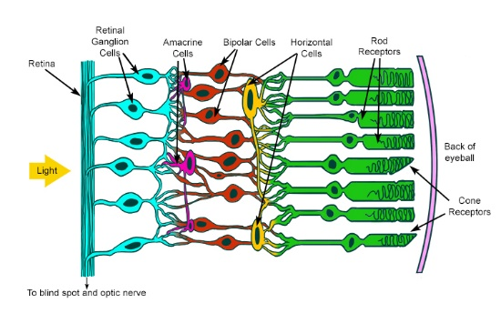
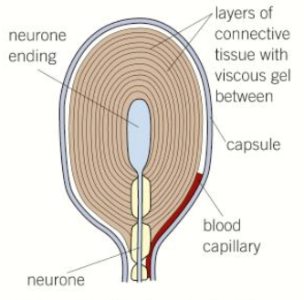
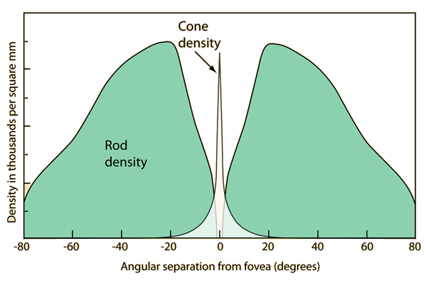
Topic 6: Stimuli and response - 3.6.1.2: Receptors
Describe the structure and function of the Pacinian corpuscle
Describe the structure and function of the osmoreceptor. Draw and label a diagram
Describe the structure and function of the Rods and cones in the retina.
Describe the features shared by all sensory receptors.
Explain why rods have a low visual acuity but cones have a high VA

Slide 8
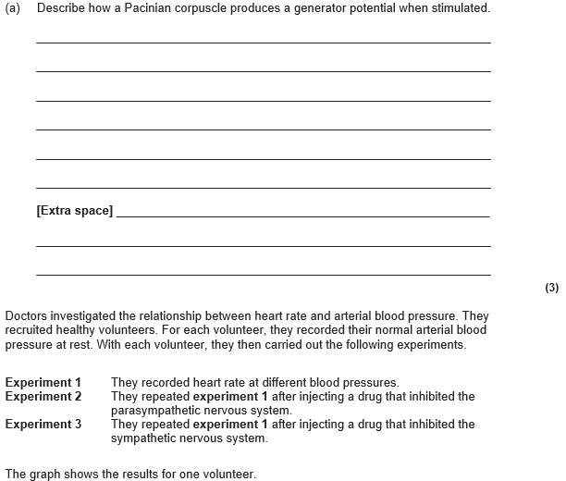
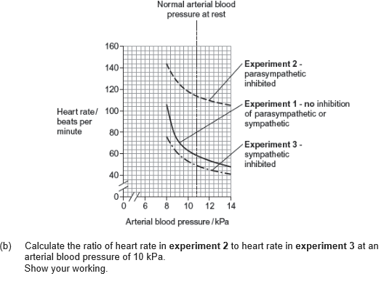

Slide 9
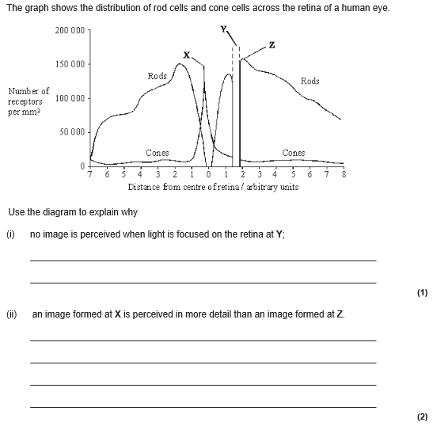
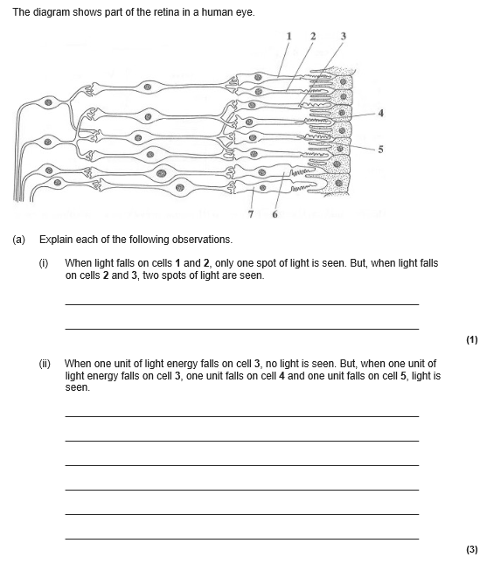
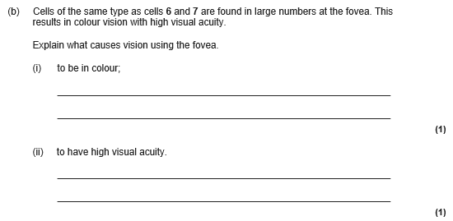

Slide 10
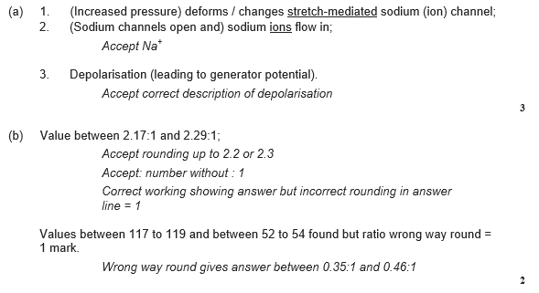
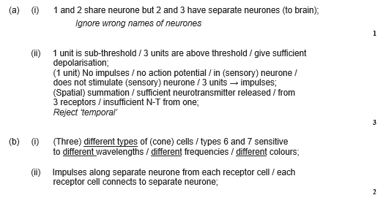
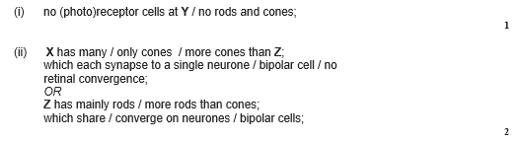

Slide 11
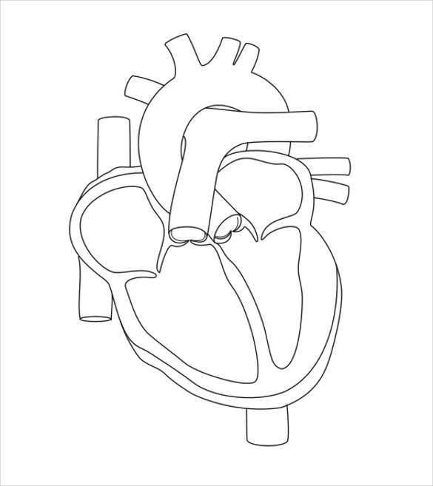
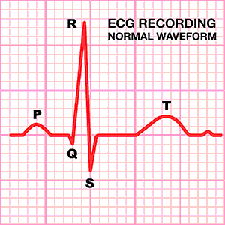
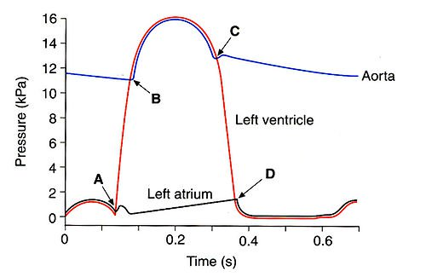
Topic 6: Stimuli and response - 3.6.1.3: Control of Heart rate
Label the structure of the heart. Including SAN, AVN and purkyne fibers
Describe how to work out heart rate, cardiac output and stroke volume.
Describe the events in the electrical control of the heart.
Describe the events in atrial systole, ventricular systole and diastole using the graph. Label the AV and SL values opening and closing.

Slide 12
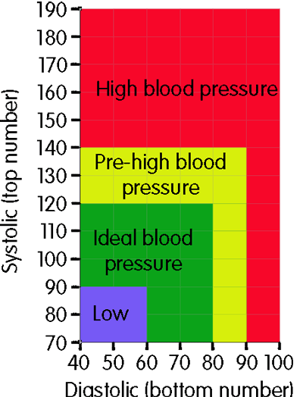
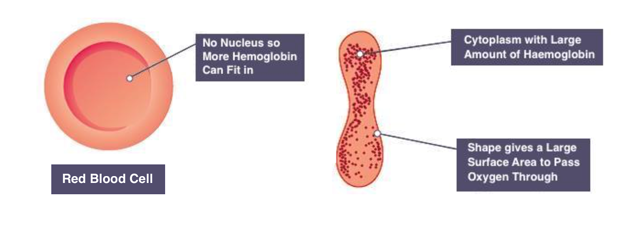
Topic 6: Stimuli and response - 3.6.1.3: Control of Heart rate
Explain how an increase in CO2 concentration leads to an increase in HR. Include chemoreceptors with locations., medulla oblongata, sympathetic nervous system, SAN.
From year 1 describe how CO2 is converted into H+ ions.
Explain how an increase and decrease in blood pressure is detected and controlled. increase in CO2 concentration leads to an increase in HR. Include pressure receptors with locations., medulla oblongata, sympathetic nervous system, SAN.
Describe how a red blood cell is adapted to its function.

Slide 13
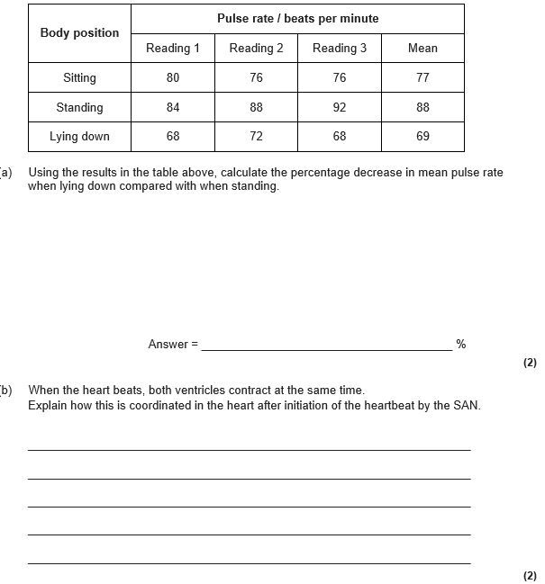
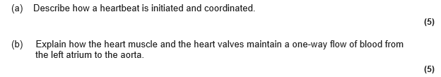
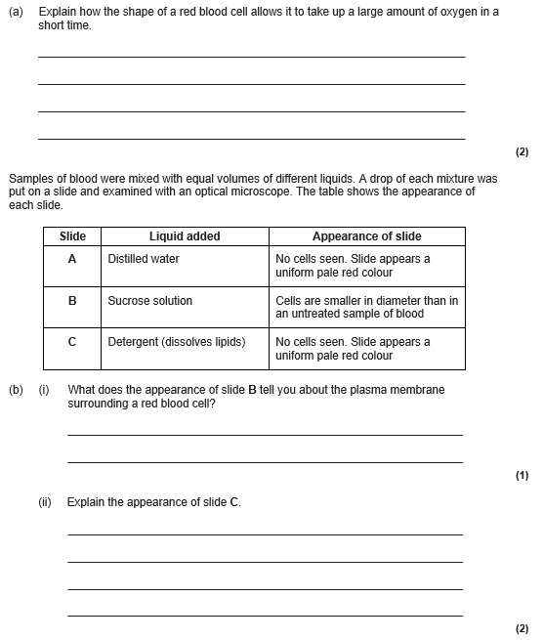

Slide 14
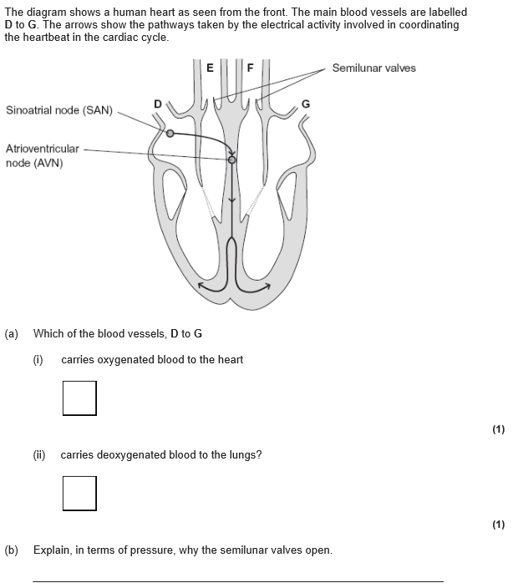
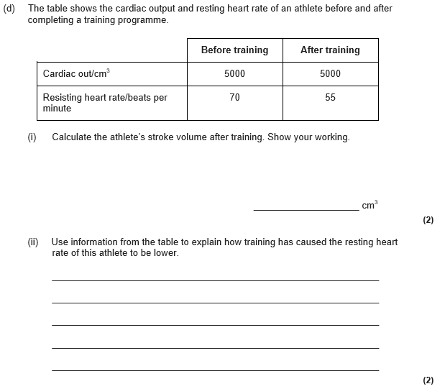

Slide 15
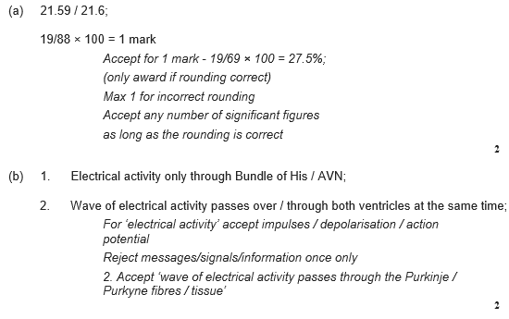
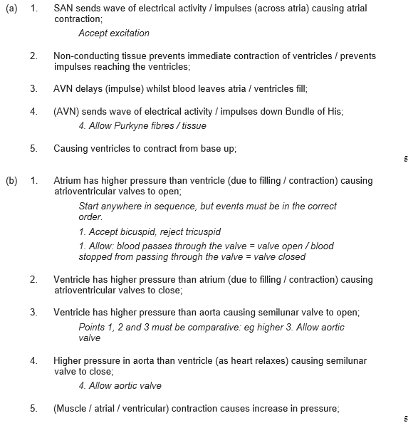

Slide 16
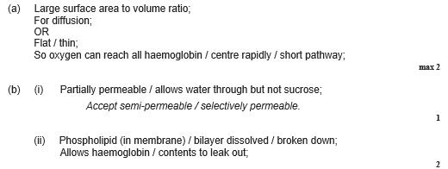
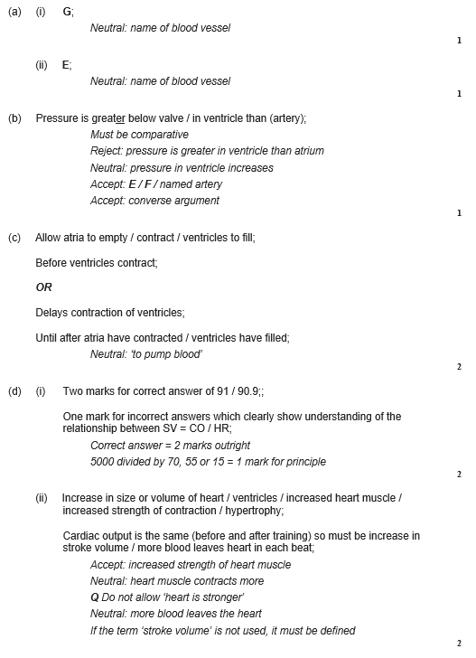

Slide 17
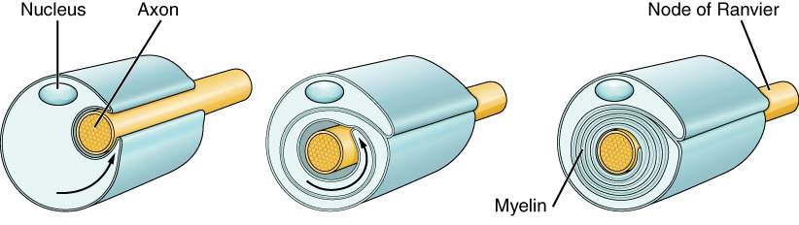
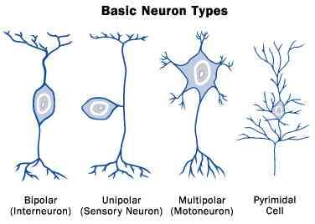
Topic 6: Stimuli and response - 3.6.2.1: Nerve impulses
Draw a contrast table for how the nervous system is coordinated compared to the hormonal system. You need at least 6 points.
Describe the structure of the myelin sheath
Draw a contrast table for how an AP travels down a myelinated and non-myelinated neurone.
Draw and label the structure of a motor neurone
Draw and label the structure of a sensory neurone

Slide 18
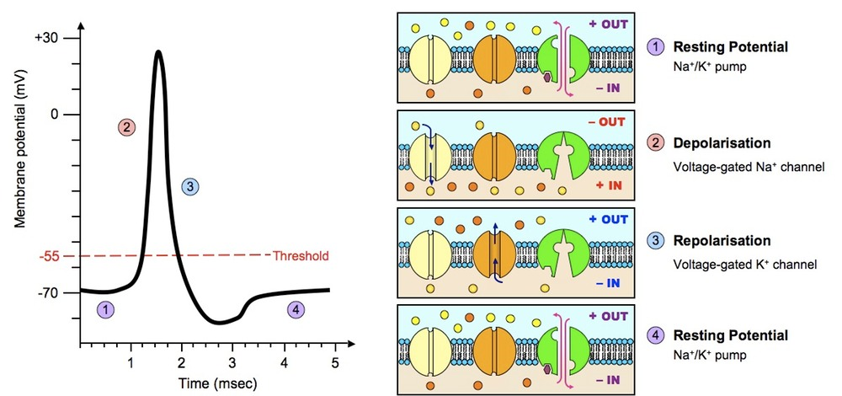
Topic 6: Stimuli and response - 3.6.2.1: Nerve impulses
Draw and describe the stage in the resting potential.
Describe the stages in an action potential.

Slide 19
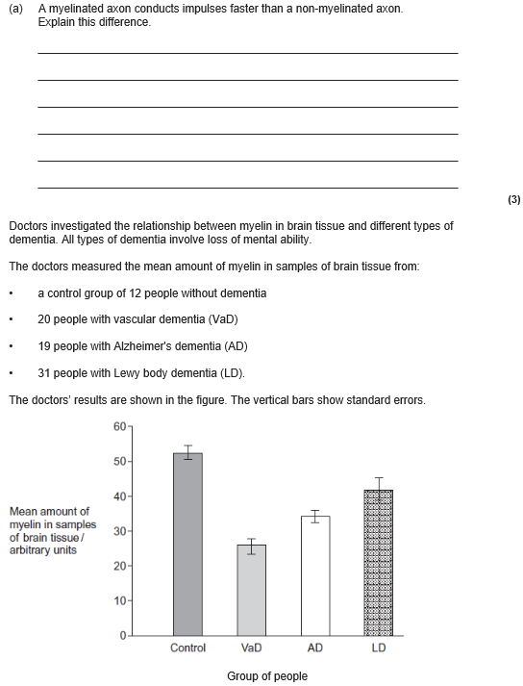
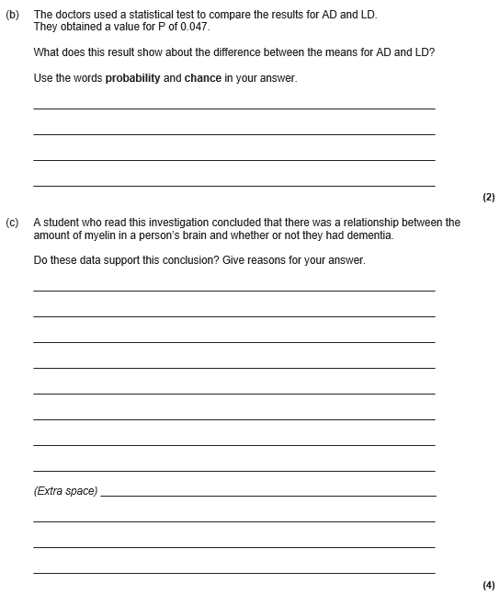

Slide 20
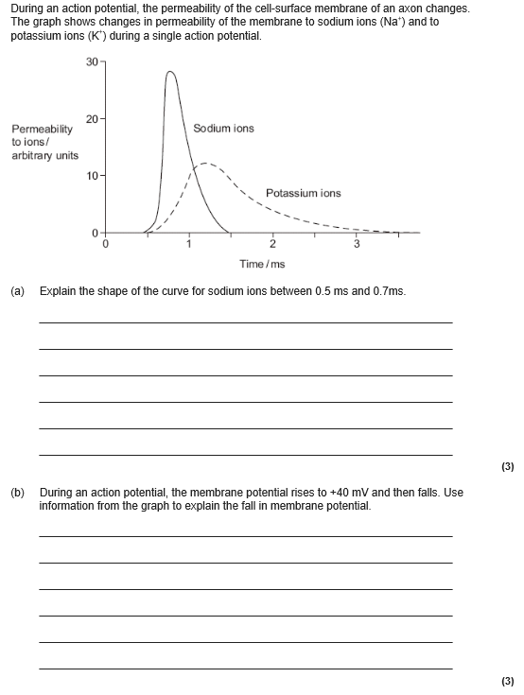
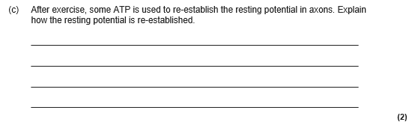
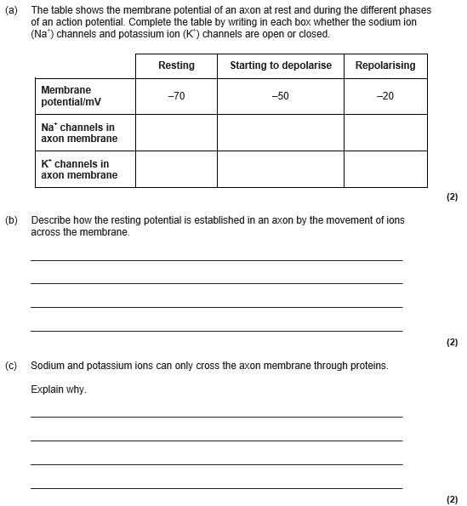

Slide 21
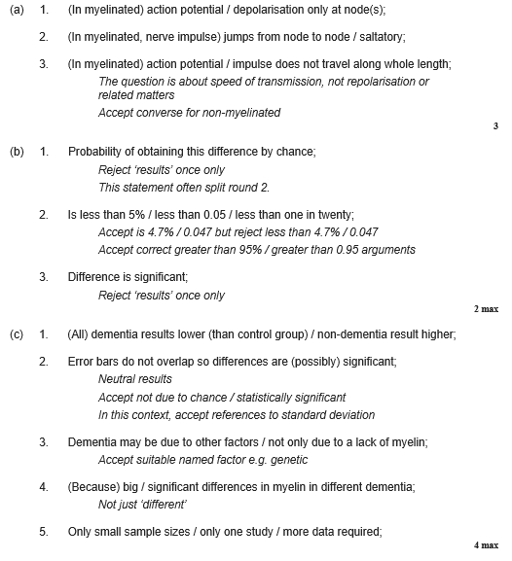
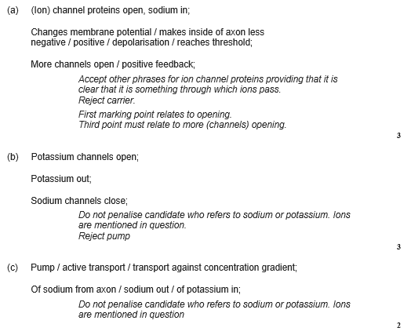
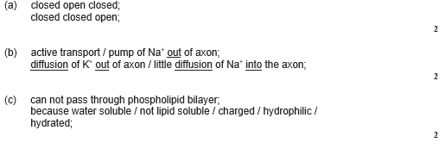

Slide 22
Topic 6: Stimuli and response - 3.6.2.1: Nerve impulses
Describe and explain 3 factors which affect the speed the AP travels,
Explain what is meant by the refractory period
Explain the importance of the refractory period.
Draw and label the components of the phospholipid bilayer.
Define and explain the All-or-nothing response.
Explain the importance of the resting potential.

Slide 23
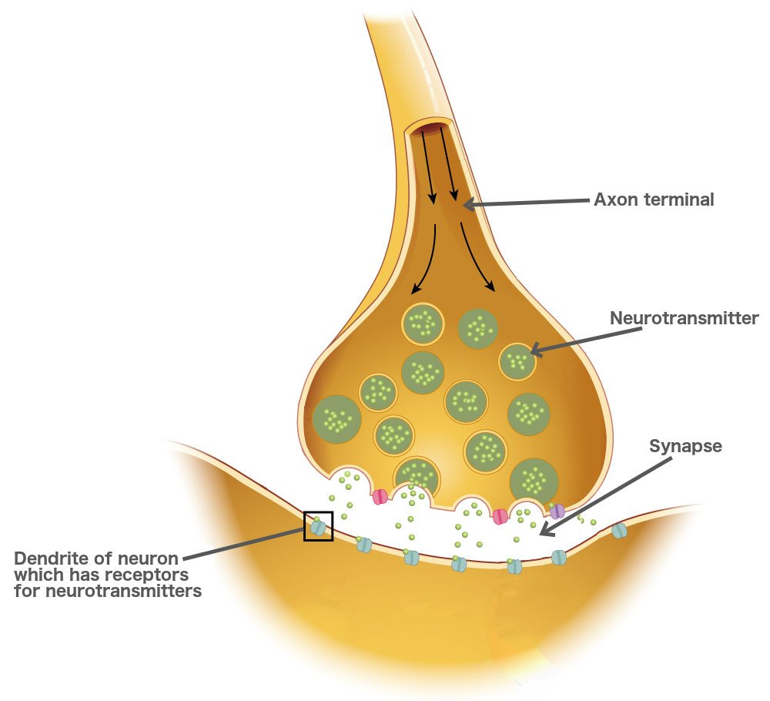
Topic 6: Stimuli and response - 3.6.2.2: Synaptic transmission
Draw and describe the events across a synpase
Explain the features of a synapse: Drawing diagrams will help
Unidirectional:
Spatial summation
Temporal summation
Inhibition
Describe and explain the effects of drugs on a synapse .

Slide 24
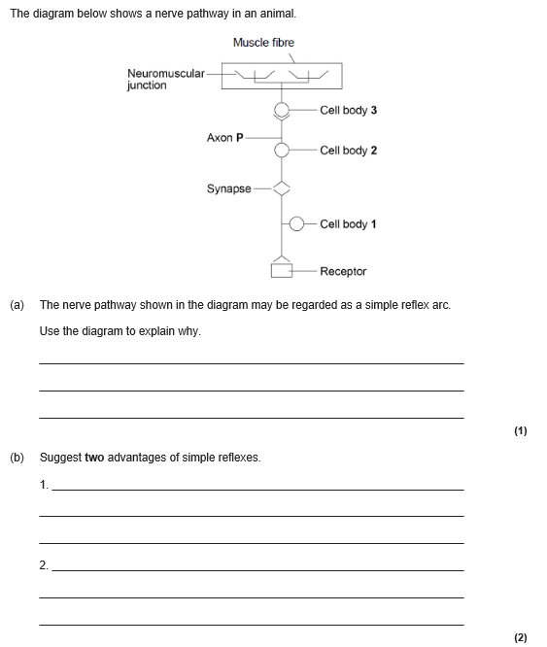
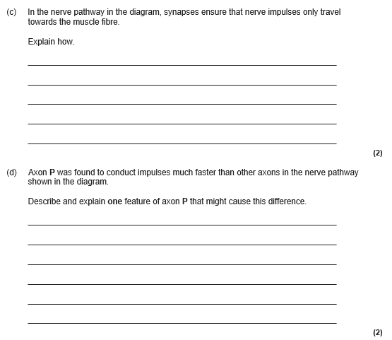

Slide 25



Slide 26



Slide 27



Slide 28


Slide 29




Topic 6: Stimuli and response - 3.6.3: Muscle contraction
Draw and describe the events across a neuromuscular junction
Label and add details to the gross structure of the skeletal muscle.
Define antagonistic muscle
Add details to the ultra structure of a muscle
Draw a contrasting table for synapses Vs Neuromuscular junction. You should have at least 3 differences.

Slide 30


Topic 6: Stimuli and response - 3.6.3: Muscle contraction
Describe the events in a muscle contraction starting from the neuromuscular.
Explain the importance of calcium to muscle contraction
Explain the importance of ATP to muscle contraction
Describe the features of slow twitch muscles
Describe the features of fast twitch muscles

Slide 31



Slide 32



Slide 33



Slide 34


Slide 35

Topic 6: Stimuli and response - 3.6.4.1 Principles of homeostasis and negative feedback
Define the terms:
Homeostasis
Positive feedback
Negative feedback
Optimum point
Receptor
Coordinator
Effector
With an example describe negative feedback
With an example describe positive feedback.

Slide 36



Topic 6: Stimuli and response - 3.6.4.2 Control of blood glucose concentration
Explain how a hormones works using adrenaline as an examples.
Describe how the structure of alpha cells are specialized for producing insulin. (Year 1)
Describe the role of the liver in regulating blood glucose. You must include Glycogenesis, glycogenolysis and gluconeogenesis.
Describe the role of adrenaline in regulating the blood glucose levels.
Define: Glycogenesis Glycogenolysis Gluconeogenesis

Slide 37


Topic 6: Stimuli and response - 3.6.4.2 Control of blood glucose concentration
Describe type 1 and type 2 diabetes.
Describe the causes for type 1 and type 2 diabetes
Add notes to the graph explaining the effect of glucose meal on blood glucose conc
Describe the treatments for type 1 and type 2 diabetes.

Slide 38





Slide 39



Slide 40



Slide 41


Slide 42




Topic 6: Stimuli and response - 3.6.4.3 Control of blood water potential.
Label the diagrams and add details of processes.
Describe the process of ultrafiltration
Describe the process of selective reabsorption
Describe how cells in selective reabsorption are specialized.
Describe how cells in ultrafiltration are specialized.

Slide 43



Topic 6: Stimuli and response - 3.6.4.3 Control of blood water potential.
Describe the process in the loop of Henle
Describe what happen in the collecting duct.
Describe the structure of ADH
Describe how osmoreceptors work, include the hypothalamus and posterior pituitary gland.
Explain how the loop of Henle is an example of a counter current multiplier.

Slide 44





Slide 45


Slide 46



Slide 47


