Slide 1
A2 Level Paper 2 and 3 - Topics 5-8
Section 5: Energy transfer in and between organisms
3.5.1 Photosynthesis
3.5.2 Respiration
3.5.3 Energy and ecosystems
3.5.4 Nutrient Cycles
Section 7: Genetics, populations, evolution and ecosystems
3.7.1 Inheritance
3.7.2 Populations
3.7.3 Evolution may lead to speciation
3.7.4 Populations in ecosystems
Section 8: Control of gene expression
3.8.1: Alteration of sequence of bases in DNA can alter the structure of proteins
3.8.2.1 Most of cell’s DNA is not translated
3.8.2.2 Regulation of transcription and translation
3.8.2.3 Gene expression and cancer
3.8.3 Using genome projects
3.8.4.1 Recombinant DNA technology
3.8.4.2 Differences in DNA between same species can be exploited for identification and diagnosis
3.8.4.3 Genetic fingerprinting
Section 6: Stimuli, both internal and external, are detected and lead to a response.
3.6.6.1 Survival and response
3.6.1.2 Receptors
3.6.1.3 Control of heart rate
3.6.2.1 Nerve impulses
3.6.2.2 Synaptic transmission
3.6.3 Skeletal muscles
3.6.4.1 Principles of homeostasis and negative feedback
3.6.4.2 Control of blood glucose concentration
3.6.4.3 Control of blood water potential.

Slide 2
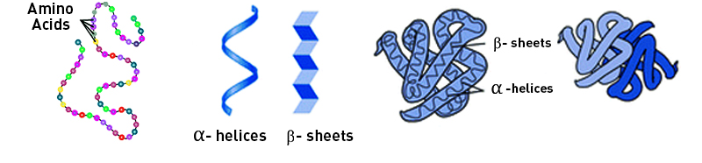
Topic 8:Control of gene expression- 3.7.1: 3.8.1: Alteration of sequence
Describe the structure of a protein
Define mutation.
Describe the effect of a substitution mutation on the DNA, mRNA and protein structure
Describe the effect of a deletion mutation on the DNA, mRNA and protein structure
List the causes of mutations and mutagenic agents:
Describe the effect of the following mutations:
Addition:
Duplication:
Inversion:
Translocation:

Slide 3
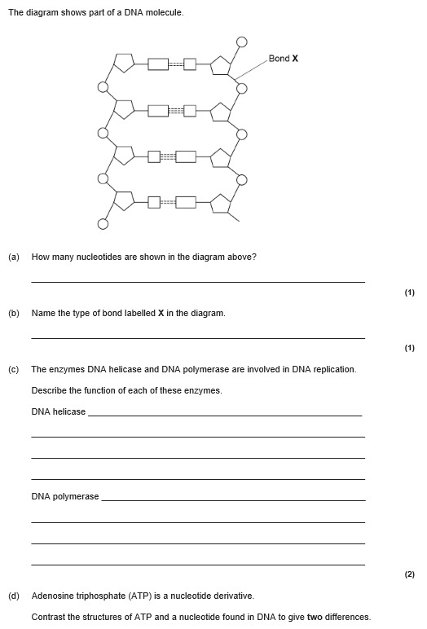
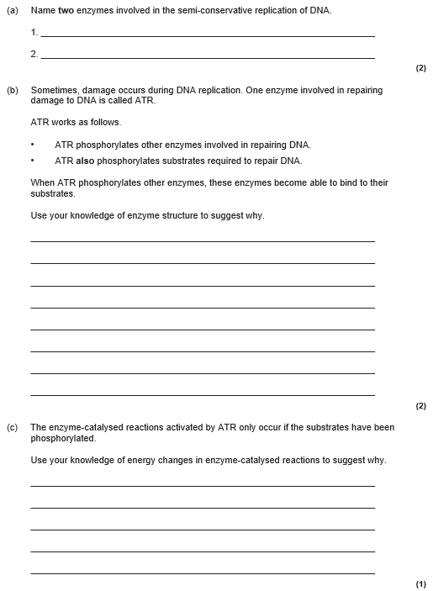
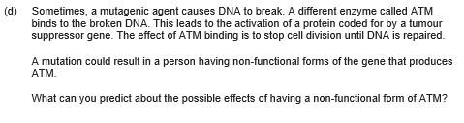

Slide 4
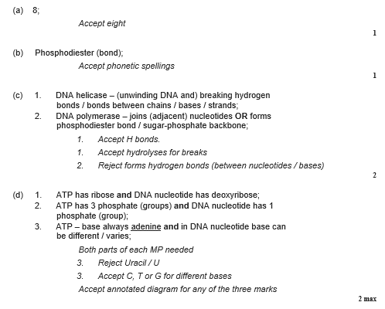
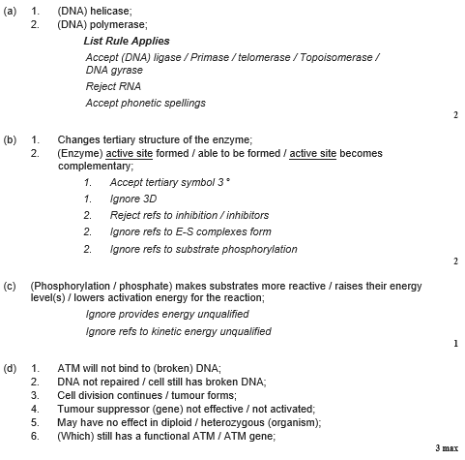

Slide 5
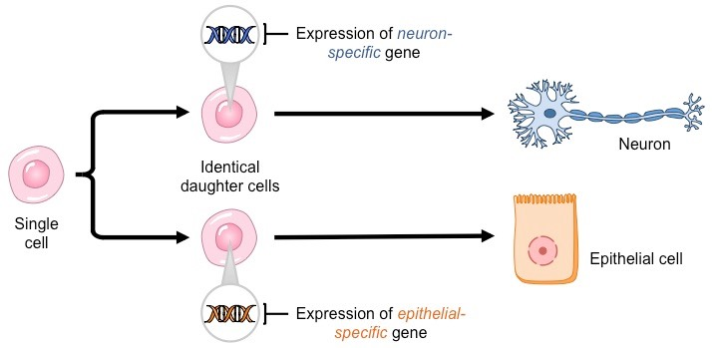
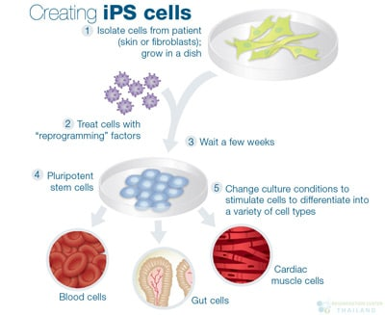
Topic 8:Control of gene expression- 3.7.1: 3.8.1: Alteration of sequence
Describe what is meant by cell differentiation and specialization.
Define totipotency:
Define induced pleuripotency:
Describe the origins and types of stem cells.
Explain what induced pluripotent stem cells are.
Explain how induced pluripotent stem cells can be used to treat disease.

Slide 6
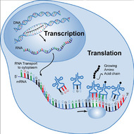
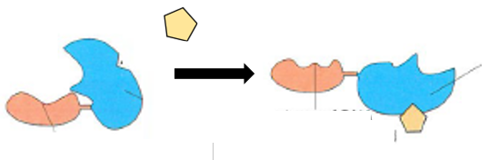
Topic 8:Control of gene expression- 3.8.2.2 Regulation of transcription and translation
Explain how estrogen affects gene expression (transcription).
Describe transcription
Describe translation

Slide 7
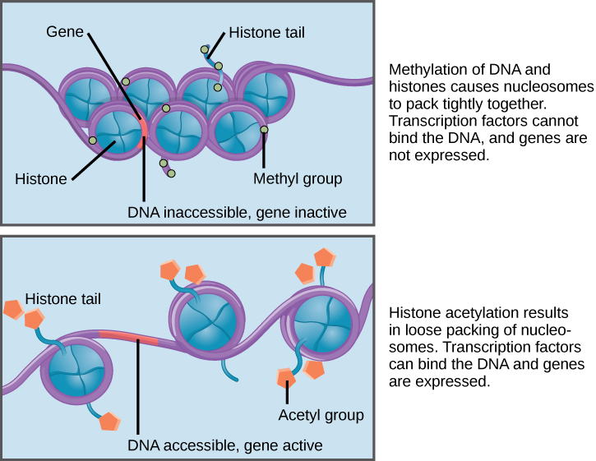
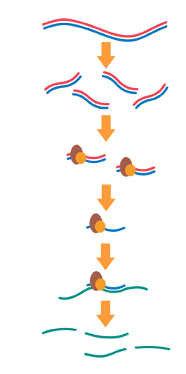
Topic 8:Control of gene expression- 3.8.2.2 Regulation of transcription and translation
Define:
Epigenetics:
Epigenome:
Draw a contrast table for acetylation and methylation of the DNA
Explain the effect of RNA interference on gene expression (translation)

Slide 8
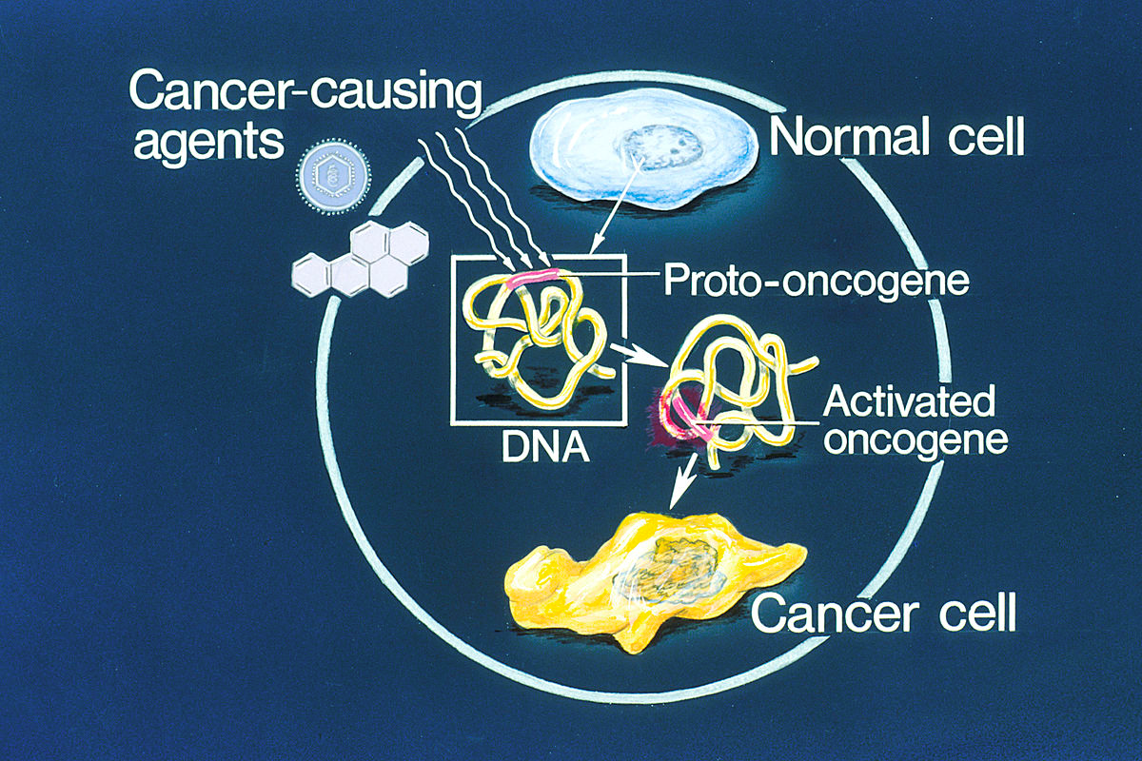
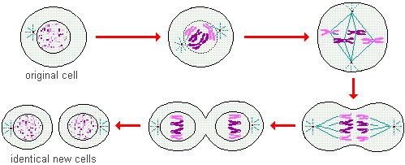
Topic 8:Control of gene expression- 3.8.2.3 Gene expression and cancer
Define cancer
Describe the role of proto-oncogenes
Draw a contrast table for benign and malignant tumors
Describe the stages of mitosis:
Explain how Oncogenes and mutated tumour suppressor genes cause cancer
Describe the role of tumour suppressor genes

Slide 9
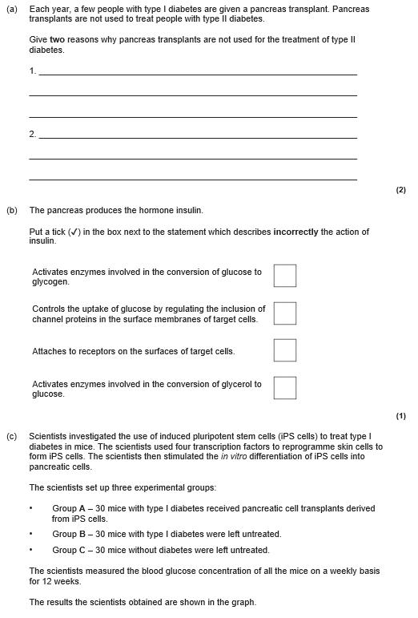
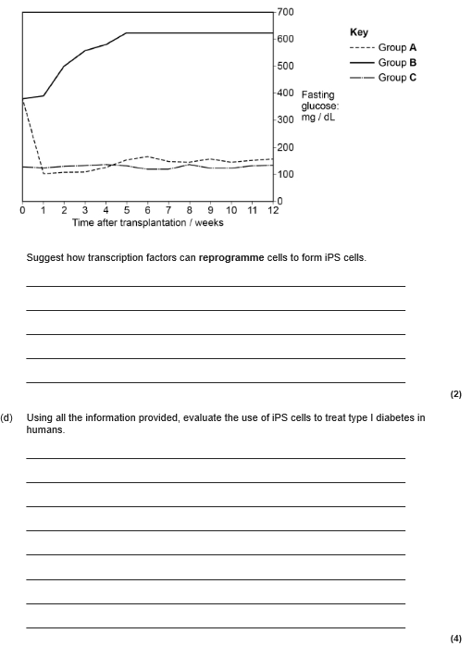

Slide 10
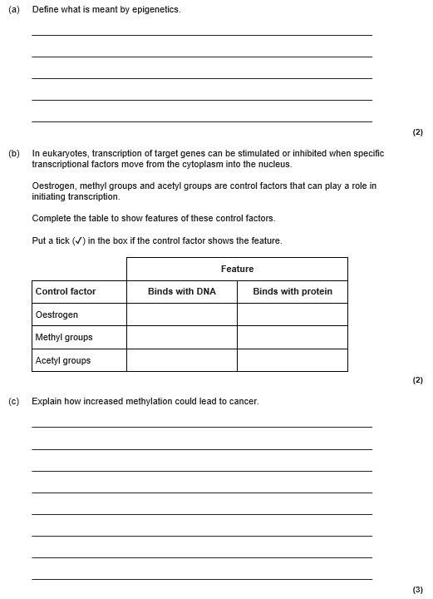


Slide 11
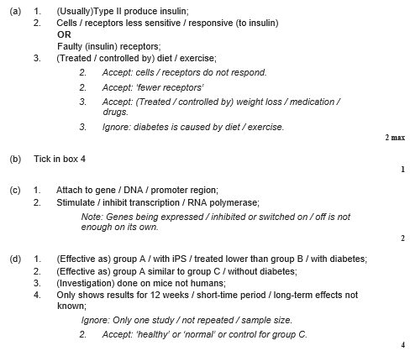
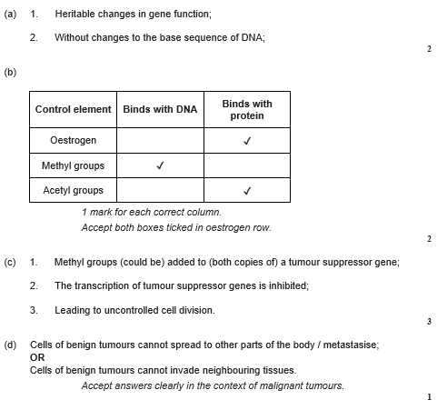

Slide 12
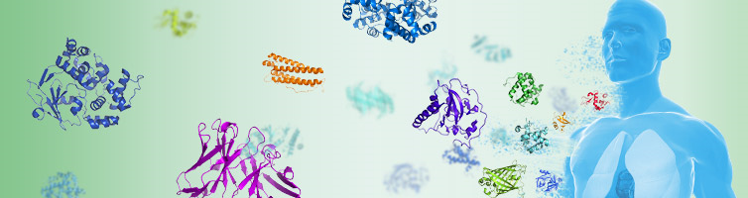
Topic 8:Control of gene expression- 3.8.3 Using genome projects
Define proteome:
Outline the importance of genome sequencing projects- why do we do them? What information do we get from them?
Describe how to determine the genome and proteome of complex organisms.
Describe how to determine the genome and proteome of simple organisms

Slide 13
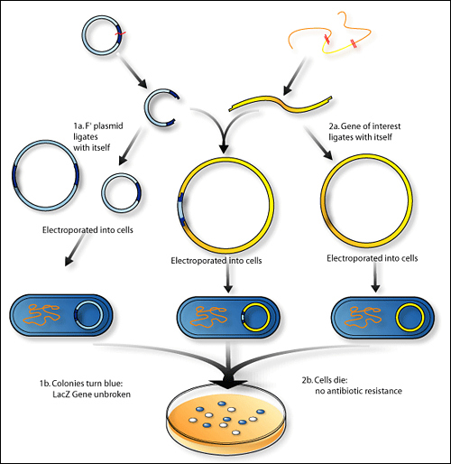
Topic 8:Control of gene expression- 3.8.4.1 Recombinant DNA technology- In Vivo
Briefly describe each of the stages:
Isolation of the gene
Insertion of the gene into a vector
Transformation of the bacteria
Identification of the transgenic bacteria
Growth/cloning of transgenic bacteria
Isolation:
Draw a diagram to describe how reverse transcription works.
Isolation:
Describe how the gene machine works.
Isolation:
Explain how restriction enzymes work highlighting the importance of sticky ends.

Slide 14
Topic 8:Control of gene expression- 3.8.4.1 Recombinant DNA technology- In Vivo
2. Insertion of a gene into a vector.
Define a vector
Give examples of vectors that can be used
3. Transformation of the bacteria
Describe how bacteria are transformed to allow vectors to enter the cell.
4. Identification of the transgenic bacteria
Draw a diagram showing how transgenic bacteria are identified using replica plating.
2. Insertion of a gene into a vector.
Draw a diagram to explain how a gene is prepared to be inserted into a vector.
4. Identification of the transgenic bacteria
Describe the 3 different types of marker used and how they help identify transgenic bacteria.

Slide 15
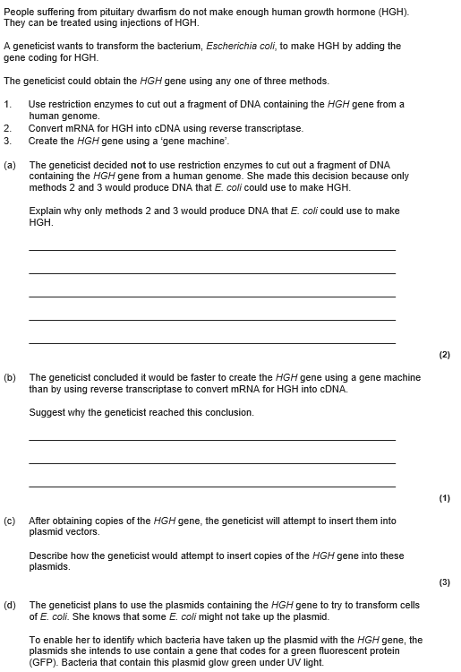
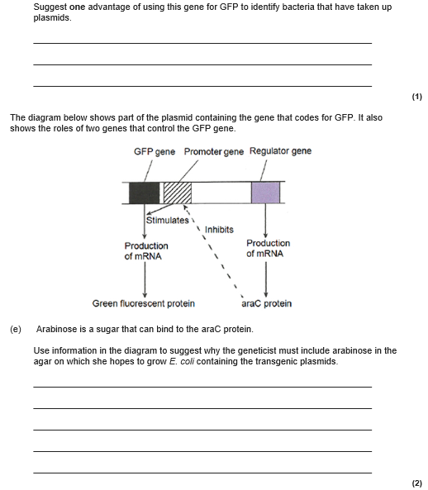

Slide 16
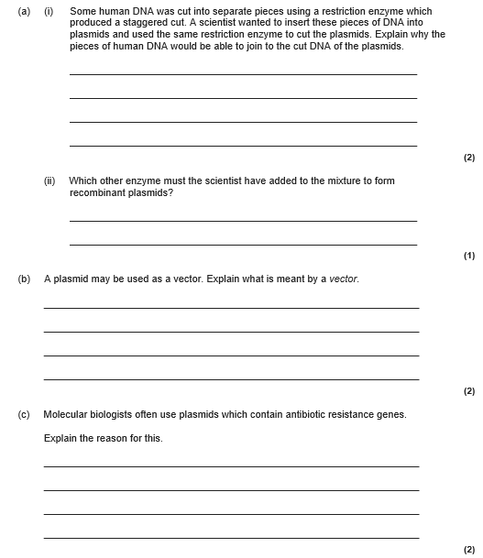

Slide 17
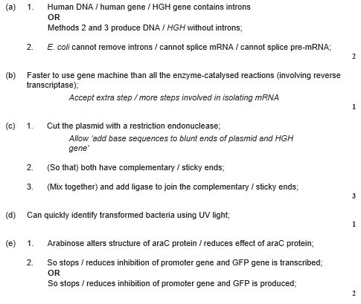
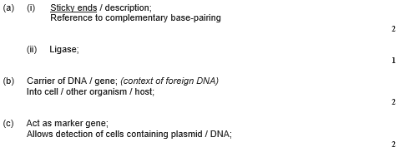

Slide 18
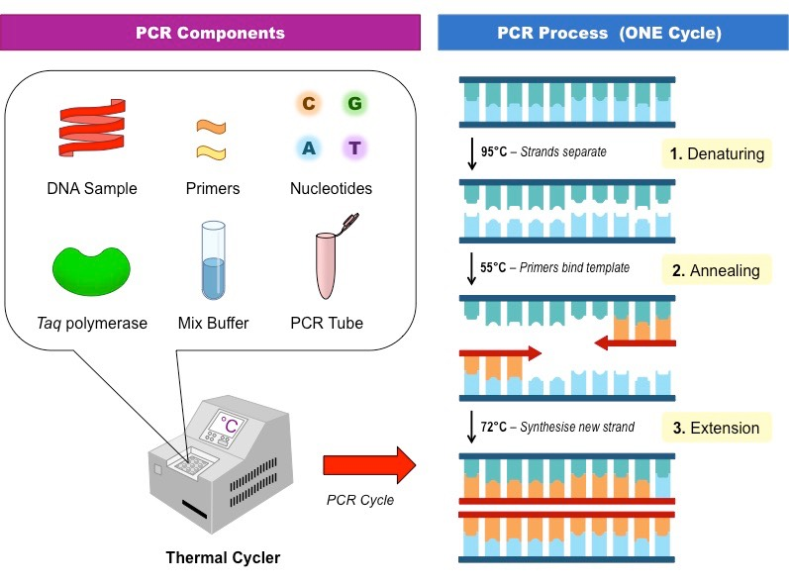
Topic 8:Control of gene expression- 3.8.4.1 Recombinant DNA technology- In Vitro
Draw a contrast table for DNA polymerase and RNA polymerase.
Describe TAQ polymerase
List 4 benefits of recombinant technology
List 4 risks of recombinant technology
Describe and explain the process of PCR.
Draw contrast table for DNA replication and PCR

Slide 19
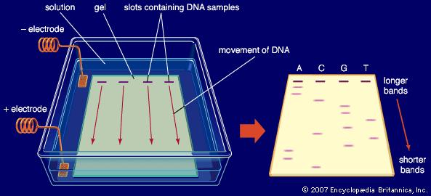
Topic 8:Control of gene expression- 3.8.4.1 Recombinant DNA technology- In Vitro
Describe and explain how DNA probes work.
Describe how DNA hybridization is used to locate specific genes.
Describe and explain the role of a genetic councilor
Describe and explain the process of electrophoresis
Draw contrast table somatic gene therapy and germ-line gene therapy.

Slide 20
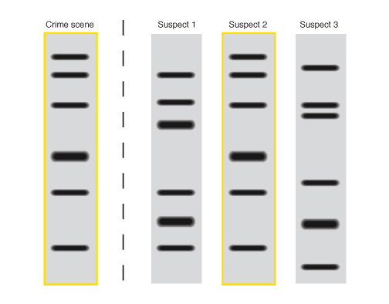
Topic 8:Control of gene expression- 3.8.4.1 Recombinant DNA technology- In Vitro
Explain how the results of genetic fingerprinting are interrupted
Describe and explain the uses for genetic fingerprinting in
Identifying evolutionary relationships
Forensic science
Medical diagnosis
Plant and animal breeding

Slide 21
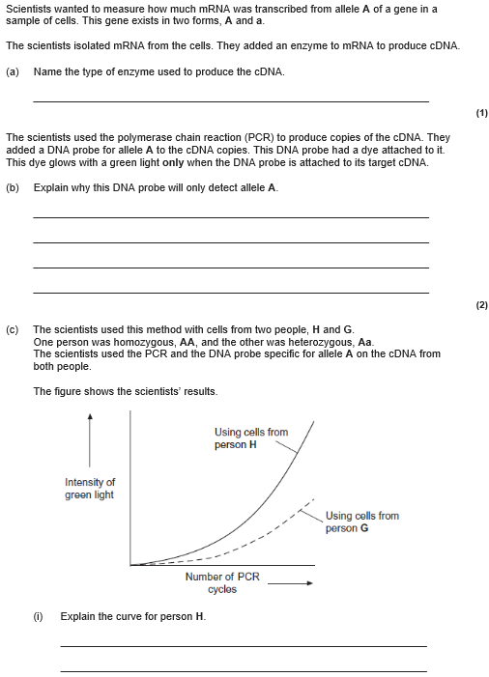
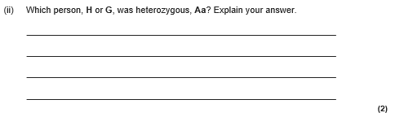
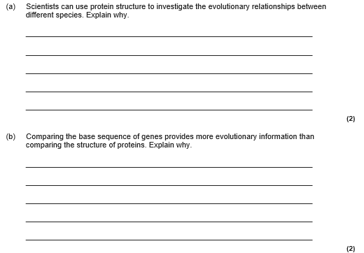

Slide 22
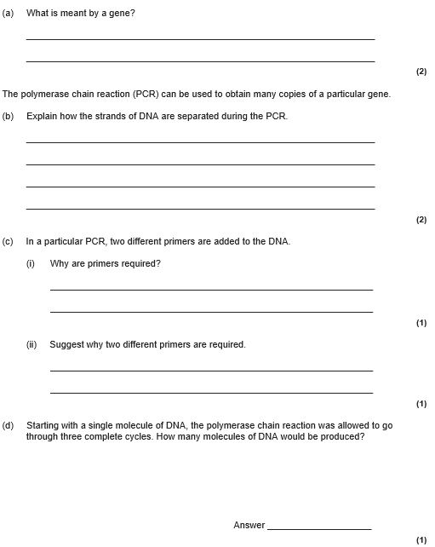

Slide 23
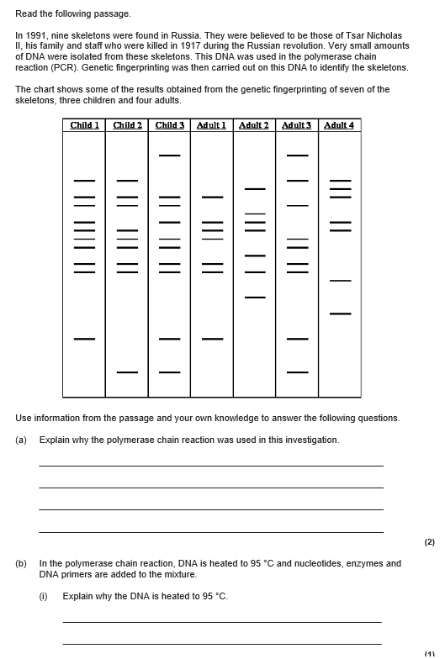
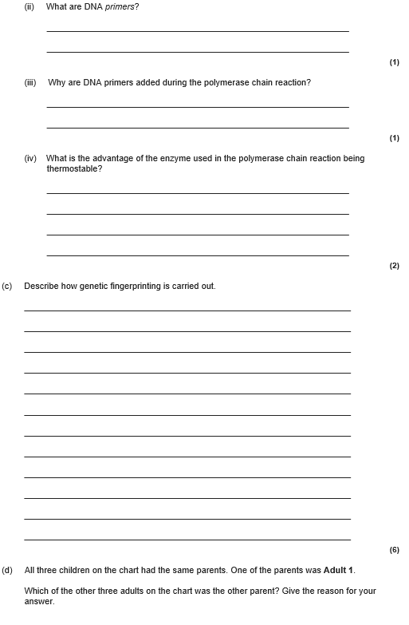

Slide 24
