Slide 1
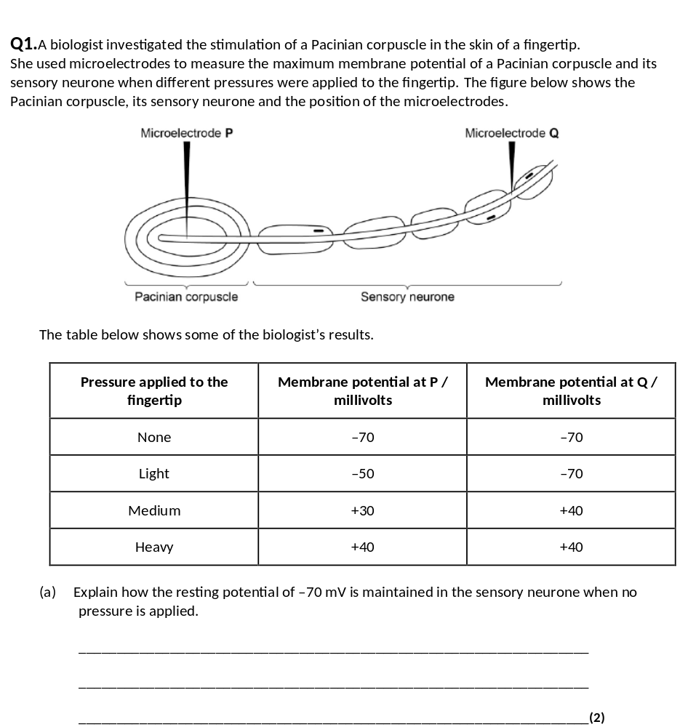
1. Membrane more permeable to potassium ions and less permeable to sodium ions;
2. Sodium ions actively transported / pumped out and potassium ions in.

Slide 2
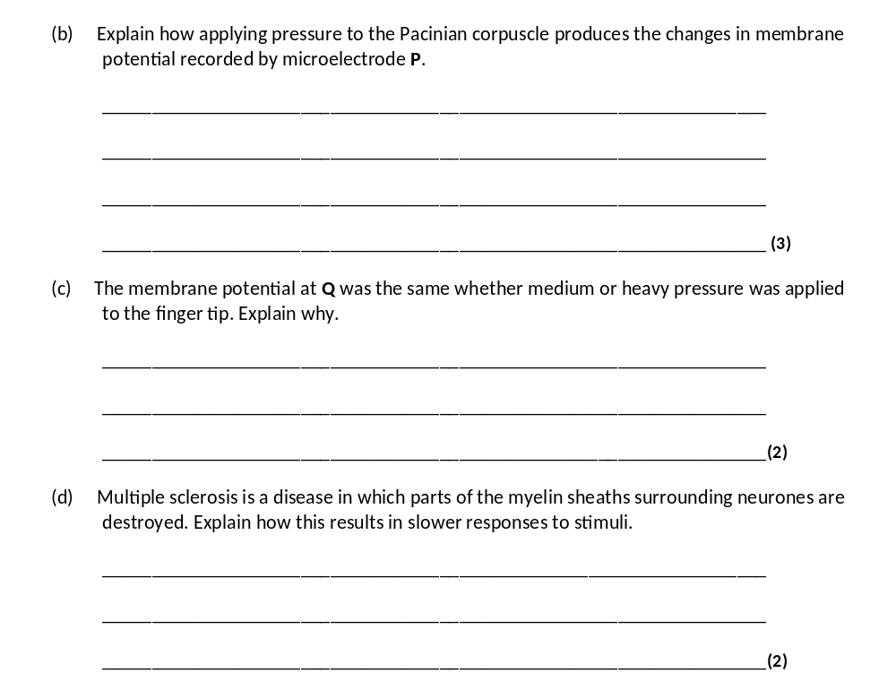
1. (Pressure causes) membrane / lamellae to become deformed / stretched;
2. Sodium ion channels in membrane open and sodium ions move in;
3. Greater pressure more channels open / sodium ions enter.
3
1. Threshold has been reached;
2. (Threshold or above) causes maximal response / all or nothing principle.
2
1. Less / no saltatory conduction / action potential / impulse unable to ‘jump’ from node to node;
2. More depolarisation over length / area of membranes.

Slide 3
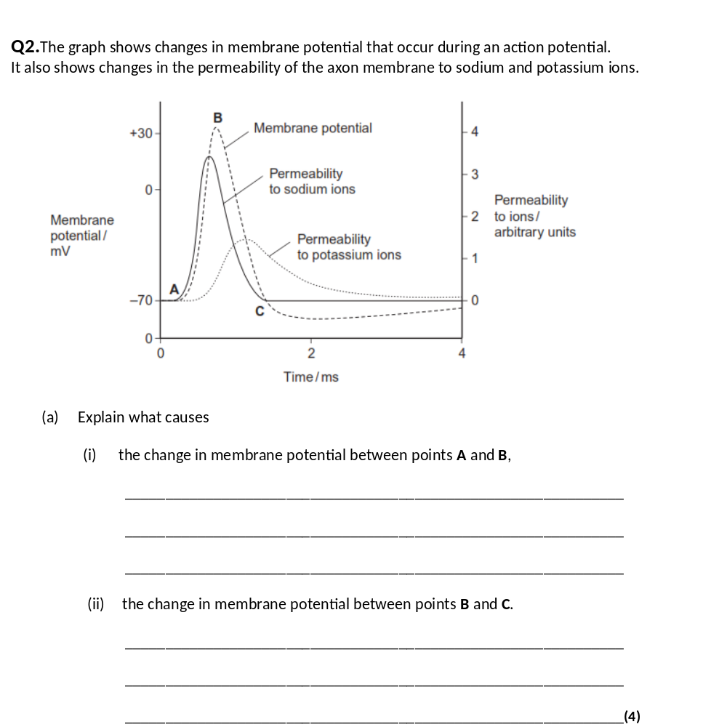
(i) A to B:
Mark (i) and (ii) as a whole
Sodium channels open / membrane more permeable to
sodium (ions);
Max 3 for each section
Sodium ions enter;
By diffusion / from high to low concentration;
Allow ‘diffusion’ point ONCE only
Ref. sodium ions have positive charge / cause change
from negative to positive potential;
Accept refs to sodium and potassium
(ii) After B:
Sodium channels close;
Potassium channels open / membrane more permeable to
potassium ions;
Potassium ions leave;
By diffusion / from high to low concentration (ONCE only);

Slide 4
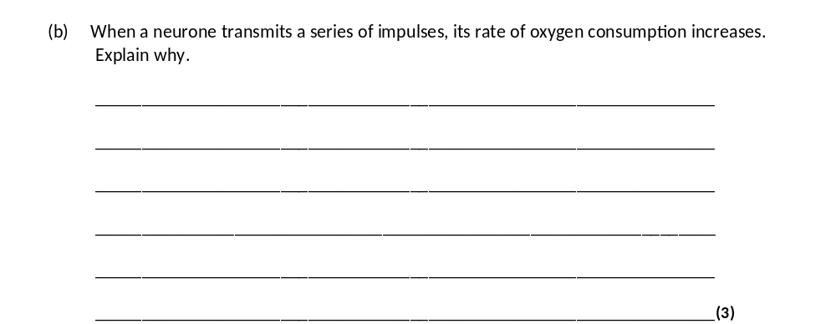
(More) respiration;
Reject anaerobic respiration
(More) energy supplied / (more) ATP supplied;
Reject ‘produce’ energy
For active transport of ions / ‘sodium (-potassium) pump’ / pumping
out sodium ions / for neurotransmitter synthesis / for vesicle movement;
Accept named e.g.

Slide 5
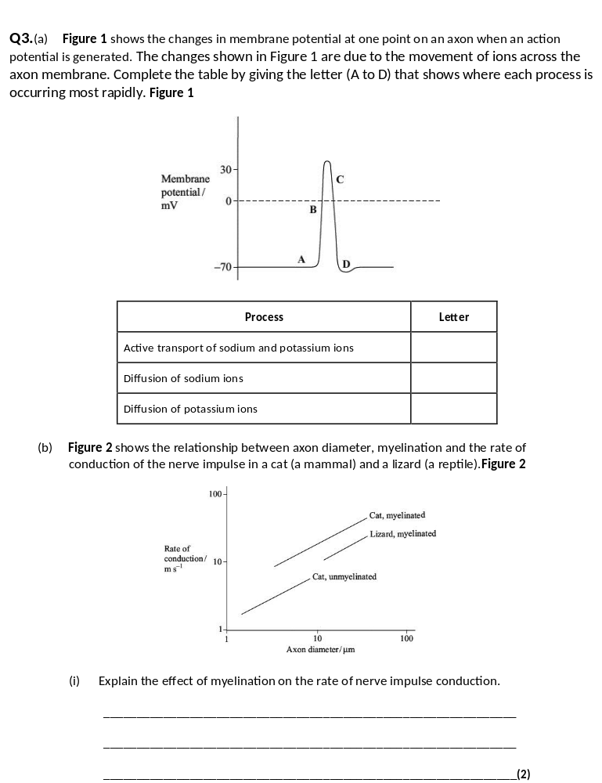
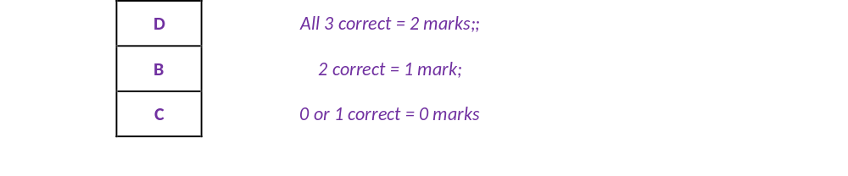
myelin insulates / prevents ion movement; saltation / described
re leaping node to node;

Slide 6
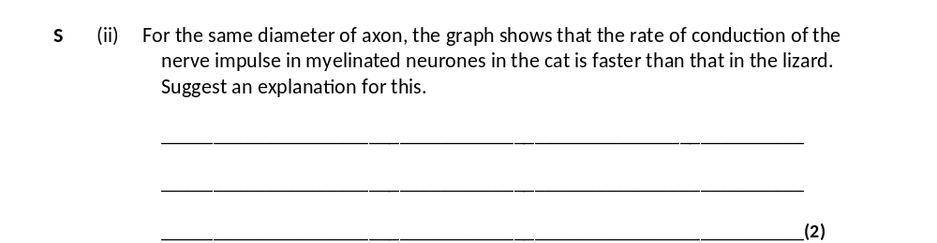
cat has higher body temperature;
ignore references to homoiothermy’ / warm-blooded
faster diffusion of ions / faster opening of ion pores / gates / channels;

Slide 7
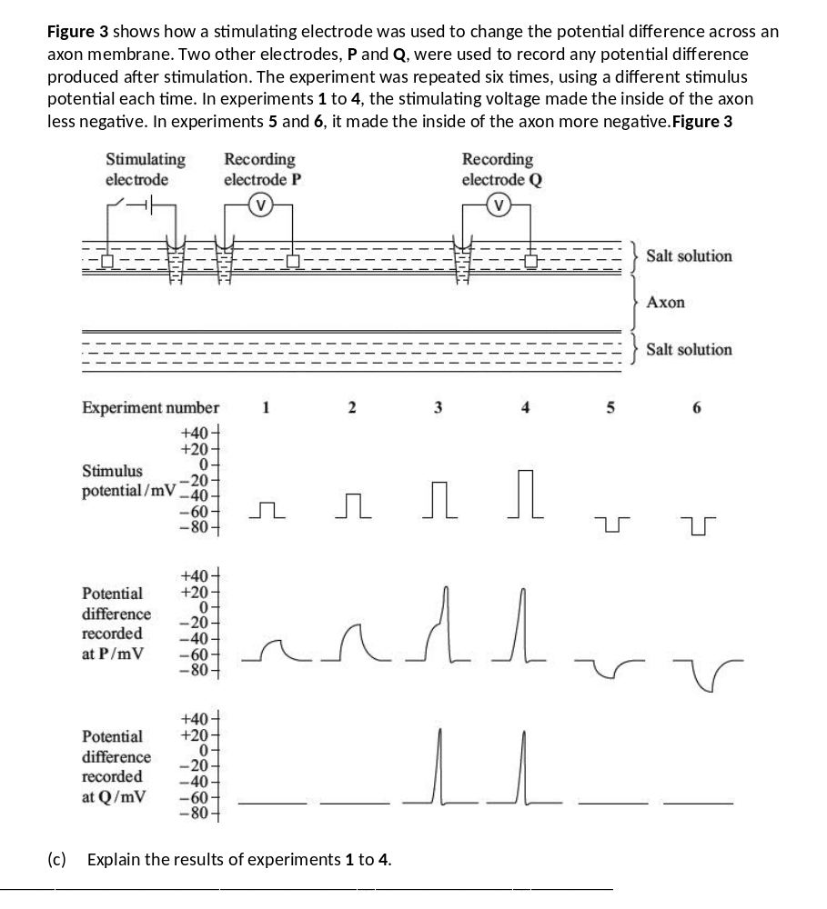
1 increasing stimulus (potential) causes decrease in potential
difference / rise in potential at P;
2 1 or 2 is sub-threshold / 1 or 2 does not give action potential / 3 or 4 is above threshold / 3 or 4 does give an action potential;
3 influx of Na⁺ ions; (not just Na / sodium)
4 voltage-gated channels (in axon membrane) opens / opens Na⁺
channels / membrane more permeable to Na⁺
(NOT just Na / sodium);
5 sufficient for stimulation of adjacent region of axon therefore impulse propagated (from P to Q);

Slide 8
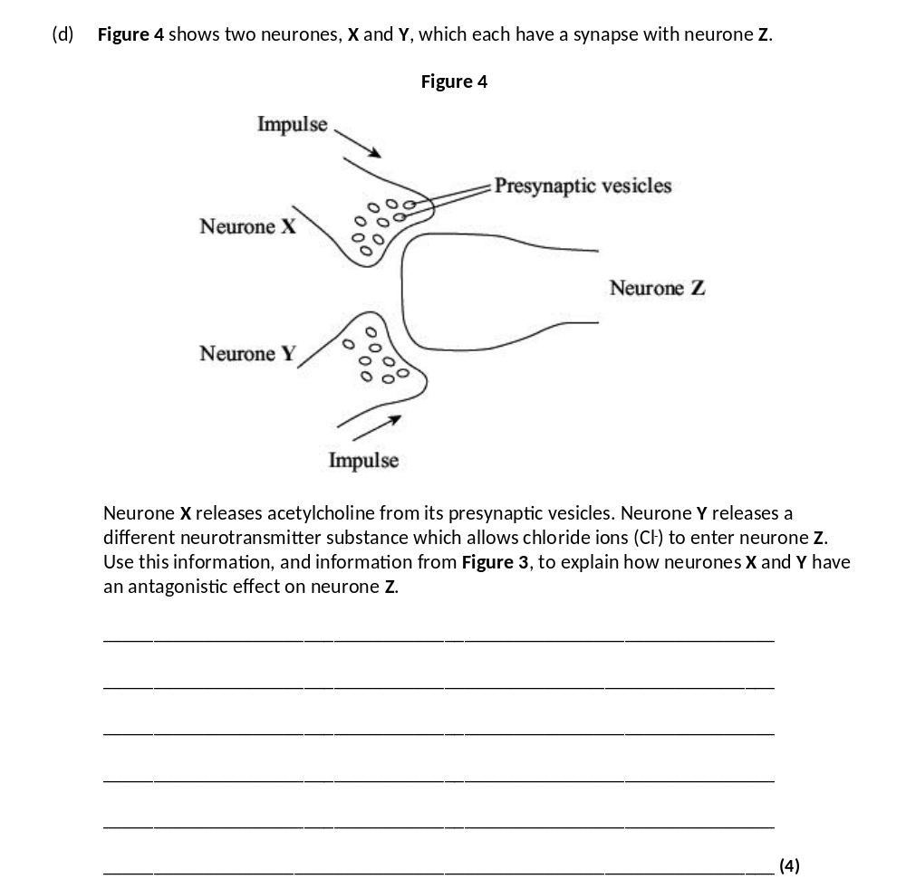
1 X / Acetylcholine → opening of Na⁺ channels / increases
Na⁺ permeability and Na⁺ ion entry into Z;
2 Y / Cl– entry - lowers potential / increases potential
difference / makes potential more negative;
3 X stimulates and Y inhibits (Z);
4 balance of impulses from X and Y determines whether Z
fires action potential / determines whether potential rises
above threshold;

