Slide 1
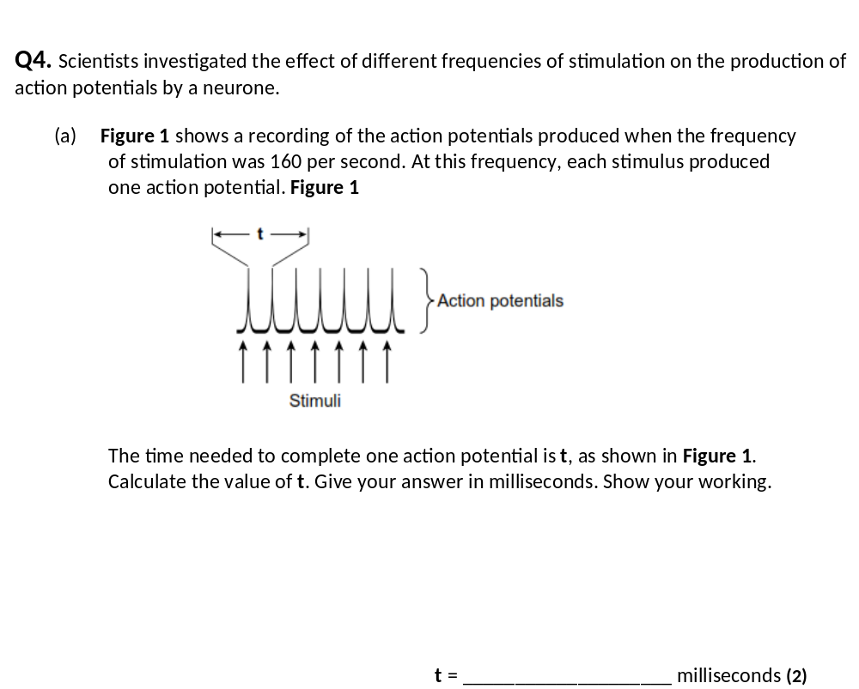
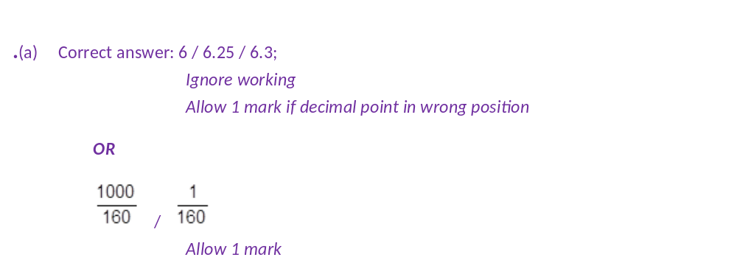

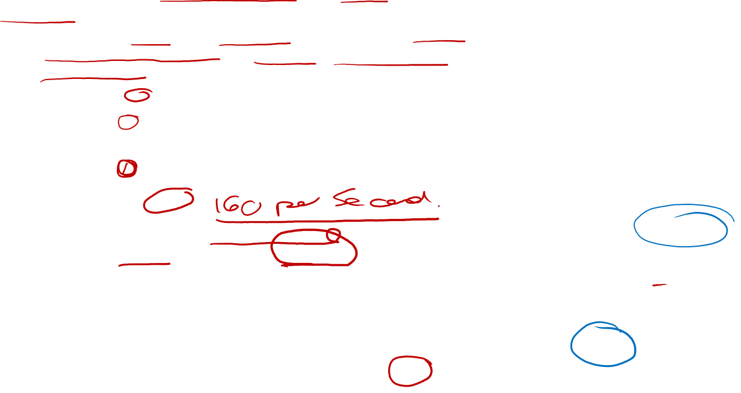

Slide 2
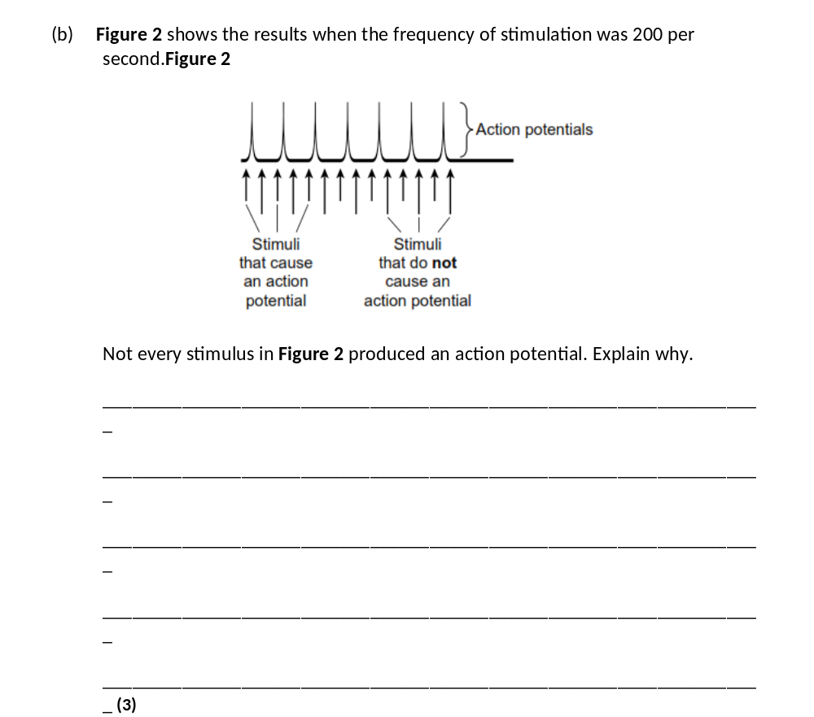
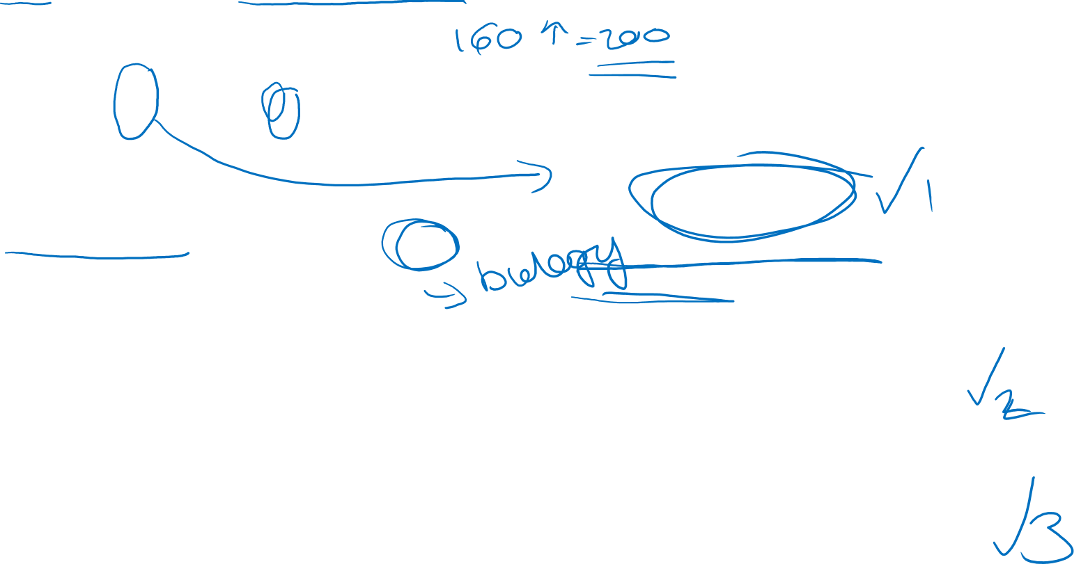
Ref. to ‘refractory period’;
Requires greater stimulation;
To reach threshold / threshold cannot be reached / to cause depolarisation;
K ⁺ channels are open / more negative potential than resting potential /
membrane is hyperpolarised;
Na ⁺ channels are inactive/are closed / sodium channels will not open;

Slide 3
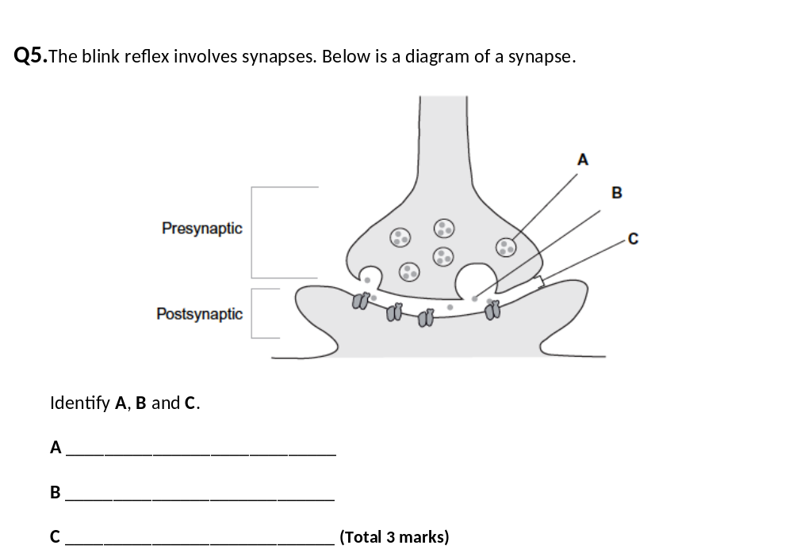
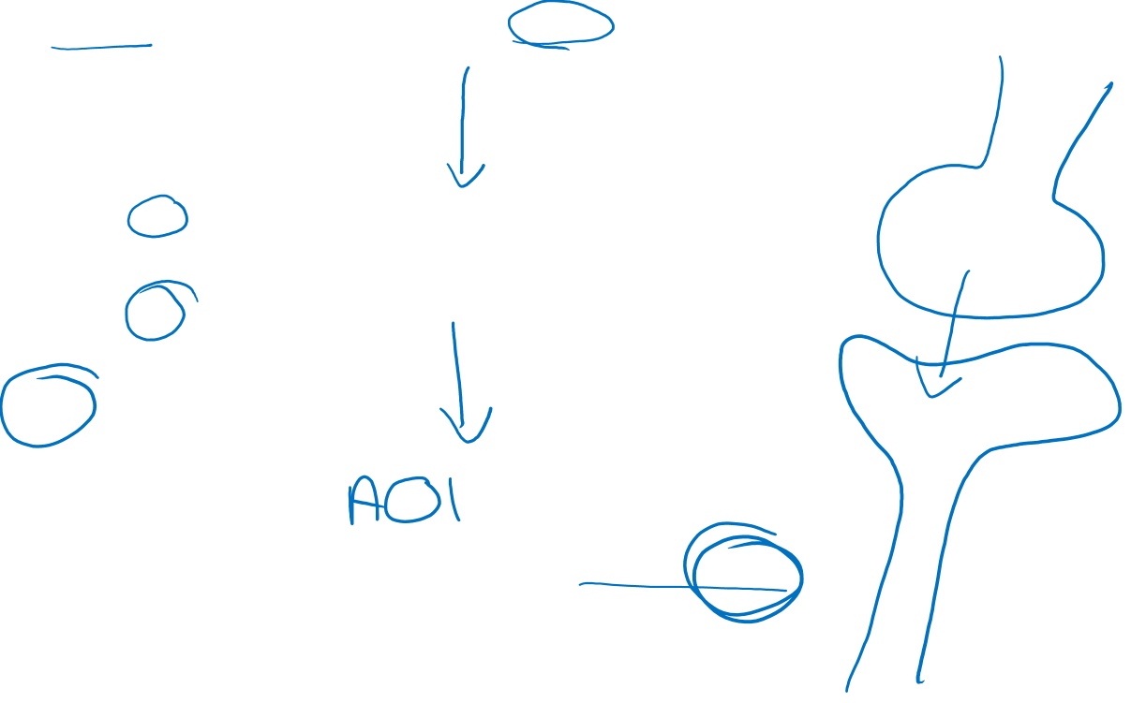
A Vesicle;
B Neurotransmitter;
C Synaptic cleft;

Slide 4
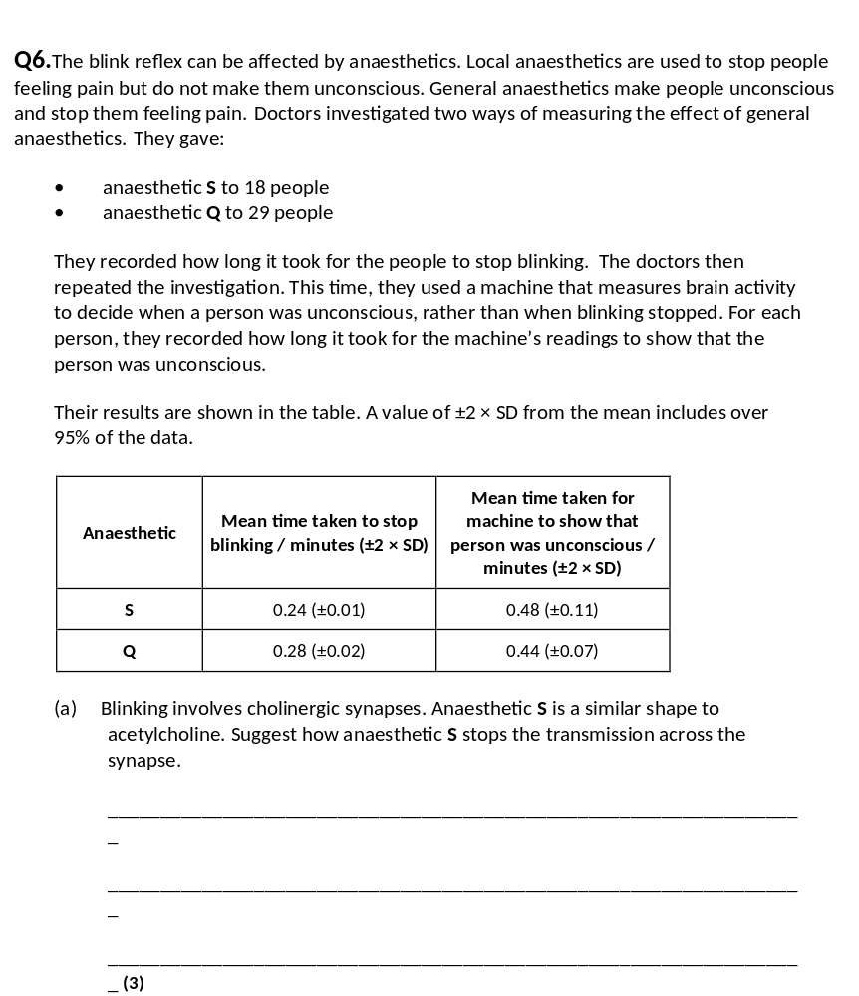
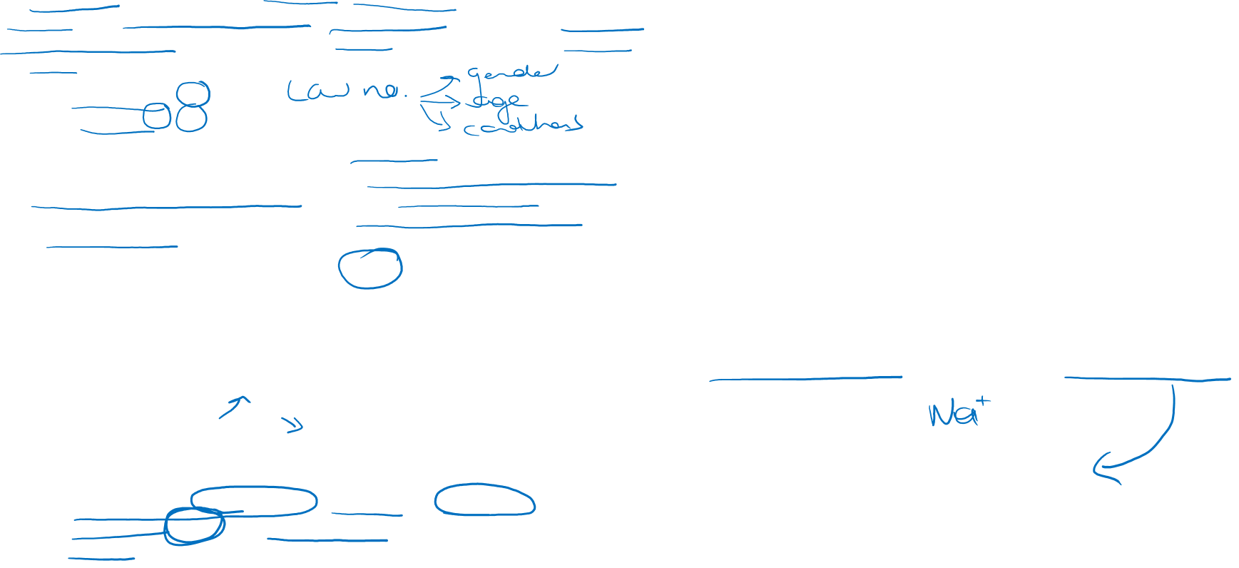
1. Complementary to receptor for acetylcholine;
2. Binds to receptor;
3. On postsynaptic (membrane);
4. Prevents acetylcholine from binding;
5. No action potential in postsynaptic neurone;
2. Accept description of ‘binds’
3. Must be in context of membrane
5. Accept ‘depolarisation’ but not ‘impulse’

Slide 5
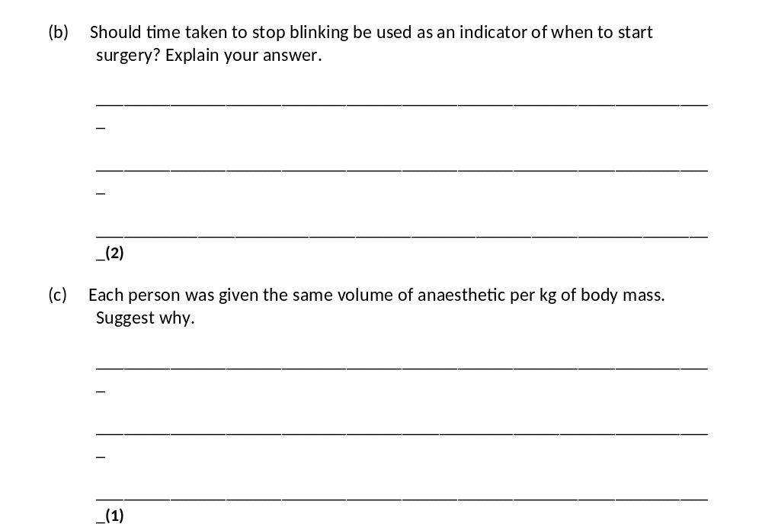
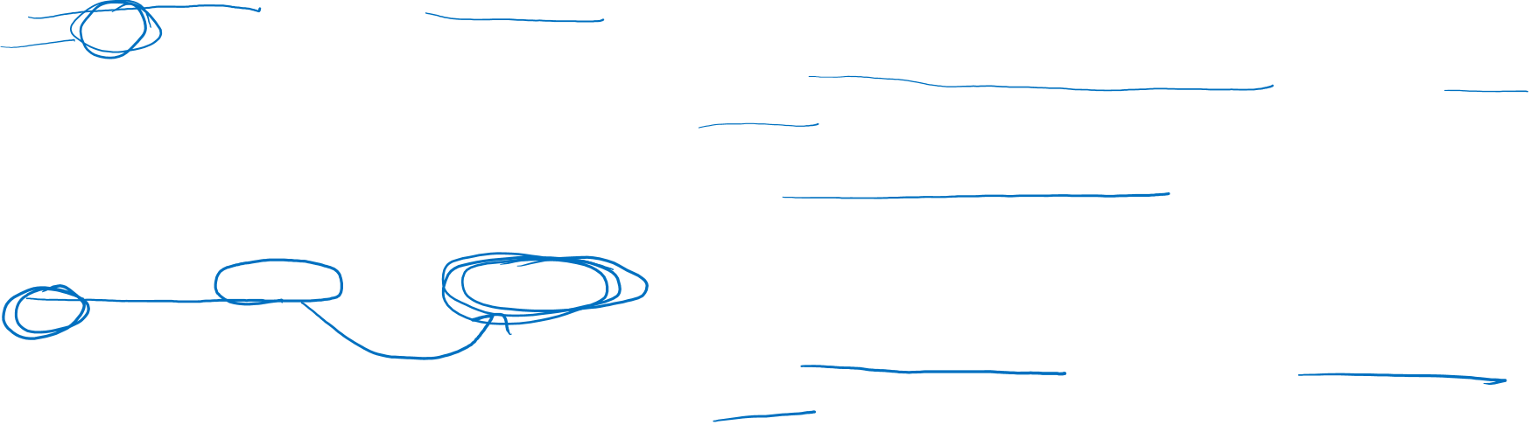
1. Takes longer to become unconscious than it does to stop blinking;
2. No overlap of standard error;
1. Accept reference to 0.24/0.28 and 0.48/0.44 in place of longer
2
(c) Different body masses but need to have comparable effects;
Do not accept ‘same’ effects or unqualified references to ‘bias / comparison / fair test’.

Slide 6
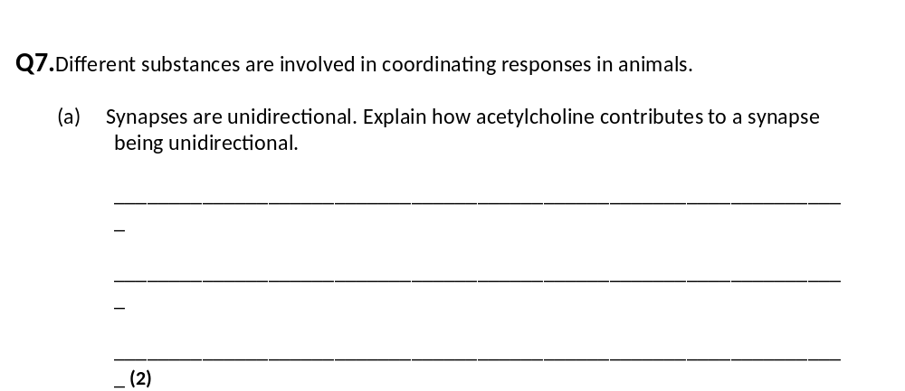
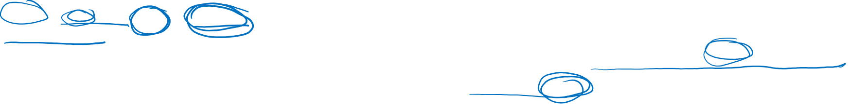
1. (Acetylcholine) released from / in presynaptic side;
2. Receptors in postsynaptic (side) / binds on postsynaptic (side);
2. Mark for diffusion only awarded in context of unidirectional movement.

Slide 7
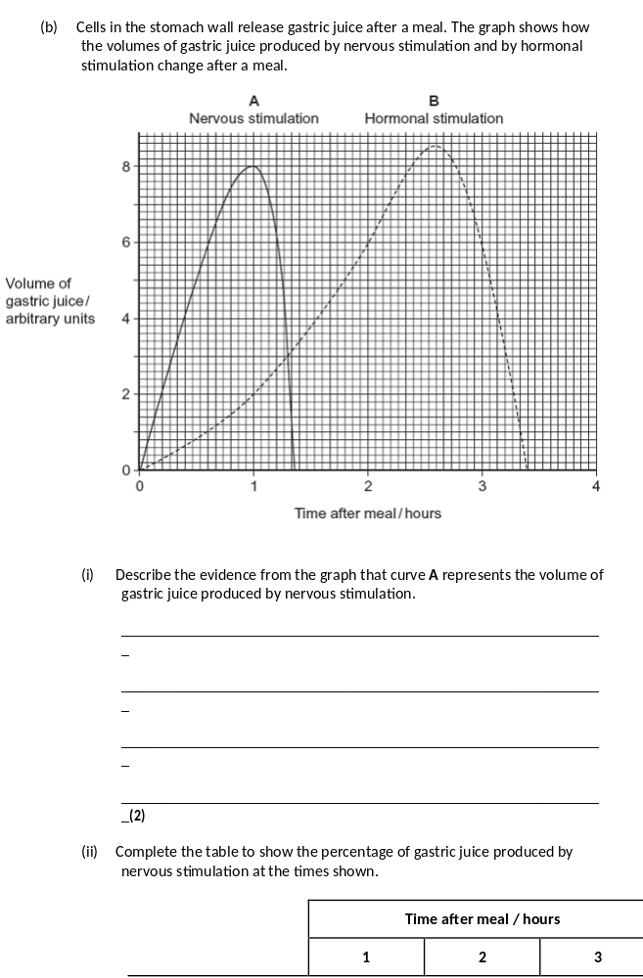
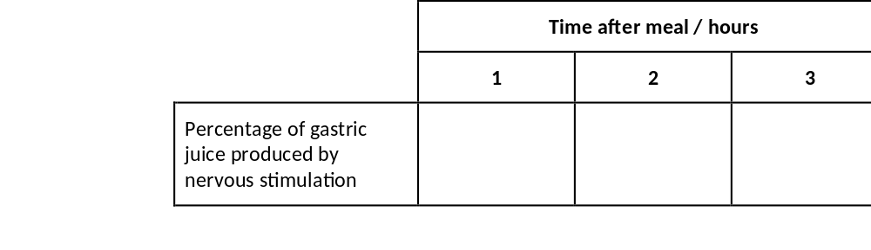
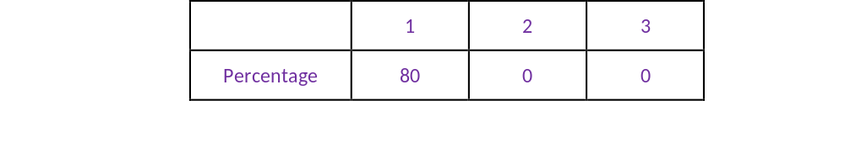
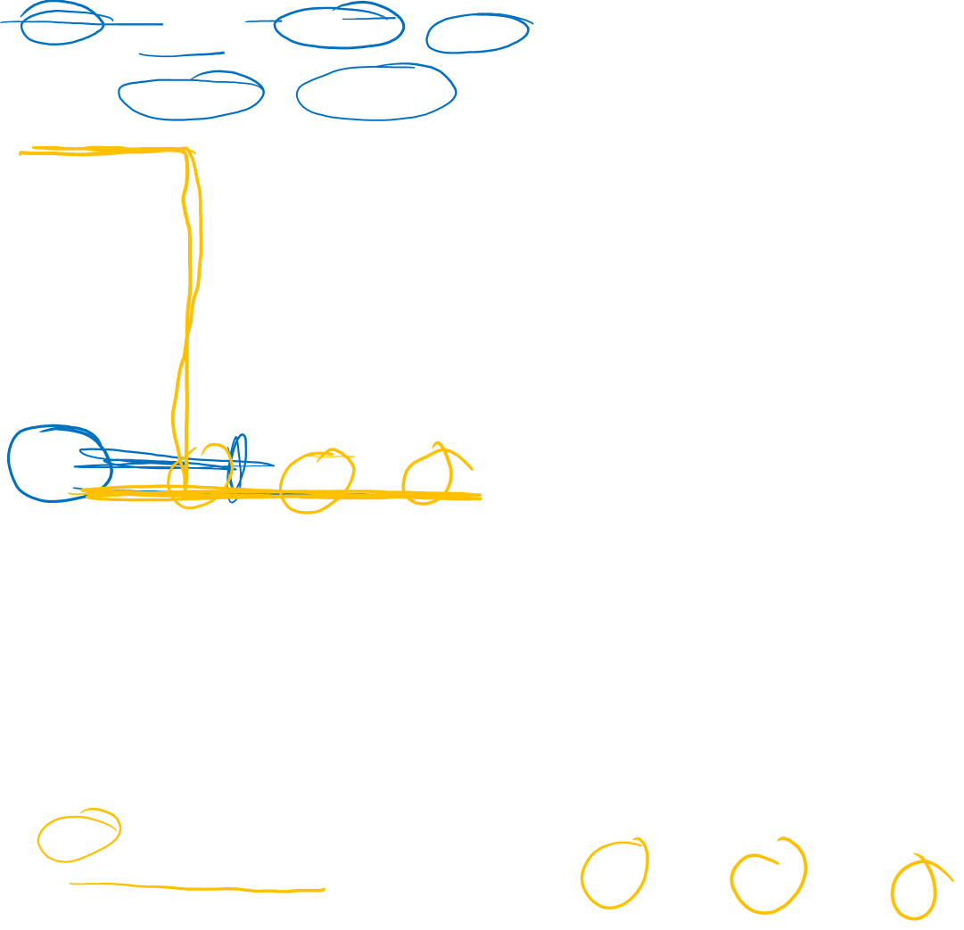
1. Rapid response;
2. Short duration;
Specific wording is not important. It is the principles that matter here.
Points may be made by referring to figures.

Slide 8
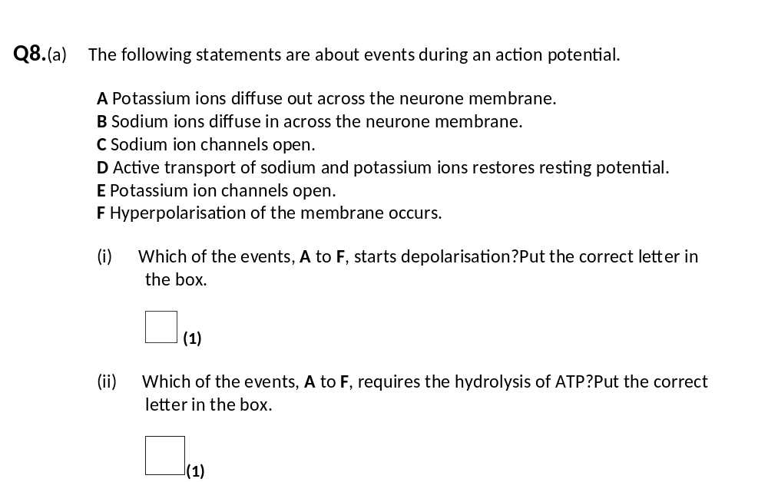
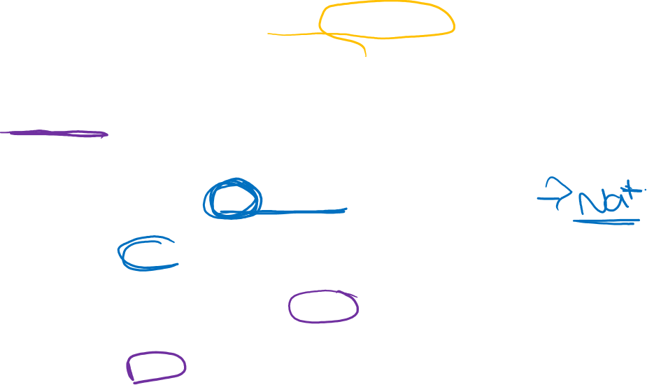
(i) C;
1
(ii) D;

Slide 9
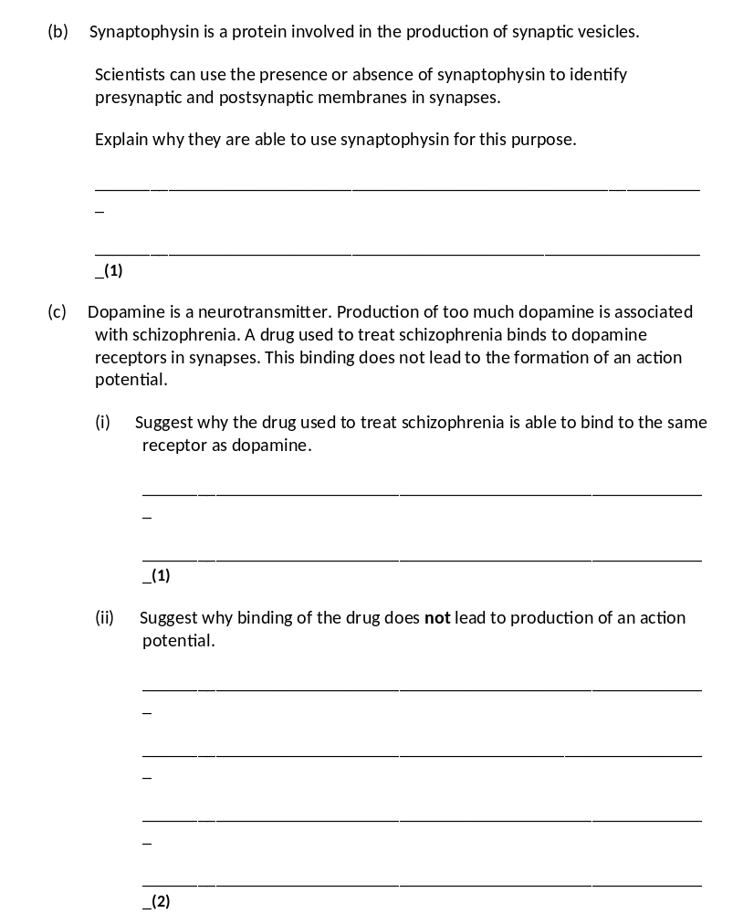
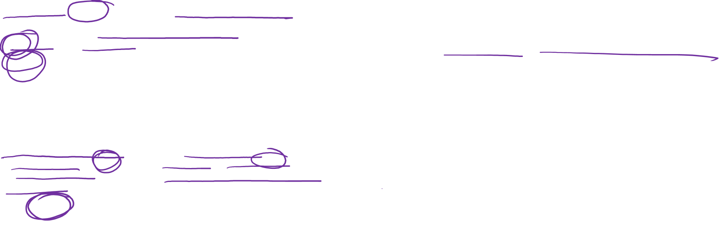
(b) (Synaptic) vesicles (only) found in presynaptic (part of synapse);
Accept bulb of synapse for presynaptic
Reject vesicles in the membrane
1
(c) (i) Has similar shape/structure to dopamine
OR
Complementary (to binding site on receptor);
Ignore competitive inhibitor
Accept tertiary structure
Reject active site
Reject same shape as dopamine/as receptor

Slide 10
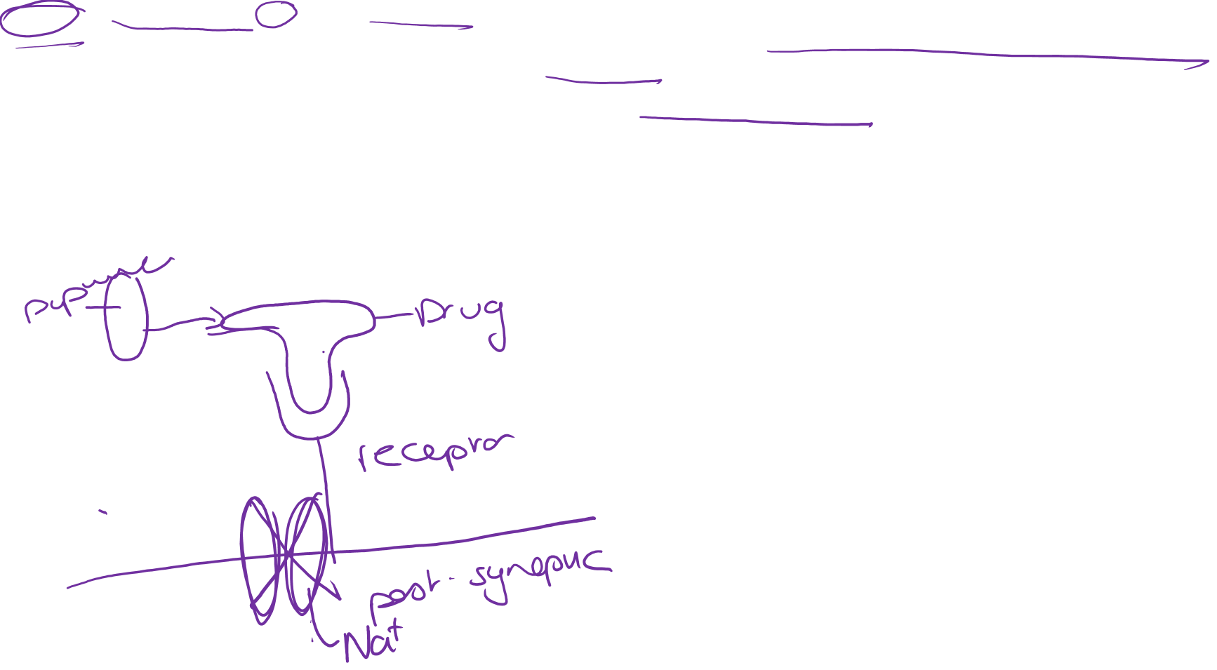
(ii) 1. (Binding) does not lead to opening of sodium ion channels;
2. (So) no depolarisation / threshold not reached / sodium ions do not diffuse in;
OR
3. Opens chloride ion channels;
4. Causing hyperpolarisation / preventing depolarisation
Mark either 1 and 2 OR 3 and 4
1. Accept stops dopamine opening sodium ion channels
1. Reject sodium unqualified
2. Accept no generator potential
3. Reject chlorine

