Slide 1

Directed study- Taxis, Kinesis and Tropism.
Receptors booklet- pages 2-4
Exam questions- pages 8-9

Slide 2
Outcome:
Explain what is meant by taxes, kineses, how they differ and how taxes & kineses aid survival.
Explain what is meant by phototropism and gravitropism, and by positive and negative tropisms and how this is caused by IAA
Watch these three videos on animal behavior.
https://www.youtube.com/watch?v=rRDovcEf_ks (3 mins 20 sec)
https://www.youtube.com/watch?v=jSKkecFzD50 (4 mins 22 sec)
https://www.youtube.com/watch?v=cmkG3acsX0A (3 mins 39 sec)
Can you pick up the difference between kinesis, taxis and tropisms?

Slide 3

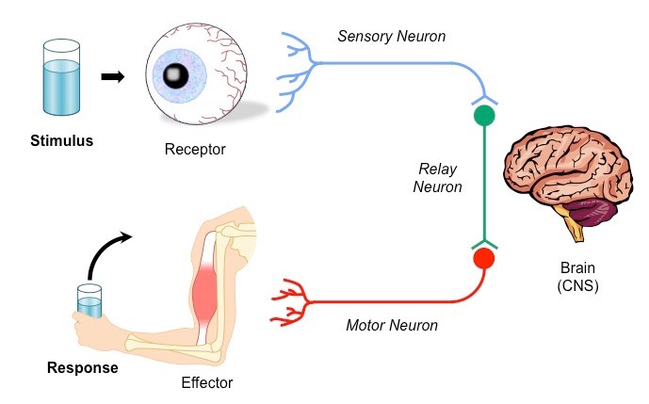
Outcome:
Explain what is meant by taxes, kineses, how they differ and how taxes & kineses aid survival.
Explain what is meant by phototropism and gravitropism, and by positive and negative tropisms and how this is caused by IAA
Term | Definition
Stimulus | Detectable change in internal/external environment that causes a change to the organism
Receptor | Cell that detects a stimulus. Receptors are specific to 1 type of stimulus
Coordinator | Formulates a suitable response to a stimulus
Effector | Organ that produces a response
Taxis | A directional response Towards the stimulus is known as positive taxis Away from the stimulus is known as negative taxis
Kinesis | A non-directional response Causes organisms to change the speed of their movement In favourable conditions movement is slow with many turns In unfavourable conditions movement is fast with few turns
Tropism (Geo, photo) | The growth of a plant in response to a directional stimulus Towards the stimulus is known as positive tropism Away from the stimulus is known as negative tropism
In your exam you are given “novel” or “unknown” examples of behaviour in different organisms, you need to be able to identify the type of behaviour shown and then justify (provide evidence for) your answer from the information the question has given you.
Do these images/descriptions show Kinesis or taxis? For taxis examples, can you work out if this is + or – ?
Complete activity page 2-3 and APPLY your knowledge

Slide 4
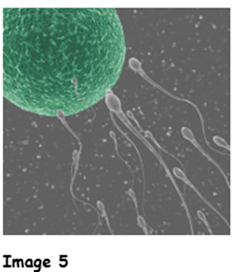
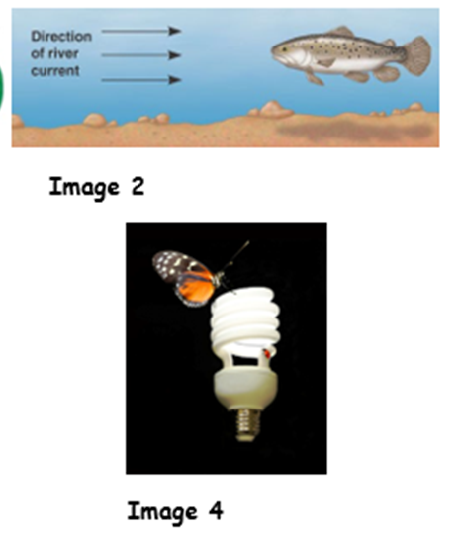
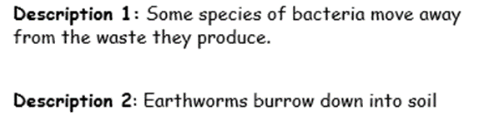
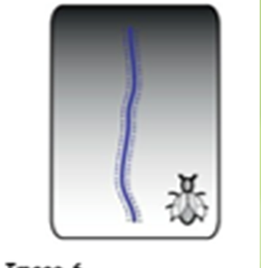
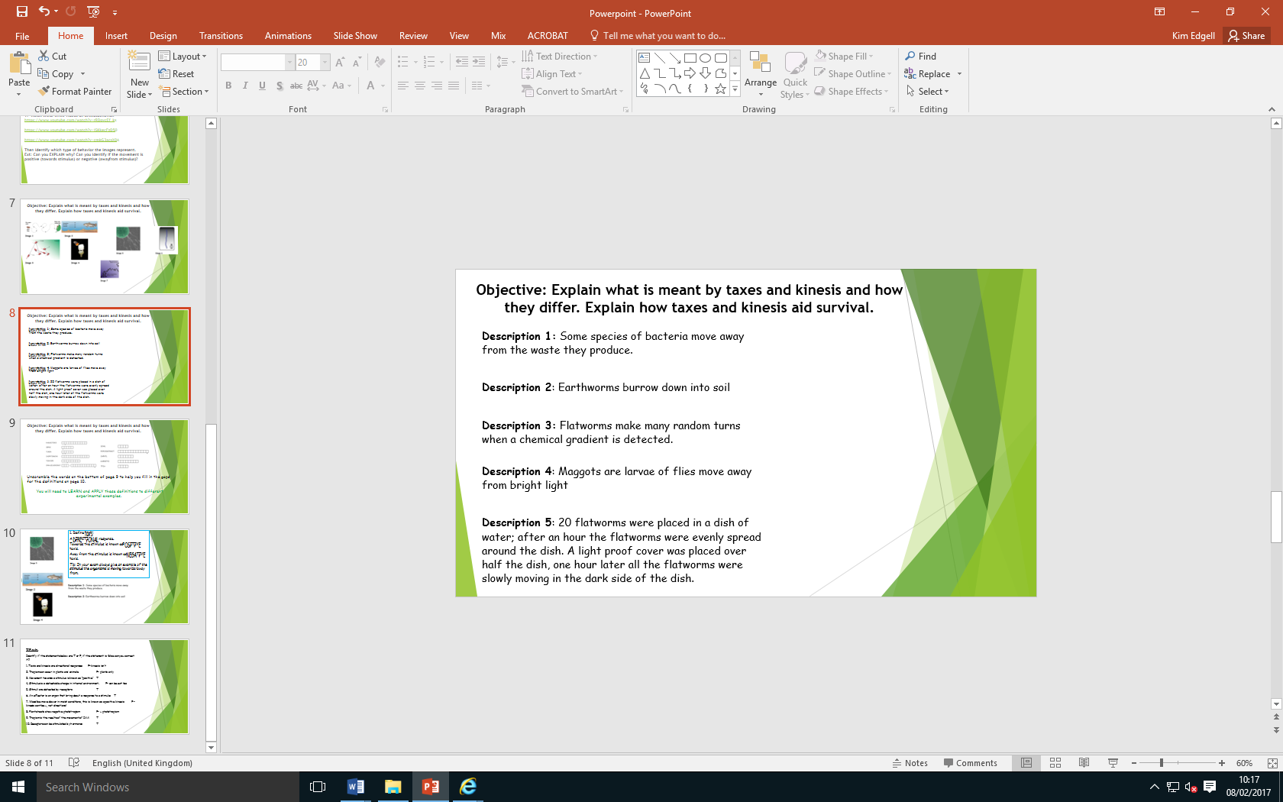
Define taxis:
A DIRECTIONAL response.
Towards the stimulus is known as POSITIVE taxis.
Away from the stimulus is known as NEGATIVE taxis.
Tip: In your exam always give an example of the stimulus the organisms is moving towards/away from.

Slide 5
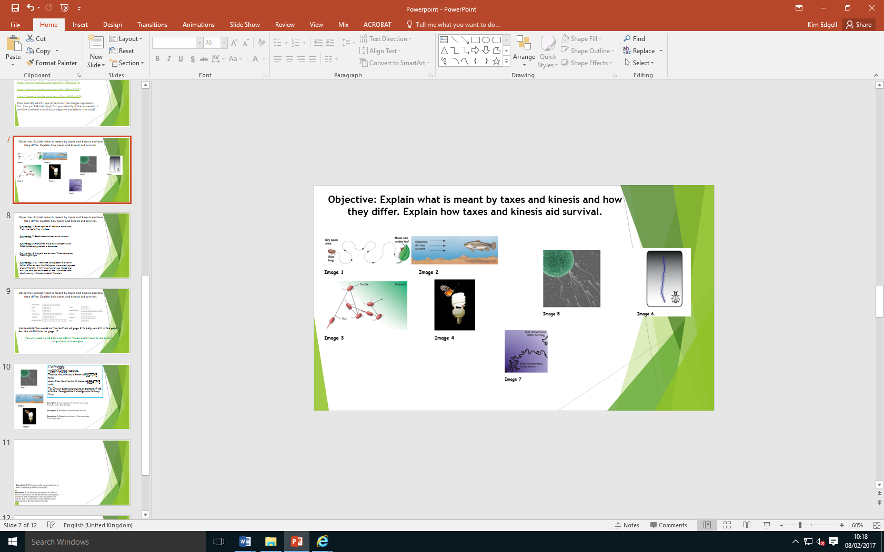
Define kinesis:
A NON-DIRECTIONAL response
Causes organism to change the SPEED of movement
In favourable conditions movement is SLOW with many TURNS
In unfavourable conditions movement is FAST with few TURNS
Tip: In your exam always give an example of the stimulus the organisms is responding to

Slide 6
Complete T/F quiz on page 4
If statement is false then you need to correct it.
1. Taxis and kinesis are directional responses F- kinesis isn’t directional
2. Tropism can occur in plants and animals. F- plants only
3. Movement towards a stimulus is known as “positive” T
4. Stimulus is a detectable change in internal environment. F- can be external too
5. Stimuli are detected by receptors T
6. An effector is an organ that bring about a response to a stimulus T
7. Woodlice move slower in moist conditions, this is known as a positive kinesis F-kinesis cant be +, not directional
8. Plant shoots show negative phototropism F- + phototropism
9. Roots show geotropism T
10. Receptors can be stimulated by hormones T
There are some exam questions to practice on pages 8&9.

Slide 7
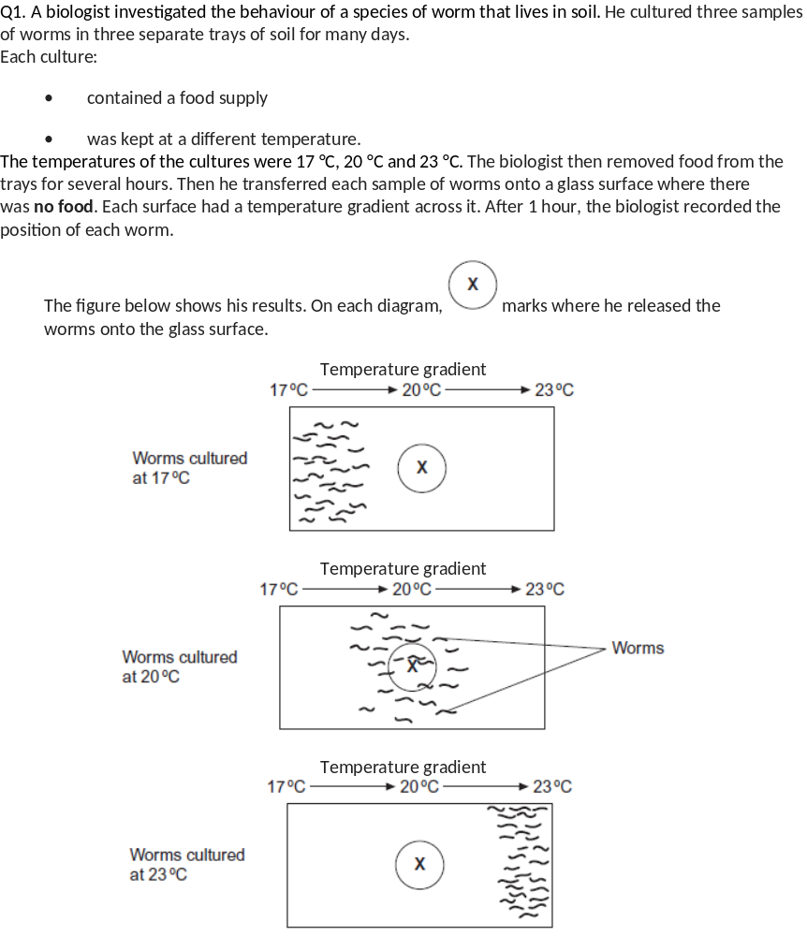
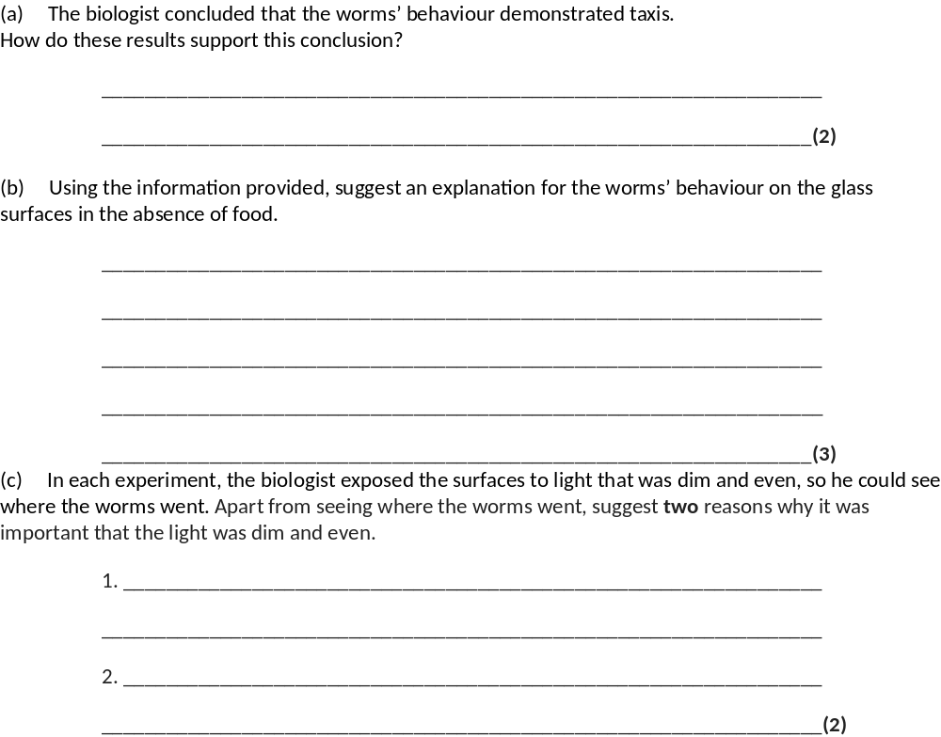
(a) 1. (Taxis is) movement towards / away from a stimulus / a directional response / movement (to a stimulus);
2. (Move towards) temperature they were used to / cultured in;
2. (Move towards) temperature they were used to / cultured in;
(b) 1. Hungry, so seeking food / in absence of food respond to temperature;
Ignore references to temperature and enzymes
Must be stated not inferred from other statements
2. Move towards temperature they were used to / cultured in;
3. Associate (this temperature) with food;
Accept they think food is here
Stated not inferred
4. (Then) stay in this temperature;
(c) 1. (Dim) worms live in soil / dark / affected by bright light / dim light is like normal environment / what they are used to;
2. (Even) because worms might move towards / away from bright light / to avoid creating light gradient / prevent worms showing phototaxis / all parts of surface exposed to same light;
Accept to avoid kinesis due to light
3. (Dim light) ensures heat from light not a variable / heat from lamp could kill / dry out worms;
Not just to control variables / factors

