Slide 1

Directed study 1- Animal transport revision- cardiac cycle.
Directed study 2- Mark receptors 1

Slide 2
Cardiac cycle
Learning Outcomes
Explain the cardiac cycle in terms of atrial systole, ventricular systole and diastole
Analyse and interpret data relating to pressure changes during the cardiac cycle

Slide 3
Cardiac cycle
Ventricular
systole
(contraction)
Diastole
(relaxation)
Atrial
systole
(contraction)
Relaxation = diastole
Contraction = systole

Slide 4
Cardiac Cycle
This is the ongoing sequence of contraction & relaxation of the atria and ventricles
The 2 phases are contraction (SYSTOLE) and relaxation (DIASTOLE).
Contraction occurs separately in the atria & ventricles
Note the pressure and volume changes throughout the cycle

Slide 5
Use these prompts when describing the phases of the cardiac cycle
- Muscle
- Pressure
- Valve
- Direction
My Parents are Very Delightful)

Slide 6
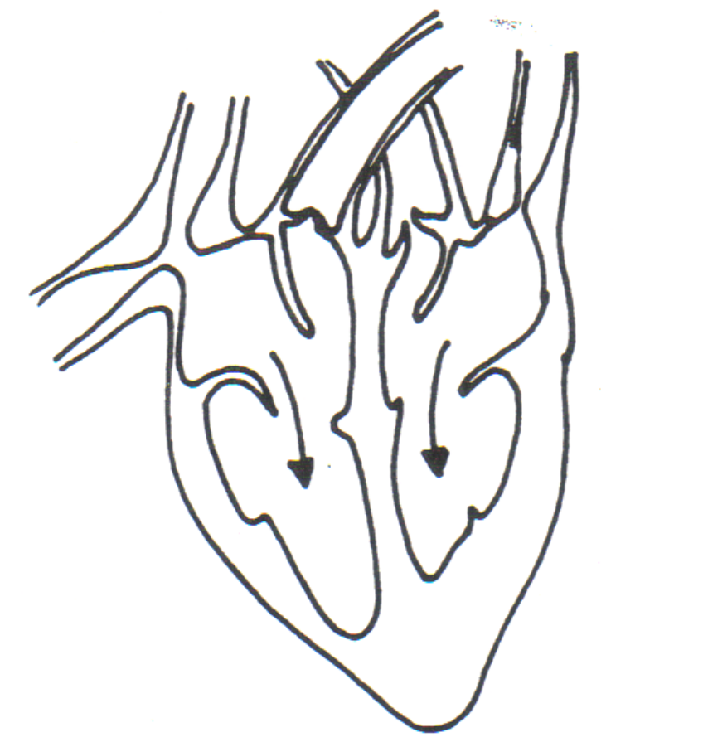

ATRIAL SYSTOLE
Muscles in atrial walls contract
Pressure in the atria increases
Valves: A-V valves are forced open when the pressure in atria is higher than in ventricles
Direction: blood flows into ventricles

Slide 7
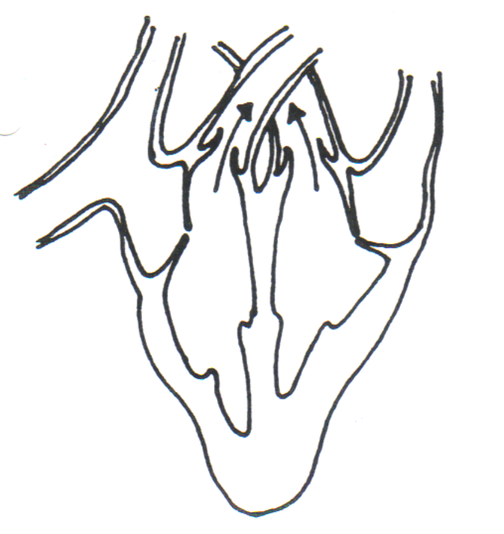

VENTRICULAR SYSTOLE
Muscles in ventricle walls contract
Pressure in ventricles increases
Valves: S-L valves are therefore forced open, AV valves are closed.
Direction: Blood flows out of arteries

Slide 8
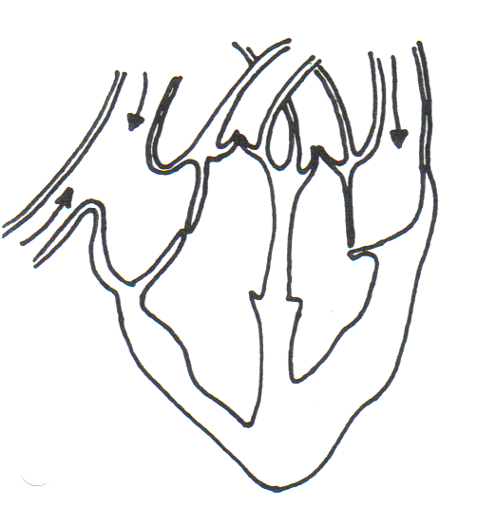
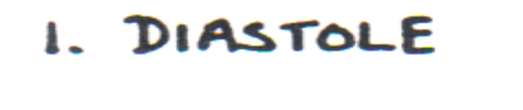
DIASTOLE
Muscle is relaxed
Pressure increases in the atria
Valves: Bicuspid and tricuspid valves open slightly
Direction: Blood starts to enter ventricles

Slide 9
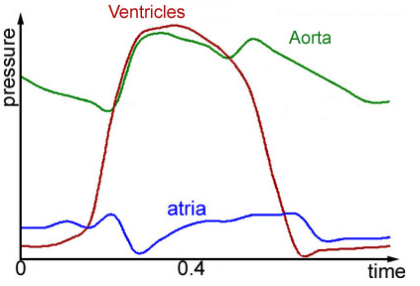
Pressure changes in left side of the heart during the cardiac cycle
Ventricular diastole causes a decrease in pressure in ventricle
lower than in the arteries,
S-L valves close.
3.
Ventricular systole causes an increase in pressure in ventricles
higher than the pressure in arteries
pushes the S-L valves open.
2.
Ventricular diastole causes a decrease in pressure in ventricle
lower than in the atria,
A-V valves open.
Ventricular systole causes an increase in pressure in ventricles
higher than in atria
pushes the A-V valves shut.
4.
1.

Slide 10
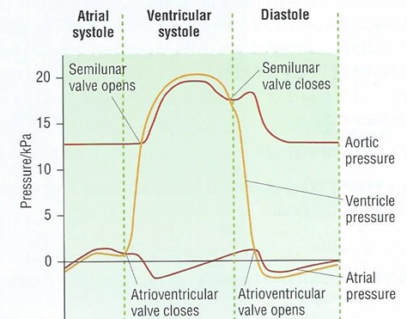

Bicuspid valve opens again due to build up of pressure in the atria
Atria are contracting – pressure increases
1
2
5
3
4
Contractions end, bicuspid valve closes, and the pressure drops due to being empty
Pressure increases due to filling of atria with blood
Atria continue filling and begin their next contraction

Slide 11
Blood moves into artery so pressure starts to drop
Ventricles finish contracting causing reduced pressure – this closes the semi-lunar valves
3
Ventricle contracts – pressure increases and forces the semi-lunar valve open
4
2
As the AV valve opens here, the ventricles start filling again, increasing pressure
Ventricle fills as the atria contract and empty – increasing pressure in the ventricles
1
5

Slide 12
Ventricles are contracting and the semi-lunar valves open – blood moves into aorta so increased pressure
Ventricles finish contracting, aorta expands, reducing pressure
No blood in the aorta yet so constant pressure
Small increase in pressure as semi-lunar valves close, aorta recoils
3
4
2
5
1
Blood moves from the aorta to other blood vessels, reducing pressure

Slide 13
Pressure changes and valves
Atrioventricular valves open = high atrial pressure, low ventricle pressure
Atrioventricular valves close = high ventricle pressure, low atrium pressure
Increased pressure in ventricles → semi-lunar valves open
Decreased pressure in ventricles → semi-lunar valves close

Slide 14
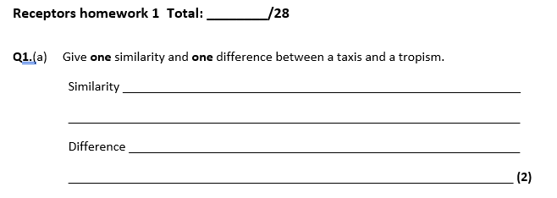
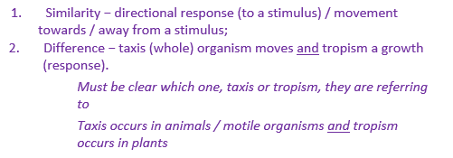

Slide 15
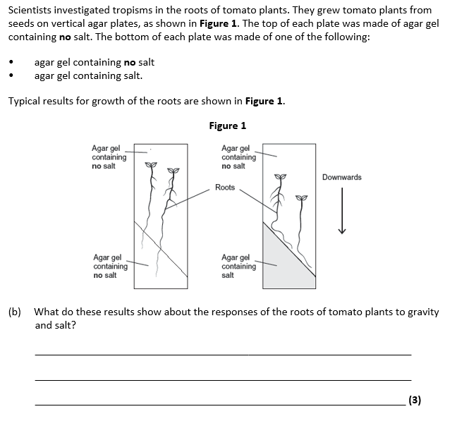
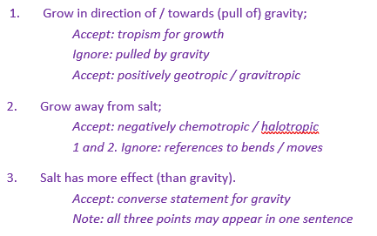

Slide 16
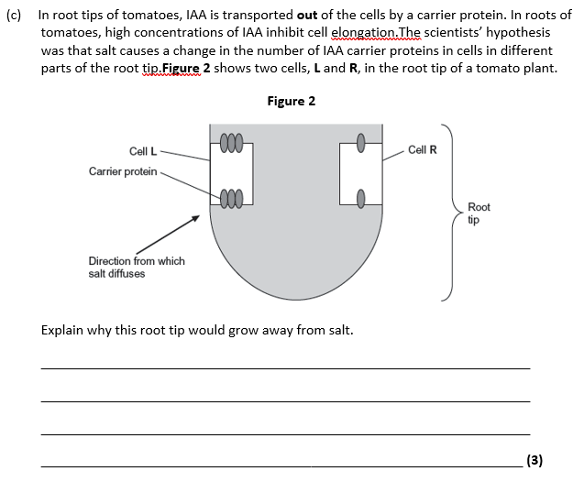
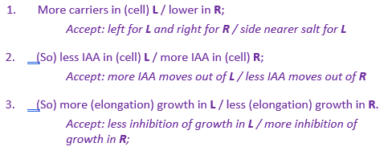

Slide 17
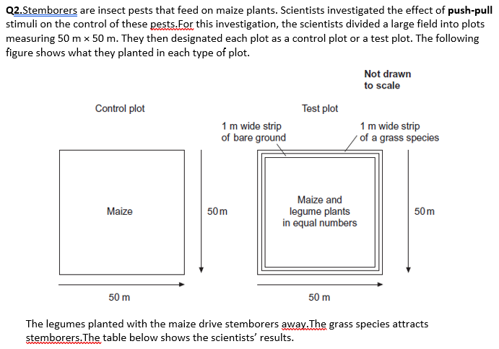
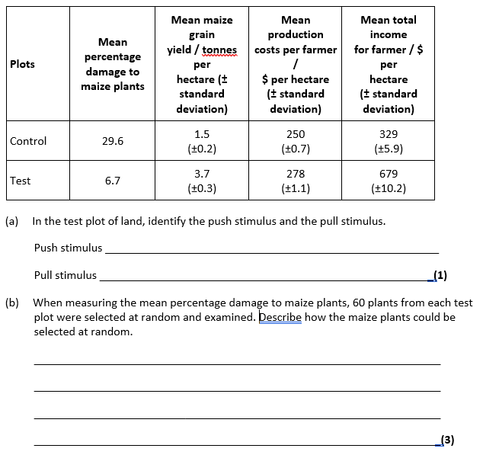

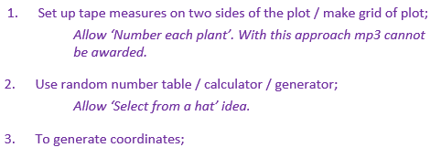

Slide 18
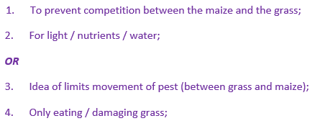
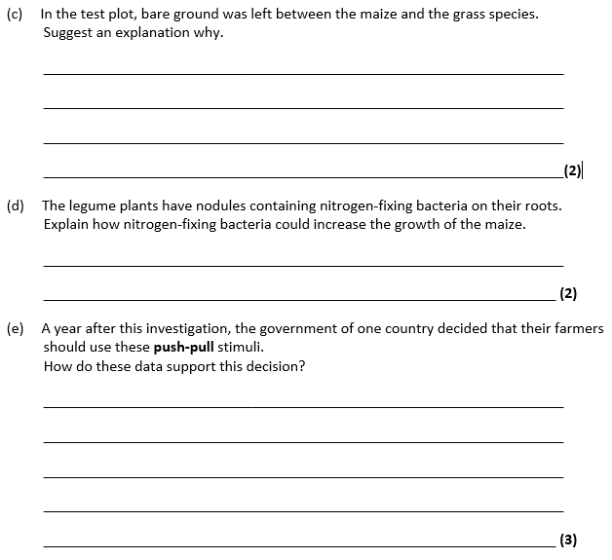
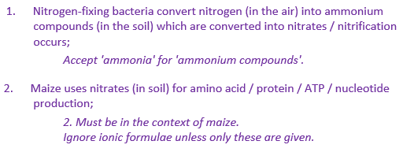
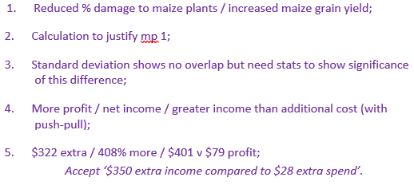

Slide 19
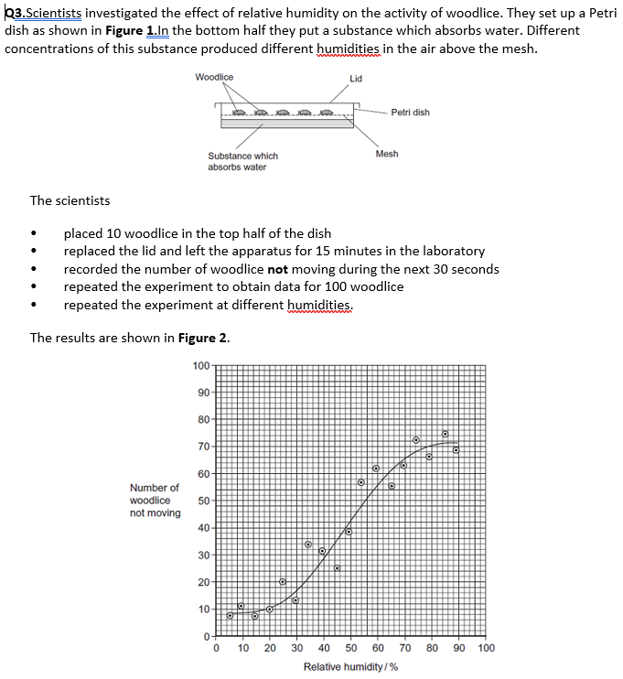
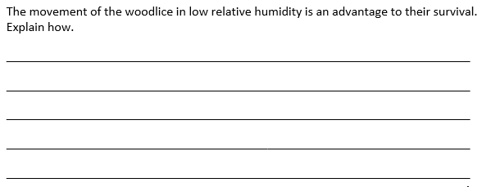


Slide 20
