Slide 1

Protein essay feedback
Becoming an essay examiner
How does the structure of proteins relate to their function?

Slide 2
Missing: No plan!
Introduction not needed- Just start your essay.
Proteins are really important to lots of different parts of biology, they are used in transport, enzymes, growth, repair and have different structures to match their functions. They are found in cells, enzymes inside cells, or can be found on the surface of cells, receptors or transport proteins. They are produced by the DNA in the nucleus and the information sent to the ER to be made.

Slide 3
Paragraph 1
Yellow highlighting = A01.
Blue highlighting = A02
Our DNA contains the code for our primary structure. The DNA is split into genes, a short section of DNA that codes for a protein. The DNA is arranged into triplets, 1 triplet codes for 1 amino-acid and the code can be degenerate which means more than 1 triplet code codes for 1 amino-acid. The triplets are converted into codons on the mRNA in a process called transcription which occurs in the nucleus. The mRNA then leaves the nucleus via the nuclear pore and attached to the ribosomes on the RER attracting the anti-codon on the tRNA to the codons on the mRNA. tRNA molecules carry specific amino-acid, when 2 amino-acids are brought together a condensation reaction occurs and a peptide bond is formed. The sequence of amino-acids are known as the primary structure. Missing detail – Translation
The primary structure can then be sent from the ribosomes to the Golgi apparatus to be modified and packaged into a functional protein. The primary structure can be folded into a B-pleated sheet or an alpha helix which is held by hydrogen bonds.
The secondary structure can then be further folded into a specific 3D shape held by hydrogen, ionic and disulphide bridges between the R groups of the amino-acid. An amino-acid also contains an amine group and a carboxylic acid group.
The tertiary structure can then be joined to other protein chains to make a quaternary protein.
An example of a quaternary protein is haemoglobin which is a 4 protein chains held in 3D shape and joined with an iron ion to which oxygen binds. No A02, not enough detail included.

Slide 4
Paragraph 1
Yellow highlighting = A01.
Blue highlighting = A02
A01/Content:
Paragraph 1: Protein structure.
Contains some points which are detailed with appropriate use of terminology, perhaps 1 significant error/irrelevant detail.
Contains A-level content though lacks detail, generally uses A-level terms with some significant errors/irrelevant detail.
Contains superficial a-level terms but poorly explained and lacking in detail with significant errors/irrelevant detail.

Slide 5
Paragraph 2
Yellow highlighting = A01.
Blue highlighting = A02
Most enzymes are in the tertiary structure; their function is to reduce activation energy so metabolic reactions like condensation and hydrolysis can happen faster. This is known as the induced fit theory. When the substrate binds to the specific and complementary active site of the enzyme forming an ESC, the active site puts a strain on the bonds in the substrate meaning it will require less energy to break or make the bond converting the substrate into the product, an EPC. The produce is no longer specific and complementary to the active site so is released. An example of this is in digestion. In the mouth the enzyme amylase is released from salivary glands to hydrolyse starch into maltose. Sometimes people are unable to digest lactose, which is a disaccharide, this can be because the enzyme doesn’t have a specific and complementary active site shape to the lactose molecule. This may have occurred because of a mutation in the gene which has changed the primary structure, the folding of the secondary and tertiary structure.
A02: some detail but not enough terminology about digestion or relating to function.

Slide 6
Paragraph 2
Yellow highlighting = A01.
Blue highlighting = A02
A01/Content:
Paragraph 2: Enzyme structure and function.
Contains some points which are detailed with appropriate use of terminology, perhaps 1 significant error/irrelevant detail.
Contains A-level content though lacks detail, generally uses A-level terms with some significant errors/irrelevant detail.
Contains superficial a-level terms but poorly explained and lacking in detail with significant errors/irrelevant detail.

Slide 7
Paragraph 3
Yellow highlighting = A01.
Blue highlighting = A02
Proteins are also really important in the transport of large or soluble molecules (these are known as hydrophobic molecules-significant error), examples include ions, glucose and sucrose. If the molecule is small and polar, like ions, they can move through a channel protein from a high to a low concentration down a concentration gradient. Channel proteins have water through their middle which ions can travel down; this is an example of facilitated diffusion. If the molecule is polar and large they use carrier proteins. These are specific to 1 type of molecule and are also used in active transport. The large molecule binds to specific active site (Significant error-wrong use of term) of the carrier protein which allows the carrier protein to change shape pulling the molecule from 1 side to the other side of the membrane. An example of this is glucose. This is an example of active transport as the molecules are moved from a low to a high concentration against a concentration gradient
A02: None .

Slide 8
Paragraph 3
Yellow highlighting = A01.
Blue highlighting = A02
A01/Content:
Paragraph 3: Membranes and transport
Contains some points which are detailed with appropriate use of terminology, perhaps 1 significant error/irrelevant detail.
Contains A-level content though lacks detail, generally uses A-level terms with some significant errors/irrelevant detail.
Contains superficial a-level terms but poorly explained and lacking in detail with significant errors/irrelevant detail.

Slide 9
Paragraph 3
Yellow highlighting = A01.
Blue highlighting = A02
Proteins are also really important in growth and repair. An organism grows or repairs itself using mitosis. There are 4 stages in mitosis- Prophase, metaphase, anaphase and telophase. In prophase the chromosomes appear because the DNA has supercoiled around histones and the 2 chromatids are held by the centromere. In metaphase the chromosomes line up along the equator, centrioles are producing spindle fibres which are attached to the centromere. In Anaphase the spindle fibres contract pulling the chromosomes apart to either pole of the cell. In telophase, the chromosomes uncoil and becomes invisible again. The cell splits into 2 cells.
Irrelevant paragraph.
Spindle fibres are proteins so focusing on role of spindle fibres could make this paragraph relevant.

Slide 10
Breadth: Overall the essay:
Essay contains several topics related to the question
Essay contains mostly suitable topics related to the question
Essay contains 1 or 2 topics related to the question-
Protein structure, enzymes.
Membranes- not enough detail
Mitosis- irrelevant
No year 2 topics included

Slide 11
Flow: Overall essay:
Each paragraph makes clear links between topics
Essay links several topics to the question and forms a series of interrelated points between each paragraph which are clearly explained
Paragraphs are not interrelated.

Slide 12
A02/Application Linking to the theme of the question:
Each paragraph make clear links to the theme of the questions
Several of the topics are clearly linked o the main theme of the question
No links are made to the them of the question. – One paragraph is clearly linked to the questions but not several so have to chose this one.
This is the most challenging part of the essay, this is what you need to practice more.

Slide 13
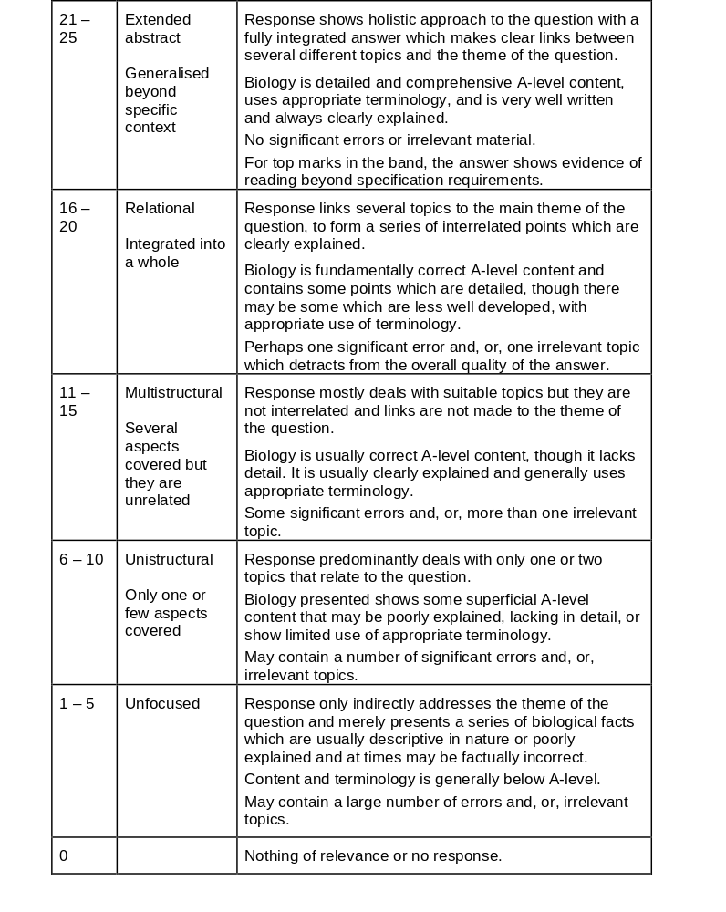
No because…
No links made between topics
Only 1 paragraph linked to the theme of the question – A02
Note: Wording says “several” so does not mean every paragraph must be clearly linked.
There are significant errors
There is irrelevant material

Slide 14
No because…
No links made between topics – interrelated
Only 1 paragraph linked to the theme of the question – A02
There are more than 1 significant errors
There is irrelevant material
Yes because…
Biology is fundamentally correct A-level content and contains some points which are detail.
Note: says some can be “less well developed”

Slide 15
No because…
Response does not deal with mostly suitable topics.
Yes because…
Topics are not linked together- interrelated.
Biology is usually correct A-level content and lack detail.
There are some significant errors and irrelevant topics.

Slide 16
The A-level content of the first paragraphs is good and clearly explained BUT
Because only 2 well explained paragraphs has to be UNISTRUCTURAL- 6-10 marks.
Would be at the higher end of the banding because of the level of detail and A02 link.
Yes because…
Predominantly deals with one or two topics that relate to the question.
Biology is superficial A-level content and poorly explained in some paragraphs. .

Slide 18
Enzyme essay feedback
Becoming an essay examiner
“The properties of enzymes and their importance in living organisms”

Slide 19
Paragraph 1-
Enzyme structure
Yellow highlighting = A01.
Blue highlighting = A02
Enzymes are globular proteins that act as biological catalysts and increase the rate of reaction by lowering the activation energy. They are folded into a precise 3D structure maintained by hydrogen, ionic and disulphide bonds. They have a groove or depression in their surface called an active site to which a specific, complementary substrate can bind. Once the substrate binds the active site changes shape slightly to fit around the substrate through by induced fit. Once an enzyme binds to its specific substrate it forms an enzyme substrate complex, then an enzyme product complex. The product will then be released from the enzyme active site leaving the enzyme unchanged and able to catalyse a further reaction. Enzymes can catalyse anabolic reactions or catabolic reactions. ATPase is an anabolic enzyme that catalyses the formation of ATP from its substrates ADP + Pi which is important in many biological processes including respiration, photosynthesis and muscle contraction which will all be discussed in this essay

Slide 20
Paragraph 2-
Muscle contraction
Yellow highlighting = A01.
Blue highlighting = A02
Muscles contract according to the sliding filament theory. This involves two filaments, actin and myosin. In a relaxed muscle the actin filament has a myosin binding site which is blocked by a protein called tropomyosin. When an action potential is stimulated in a muscle fibre cell this stimulates the release of calcium ions from the sarcoplasmic reticulum into the sarcoplasm. These calcium ions bind to troponin which causes tropomyosin to change shape and uncovers the myosin binding site on the actin filament. The myosin head (with attached ADP) binds to the actin filament forming an actin myosin cross bridge. Once attached the myosin head changes angle, pulling the actin filament along and releasing a molecule of ADP. An ATP molecule then attaches to the myosin head causing the myosin to detach. Calcium ions then activate the enzyme ATPase which hydrolyses ATP to ADP + Pi which provides the energy to recock the myosin head to its original position so it can bind further along the actin filament, this is the importance of the enzyme. ATP synthase is an enzyme which then catalyses the resynthesis of ATP from ADP + Pi so the muscle contraction cycle can continue. Without enzymes muscle contraction could not occur and animals would be unable to move which would prevent prey escaping from predators or predators catching prey. ATP is required for muscle contraction and is produced during aerobic respiration through a series of enzyme controlled steps

Slide 21
Paragraph 3-
Aerobic respiration
Yellow highlighting = A01.
Blue highlighting = A02
There are four stages in aerobic respiration that result in the production of ATP. Glycolysis is the first stage and occurs in the cytoplasm. Glucose is the starting substrate which must be activated by phosphorylation by enzymes using the Pi from the hydrolysis of ATP (this is also catalysed by enzymes). The phosphorylated glucose is split into 2 triose phosphate molecules which are dehydrogenated using dehydrogenase enzymes which results in the production of reduced NAD and pyruvate. The 2 pyruvate produced from each glucose at the end of glycolysis enter the link reaction where further dehydrogenation reactions result in the formation of more reduced NAD and enzyme controlled decarboxylation reactions result in the production of CO2. The acetyl co enzyme A produced at the end of the link reaction enters the krebs cycle where a series of enzyme controlled reaction result in the further production of reduced coenzymes (NAD & FAD), ATP and CO2. The importance of enzymes are to produced reduced NAD and FAD which are used in oxidative phosphorylation on the ETC of the Cristae. The reduced coenzymes are oxidised and are able to donate their electrons to a series of electron carriers and the energy lost during this transfer is used to pump proteins into the mitochondrial intermembrane space. The diffusion of these protons through the mitochondrial membrane into the matrix provides the proton motive force to drive the synthesis of ATP from ADP+Pi by the enzyme ATP synthase which is found in the stalked particles. Without enzymes the stages of aerobic respiration would be unable to occur and ATP would not be produced so organisms would be unable to carry out active transport, muscle contraction and movement. One of the products of aerobic respiration is carbon dioxide. This is one of the substrates for photosynthesis which is another metabolic process, important in plants, which is controlled by enzymes.

Slide 22
Paragraph 4-
Photosynthesis
Yellow highlighting = A01.
Blue highlighting = A02
Photosynthesis occurs in plants and produces the products oxygen and glucose from the substrates carbon dioxide and water. It converts light energy into chemical energy in glucose. It occurs in two stages: the light dependent and the light independent reaction. In the light dependent reaction the ATPase enzyme is used to produce ATP from ADP + Pi and reduced NADP is produced. ATP is required for the light independent stage of photosynthesis to occur which results in the formation of glucose required for plant growth. During the Calvin cycle carbon dioxide combines with ribulose bisphosphate to produce Glycerate – 3 phosphate. This reaction is catalysed by the enzyme RUBISCO. Glycerate -3 phosphate is then reduced to triose phosphate using the energy from the hydrolysis of ATP. Triose phosphate is either then condensed to form glucose or used to regenerate ribulose bisphosphate so the cycle can continue. The importance of the enzymes are to produce ATP and glucose which the plant needs to carry out aerobic respiration and provide ATP for processes including active transport, mitosis, condensation and hydrolysis reactions. The glucose produced during photosynthesis is converted into starch as a storage molecule in plants. Starch is digested by an enzyme amylase and the final topic area I will consider in this essay is the roles played by enzymes in the process of digestion

Slide 23
Paragraph 5-
Digestion
Yellow highlighting = A01.
Blue highlighting = A02
The role of the human digestive system is breakdown large molecules into smaller soluble molecules that can be absorbed into the blood stream. Various different enzymes are required. Amylase in an enzyme that can hydrolyse alternate glycosidic bonds in starch to produce the disaccharide maltose. Amylase is produced by the salivary glands in the mouth and the pancreas. The glycosidic bonds in maltose can then be hydrolysed by the enzyme maltase, located in the membrane of the cells lining the intestines, to produce alpha glucose which can be absorbed into the blood in the small intestine by the process of cotransport. The importance of digestive enzymes are that they lower the energy required for digestion to hydrolyse the glycosidic bonds. Without enzymes, this would mean that animal would not be able to absorb glucose into the blood stream to be carried to respiring tissues for aerobic respiration to produce ATP. Without ATP not metabolic reactions can occur.

Slide 24
Yes because…
Each paragraph shows a clear link to the theme of the question “the importance of the enzymes….”
Each paragraphs shows a clear link to different topics- Flow
Biology is detailed uses appropriate terminology
No significant errors or irrelevant material
No beyond the specification information included so maximum marks – 22 marks
Extended abstract.

