Slide 1
Homeostasis recap lessons

Slide 2

Tasks:
Complete revision poster using control of blood water potential booklet.
40 minutes MAXIMUM – please put your thumb up on Teams when you are done.
***Anything you don’t understand ask me now****
2. Complete exam questions after completing revision poster

Slide 3
Controlling blood water potential
Kidney structure:
Describe the parts of the kidney:
Draw and label a nephron:
Explain the process of selective reabsorption
Explain how the cells of the PCT are specialised?
Explain the osmoreceptors are stimulated.
Explain the negative feedback system for osmoregulation.
Explain the action of ADH.
Explain the process of ultrafiltration:
Explain the role of the Loop of Henle

Slide 4
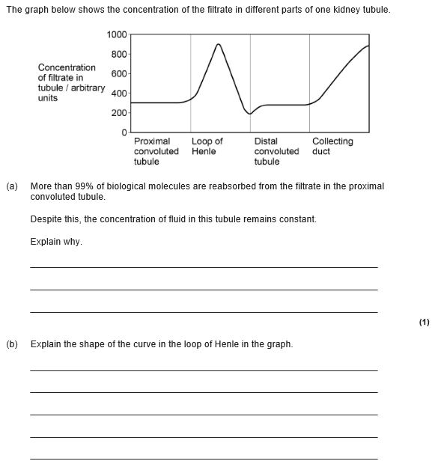
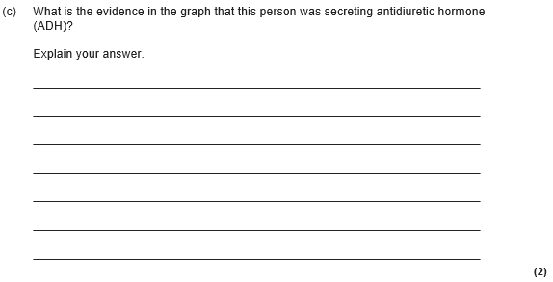

Slide 5
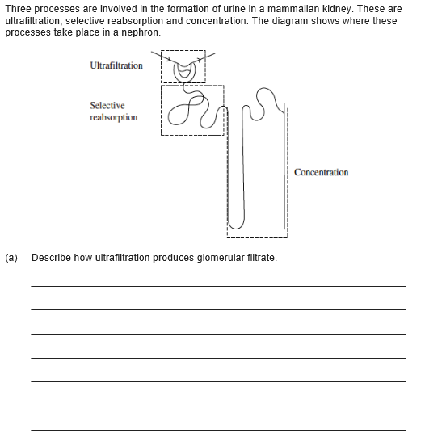

Slide 6
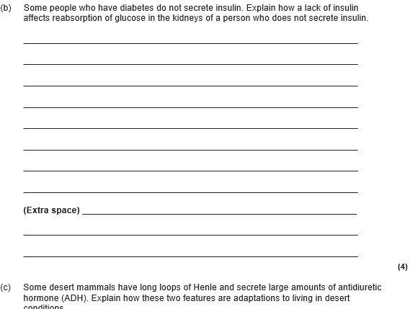

Slide 7
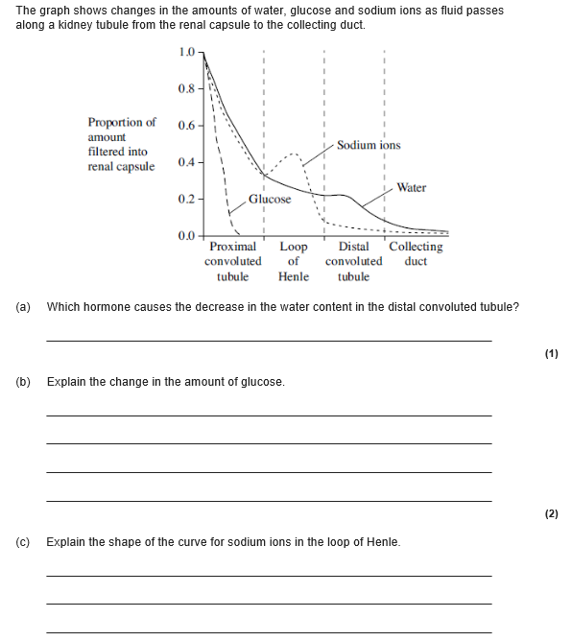

Slide 8
Tasks:
Complete revision poster using control of blood glucose concentration booklet.
40 minutes MAXIMUM – please put your thumb up on Teams when you are done.
***Anything you don’t understand ask me now****
2. Complete exam questions after completing revision poster

Slide 9
Controlling blood glucose concentration Definitions:
Give an example of negative and positive feedback:
Describe the role of the liver in regulating blood glucose:
You must include Glycogenesis, glycogenolysis and gluconeogenesis.
Explain how a hormones works using adrenaline as an examples:
Describe the role of adrenaline in regulating the blood glucose levels:
Describe the cause and treatment of type I and type II diabetes:

Slide 10
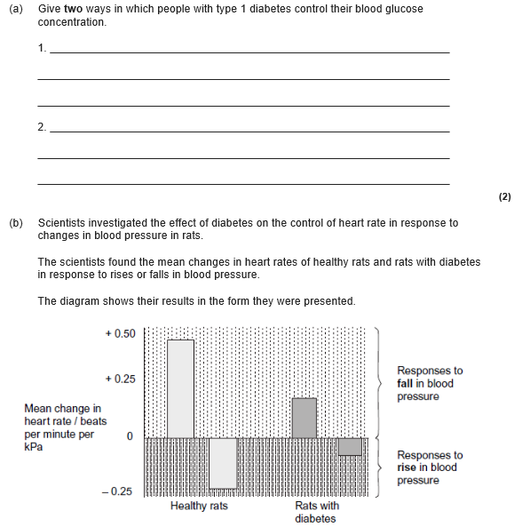
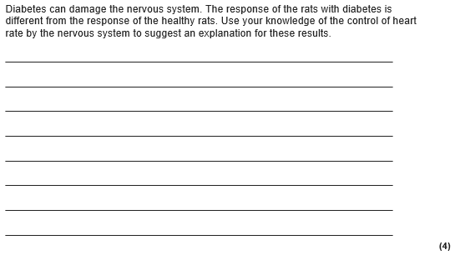

Slide 11
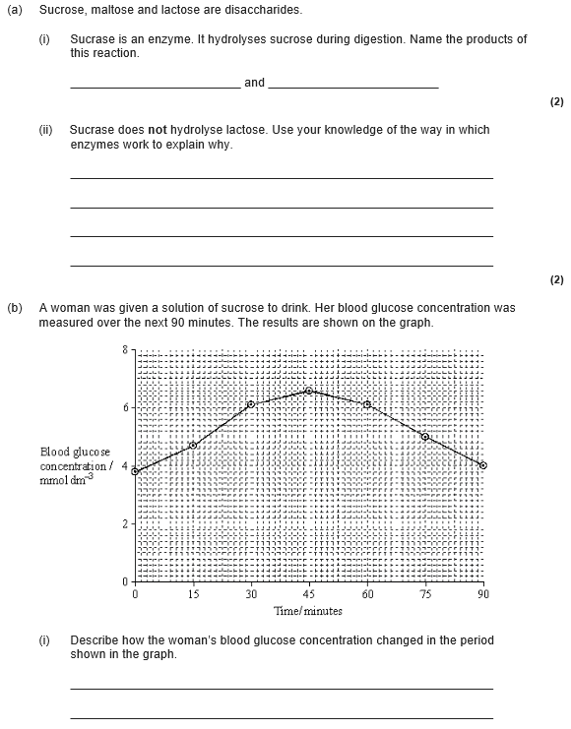
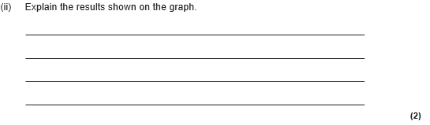

Slide 12
